Slide 1
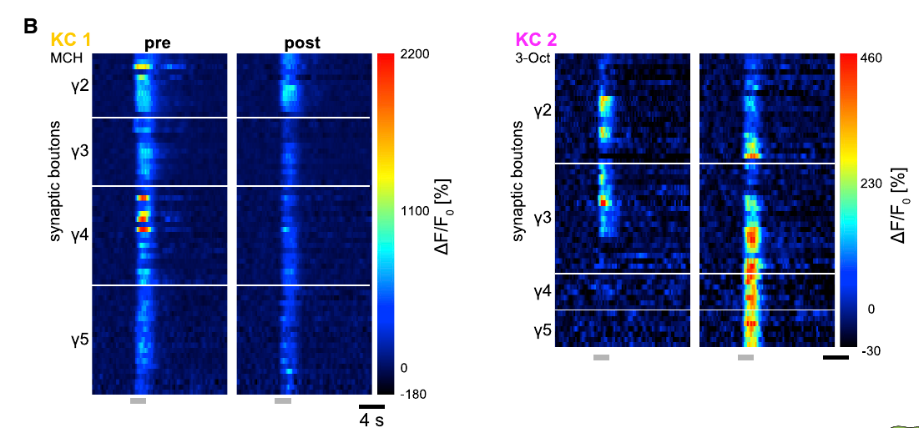
Fig 5 B
Same Kcs are shown in Fig 1 G in there pre state

Slide 2
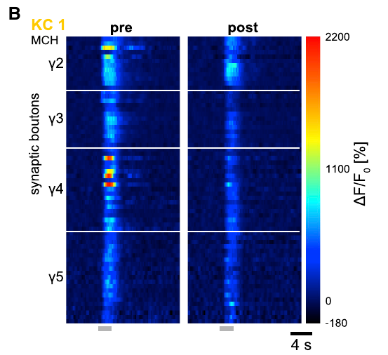
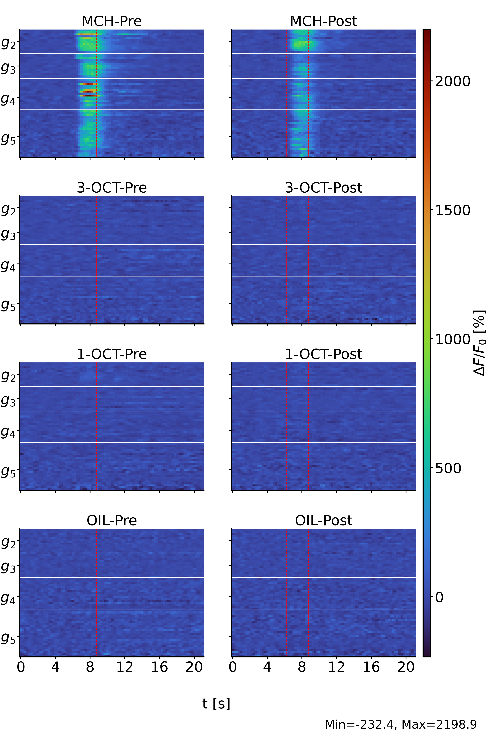
Fig 5B KC 1 = A_160621_0107_0607_fly1_cell2_pre_post

Slide 3
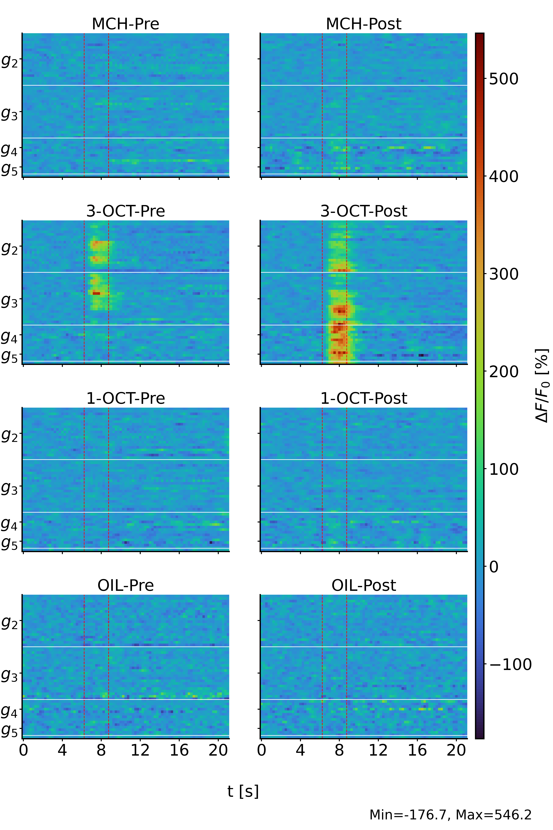
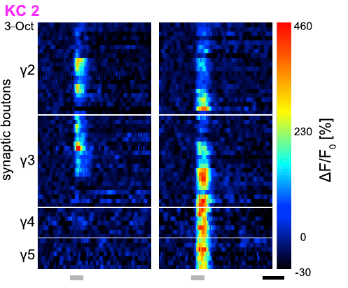
Fig 5B KC 2 = A_160621_0107_0607_fly1_cell2_pre_post

Slide 4
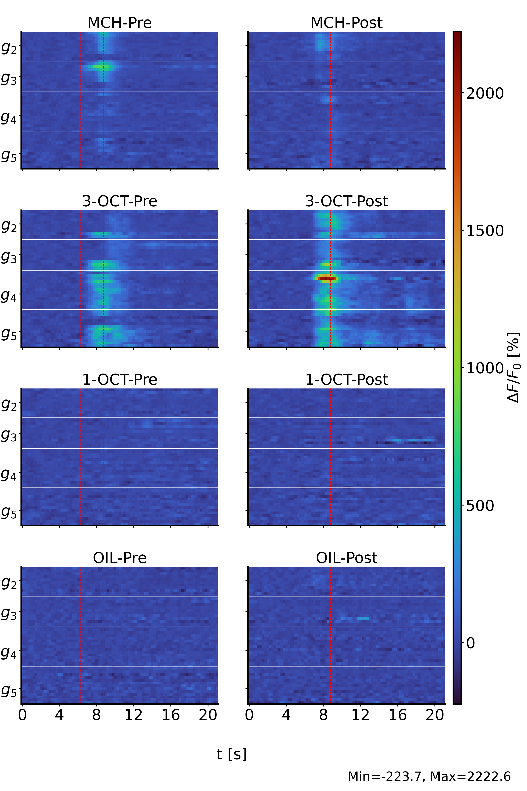
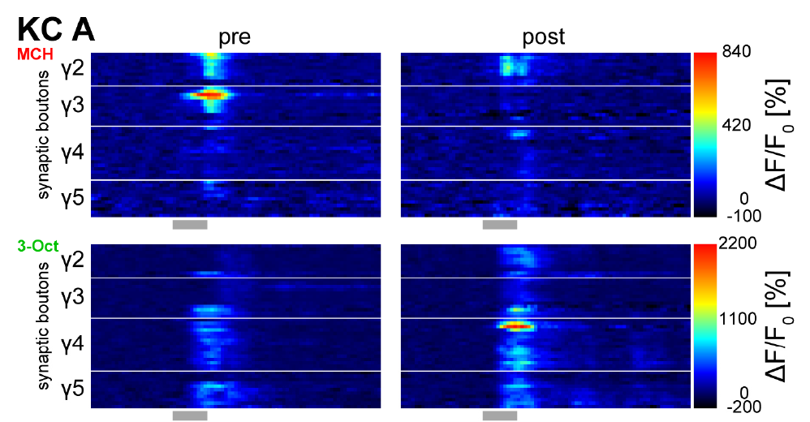
Fig S7 KC A =
A_160802_1308_1808_fly2_cell1_pre_post

Slide 5
Fig S7 KC B
Could not find a fitting image in testgroup

Slide 6
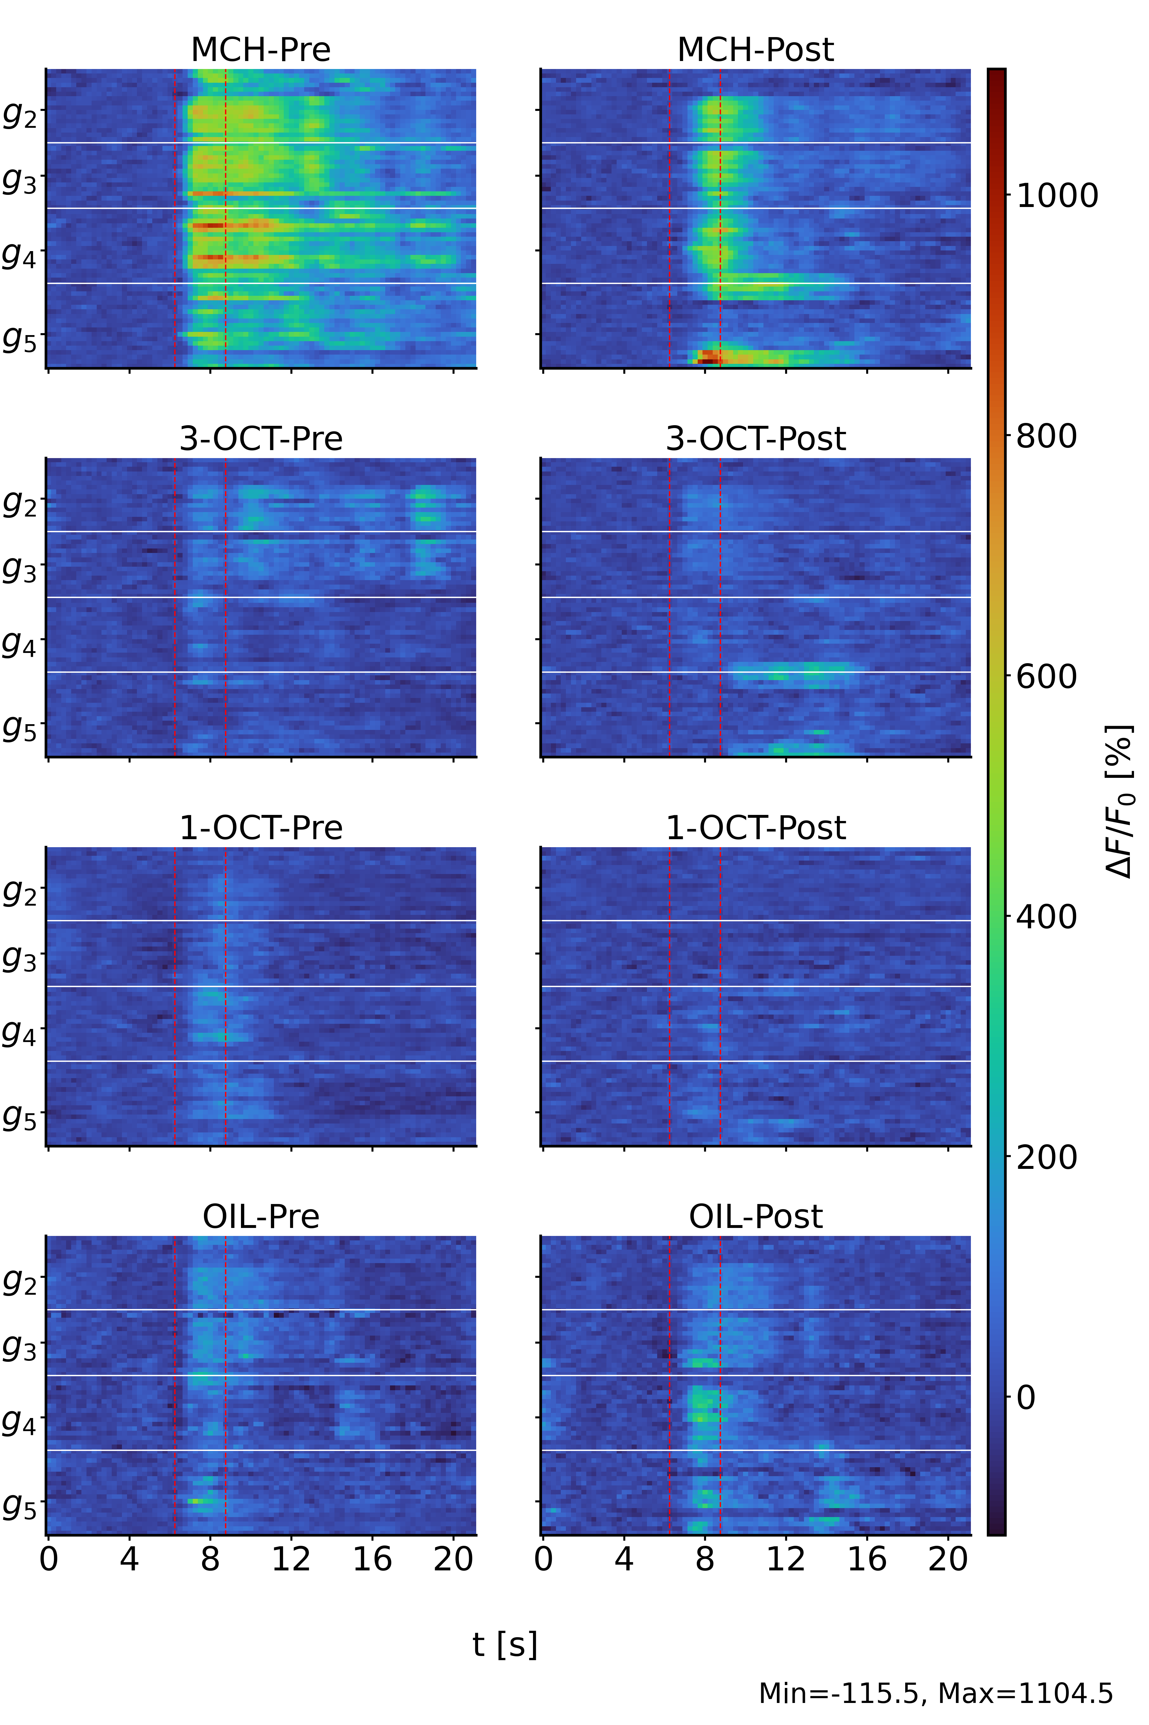
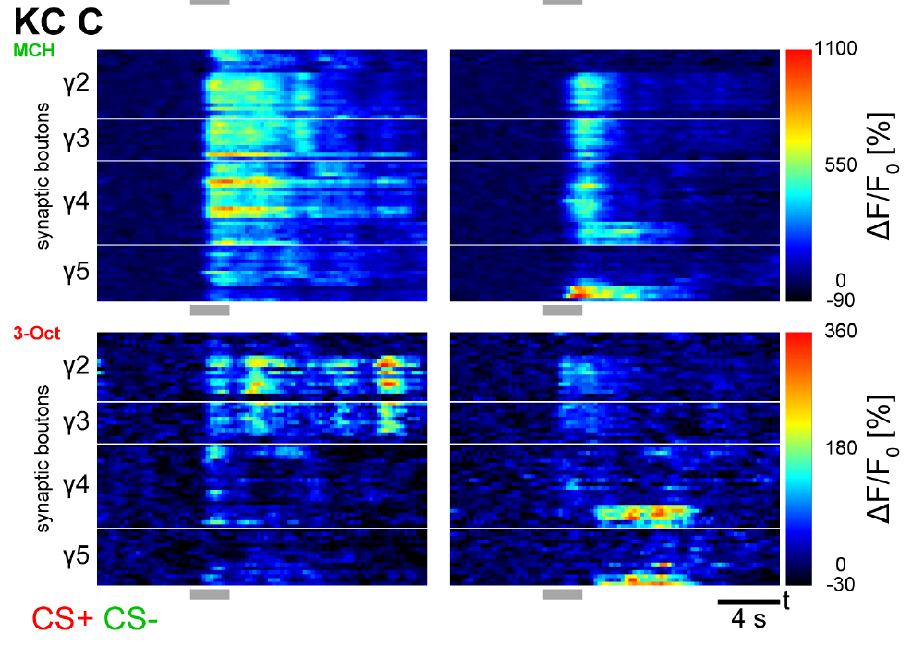
Fig S7 KC C =
A_171010_2010_2510_fly1_cell1_pre_post

