Slide 1
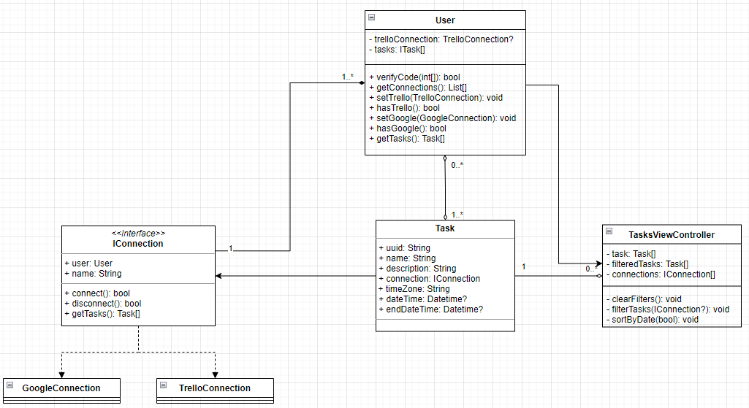
Smart Mirror by: Ryan Wiesenberg
The goal of the smart mirror is to aggregate and present daily and upcoming tasks, aggregated for the user approaching the mirror based on supported, linked accounts.

Slide 2
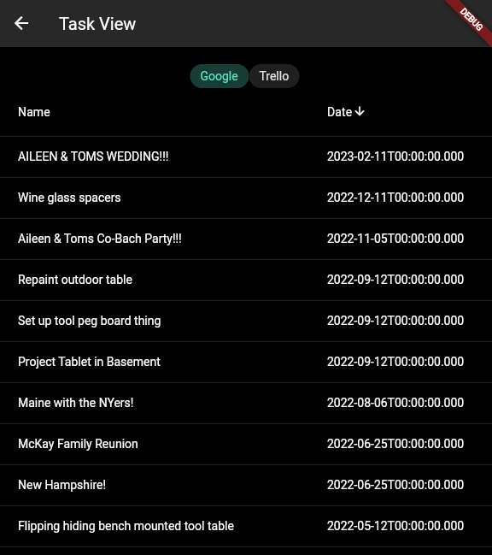
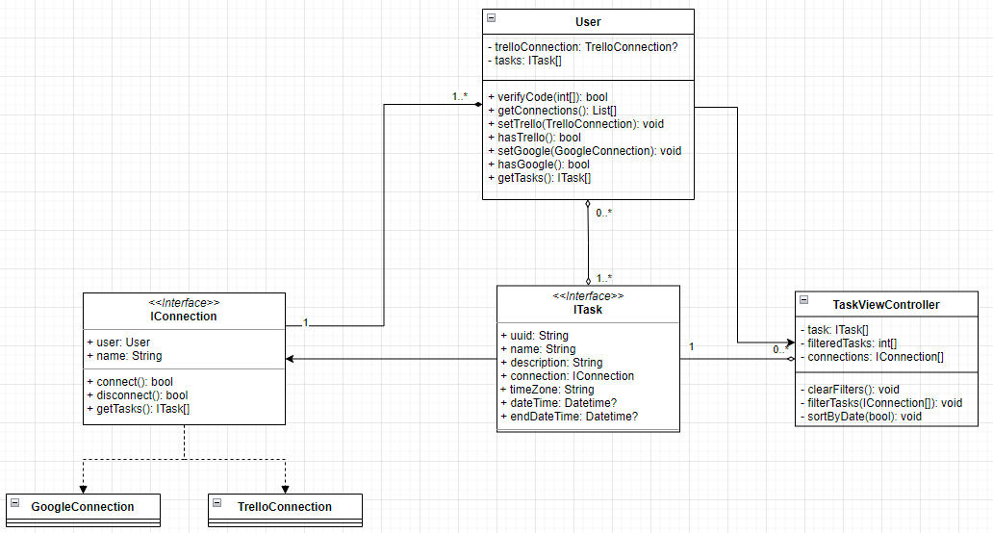
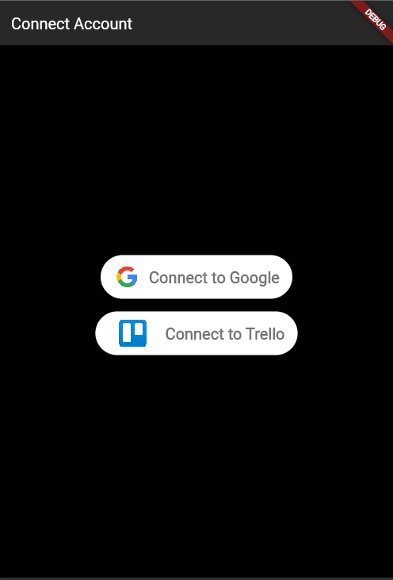
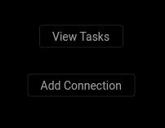
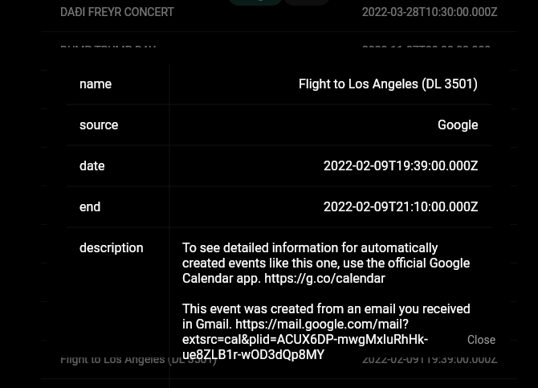
Smart Mirror

