Slide 1
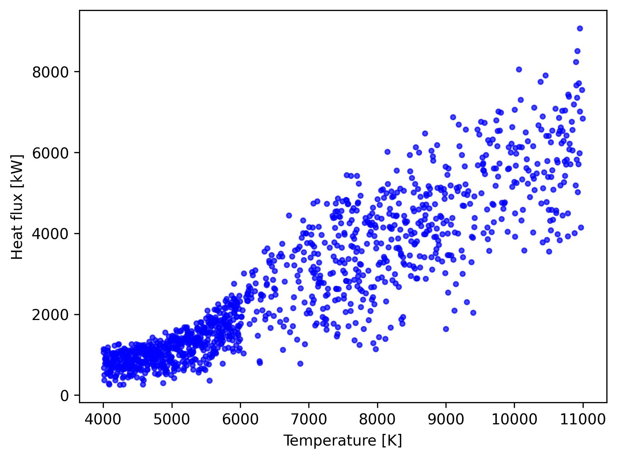
Stagline simulation for surrogate model training
Less converged simulations at higher temperature
Adding data could improve the accuracy of the model ?
Use 0D model to compute HF on non-converged simulation conditions

Slide 2
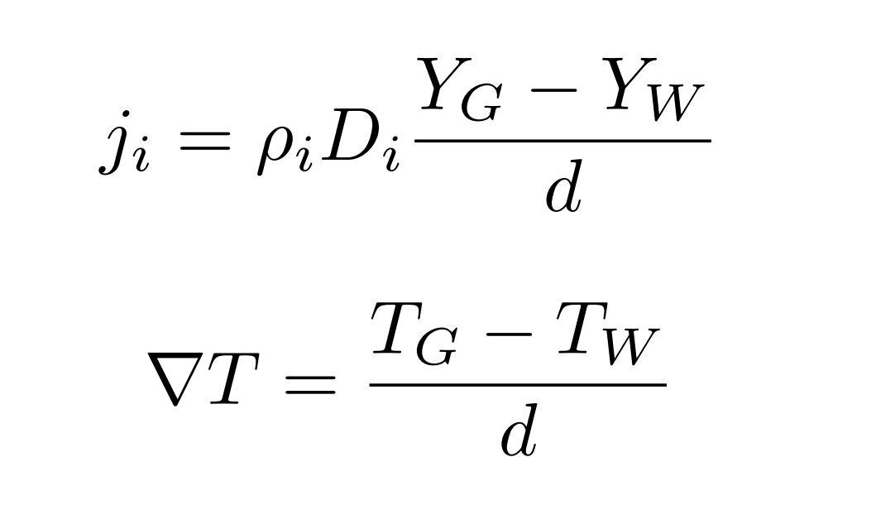
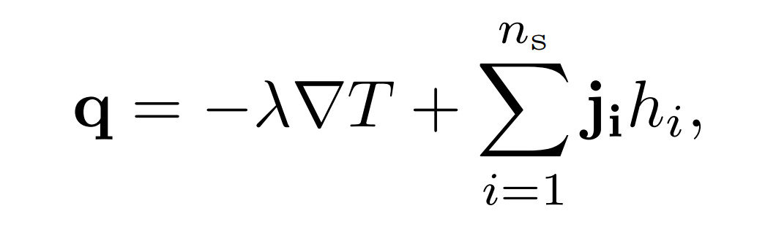
Mixture, Tinlet, Tsurface, Pstat, …
OD reactor
dx imposed to 1e-3
dx found to match exp. values

Slide 3
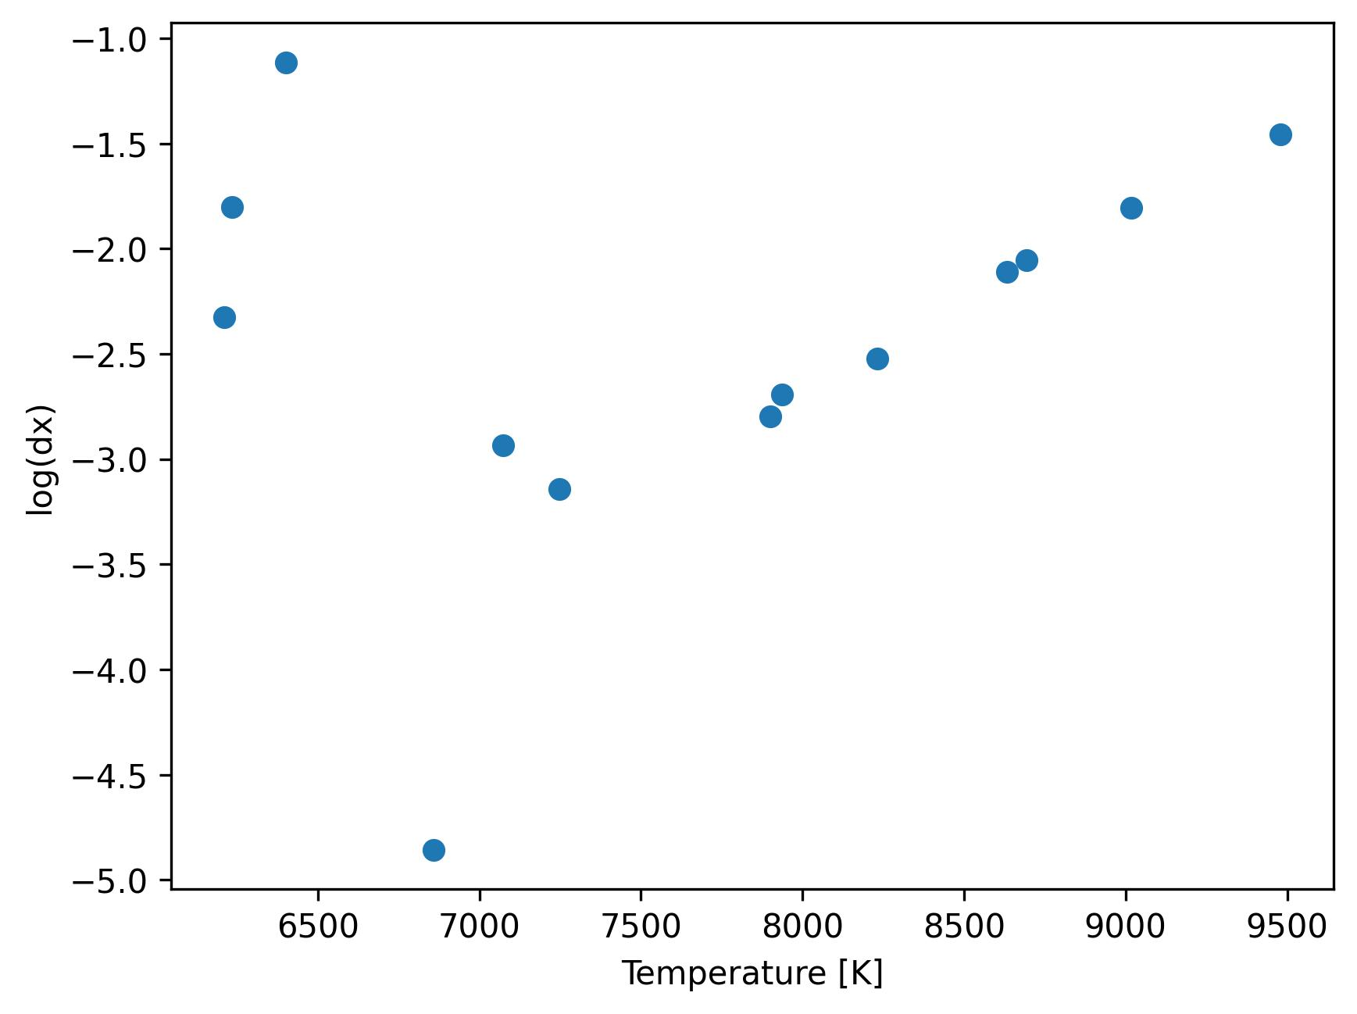
Experimental data : Pstat = 15 mbar

Slide 4
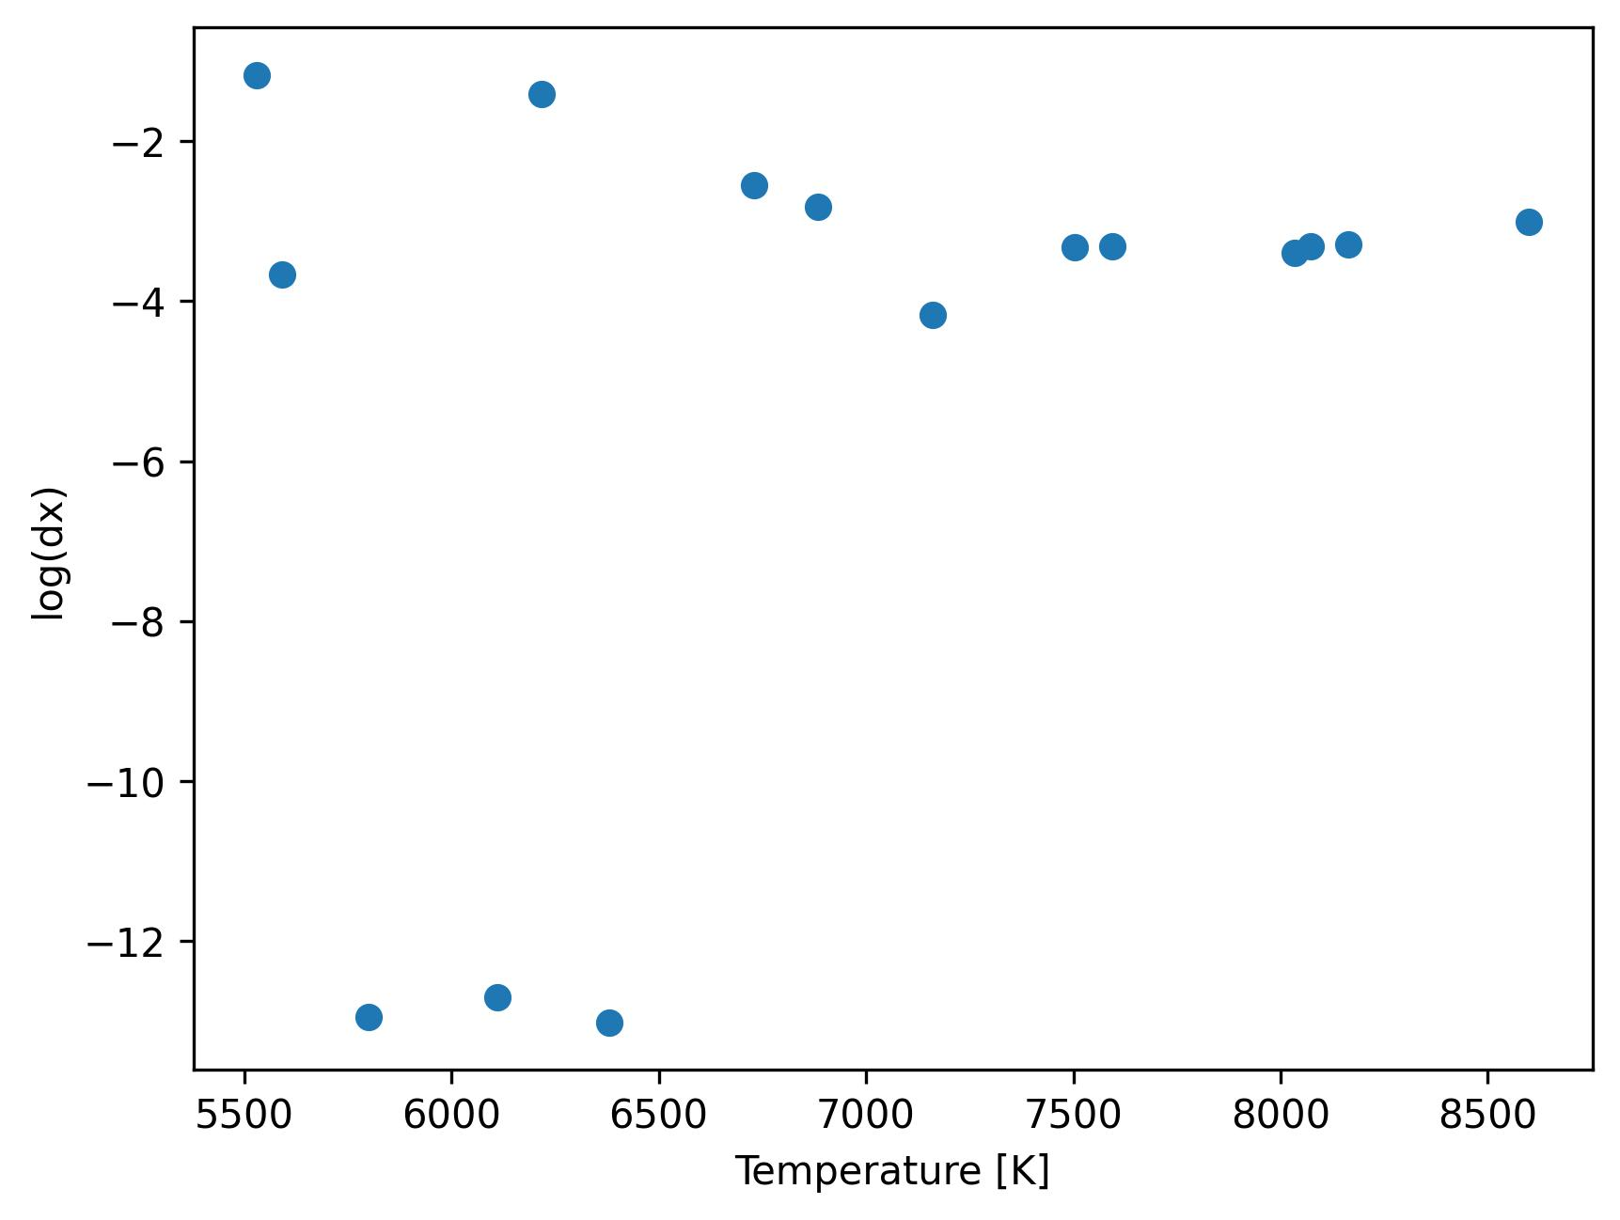
Experimental data : Pstat = 50 mbar

Slide 5
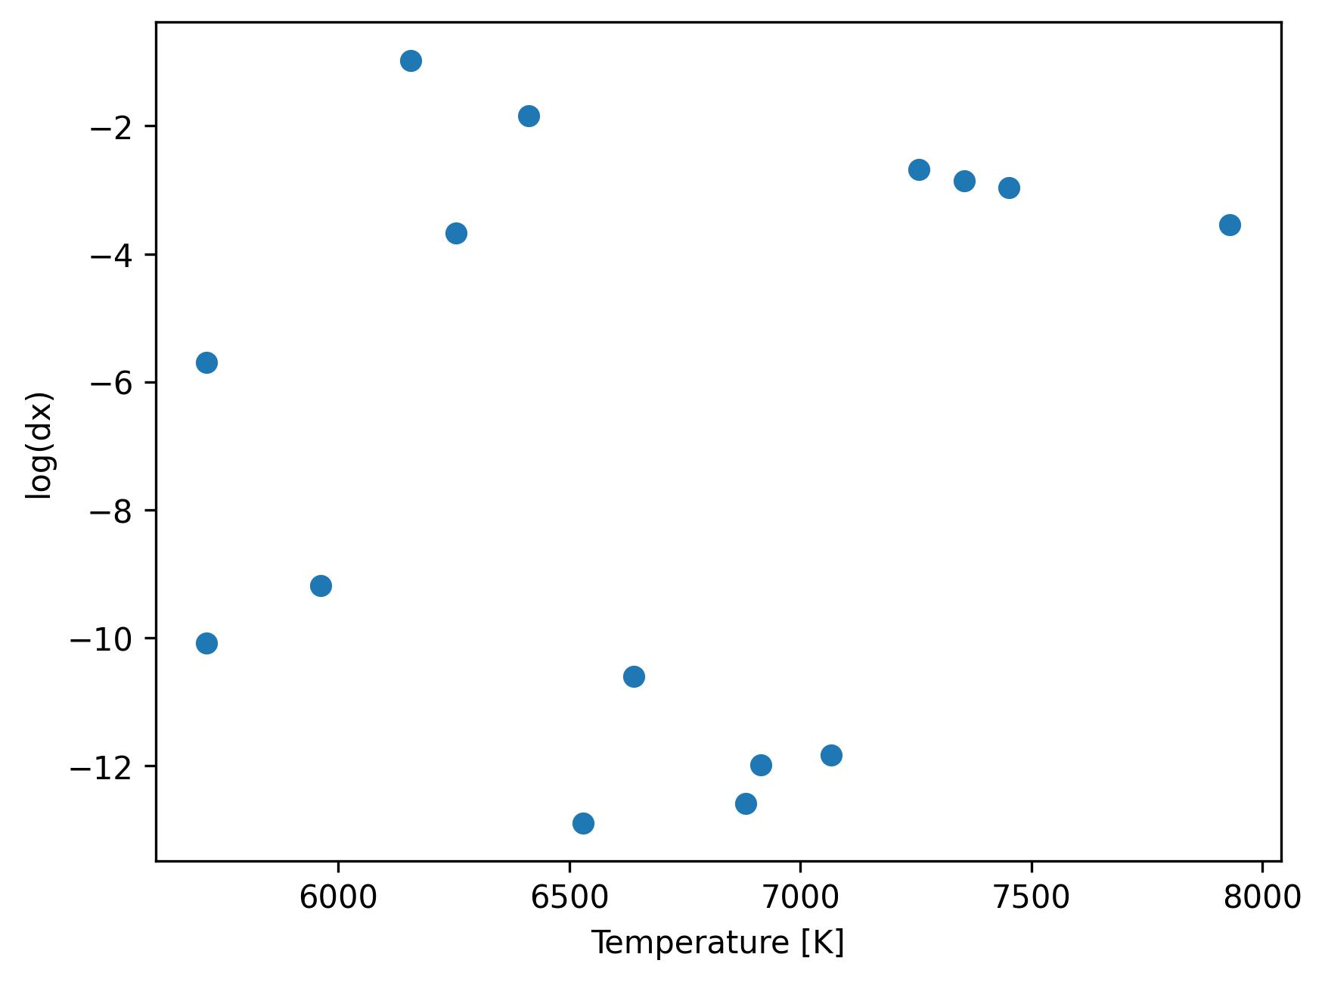
Experimental data : Pstat = 100 mbar

Slide 6
Stagline simulation for surrogate model training
With exp. data, T is limited to a certain range
→ Add converged stagline simulations ?

