Slide 1

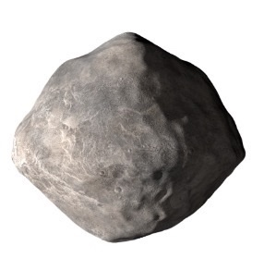
0D reactor for fast and reliable wall heat flux computation
PCMAF exam
Justin Pesesse
Notes:
Michele M.

Slide 2
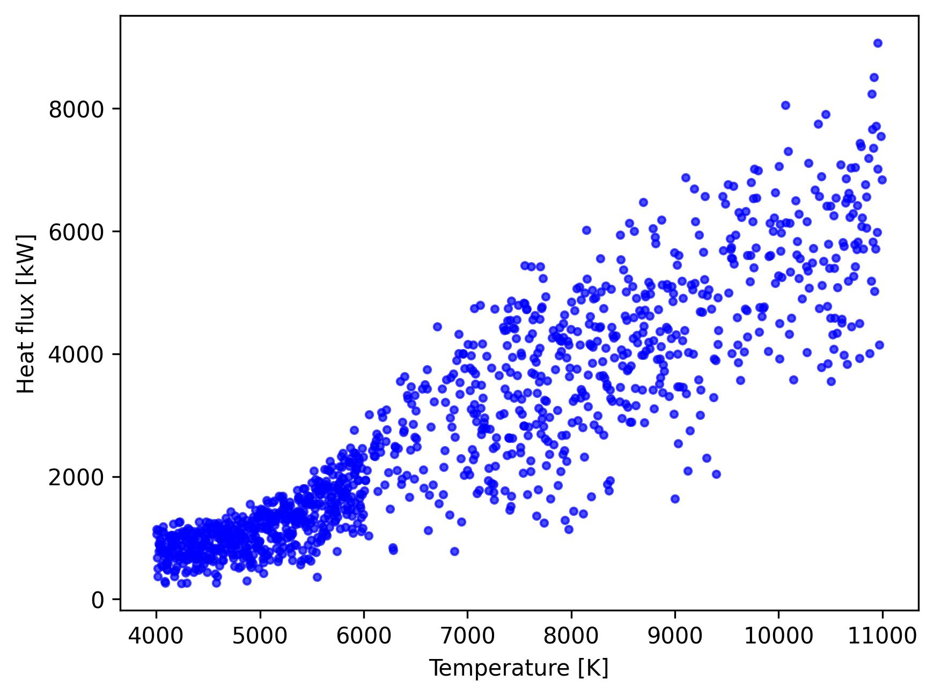
Stagline simulation for surrogate model training
Less converged simulations at higher temperature
Adding data could improve the accuracy of the model ?
Use 0D model to compute HF on non-converged simulation conditions

Slide 3
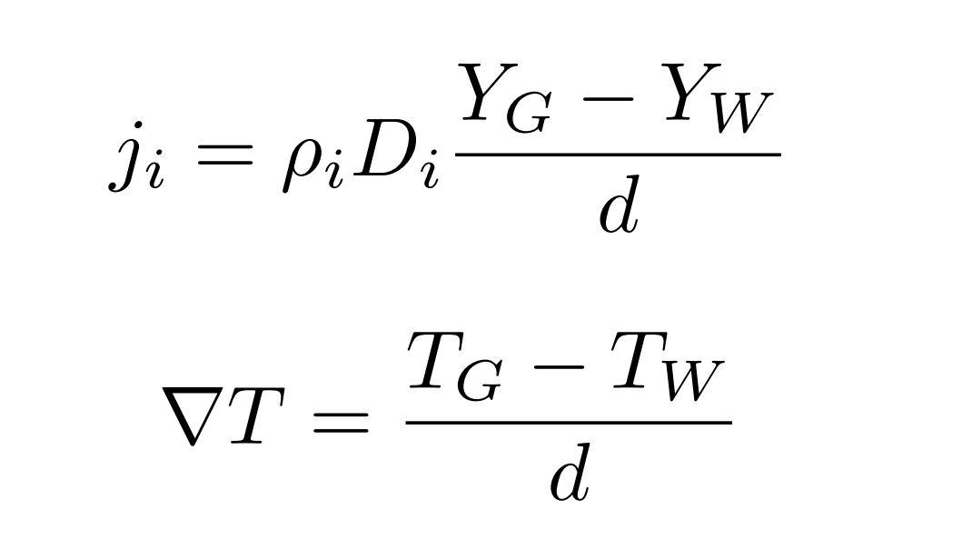
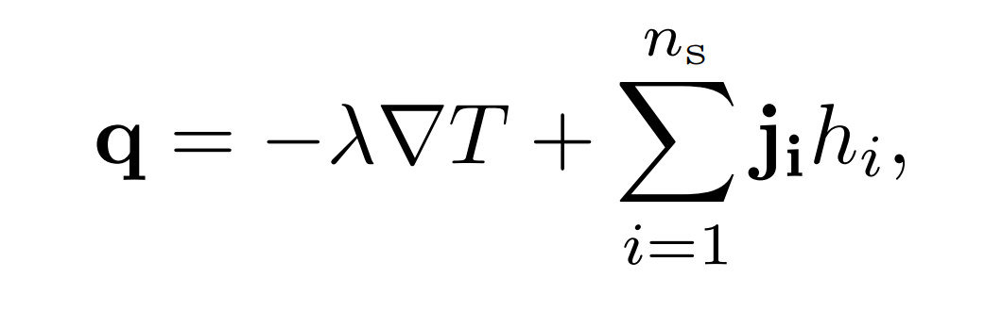
0D reactor with experimental data
Mixture, Tinlet, Tsurface, Pstat, …
OD reactor
dx imposed to 1e-3
dx found to match exp. values

Slide 4
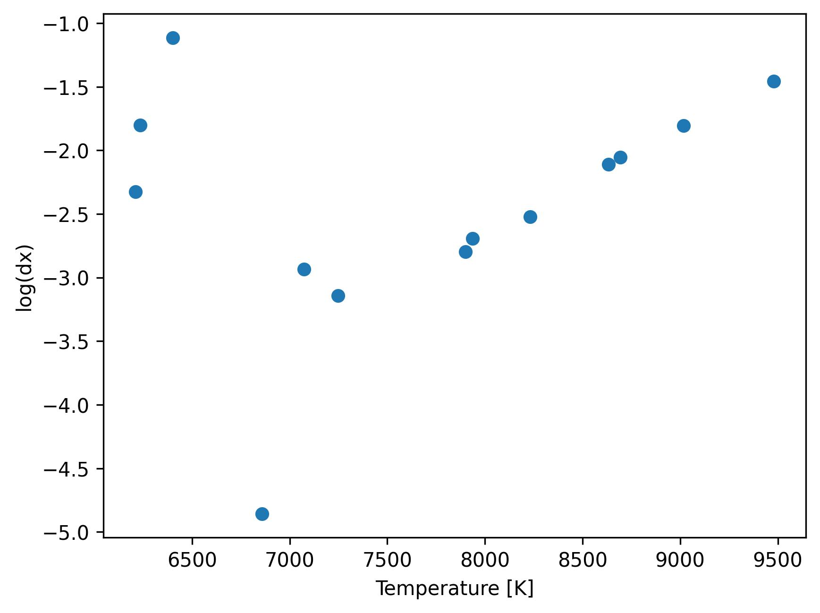
0D reactor with experimental data
Experimental data : Pstat = 15 mbar

Slide 5
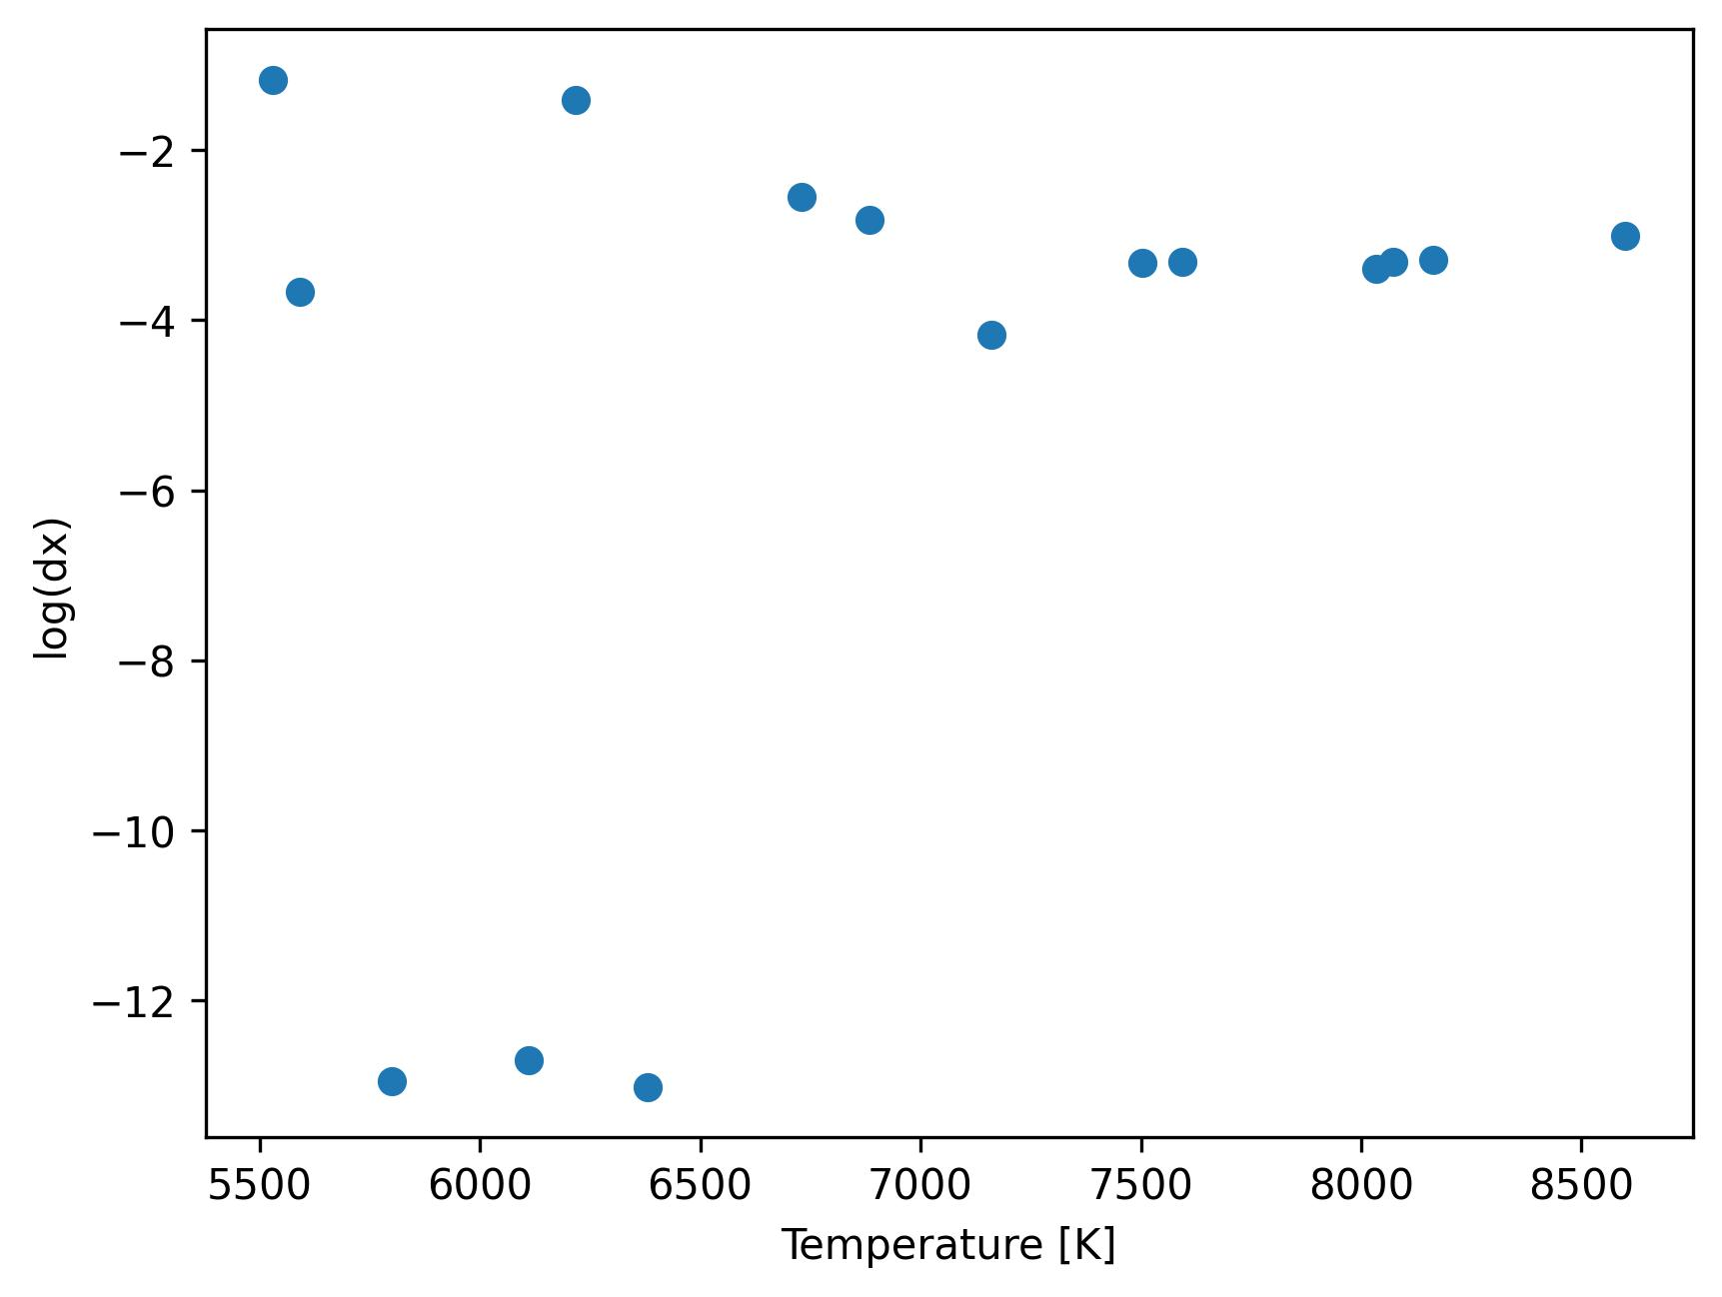
0D reactor with experimental data
Experimental data : Pstat = 50 mbar

Slide 6
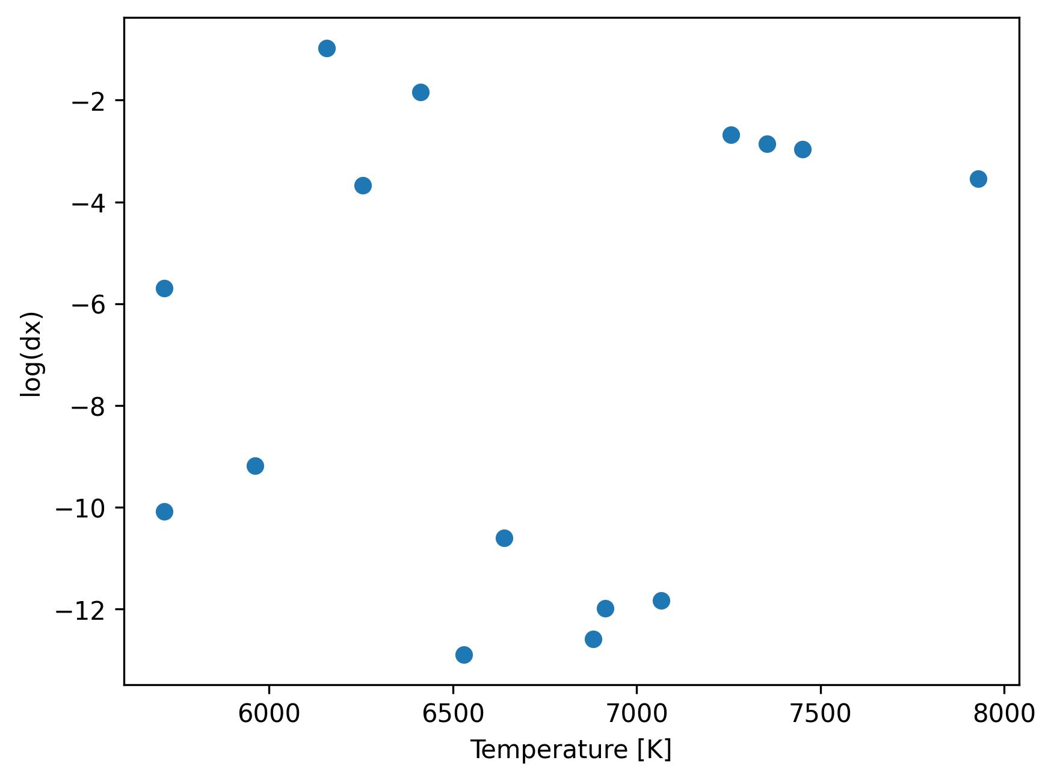
0D reactor with experimental data
Experimental data : Pstat = 100 mbar

Slide 7
0D reactor with surrogate model data
Stagline simulation for surrogate model training
With exp. data, T is limited to a certain range
→ Add converged stagline simulations ?

Slide 8
0D reactor with surrogate model data
Mixture, Tinlet, Tsurface, Pstat, …
OD reactor
What to impose for dx

Slide 9
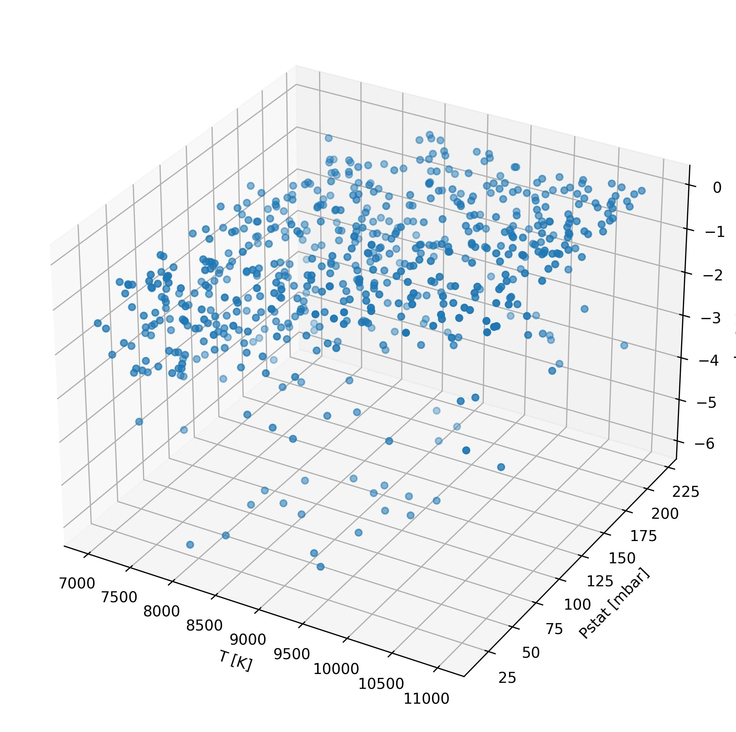
0D reactor with experimental data
Separate values for dx_diff and dx_conv:
Very chaotic behavior for dx_diff → Seems to be very dependent on the flow state (mass fraction)
No pattern could be found
Same values for dx_diff and dx_conv:
Less chaotic but same observations !
The chaotic variation of dx_diff is influencing a lot the common value for both dx
➔ Solution: Impose dx_diff to 1e-3 and tune dx_conv

Slide 10
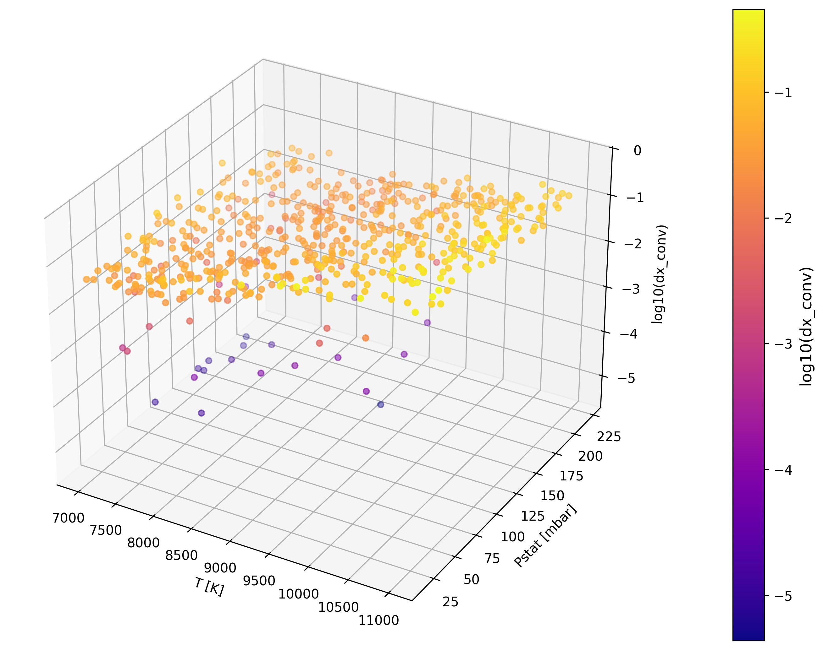
0D reactor with surrogate model data

Slide 11
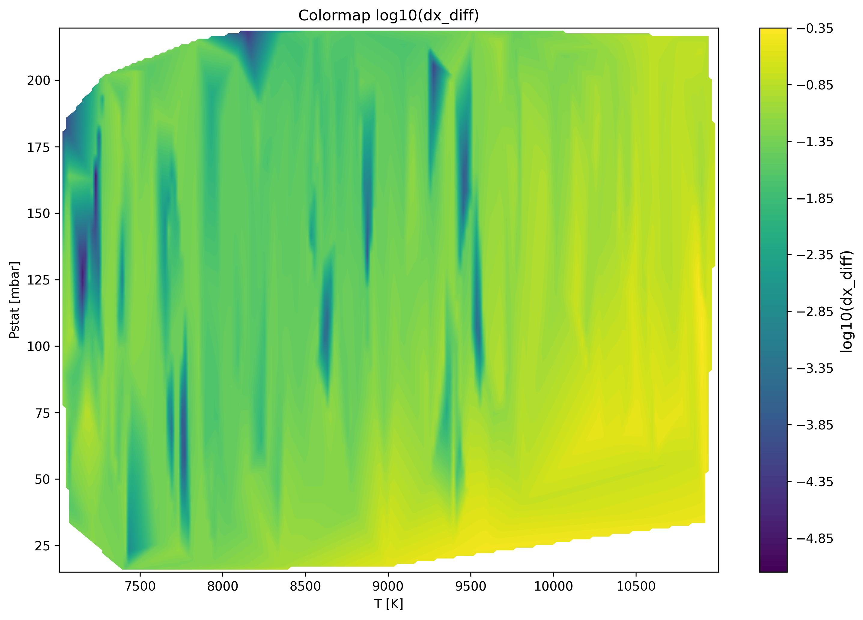
0D reactor with surrogate model data

Slide 12
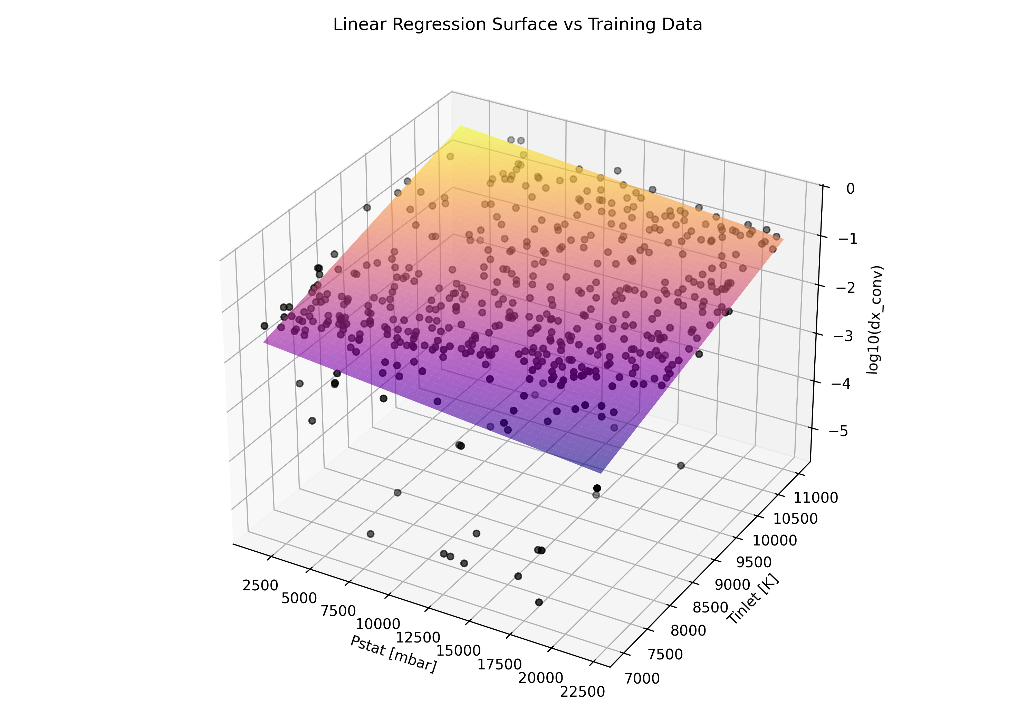
0D reactor with surrogate model data : linear regression
NRMSE : 12.54%
Linear trend is observed
Linear regression is too simple for the problem

Slide 13
0D reactor with surrogate model data : Advanced ML tools ?
Future work:
Use advance ML tools for higher accuracy ?
In depth study on the behavior of dx_diff ?
Test dx model on unconverged Stagline

