Slide 1


GUARD
DIGITAL SAFETY
GUARD
Digital safety for everyday life
Protection before the click, reply or payment
GUARD v1.0
Notes:
Layout follows slide 1 of the supplied Hydrogo Pitch Deck 2025. Guard product statement is based on the founder's stated vision. Image is an existing Guard brand asset.

Slide 2

TARGET USER
Name:
Ama Mensah
Occupation:
Small business owner
Location:
Accra, Ghana
Main device:
Android smartphone
Pain Points
Goals
• Suspicious calls and messages
• No quick way to verify them
• Fear of losing money or data
• Know what to trust
• Stop fraud before acting
• Protect family and business
GUARD
02
DIGITAL SAFETY
Notes:
Layout follows Hydrogo slide 2. Ama Mensah is an illustrative persona, not a named customer. The persona captures Guard's intended everyday-user segment.

Slide 3
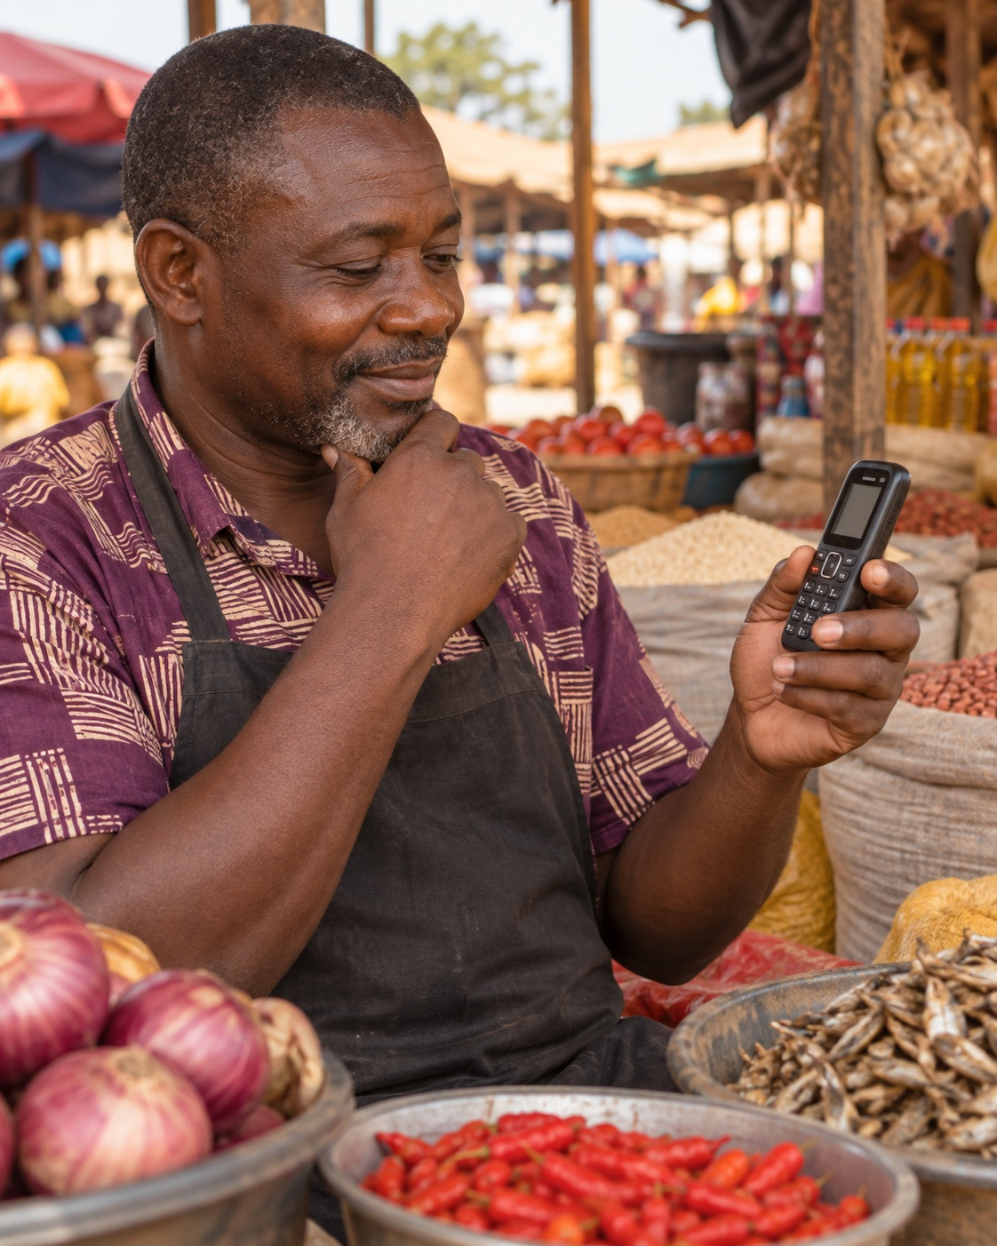
PROBLEM
24,778
reported financial-sector fraud cases in Ghana in 2025, up 48% from 2024.
Fraud reaches users through calls, SMS, email, links and chat before money changes hands.
Bank of Ghana Fraud Report 2025
GUARD
03
DIGITAL SAFETY
Notes:
Layout follows Hydrogo slide 3. Source: Bank of Ghana Fraud Report 2025, 24,778 cases in 2025 versus 16,733 in 2024. https://www.bog.gov.gh/wp-content/uploads/2026/07/FRAUD-REPORT-2025.pdf. Fraud-channel description reflects Guard's product scope and does not claim every reported case used every channel.

Slide 4


SOLUTION
GUARD
Guard is a permission-based digital safety companion that assesses suspicious calls, SMS, email, links and supported app notifications.
SMS alert
Your account is blocked.
Send the OTP now.
When risk appears, Guard explains the warning and gives the user a safer next action before they click, reply, share a code or send money.
HIGH RISK
Do not share the code.
Verify independently.
Current product: working web checker and shared analysis API
GUARD
04
DIGITAL SAFETY
Notes:
Layout follows Hydrogo slide 4. The web checker and API exist today. Background and in-channel protection represents the intended native product. Android, iOS, email and third-party app coverage depends on user permission, official APIs and platform policy.

Slide 5
IMPACT
Financial Safety
Digital Trust
Inclusion
Local Intelligence
Warn users before a fraudulent interaction becomes a financial loss.
Explain the signals so people can decide with more confidence.
Make fraud guidance clear for everyday users, families and small businesses.
Use consented reports to improve detection of Ghana-specific fraud patterns.
GUARD
05
DIGITAL SAFETY
Notes:
Layout follows Hydrogo slide 5. These are intended impact pathways, not measured outcomes. Guard does not yet claim a quantified reduction in fraud losses.

Slide 6
COMPETITOR ANALYSIS
Category | Cross-channel | Proactive warning | Local context | Explains risk | User cost
Guard | Yes | Planned | Yes | Yes | Free + paid
Caller-ID tools | Limited | Calls | Limited | Limited | Free + paid
Email spam filters | No | Email | Limited | Limited | Bundled
URL checkers | No | Manual | Limited | Partial | Often free
Category-level comparison. Named competitor validation remains part of customer and market research.
GUARD
06
DIGITAL SAFETY
Notes:
Layout follows Hydrogo slide 6. This is a category-level positioning comparison, not an audited claim about every product. 'Planned' distinguishes Guard's intended proactive native experience from the current manual web checker.

Slide 7
MARKET SIZE
30.5M
TAM Ghana connected market
Total Addressable
Market
30.5 million mobile data subscriptions
TO SIZE
SAM Reachable Android users
To size from device share and permission eligibility
Serviceable
Addressable Market
TO VALIDATE
SOM Initial pilot and partner reach
To validate through pilots and conversion
Serviceable
Obtainable Market
GUARD
07
DIGITAL SAFETY
Notes:
Layout follows Hydrogo slide 7. Source for TAM proxy: National Communications Authority, 30,515,711 mobile data subscriptions and 89.53% penetration in June 2026, https://nca.org.gh/. Subscriptions are not unique users and do not represent revenue. SAM and SOM remain intentionally unsized until Android share, reach, eligibility, conversion and pricing are validated.

Slide 8

REVENUE MODEL
Direct sale B2C and B2B
Free
Essential checks and supported warnings
Premium
Personal and family protection
Business
Seats, API usage and licensed integrations
Price
Validate in consumer and partner pilots
Unit cost
Measure cost per assessment and support
Margin
Set after usage and infrastructure tests
GUARD
08
DIGITAL SAFETY
Notes:
Layout follows Hydrogo slide 8. The revenue model is proposed. The supplied materials do not document validated prices, cost per assessment, gross margin, signed customers or revenue.

Slide 9
TRACTION
80%
60%
50%
80%
User Research
Frontend and Screens
Data and Backend
Stakeholder Engagement
Internal progress estimate
Core product flows built
FastAPI and PostgreSQL foundation
Internal progress estimate
6
22
2
API
Check Types
Database Tables
User Workflows
Local Verification
Messages, screenshots, links, numbers, payments and calls
Reported in the October 2026 update
User and administrator experiences
Registration, login and profile route tested
GUARD
09
DIGITAL SAFETY
Notes:
Layout follows Hydrogo slide 9. Progress percentages, database-table count and local API verification come from the October 2026 internal project update represented in the supplied Guard deck. They are not independently audited. Current workspace evidence supports the six check types, user/admin workflows and shared backend foundation.

Slide 10
Key Milestones
1
2
3
4
Q4: 2026
Q1: 2027
Q2: 2027
H2: 2027
MVP Integration and Quality
Android Pilot
Email and iOS
Partner Pilots
• Connect the web flows to the shared API
• Establish accuracy and false-alert baselines
• Define production privacy controls
• Implement call-screening and notification access
• Test permission comprehension
• Pilot with selected everyday users
• Add authorized Gmail connection
• Build supported Apple extensions
• Measure cross-channel value
• Run SME and institutional pilots
• Improve moderated local intelligence
• Prepare regional-language expansion
GUARD
10
DIGITAL SAFETY
Notes:
Layout follows Hydrogo slide 10. These are proposed milestones, subject to resources, user research, platform policy and technical validation. Android and Apple capabilities differ; third-party messaging coverage depends on supported integration points.

Slide 11
GUARD
DIGITAL SAFETY
OUR TEAM
01
02
03
04
05
FSA
YBI
JB
KA
DOA
Fuseini Saida
Ayisha
Yusif Babamu
Issah
Josephus
Bawah
Kelvin
Ahorbo
Dennis Owusu
Adarkwarh
Role and relevant
experience to confirm
Role and relevant
experience to confirm
Role and relevant
experience to confirm
Role and relevant
experience to confirm
Role and relevant
experience to confirm
Seeking pilot partners, representative fraud data, technical mentorship and strategic support
Notes:
Layout follows Hydrogo slide 11. Team names come from the supplied Guard investor deck. Roles, biographies, contact details and individual proof points were not provided and remain explicit completion items. The closing support request reflects the supplied Guard deck.

