Slide 1
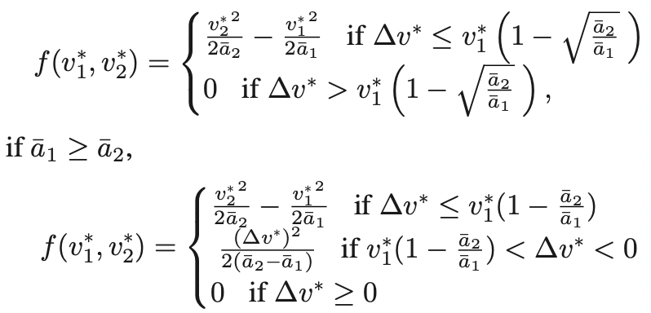
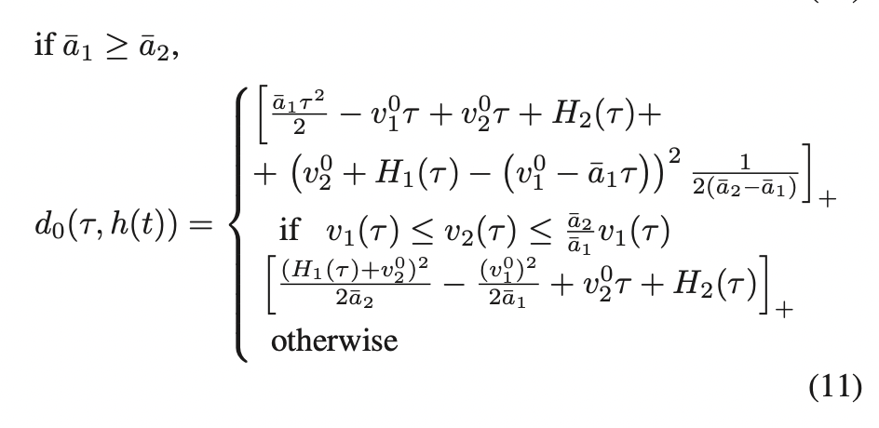
Towards a Complete Safety Framework for Longitudinal Driving

Slide 2
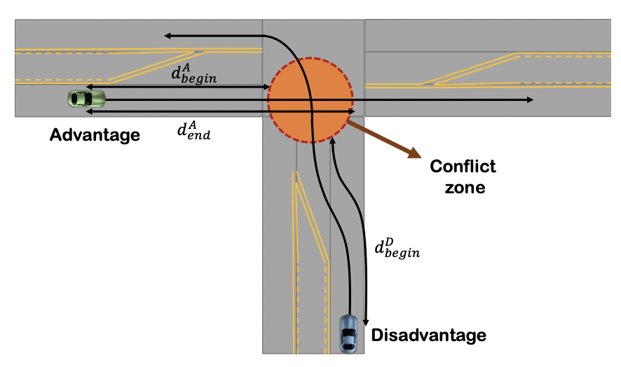
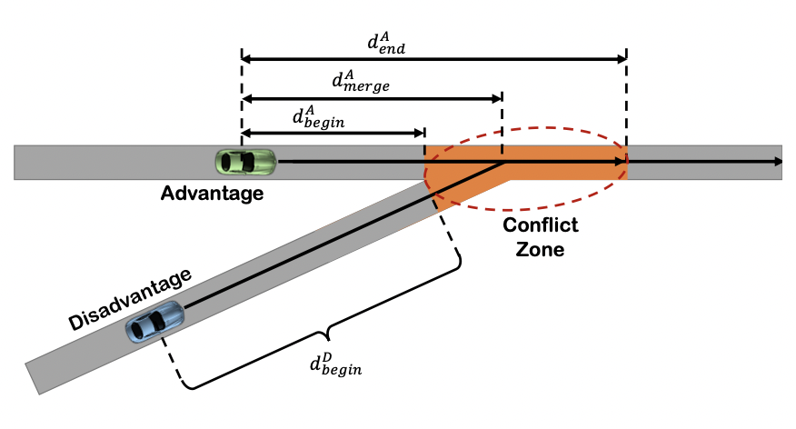
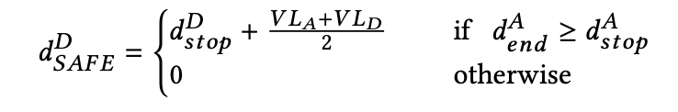

Cooperative Driving of Connected Autonomous Vehicles Using Responsibility-Sensitive Safety (RSS) Rules

Slide 3
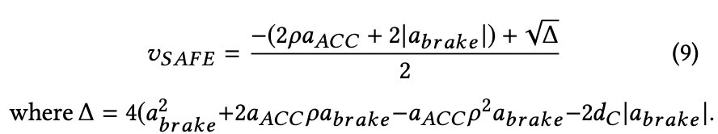
-We represent the future position of the CAV with a subset of its expected route(R)
-First, CAVs computes the distance between the mid point of edges on their path. All contiguous edges that have a distance less than dth are considered to be a part of the same conflict zone.
-A PDG (Partial Dependency Graph) gives information on the conflicts between that CAV and every other CAV.
-A CDG (Complete Dependency Graph) is the combination of all the PDGs we get from all the CAVs.
-The safe velocity, vSAFE , is determined based on the minimum safe distance that the ego CAV must maintain from the conflict zone given that other CAV –which has the advantage– may slow down at any point in time and stop inside the conflict zone.

Slide 4
Deadlocks
When CAVs interact with each other in different scenarios, they may face a deadlock situation where CAVs yield to each other for an indefinite time.
RSS rules do not consider the interaction among other CAVs and therefore, cannot detect cases where a deadlock happens.

Slide 5
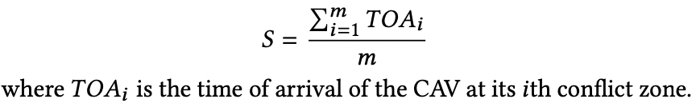
After constructing the CDG, each CAV checks if the CDG has a cycle. We use the Depth-First Search (DFS) algorithm to detect cycles.
If a deadlock is detected, each CAV calculates a score for each CAV that is involved in the cycle based on its average time of arrival i.e.
Once the leader is determined, the direction of all incoming edges to the leader’s node is reversed.
If the CDG has no cycles, then there is no deadlock involving the ego CAV.

Slide 6
RESULTS
To verify that CAVs are always safe, we force the CAV with the advantage to suddenly decelerate at different times. We show that no accident will happen regardless of the deceleration time and CAVs maintain a minimum safe distance of 5 meters. Using brute-force testing, the deceleration time of the CAV with the ad- vantage varies in a 30-second interval with a 0.1 s increment that includes critical times that stops inside the conflict zone.
For the case that no deadlock resolution is done, CAVs slow down to yield to other CAVs and eventually stop and will wait forever. For the case with deadlock resolution, CAVs slow down at first but speed up when their conflict zone is cleared.

Slide 7
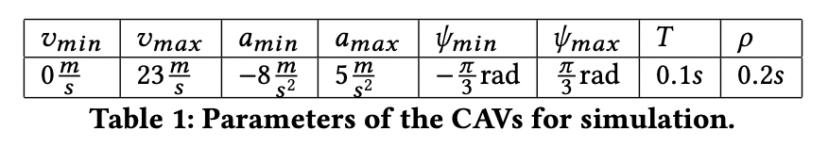
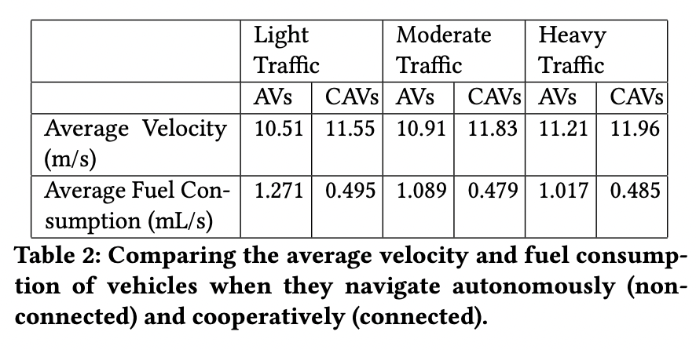
Future Work
Future works include taking into account various fault models (e.g. the network delay is larger than T or a CAV is unable to communicate, a CAV is being compromised and lies about its position and/or its future trajectory, etc.) with the help of infrastructure

Slide 8
Lane change scheduling for connected and autonomous vehicles
-first part is about making space for another cav to join the platoon.
-In this paper, we are interested in finding feasible group paths for a group of vehicles while minimizing the time for completing all LCs while approaching a critical point on a road segment. This goal is achieved by finding a feasible group path that minimizes the maximum LC time.
-LC time being the time between the lane change and the intersection.
-We want to find a feasible group path ∈ such that the overall LC completion time 𝜏 in (9) is minimal, while all vehicles in stay as close as possible to the virtual leader position 𝑥0.

Slide 9
-Since CAVs travel in a given direction, LCs of CAVs that are more ahead affect the motion of CAVs behind. Hence, we step-by-step compute the paths of CAVs starting from CAVs in the front.
-Not a optimal solution.
-formulate a reachable set using smooth trajectories
-Define a minimum predecessor whose position is given by the minimum predecessor of the target predecessor and current predecessor.
-Algorithm to smoothen the velocity curve of this minimum predecessor
-Now the crossing vehicle and the target follower will follow the minimum predecessor

Slide 10
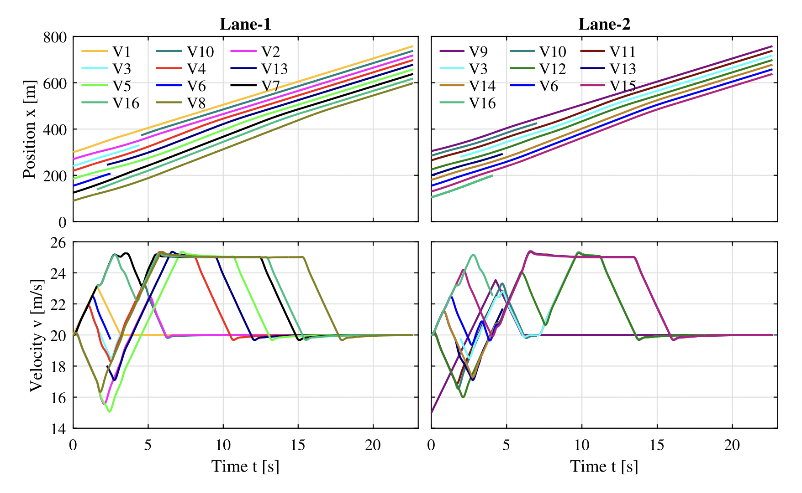
-Finally the minimum velocities of the cars in the platoon is set to different values based on the cars position.
-In dense traffic, vehicles follow each other at the desired distance specified. That is, if one of the vehicles reaches the minimum velocity 𝑣min, all of its followers also have to drive at 𝑣min. As a result, these vehicles will not be able to open gaps for LCVs until a speed increase.

Slide 11
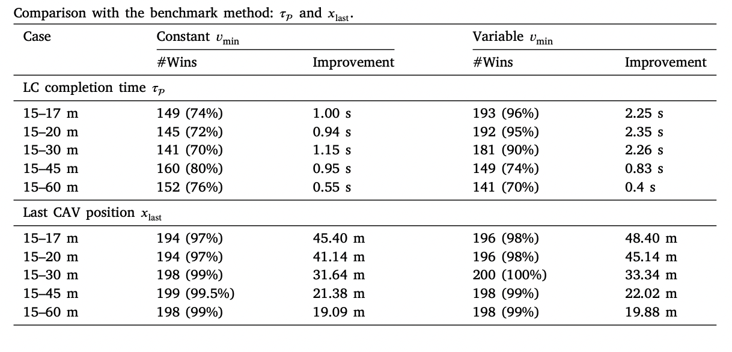
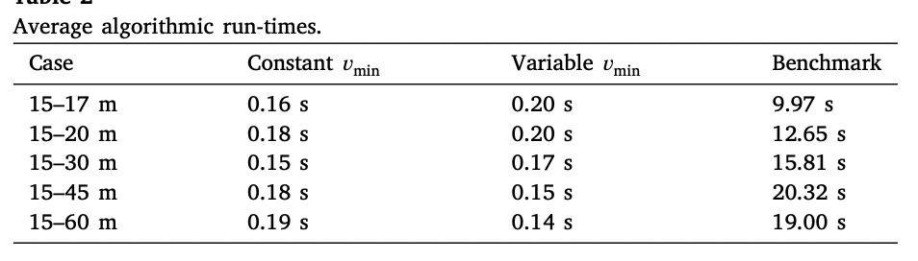
Vehicle constraints
the speed values 𝑣st = 20m/s,𝑣min = 15m/s and 𝑣max = 25m/s, the acceleration values 𝑎min = −2 m∕s2, 𝑎max = 2m/s2, and the jerk values 𝑗 = ±1000 m∕s3.

Slide 12
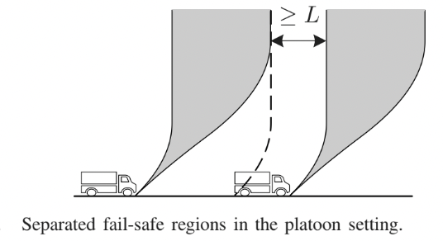
Safe and Efficient Cooperative Platooning
-The preceding vehicle sends its fail safe trajectory to the follower.
-The adjusts likewise and sends its failsafe trajectory to its follower.

Slide 13
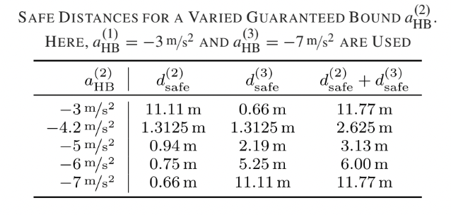
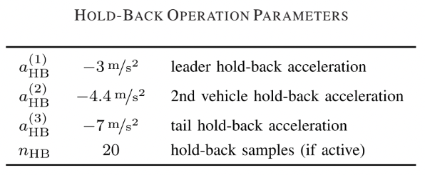
Braking hold back startegy
In terms of inter-vehicle distances, it is advantageous if a(i) > a(i+1) holds.

Slide 14
Path planning and decision making for lane change of CAVs
First I decided on a state space.
The state space here is just the S(distance) and v(velocity) of a vehicle after time t.
In the next slide I show all the points of the state space where the vehicle can be in after this time t given a max and min acceleration and a max and min velocity.
I also defined four types of paths which can cover the part of the state space that is reachable.

Slide 15
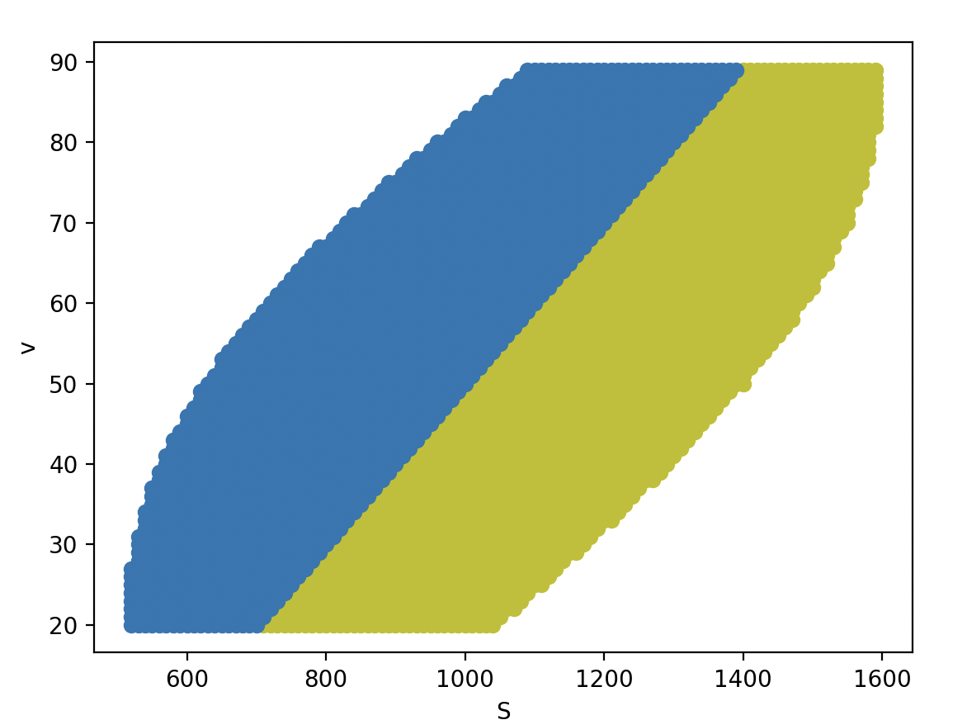
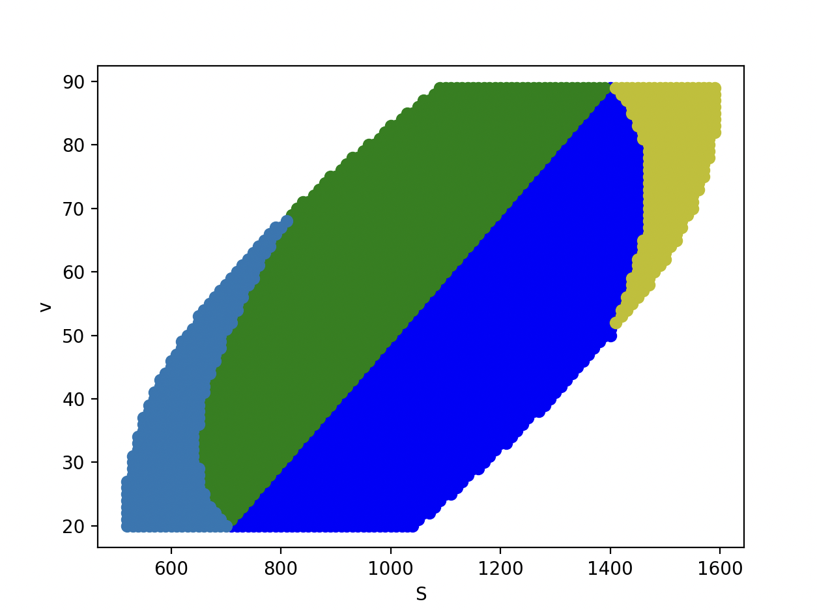
Simulation to prove that the four types of path selected cover the state space
Just including the Q+Q-,Q-Q+ paths
Including all four paths
Included all 4 types of path because the max or min velocity becomes needlessly high/low at the corners of the state space

Slide 16
The algorithm picks a point on the road to move into a platoon.
For this we first plot points on the road corresponding to every part of the platoon into which the vehicle can enter into.
This gives us a list of proposed points on the state space, from which we pick a point based on a value function that can depend upon the vehicles in front of the vehicle, behind it and also the max velocity and acceleration required.
The point that we pick depends on the shape of the road.
Note: Current platoon: platoon from where vehicles shift into another lane
Target platoon: platoon already in the lane where vehicle is shifting into

Slide 17
The method described in the last slide works on a platoon as well, where we execute the algorithm for each vehicle one by one keeping in mind the decisions of the previous vehicle.
The position of the vehicle in the platoon can also be used in the “value function” to make it easier for the following vehicles.
After this the vehicles in the target platoon shift into place to make space for the new vehicles while the vehicles in the current platoon move to the decided points.
After this, the vehicles can move into the target lane.
I also wrote the control signals required for this.

Slide 18
Here every point in the reachable set in the state space is given a specific path(set of acceleration values) which is then used for the decision making process and the final lane change.
I just used four “types” of paths for this to prevent over complication but it is possible to decide upon different sets for these points which would definitely improve the algorithm and give us “better” ways to go about the lane change.
This would most probably need a learning method to give optimal results.
Changing just the value function can also effect the behaviour of the lane change.

Slide 19
I also attached photos of how velocity is affected by throttle and brake.
I also sent the videos of the simulator that i currently have.

