Slide 1
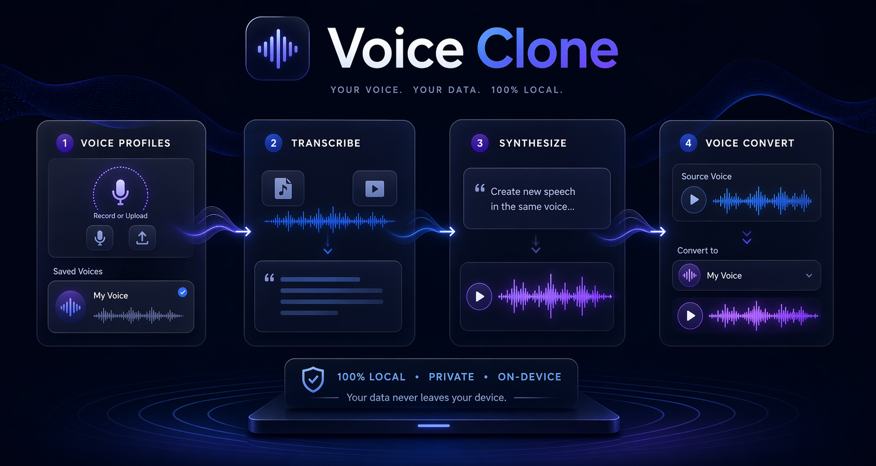
01
LAUNCH
Voice Clone
Local voice cloning studio for saving voices, transcribing media, generating new speech, and converting one voice into another.
100% local
Private by design
Qwen3-TTS + faster-whisper
Voice Clone • Local-first voice cloning studio

Slide 2
02
PROBLEM
Why I built it
Most voice tools are fragmented across scripts, cloud dashboards, and disconnected workflows.
Saving a reusable reference voice is usually separate from transcription.
Voice generation and voice conversion often live in different tools.
Cloud-first tools raise privacy concerns for personal voice data.
Local workflows are powerful, but the UX is usually rough.
This project puts everything into one clean local studio.
Voice Clone • Local-first voice cloning studio

Slide 3
03
WORKFLOW
What the app does
Voice Profiles
Transcribe
Synthesize
Convert
1
2
3
4
Record or upload a reference clip and save a reusable voice profile.
Turn audio or video into cleaned transcript text plus subtitle timing.
Generate new speech from saved voice style and target text.
Transcribe source media and re-speak it using another saved voice.
Voice Clone • Local-first voice cloning studio

Slide 4
04
ARCHITECTURE
How it works under the hood
The project is intentionally local-first and split into a clear frontend/backend pipeline.
Frontend
Backend
Models + files
Next.js 16
React 19
Tailwind 4
SSE client + recorder
FastAPI
Audio normalization
Model manager lock
Streaming endpoints
Qwen3-TTS
faster-whisper
saved_voices/
generated/
User actions flow left → right and results stream back into the UI.
Voice Clone • Local-first voice cloning studio

Slide 5
05
WHY IT MATTERS
What makes this useful
Practical benefits
Technical choices
One place to manage voice references and transcripts
FastAPI backend with SSE progress events
Subtitle-ready transcription with timed segments
Audio normalization for browser upload formats
Editable review-first flow for conversion
Async-safe model mutual exclusion
Private local processing instead of cloud upload
Simple file-based voice profile storage
Voice Clone • Local-first voice cloning studio

Slide 6
06
LAUNCH
Voice Clone is live
Built as a local-first voice studio for saving voices, transcribing media, generating speech, and converting recordings in one workflow.
Best fit for:
builders
indie hackers
local AI tool fans
voice workflow experiments
GitHub repo in comments / post copy
Voice Clone • Launch carousel draft

