Slide 1
Web Application Security
Lesson 1:
Basics

Slide 2
Learning Outcome
On completion of this module, students will be able to:
Apply a detailed methodology to your web application penetration tests.
Analyze the results from automated web testing tools to remove false positives and validate findings. Manually discover key web application flaws.
Analyze traffic between the client and the server application using proxy tools to find security issues within the client-side application code.
Create configurations and test payloads within other web attacks.

Slide 3
Assessment
Final Exam: 100%
The exam material covers the entire contents of the book "Innocent Code", supplemented with variations on it that are addressed in the weekly assignments.

Slide 4

Text book
Innocent Code: A Security Wake-Up Call for Web Programmers
Wiley; 1 edition (January 30, 2004)
By Sverre H. Huseby

Slide 5

Extra reading
Web Security Testing Cookbook: Systematic Techniques to Find Problems Fast
O'Reilly Media; 1 edition
By Paco Hope, Ben Walther

Slide 6

Extra reading
The Web Application Hacker's Handbook: Finding and Exploiting Security Flaws
Wiley; 2 edition (September 27, 2011)
By Dafydd Stuttard, Marcus Pinto

Slide 7
HTTP (Hypertext Transfer Protocol)

Slide 8
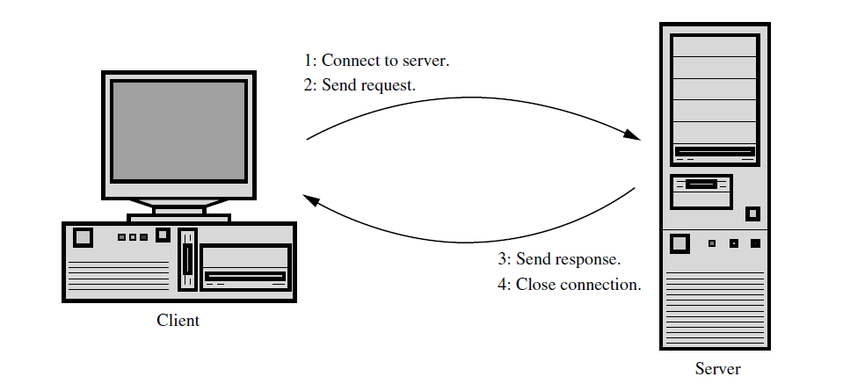
Client-Server Model of WEB

Slide 9
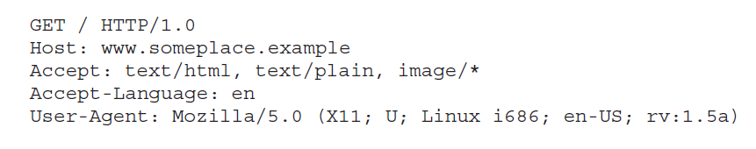
Requests and Responses
HTTP is line oriented, just like many other Internet protocols. Communication takes place using strings of characters, separated by carriage return (ASCII 13) and line feed (ASCII 10).
Example: http://www.someplace.example

Slide 10
Request
POST, HEAD, …
Request-URI
HTTP-Version identifier
Method token
Request-line
Request-header lines

Slide 11
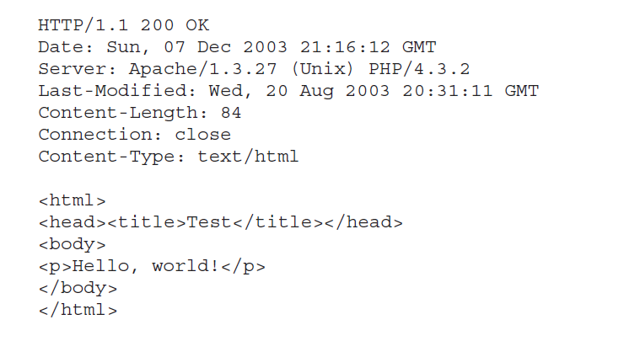
Response

Slide 12
Get Request vs. Post Request

Slide 13
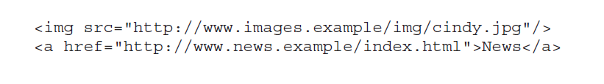
The Referer header
A Referer header is sent by most browsers on most requests.
The header contains the URL of the document from which the request originated.
http://www.site.example/index.html

Slide 14
Caching
Caching refers to temporarily storing documents close to the final destination, in order to reduce download times.
Two types of web caches:
Local cache: is managed by the browser itself.
Shared (proxy) cache: is typically a server in the local area network.

Slide 15
Cookies
HTTP is a stateless protocol.
We would like to have state between requests. What state for example?
Google search engine once used cookies to allow users (even non-registered ones) to decide how many search results per page they wanted to see.
Cookies are introduced as an extension to HTTP to give us just the state.
With cookies, the web server asks the client to remember a small piece of information. This information is passed back by the client on each subsequent request to the same server.

Slide 16

Cookies
HTTP headers are used for both setting and returning cookies:
Cookies are returned using the Cookie header:
Name of cookie and its value
to which parts of the document hierarchy on this server
that cookie should be returned
How many seconds to remember it

Slide 17
Cookies
Drawbacks:
Firstly, cookies may be limited in size, so space consuming states cannot be safely represented using cookies.
Secondly, cookies are handled on the client-side, so we have to keep making sure that a misbehaving user doesn’t change the state to his own liking.
Both limitations would be solved if we could keep the state information on the server side.

Slide 18
Sessions

Slide 19
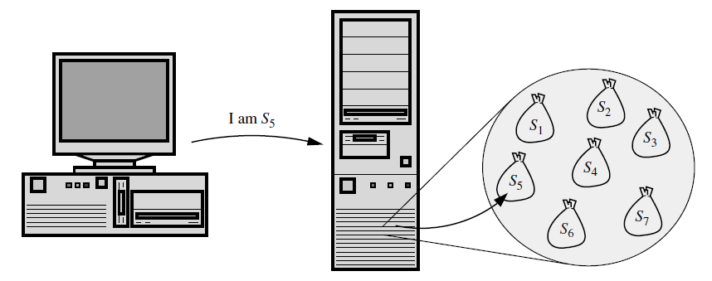
Sessions (Session Objects)
Sessions are server-side collections of variables that make up the state.
How to associate a set of data on the server to the correct client?
Answer: Session ID
The common approach is to have the client pass a session ID on each request.
The session ID uniquely identifies
one session object on the server,
the session object ‘‘owned’’ by the
client making the request.
Security problem with sessions?

Slide 20
Session hijacking
Many web sites use a session-based log-in, in which a session is initiated once
the user has given a valid user name and password.
If somebody gets access to the session ID of a logged in user?
The attacker would not need to know the password of the victim, as the session ID works as a ‘‘short-time password’’ or a proof of successful authentication after a user has logged in.

Slide 21

Session hijacking
How would the attacker gain access to the session ID?
Guess it,
Calculate it,
Brute-force it,
Find it by trial and error
Cross-site Scripting
Use referer header
Packet sniffing
…

Slide 22
Session hijacking
The security of sessions lay in the secrecy of the session ID.
The number one goal to prevent session hijacking is to keep the session ID unavailable to third parties.
As an extra precaution, many web sites implement secondary measures to limit the risk of session hijacking, even if a session ID becomes available to attackers.
However, none of these secondary mechanisms offer full protection against hijacking.
The secrecy of the session ID is the only mechanism that gives real protection.

Slide 23
HTTPS

Slide 24
HTTPs: Encrypted Communication
In a web setting, encryption usually means HTTPS.
Packet sniffing attacks the network transport rather than the application or the client.
The correct approach to protect against sniffing is to encrypt all communication.
On the Web, encryption is handled by passing HTTP over Secure Socket
Layer (SSL), or Transport Layer Security (TLS), giving a protocol normally known as HTTPS.

Slide 25
Summary

Slide 26
Summary
HTTP is a simple, text-oriented protocol.
Clients connect to servers and send requests, each of which draws a response from the server.
Headers are used to control the communication, and to pass cookies.
All request headers and data are controlled by the client.
An attacker may thus easily pass headers and data after his own liking.

Slide 27
Summary
Sessions are server-side containers for state information.
Attackers may be able to hijack the sessions of other users by getting hold of their session ID.
Several measures are available to make session hijacking hard, but the real solution is to keep the session ID a secret.
HTTPS protects data that pass between the client and the server.
Unfortunately, real world implementations of HTTPS are not bulletproof. Many weak links play a part in the game, and some of those links may easily break.

Slide 28
Your tasks for this week
Reading:
“Innocent Code: A Security Wake-Up Call for Web Programmers (Chapter 1)
Quiz:
WAS week 1 on the course page on the Edmodo.

