Slide 1

Babak Emami,
Emami.Babak@gmail.com
647-326-6199

Slide 2

Eli Lilly Canada - Customer Data Analytics – Case Study

Slide 3

Agenda
Question 1 :
How would you have assessed the impact of a sales person* 20 years ago (when only 1 source of information existed)
How would you assess their impact today (information is available to all equally)?
What type of data would you collect and what analysis would you do to show level of impact of a Sales person today?
Create a mockup of how you would present your results to the CEO how is looking to reduce the size of the sales force
Question 3:
What approach would you take to manage this request
Python based Search engine application:
Improve the customer satisfaction by increasing the employee’s knowledge

Slide 4


Question 1 How would you have assessed the impact of a sales person* 20 years ago (when only 1 source of information existed)
The success rate for a salesperson could be a combination of how many interactions they had with customers and how good their conversion rate is. Simply converting more leads to customers results in a better sale.
When the salesperson is the main source of information the 2 features of number of impressions and the conversion rate could specify the performance of the seller. Since the seller is the source of the information and having a higher sales means more success in conveying their knowledge about the product.

Slide 5

Question 1 How would you assess their impact today (information is available to all equally)?
Today when a customer walks in they have most of the information. For salesperson, the challenge of pitching one new product is now shifted to have a broad knowledge of the pros. and cons. of each product.
Despite this difference, the success rate still is related to the sales outcome which is converting leads to customers. We should, however, consider that new features can also be added to the calculation. Customer satisfaction/feedback is fairly a new feature that can play a critical role .Collecting feedback from customers is easy and very popular.

Slide 6

Question 1 What type of data would you collect and what analysis would you do to show level of impact of a Sales person today?
Collect:
Number of Customer interactions per hour
Conversion rate - How many of the conversations lead to the sale
Customer feedback/ Satisfaction
Sales Amount
Calculate:
Conversion ratio: $\frac{Conversion rate}{Number of Customer interactions per hour}$ *100
Productivity: $\log_{Number of Customer}({Conversion rate) }$
Salespersons rank: productivity * conversion ratio

Slide 7

Question 1 Create a mockup of how you would present your results to the CEO how is looking to reduce the size of the sales force
To present the employees’ production we can calculates their customer services, productivity and productions in each period and evaluate their billabilities using ranking matrix.
In this case, I want to present the employee production matrix for the home-hardware department at the XYZ company.

Slide 8

How to rank employees based on their activities and productions

Slide 9
Production matrix visualization

Slide 10
Question 3 The excitement behind analytics is growing more and more within Lilly Canada. As you pass the VP of Medical in the hallway, he mentions that he saw an amazing Dashboard in tableau coming from Europe and says he wants one too.
Before jumping to the solution there will be some critical questions to be answered:
What is the current system of use?
What are the key features in the new system that they are interested in?
Compare the two system (Current and the potential new ones), the differences, are they pain points or nice to have features?
What is the cost (time, resource) for implementing the new system?
If the decision is to go with the new dashboard, what is the exact requirement that would be beneficial for us so instead of just creating something just similar to that existing Dashboard, We tailor our own solution to match our flow?

Slide 11
Python-based Search Engine Application

Slide 12

Suggestion
Suggestion method to improve customer satisfaction and increase the employees’ productions:
Customer satisfaction/feedback is fairly a new feature that can play a critical role. Collecting feedback from customers is easy and very popular.
Today when a customer walks in they have most of the information. For salesperson, the challenge of pitching one new product is now shifted to have a broad knowledge of the pros and cons of each product.
Employees can increase their knowledge using analytical techniques to have appropriated answer for the client’s questions.
listen, understands and provides the best suggestion based on the clients’ requirements
To address this feature, I have created a python-based search engine to help the employees.

Slide 13

An example: Babak is an Employee working at the media department. He wants to know about the most common questions for the canon lens “sigma 70-200” and he wants to have a landscape of this products and the simile's ones prices
Algorithm will provide following results:
Most popular question based on google suggestion:
Seller can have estimation about the clients’ questions
The products’ price from the other companies such as eBay :
Seller will have a comprehensive knowledge about the product’s price and the other simmerers one on the market.
Using these information's, employee can provide the most accurate consultant for the client and the customers satisfaction would be increased consequently

Slide 14
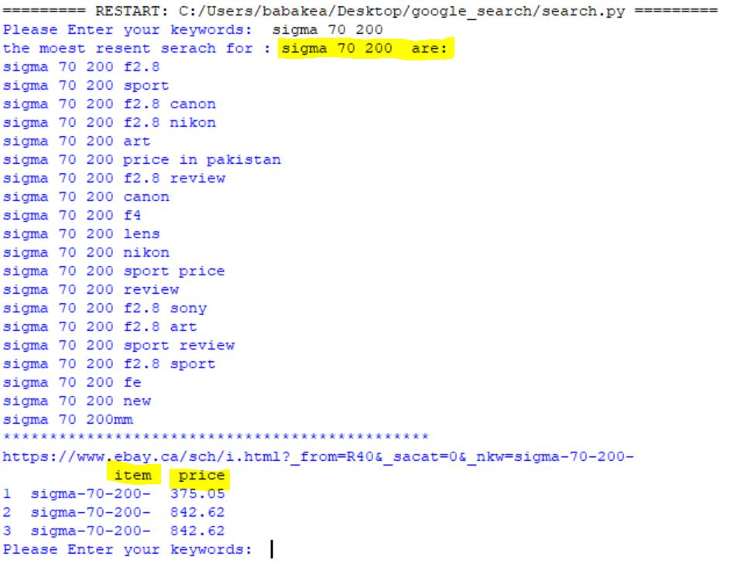
Sample Results

Slide 15
How To Run
Run the Start.bat or Start.Sh to run the Python file,
Installing the python libraries
pip install pandas, numpy, requests , BeautifulSoup
Call the project file :
python Start.py

Slide 16
Use Google search API to record the most common search
url=http://suggestqueries.google.com/complete/search
qserach=input('Please Enter your keywords: ')
params= { "client": "chrome", "q" : qserach, "hl" : "en"}
r= req.get(url,params=params)
print ("the moest resent serach for :",qserach , "are:")
for j in (r.json()[1]):
print (j)

Slide 17
Use BeautifulSoup to extract the information , from the eBay website
ebayurl="https://www.ebay.ca/sch/i.html?_from=R40&_sacat=0&_nkw={0:s}".format(qserach)
html= urllib.request.urlopen(ebayurl).read()
soup=b(html,"html.parser")
for post in soup.findAll("li",{"class" :"sresult lvresult clearfix li shic"}):
item=post.findAll("a", {"class" : "vip"})[0]
price=re.findall("\d+\.\d+", post.findAll("span",{"calss","bold"})[0].text)[0]
title=item.text
link=item['href']
df.loc[i]=[i,qserach,title, link,price]
df = df.sort_values(by=['price'])

Slide 18
Conclusion
All results will be recoded to the excel sheet name results.xlsx
writer = pd.ExcelWriter('Results.xlsx’)
Most common search :
df1.to_excel(writer,'Google suggestion’)
Product’s price on Eaby:
df.to_excel(writer,'ebay -prices’)
writer.save()

Slide 19

Thank you for the attention

