Slide 1
Income Prediction binary classification
By Babak Mehrabi

Slide 2
Outline
Introduction
Data Analysis
Modelling (XGBoost, FNN)
Next Steps

Slide 3
Introduction
Task: Predict whether a person’s income is over 50K/year or not based on different features
48842 records with 14 features and 1 response variable
66% taken as train data, 33% as test data
Unbalanced binary classification problem

Slide 4
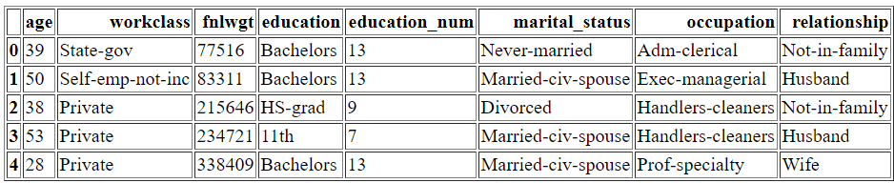
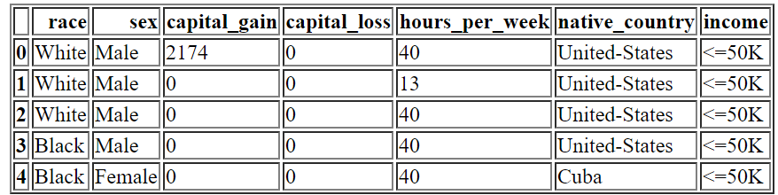
Introduction: A peek into the data

Slide 5
Data Analysis (steps)
Variable Identification (for ex. categorical or numerical etc.)
Analysis of Missing Values (NaNs)
Data Cleaning
Univariate EDA (exploratory data analysis)
Bivariate EDA (correlations, chi-2 test)
Feature Engineering & Selection Ideas

Slide 6
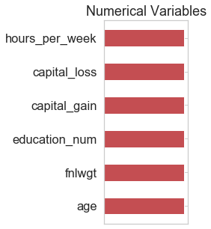
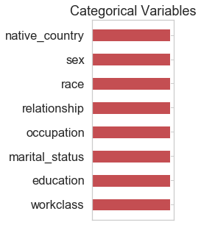
Variable Identification
education_num can be considered as a categorical variable too, depending on the model whether it is tree-based (Random Forest, xgboost) or linear-based (logistic regression, neural networks)

Slide 7
Missing values and data cleaning
There were no missing values in form of NaNs, however there are missing values in form of “?”, which is not a problem for tree-based models as they can be treated as a level.
For linear-based models we can dummy-encode them, and they still create no issue, as their lack is also a kind of information
There were 30 duplicated rows in the whole data, which were dropped

Slide 8
Univariate EDA
Barplots for categorical features wherein counts for both train & test datasets are shown
  This is important because we can find out if there is a major difference between the distribution of variables among train and test datasets
Histograms and density functions for numerical features
dispersion plot for numerical features vs the row index (in J notebook)
  The data points are plotted versus the row. (Good for discovering irregularities)

Slide 9
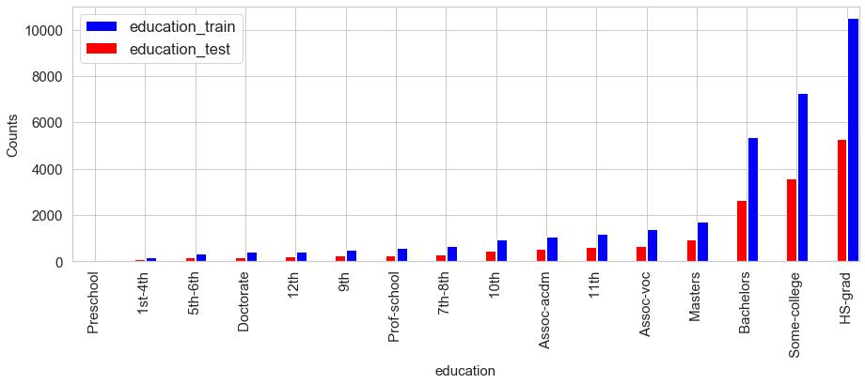
Univariate EDA: barplot for categorical features, example

Slide 10
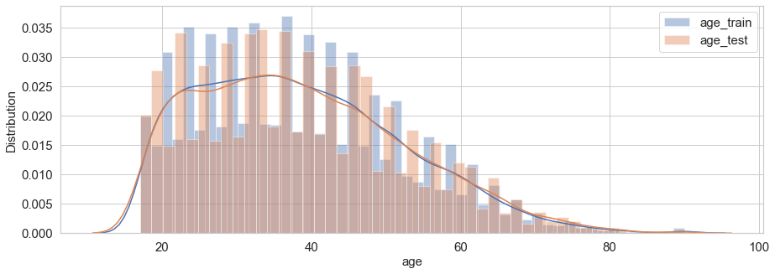
Univariate EDA: histogram for numerical features, example

Slide 11
Univariate EDA: observations
workclass, occupation and native_country have missing values which is denoted by “?”. This is not a problem for tree-based models however!
In variable native_country, one level "United-States" has the highest frequency (89.6%)!
variable fnlwgt sounds to have outliers
variables capital_gain and capital_loss mostly have zero as their value
40 hours is the most common level in hours_per_week variable

Slide 12
Bivariate EDA
Heatmap plot of correlation among different variables (numerical)
  Potential discovery of collinearity among variables
  Response variable can be treated as a numerical feature by dummy-encoding, thus enabling us to calculate its correlation with other features (good for feature selection)
  This heatmap is plotted only for numerical features (including response)
Heatmap to plot chi-2 test results (categorical)
  Good to find out dependency among the response variable and other features, to help us with feature selection

Slide 13
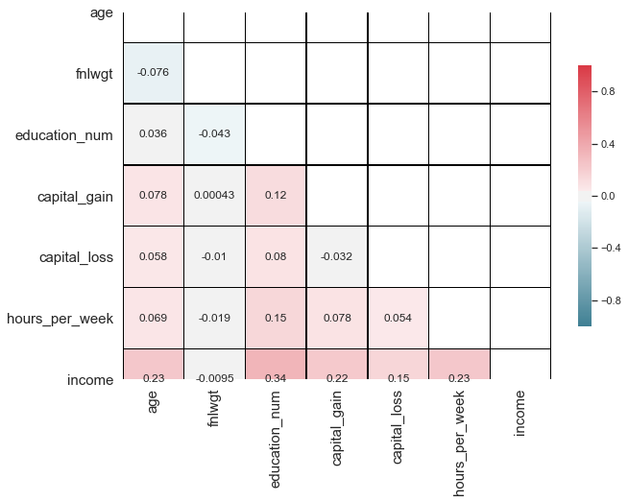
Bivariate EDA: heatmap of correlation
The response variable “income” has a very low correlation with the numerical feature “fnlwgt”. This is the first hint that maybe we should drop this feature
Apart from that, there is not much more finding

Slide 14
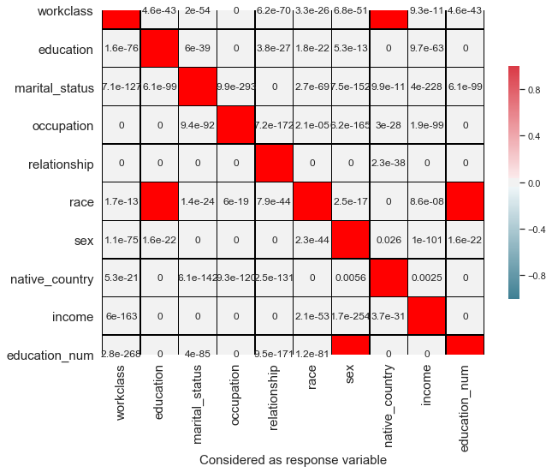
Bivariate EDA: heatmap for chi-2 test
In chi-2 test, the dependency among an output variable and some features are calculated.
Each variable is once considered as the output variable including our own response variable, and its dependency with other features are analyzed with p-values
The values in cells are p-values
response variable: income

Slide 15
Bivariate EDA: heatmap for chi-2 test
If p-value <= alpha:
  significant result, reject null hypothesis (H0), dependent.
If p-value > alpha:
  not significant result, fail to reject null hypothesis (H0), independent.
Assuming alpha= 0.05, most of p-values are way smaller than alpha
Those p-values greater than alpha were colored with red. These are the non-diagonal red cells
The most important finding is that the response variable is dependent on all features with 95 % confidence interval

Slide 16
Feature Engineering & Selection Ideas
General
  We have many categorical variables with many levels (8 vs 6). This might suggest that tree-based models (such as Random Forest, XGboost etc. ) maybe be better candidates. But we could still try other models
  Considering the Cartesian product of categorical features may improve the performance of the model
model specific
  For tree-based models, we will label-encode the categorical variables, although for XGBoost we could also consider the one-hot encoded features
  For linear-based models, we will one_hot_encode them.

Slide 17
Modelling (XGBoost)
Since the data is imbalanced, we choose roc_auc as our metric to be reported
In XGBoost, hyperparameters must be optimized
In theory, one would need to large grid search in order to find the optimal hyperparameters, but in practice this is impossible
So we have a different approach to hyperparameter optimization

Slide 18
Modelling (XGBoost): Our approach to hyperparameter optimization
Choose a high learning rate
Determine the optimum number of trees for this learning rate, assuming an initial set of hyperparameters
Tune tree-specific parameters (max_depth and min_child_weight)
Tune gamma
Tune subsample and colsample_bytree
Tune regularization parameters (lambda, alpha)
Lower the learning rate with the found hyperparameters

Slide 19
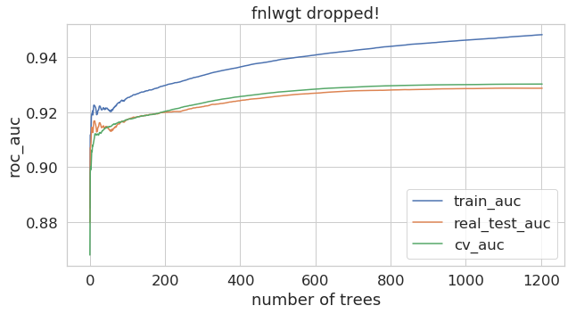
Modelling (XGBoost): train, test, cross-validation auc
As it can be seen from the plots, we have approximated the real test auc very well with the cross-validation auc
Real test-auc is always lower than the approximated cv auc

Slide 20
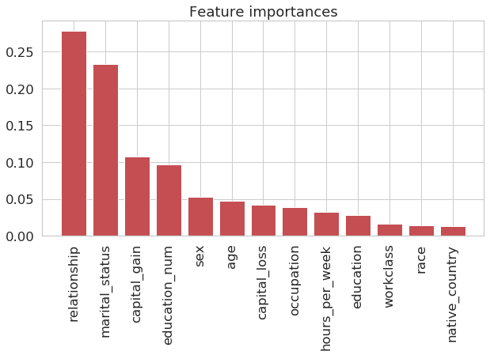
Modelling (XGBoost): feature importance
As it can be seen, native_country does not have much importance. Besides, it has too many levels.
Removing native_country has a very minimal effect on the test auc (tested)

Slide 21
Modelling (XGBoost): model performance
Confusion matrix for train data
Confusion matrix for test data
auc
0 | 1
20742 | 779
3978 | 7062
0 | 1
10292 | 534
2143 | 3312
train auc | test auc
0.948283 | 0.928779

Slide 22
Modelling (XGBoost): categorical features dummy encoded
We expect that the performance of the model improves because now features have spread out in the features space, from a label encoded to a dummy encoded state
This gives the XGBoost algorithm the flexibility to learn more complex relationships

Slide 23
Modelling (XGBoost): categorical features dummy encoded
Confusion matrix for train data
Confusion matrix for test data
auc
0 | 1
20621 | 778
4099 | 7063
0 | 1
10249 | 524
2186 | 3322
train auc | test auc
0.946151 | 0.929234
Comparing to when the features were only label encoded, the performance slightly improved.

Slide 24
Modelling (XGBoost): categorical features dummy encoded, selecting features
Considering all the dummy features, we have around 107 features
After dropping those ones whose importance are zero according to XGBoost algorithm, the number of remaining features reduced to 92
In other words, XGBoost helped us select features
Interestingly, these non-important features are mostly different levels of “native_country”, but nothing surprising as we already knew it is not an important feature comparing to other features.

Slide 25
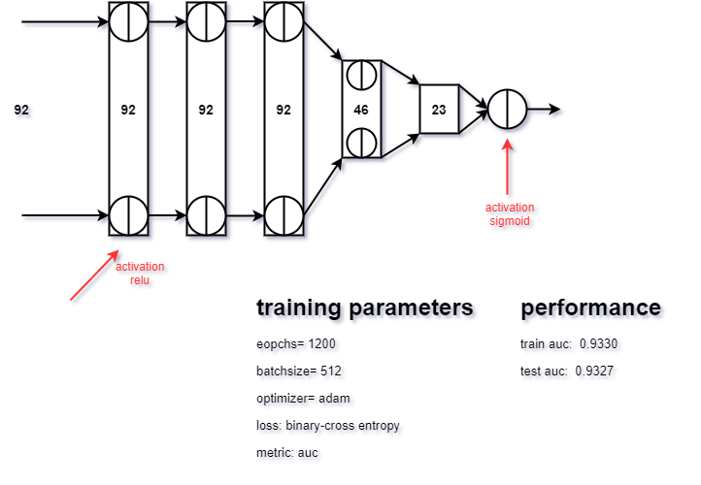
Neural Network: Dummy features with omitted features from the XGBoost results
Here we see the architecture of the feed forward neural network we used for training.
The architecture is not unique and it is itself a hyperparameter
We could already improve our auc metric comparing to XGBoot by almost 0.003

Slide 26
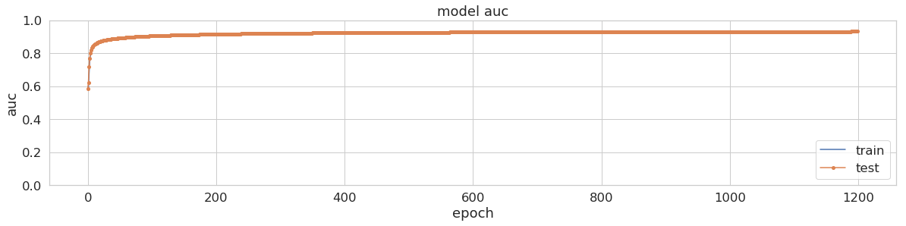
Neural Network: Dummy features with omitted features from the XGBoost results

Slide 27
Neural Network: Dummy features with omitted features from the XGBoost results
Confusion matrix for train data
Confusion matrix for test data
auc
0 | 1
23742 | 978
831 | 7010
0 | 1
10892 | 1543
1442 | 2404
train auc | test auc
0.9327 | 0.9327
Performance improved w.r.t XGBoost

Slide 28
Next steps
Train other models such as SVM, random forest, naive Bayes etc.
Build an stacking of models to improve the performance
Try to optimize models for other metrics such as precision, recall or F1-score if needed
More feature engineering based on the domain knowledge

