Slide 1
Telecom Customer Churn Prediction
PG-DBDA FEB 2025
Prepared by: Aditi Singh & Babaly Jaiswal

Slide 2
Problem Statement
Predict the likelihood of customer churn for a telecom provider.
Identify actionable drivers for targeted retention offers.
Reduce customer loss and improve retention.

Slide 3
Aims & Objectives
Conduct exploratory data analysis (EDA) on customer data.
Handle missing values, encode categorical variables, and scale features.
Train and evaluate Logistic Regression, Decision Tree, Random Forest, XGBoost.
Compare and select the best-performing model.
Deploy model for real-world predictions.

Slide 4
Dataset Overview
The dataset consists of customer demographic information, account details, and service usage statistics. .
The target variable is 'Churn', which indicates whether the customer has left (1) or stayed (0).

Slide 5
Project Workflow
Data Collection
Data Cleaning & Typing
EDA & Insights
Encoding & Split
Model Evaluation
Modeling
Logistic regression
Decision Tree
Random Forest
XG-Boost
Deployment & Monitoring
Accuracy
Precision
Recall
F1-Score

Slide 6
EDA Insights
Month-to-month contracts show higher churn rates.
Online Security and Tech Support reduce churn likelihood.
Higher monthly charges increase churn risk.
Longer tenure reduces churn probability.

Slide 7
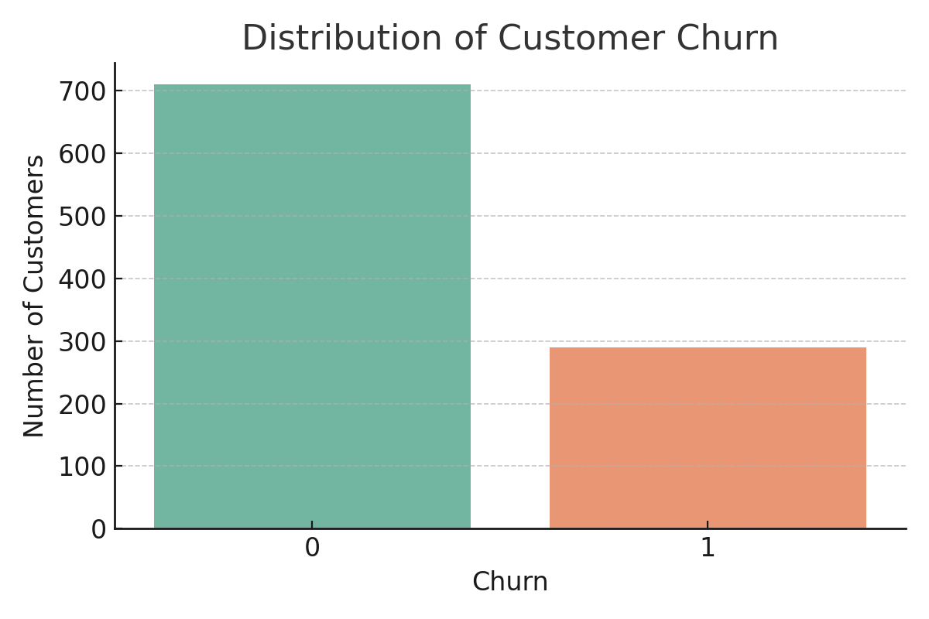
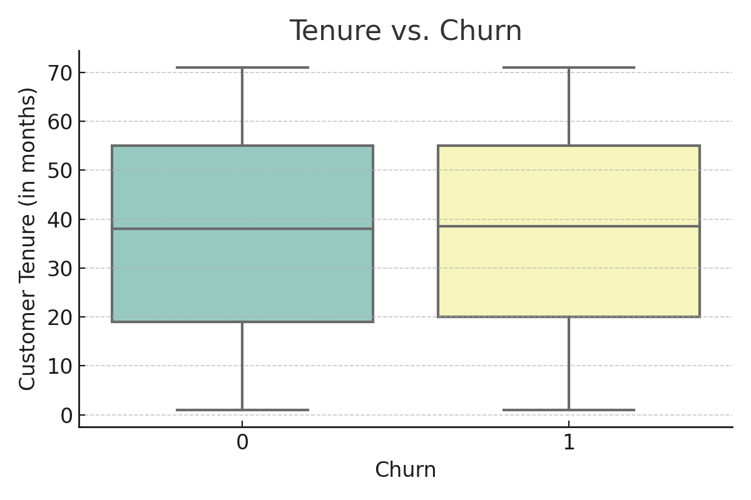
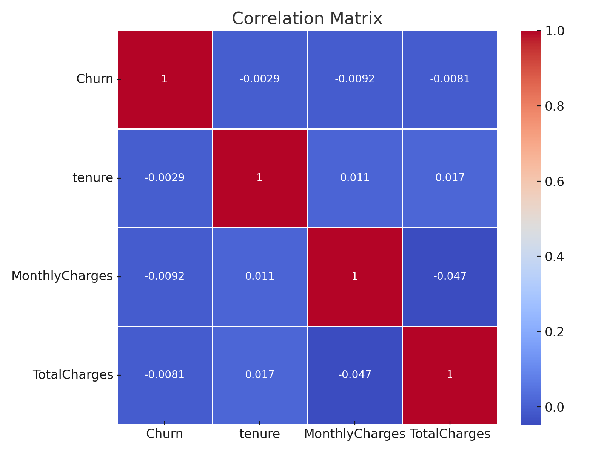

Slide 8
Models Implemented
Logistic Regression
Decision Tree Classifier
Random Forest Classifier
XGBoost Classifier

Slide 9
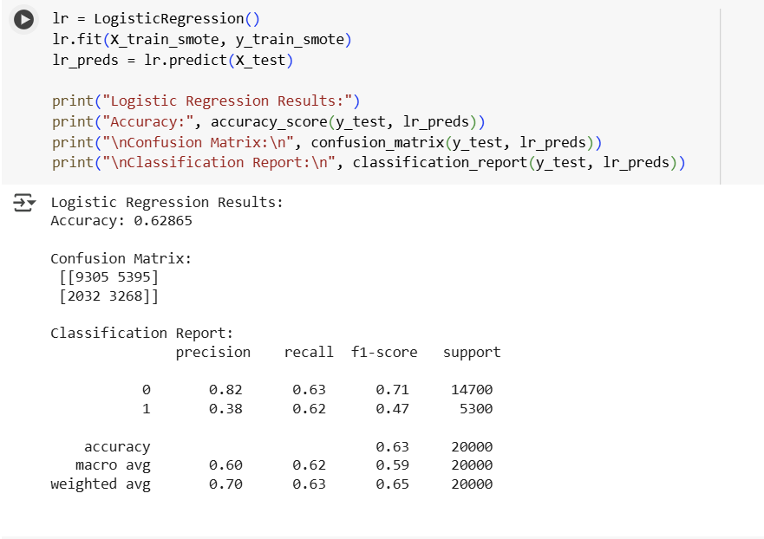
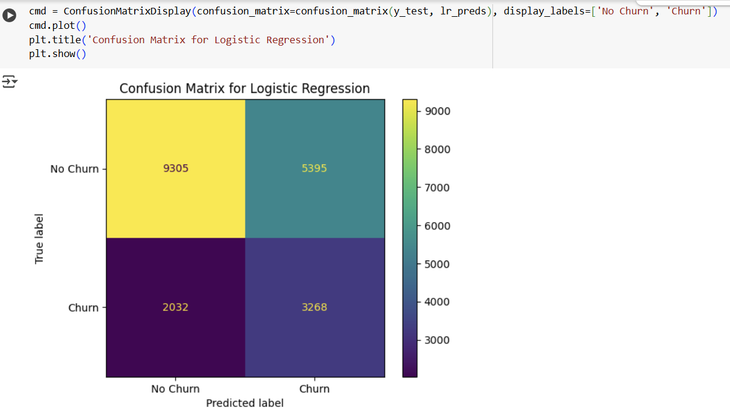
Logistic Regression

Slide 10
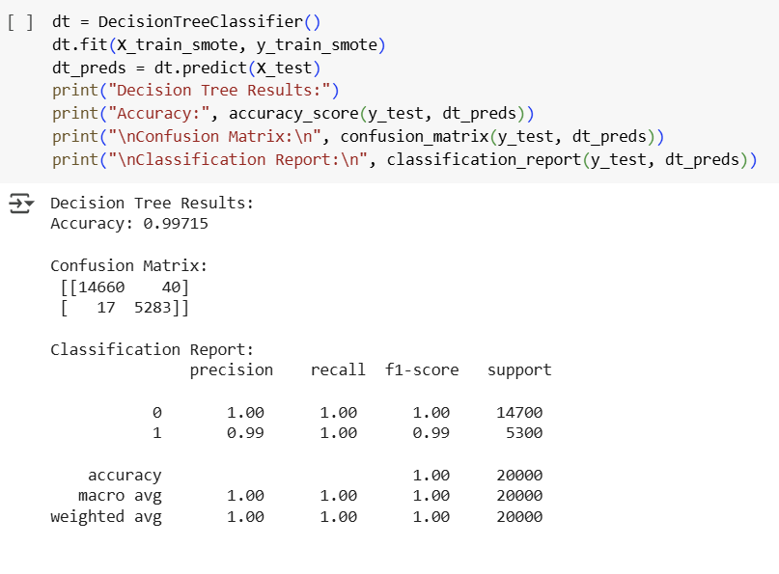
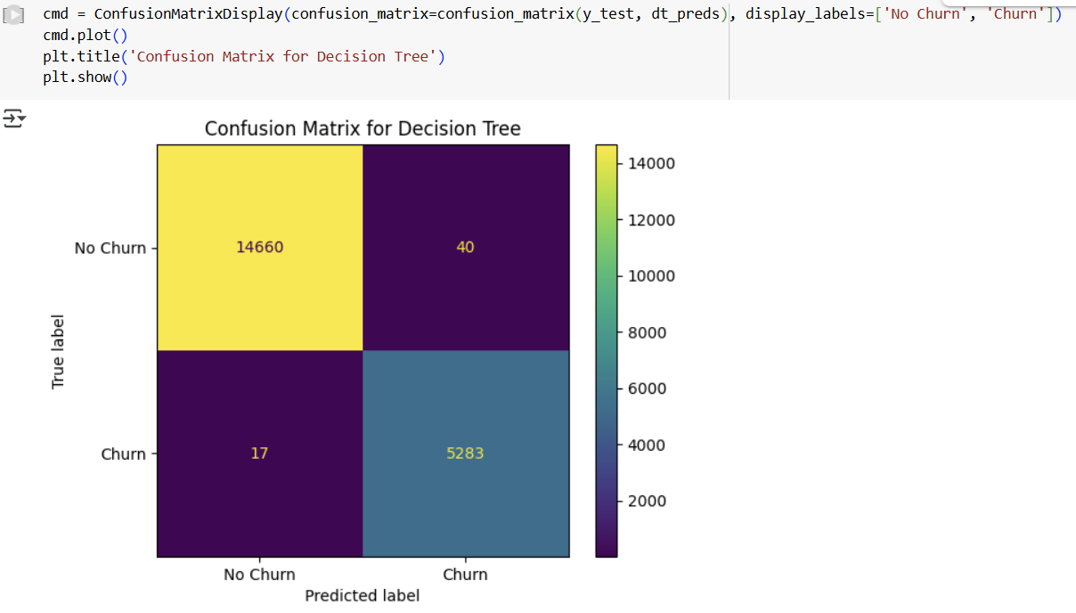
Decision Tree Classifier

Slide 11
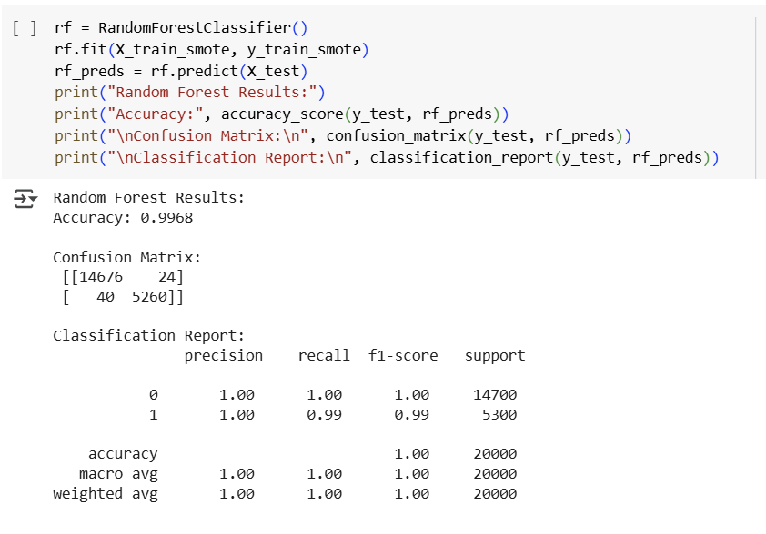

Random Forest Classifier

Slide 12
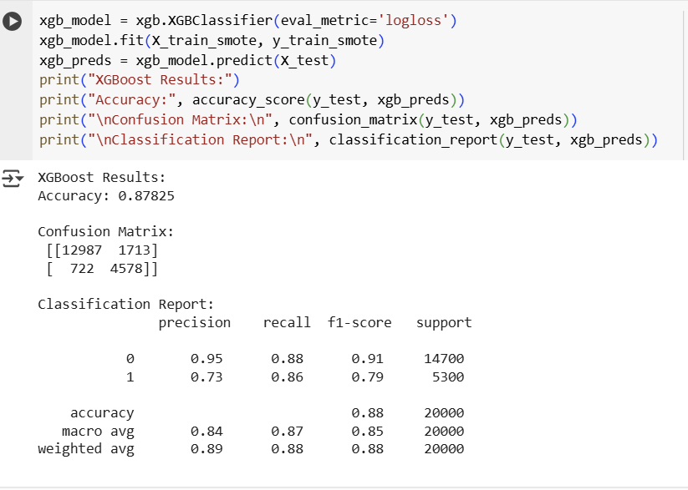
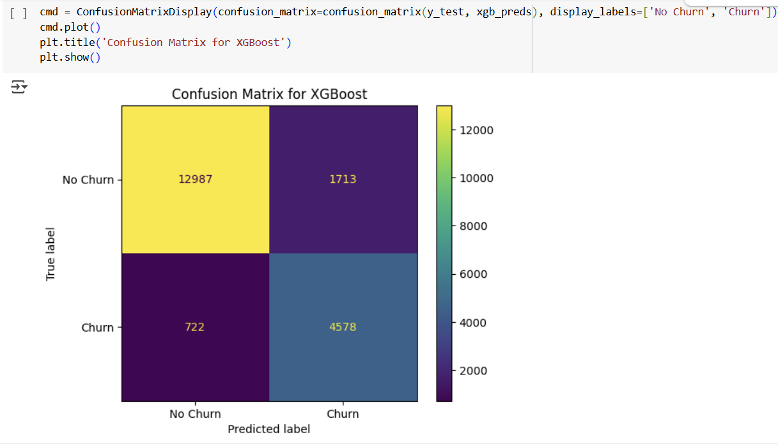
XGBoost Classifier

Slide 13
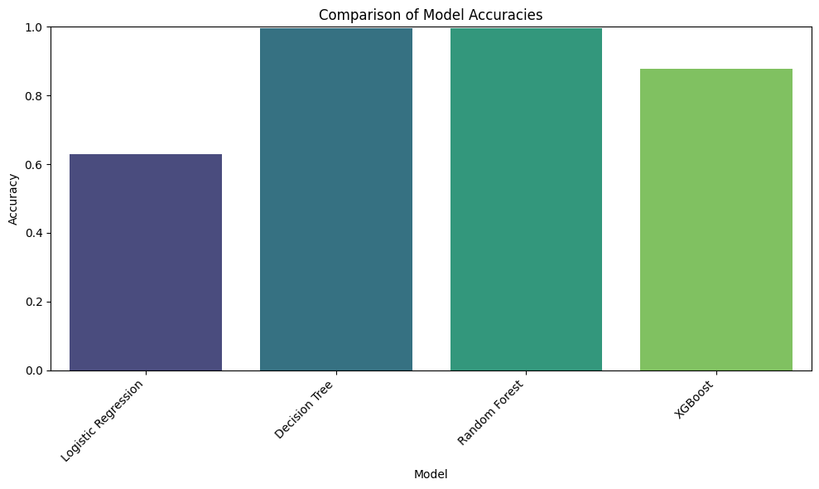
Model Comparison
Decision Tree & Random Forest achieved highest accuracy. Best model selected based on accuracy and interpretability.

Slide 14
User Interface Overview
Tkinter-based desktop application.
Collects numeric & categorical inputs.
Maps inputs to trained feature vector and predicts churn.
Displays results in a pop-up message box.

Slide 15
UI Workflow Diagram
User Opens App
Enter Customer Details
(Numeric & Categorical)
Convert to Feature Vector
Run Prediction
(ML Model)
Display Result
(Churn / No Churn)

Slide 16
UI Screen – Input Form
Numeric Fields: Tenure, TotalCharges, MonthlyCharges
Dropdowns for Categorical Features
Predict Button

Slide 17
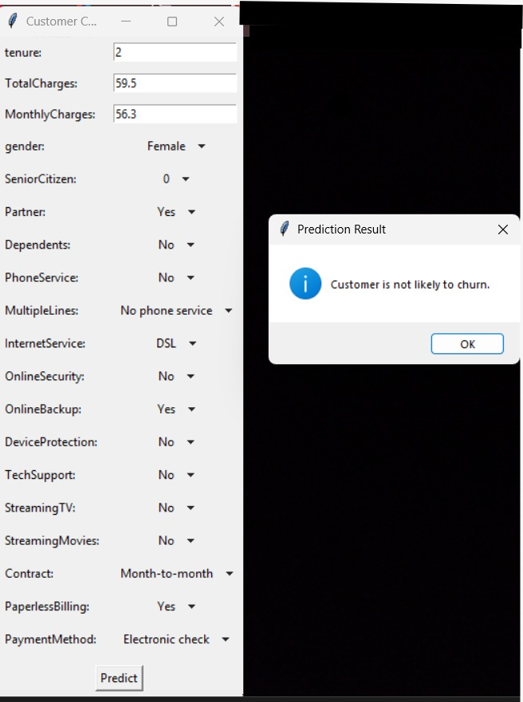
UI Screen – Prediction Output
Prediction Result Display

Slide 18
Conclusion
Tree-based models provided the best performance.
Key churn drivers: contract type, tenure, monthly charges.
Pipeline and UI enable quick scoring and targeted retention.

Slide 19
Future Scope
Tune probability thresholds for optimal retention ROI.
Add SHAP explainability to show top reasons per prediction.
Automate drift monitoring and periodic retraining.
Integrate with CRM for real-time offers.
Deploy as a real-time API service.

