Slide 1
Synthetic Trace Generator
Changhai Man
cman8@gatech.edu

Slide 2
What/Why Synthetic Trace Generator
Synthetic Trace Generator is a Chakra ET generator. In general we have two ways get Chakra ETs:
Gather from real system
Need to have the system to gather the trace. ×
Need to have workloads codes, which takes time to implement. ×
Synthesized from scratch
Do not contain detailed information including runtime, control dependency, etc. ×
Much easier to run. √
Able to explore parallel strategies do not even exist yet. √

Slide 3
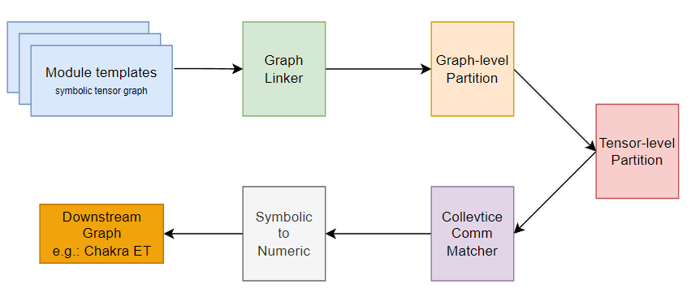
Generation Flow
Neural Architecture
Pipeline Parallel
How pipeline is staged
Data/Tensor/Seq
Parallel
Parameters:
Model dimensions, Parallel Degree

Slide 4
How to use that?
# prepare environments
$ git clone git@github.com:changhai0109/symbolic_tensor_network.git
$ cd symbolic_tensor_network
$ conda env create -f environment.yml
$ conda activate symbolic_generator
# run generator
$ python main.py –h
usage: main.py [-h] --output_dir OUTPUT_DIR --output_name OUTPUT_NAME --comm_group_file COMM_GROUP_FILE --dp
DP --tp TP [--sp SP] [--pp PP] --weight_sharded WEIGHT_SHARDED [--din DIN] [--dout DOUT]
[--dmodel DMODEL] [--dff DFF] [--batch BATCH] [--seq SEQ] [--head HEAD]
[--num_stacks NUM_STACKS] [--chakra_schema_version CHAKRA_SCHEMA_VERSION]
Then it will generate transformer workloads in Chakra ET format with specified parameters, for example:
$ python main.py --output_dir generated/ --output_name workload.%d.et --comm_group_file comm_group.json --dp 2 --mp 2 --pp 2 --weight_sharded 0 --chakra_schema_version v0.0.4
$ ls generated/
comm_group.json workload.0.et workload.1.et workload.2.et workload.3.et workload.4.et workload.5.et workload.6.et workload.7.et

Slide 5
Parameter List:
Generator related parameters
Parameter | Explaination | Value
output_dir | Folder to place output files | ./output
output_name | The name of output ETs | workload.%d.et
comm_group_file | The name of generated comm group file | comm_group.json
chakra_schema_version | The output chakra ET schema version | {v0.0.4, v0.0.1, json}
Parallel strategy parameters
Model parameters
Parameter | Explaination | Value
dp | Data parallel degree | 32
tp | Tensor parallel degree | 4
pp | Pipeline parallel degree | 2
sp | Sequence parallel degree | 4
weight_sharded | FSDP or not FSDP | True/False
Parameter | Explaination | Value
din | Size of input embedding | 51200
dout | Size of output embedding | 25600
dmodel | Size of feature size | 25600
dff | Size of feature of FFN | 25600*4
seq | Sequence length | 1024
head | Num of attention head | 128
num_stacks | Num of encoder stacks | 32

Slide 6
Examples:
# generate with dp=8, tp=4, pp=4, no FSDP
$ python main.py --output_dir generated/ --output_name workload_1.%d.et --comm_group_file comm_group_1.json --dp 8 --tp 4 --pp 4 --sp 1 --weight_sharded 0
# generate with dp=64, tp=1, pp=1, FSDP
$ python main.py --output_dir generated/ --output_name workload_2.%d.et --comm_group_file comm_group_2.json --dp 64 --tp 1 --pp 1 --sp 1 --weight_sharded 1
# generate with GPT3-13B, dp=64
$ python main.py --output_dir generated/ --output_name workload_3.%d.et --comm_group_file comm_group_3.json --dp 64 --din 5140 --dout 5140 --dff 20560 --dmodel 5140 --batch 2048 --seq 2048 --head 40 --num_stacks 40
# generate with Llama2-7B, dp=64
$ python main.py --output_dir generated/ --output_name workload_4.%d.et --comm_group_file comm_group_4.json --dp 64 --din 4096 --dout 4096 --dff 16384 --dmodel 4096 --batch 2048 --seq 2048 --head 32 --num_stacks 32
# generate with dp=4, tp=4, pp=2, sp=2, FSDP, output json format
$ python main.py --output_dir generated/ --output_name workload_5.%d.json --comm_group_file comm_group_5.json --dp 4 --tp 4 --pp 2 --sp 2 --weight_sharded 1 --chakra_schema_version json
# generate with dp=64, tp=1, pp=1, FSDP, output v0.0.1 chakra schema for astrasim 2.2.0
$ python main.py --output_dir generated/ --output_name workload_6.%d.eg --comm_group_file comm_group_6.json --dp 64 --tp 1 --pp 1 --sp 1 --weight_sharded 1 --chakra_schema_version v0.0.1

Slide 7
Comments
About Comm Group
As you might noticed that STG generate a file called comm_group, which content is describing how comm_group is defined for this workload.
However, current astra-sim do not support it yet, which means for simulations involving multiple parallel dimensions might result in wrong result or fail
We are solving this in PR#167
Can I use it to generate models other than transformers:
In theory, yes. However, you might need to manually define templates for your model.
For transformers, I integrate the templates into the code base under here.
We are developing a tool that can generate these templates from torch.fx by building a one-to-one mapping between STG and ATen operators.
How about Mixture-of-Experts?
Not supported yet.
MoE is special because it involves the gating and token-exchange phase between experts, which requires more capability other than just defining another set of templates.
We are working towards it.

