Slide 1

iLikeVideoGames
iLikeVideoga.me
Brandon Smith
Lauren Gamboa
Amy Phan

Slide 2
Project Overview
Web-scraping service to provide you enjoyable games for low prices
Recommendations made based on your Steam Library
Allows users to discover new Steam games

Slide 3
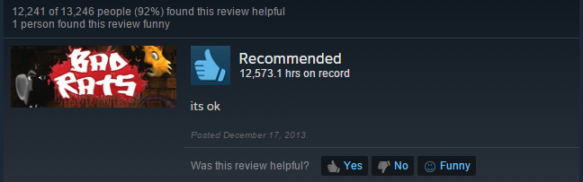
Where we left off
Majority of students in this room use steam
Dissatisfaction with Steam recommendation queue
Man with 12,000+ hours on Bad Rats.

Slide 4
What is iLikeVideogames again?
Groundbreaking combination of:
A videogame recommendation service designed to be better than Steam’s Recommendation Queue
A web scraper designed to find the best discounts on games on Steam and other places on the web
Finding affordable games that are both unique and enjoyable - for picky users with limited time and money

Slide 5
What’s wrong with Steam?
My Queue last night + reason why game was recommended
Half-Life: Source (Because it is popular)
Star Wars: KOTOR (Because it is popular)
Borderlands (Because it is popular)
Rage (Because it is popular)
Satellite Reign (Because it is popular)
Transistor (Because it is popular)
DiRT 3 (Because it is popular)
Legend of Heroes: Trails in the Sky (Because it is popular)
School of Dragons (Popular, but most of the reviews are negative???)
Football Manager 2016 (Because it is popular)
Deus Ex: Mankind Divided (“New”, but $60 and not even released yet)
Orion: Prelude (Because it is popular, but infamously bad)

Slide 6

THIS IS NOT MY LIBRARY TAILORED SUGGESTION QUEUE
THESE ARE NOT MY COOL AND INTERESTING GAMES
MY GOD, WHAT HAVE THEY DONE?
(Same as it ever was, same as it ever was, same as it ever was…..)

Slide 7
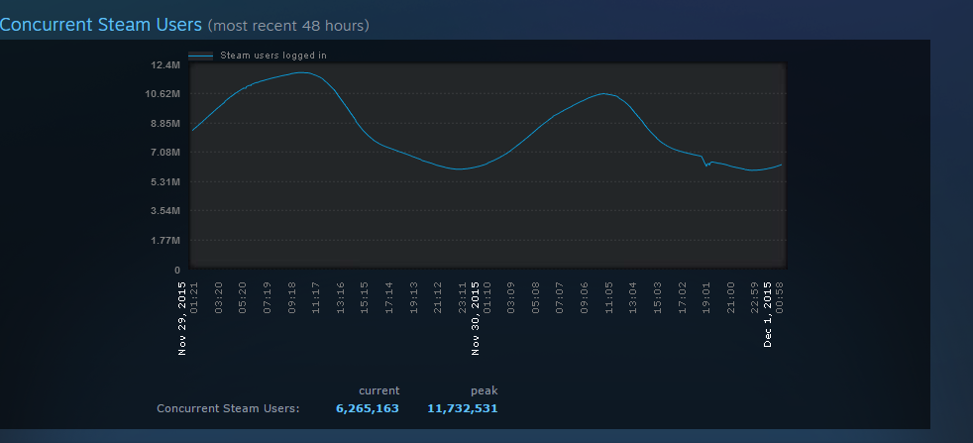
Audience
Over 125 million active steam users
Over 7000 video games on Steam
Target Audience: Users 18-30 years old with 15-200 games on Steam
Classified as “Discerning Users”
“Casual Users” (library < 15 games) and “Collectors” (library > 200 games) may not need our service

Slide 8


Under the Hood
Back End: Nodejs, mysql, SteamAPI
Web Scraping: cheerio
Front End: Nodejs, Kube CSS Framework

Slide 9
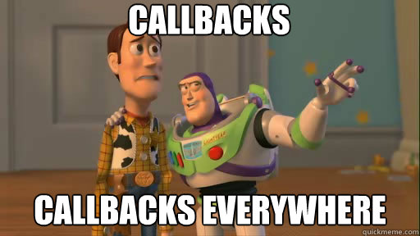
Under the Hood
Back End: Nodejs, mysql, SteamAPI
Web Scraping: cheerio
Front End: Nodejs, Kube CSS Framework

Slide 10
How it Works
Back End: node-mysql database containing entries for all 7000+ Steam games available
Front End: Website where users generate their recommendations
No login required, just Steam profile name or ID
Info sent to back-end javascript SteamAPI
User info sent to mysql-database
Database query made based on game tags and playtime
Recommendations generated, templated to HTML, written back to website
Just give us your Steam Id, and we can do all the rest! No login required!

Slide 11

Demo
Ilikevideoga.me

Slide 12
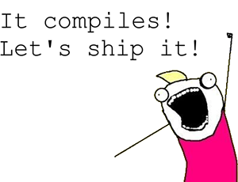
Expectations Reality

Slide 13

Business Model
Sustainability
Advertisements
Used to pay for server costs and other small expenses
Premium Service
Alert system to alert users about pricing of an game on wish list on various sites
Extend features to Steam Greenlight, Early Access games and community mods
Profit
Buyout from interested parties

Slide 14




Future Works
Amazon Scraping
Improvement of recommendations
Crowdsourcing possibilities
Quality Assurance
Mobile apps!
Steam Marketplace integration
“No “Indie”/No Art” Game Filter

Slide 15
Questions?

