Slide 1

Netflix Titles Analysis Report
A comprehensive, data-driven analysis of 9,827 titles spanning over a century — from April 17, 1902 to July 3, 2024 — evaluating metrics, trends, and viewer engagement patterns across the Netflix library.

Slide 2

Executive Summary: Core Metrics
9,827
40.33
Total Titles
Avg. Popularity
Spanning 1902–2024
Right-skewed — most titles cluster below 35
6.44
1.39K
Avg. Rating
Avg. Vote Count
Rises to 6.51 when excluding 100 zero-vote placeholders
Driven by classics & blockbusters with 20,000+ votes
Removing unreleased or unvoted titles shifts the average rating upward, providing a more accurate representation of viewer sentiment.

Slide 3
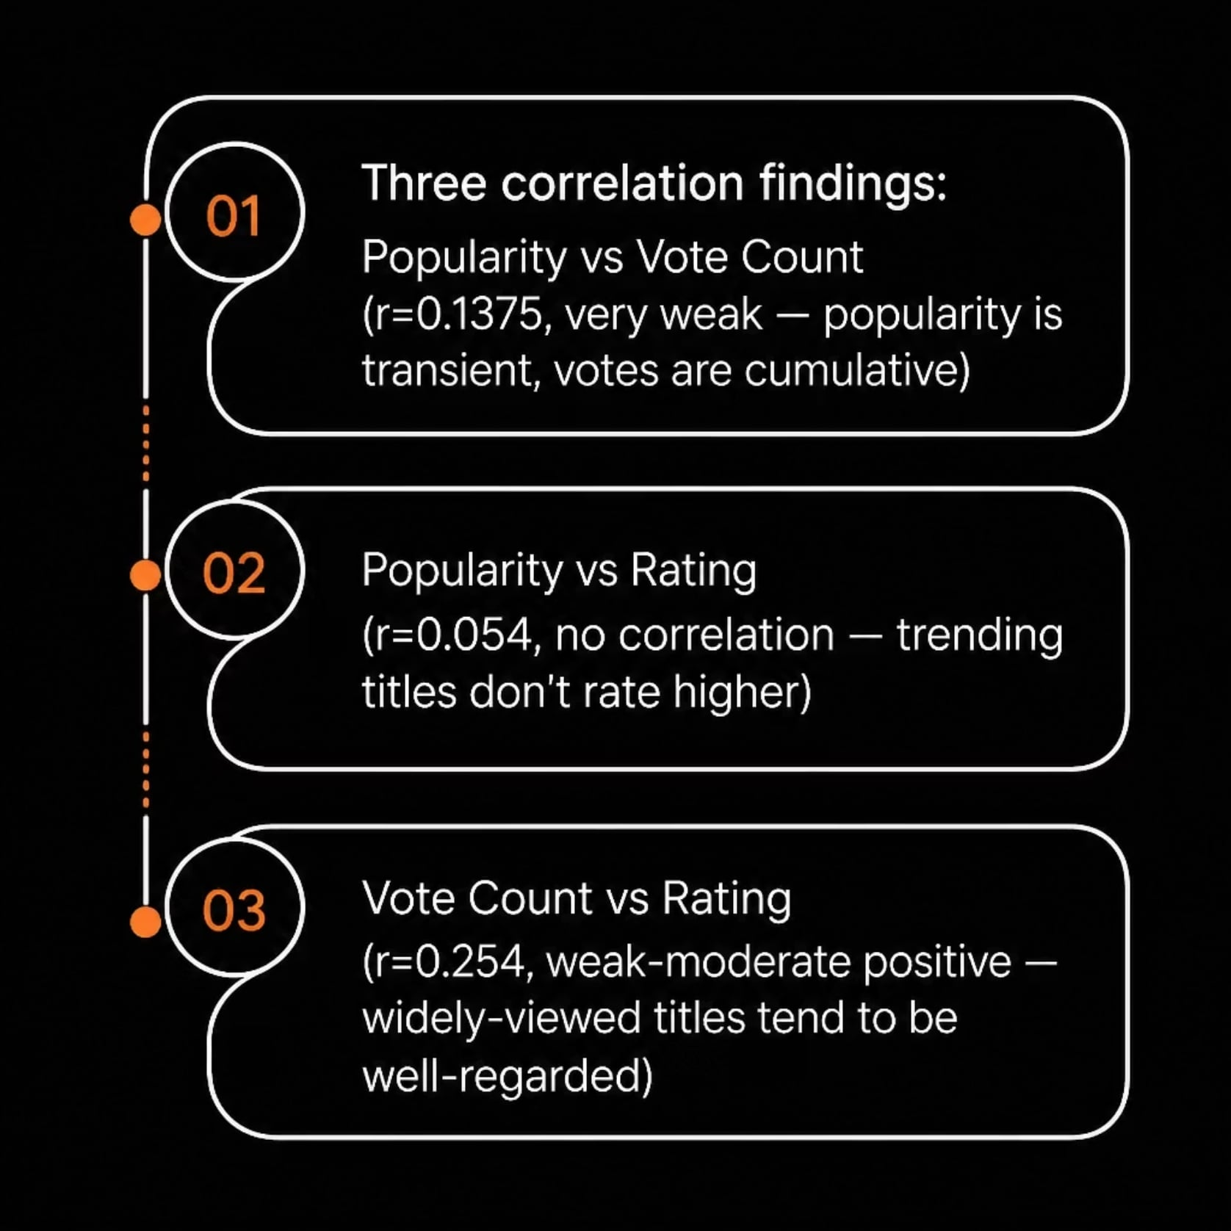
Correlation Insights
Key Relationships
Popularity vs. Votes (r=0.1375): Very weak correlation. Popularity reflects current streaming activity; votes measure long-term engagement.
Popularity vs. Rating (r=0.054): No correlation. Trending titles don't systematically rate higher or lower.
Votes vs. Rating (r=0.254): Weak-moderate positive. Highly-voted titles cluster in the 7.0–9.0 range; low-vote titles show extreme variance (1.0–10.0).

Slide 4
Top 5 Most Popular Titles
1
2
3
Spider-Man: No Way Home (2021)
The Batman (2022)
No Exit (2022)
Popularity: 3,827.66 | Rating: 8.10 | Votes: 1,151
Popularity: 2,618.09 | Rating: 6.30 | Votes: 122
Popularity: 5,083.95 | Rating: 8.30 | Votes: 8,940
4
5
Encanto (2021)
The King's Man (2021)
Popularity: 2,402.20 | Rating: 7.70 | Votes: 5,076
Popularity: 1,895.51 | Rating: 7.00 | Votes: 1,793

Slide 5
Most Engaged & Critically Acclaimed
TOP 5 BY VOTE COUNT
TOP 5 BY RATING (≥8.5, 500+ VOTES)
Inception (2010)
Interstellar (2014)
The Godfather (1972)
Shawshank Redemption (1994)
31,077 votes | Rating: 8.40
27,975 votes | Rating: 8.40
Rating: 8.70 | Votes: 15,614
Rating: 8.70 | Votes: 20,911
The Dark Knight (2008)
The Avengers (2012)
26,490 votes | Rating: 7.70
Dilwale Dulhania Le Jayenge (1995)
Gabriel's Inferno Part III (2020)
26,994 votes | Rating: 8.50
Deadpool (2016)
Rating: 8.70 | Votes: 3,474
Rating: 8.60 | Votes: 946
26,390 votes | Rating: 7.60
Schindler's List (1993)
Rating: 8.60 | Votes: 12,474

Slide 6
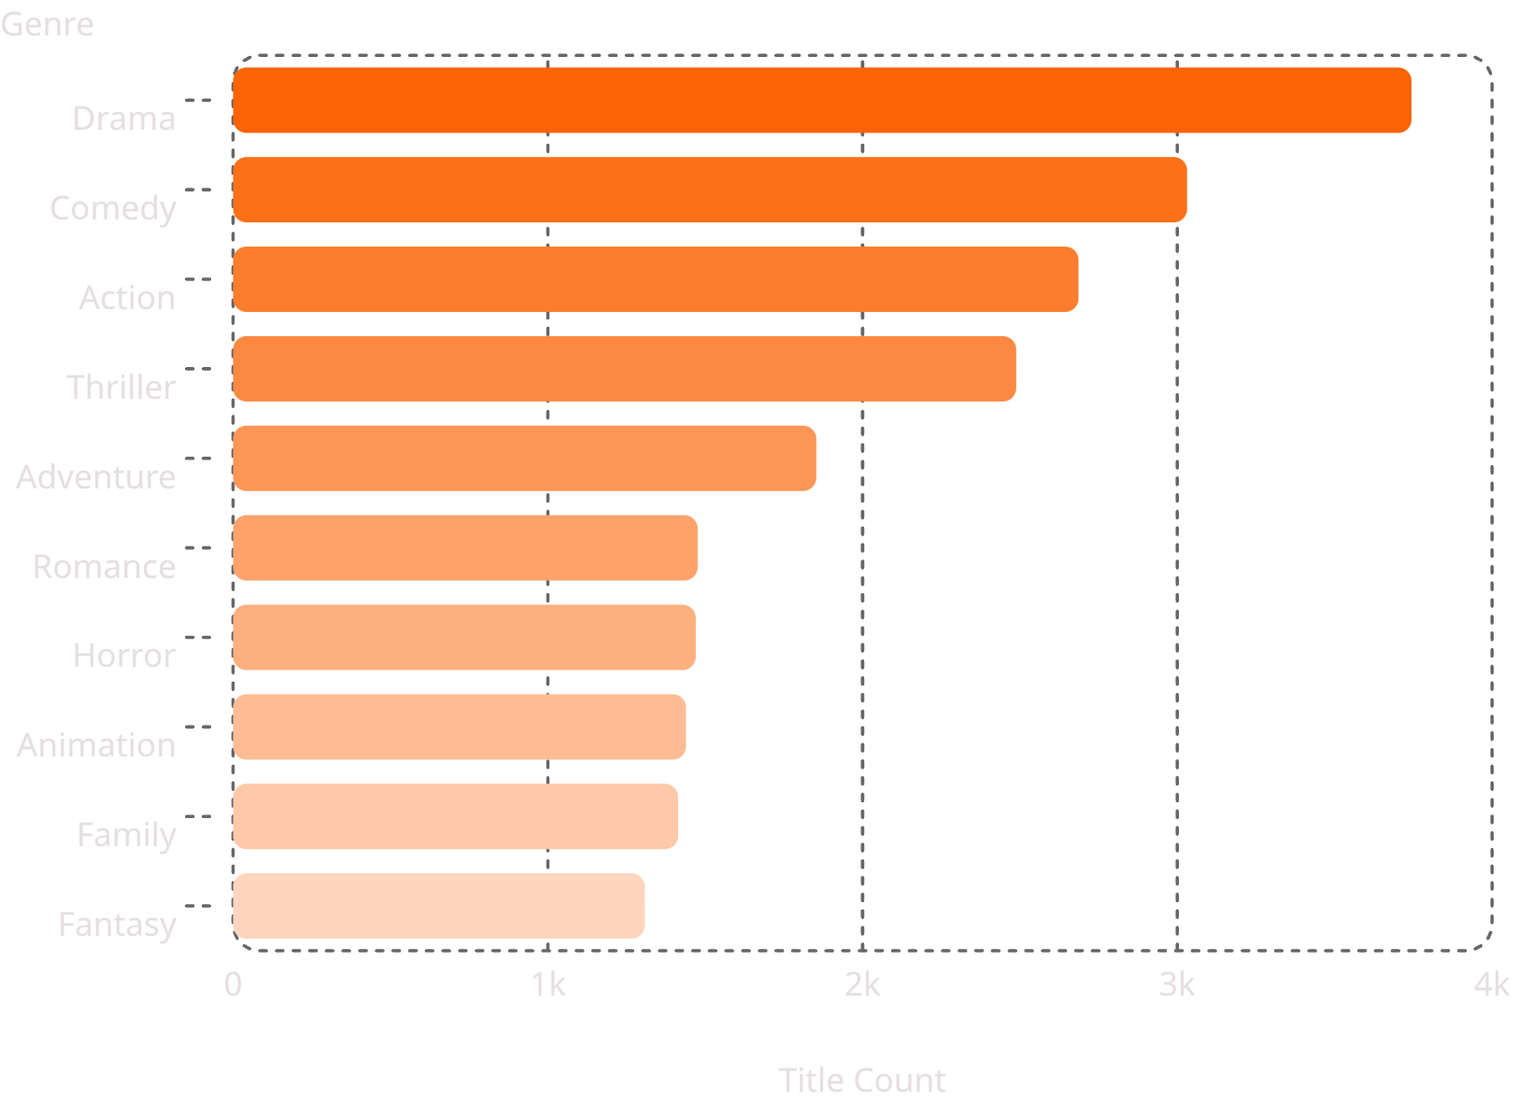
Genre Deep-Dive: Volume & Performance
Key Genre Findings
Volume Leader: Drama dominates with 3,744 titles, followed by Comedy (3,031) and Action (2,686) across 19 unique genres.
Popularity Leader: Adventure leads at 53.74 avg. popularity, followed by Fantasy (53.08) and Animation (52.43).
Rating Leader: History tops ratings at 6.97, followed by War (6.95) and Music (6.88).
Underperformer: Horror has the lowest avg. rating (5.94) despite 1,470 titles and solid popularity (38.26).

Slide 7


Language Analysis
English dominates with 7,570 titles (~77%), but non-English content shows strong metrics in both popularity and rating.
🇮🇳 Hindi — Popularity Leader
Avg. Popularity: 85.93 (26 titles)
Avg. Rating: 6.63
🇹🇷 Turkish
Avg. Popularity: 71.63 (15 titles)
Avg. Rating: 6.45
🇸🇪 Swedish — Rating Leader
Avg. Rating: 7.02 (23 titles)
Avg. Popularity: 21.16
🇯🇵 Japanese
Avg. Rating: 6.98 (645 titles)
Avg. Popularity: 40.72
Hindi and Turkish content drive massive popularity relative to their small volume. Japanese and Swedish content earn strong critical acclaim (particularly anime for Japanese).

Slide 8
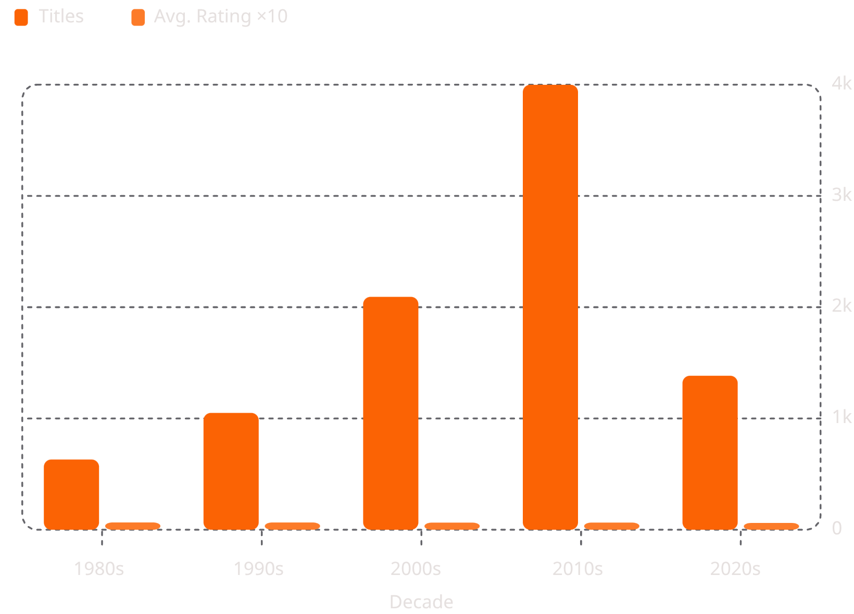
Temporal Trends: Decade-by-Decade Growth
Exponential Library Growth
Content volume exploded from under 200 titles (pre-1960s) to 3,999 titles in the 2010s — a 20× increase.
Average ratings remained stable (~6.4–6.55) across decades, except the 2020s at 6.11 — skewed by incomplete data.
2020s titles show dramatically higher avg. popularity (107.28) due to newer releases still experiencing high search/streaming traffic.

Slide 9
Data Anomaly: 2022–2024
What the Data Reveals
Data collection likely cut off in early 2022. The dataset contains only 208 titles in 2022, 8 in 2023, and 1 in 2024.
Of these 217 titles, 91 have exactly 0 votes and 0.0 ratings — representing upcoming or unreleased titles at time of export.
Including Placeholders
Excluding Placeholders
2022 Avg. Rating: 3.64 (artificially low)
2022 Avg. Rating: 6.00 (normal range)

Slide 10


Key Takeaways
Popularity ≠ Quality
No correlation between popularity and ratings (r=0.054). Trending titles don't rate higher — popularity is transient, not a quality signal.
Engagement Signals Quality
Highly-voted titles cluster in the 7.0–9.0 range (r=0.254). Widely-viewed films that stand the test of time tend to be well-regarded.
Non-English Content Punches Above Its Weight
Hindi and Turkish titles drive outsized popularity; Japanese and Swedish content earns top ratings — strong niche appeal.
Data Quality Matters
Zero-vote placeholders artificially depressed 2022 ratings from 6.00 to 3.64. Cleaning the dataset is essential for accurate analysis.

