Slide 1
VIRTUAL VOICE ASSISTANT
-By Raghav Babbar
BCA 6B
06390202018

Slide 2
Introduction
In today’s era almost all tasks are digitalized. We have Smartphone in hands and it is nothing less than having world at your finger tips. These days we aren’t even using fingers. We just speak of the task and it is done. There exist systems where we can say Text Dad, “I’ll be late today.” And the text is sent. That is the task of a Virtual Assistant.
It also supports specialized task such as booking a flight, or finding cheapest book online from various e-commerce sites and then providing an interface to book an order are helping automate search, discovery and online order operations.
Virtual Assistants are software programs that help you ease your day to day tasks, such as showing weather report, creating reminders, making shopping lists etc. They can take commands via text (online chat bots) or by voice. Voice based intelligent assistants need an invoking word or wake word to activate the listener, followed by the command. For my project the wake word is DUDE. We have so many virtual assistants, such as Apple’s Siri, Amazon’s Alexa and Microsoft’s Cortana. For this project, wake word was chosen DUDE

Slide 3
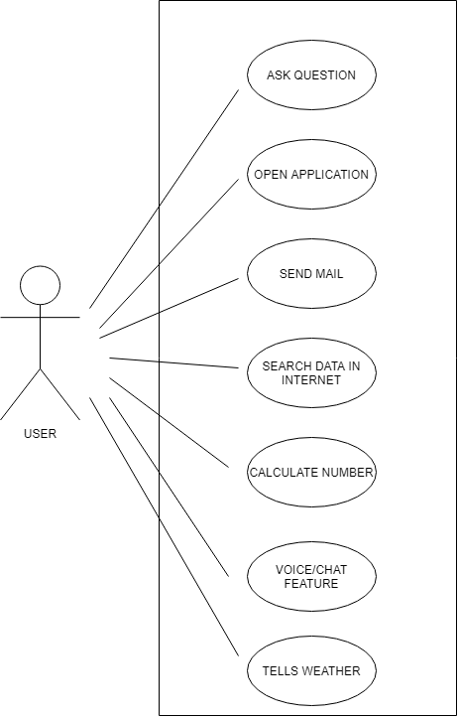
Use Case Diagram

Slide 4
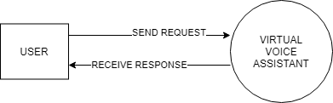
DFD 0

Slide 5
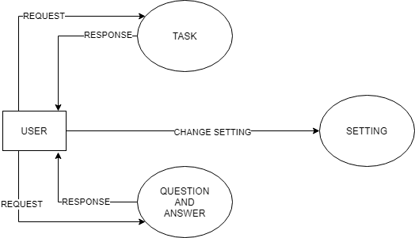
DFD 1

