Slide 1

Virtual Voice Assistant

Slide 2
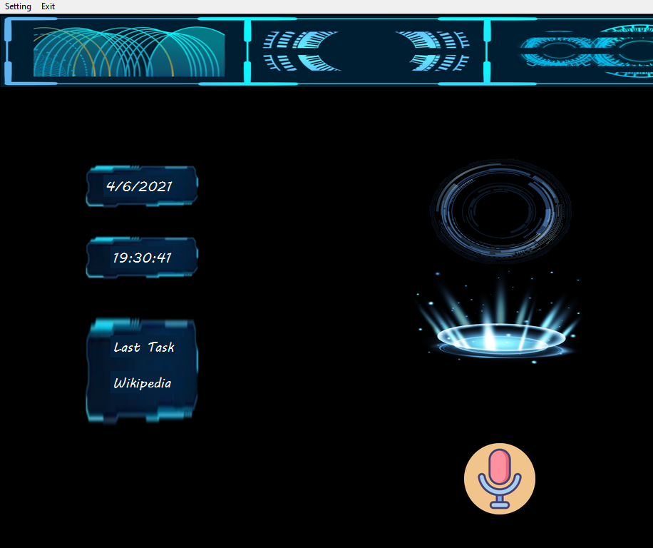
ABSTRACT
Purpose of virtual assistant is to being capable of voice interaction, music playback, making to-do lists, setting alarms, streaming podcasts, playing audiobooks, and providing weather, traffic, sports, and other real-time information, such as news. Virtual assistants enable users to speak natural language voice commands in order to operate the device and its apps.
There is an increased overall awareness and a higher level of comfort demonstrated specifically by millennial consumers. In this ever-evolving digital world where speed, efficiency, and convenience are constantly being optimized, it’s clear that we are moving towards less screen interaction.

Slide 3
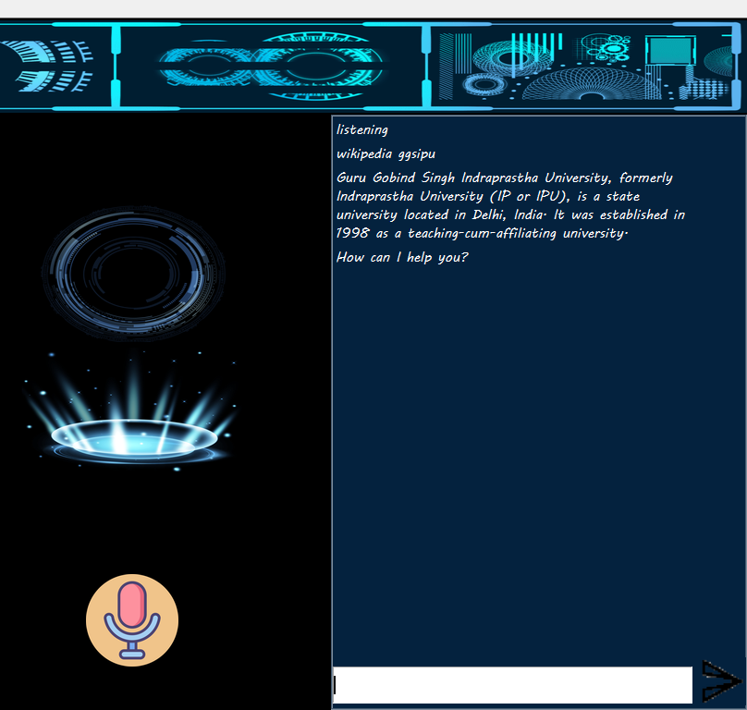
REQUIREMENTS
HARDWARE REQUIREMENT
Processor: Pentium-4 class processor or Above
RAM: 2GB of RAM or Above
Operating System: Windows XP or Above
SOFTWARE REQUIREMENT
Front End: Tkinter
Language: Python v3.8.5

Slide 4


DIAGRAMS

Slide 5
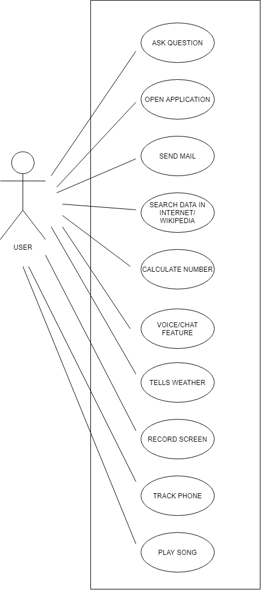
Title
USE
CASE
DIAGRAM

Slide 6
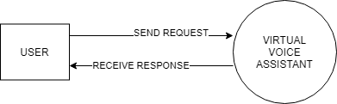
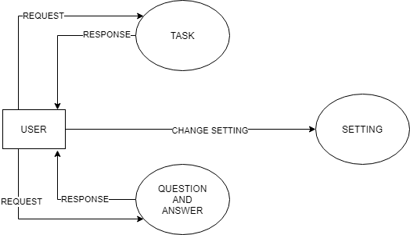
Title
DATA FLOW DIAGRAMs
ZERO-LEVEL
FIRST-LEVEL

Slide 7
Code

Slide 8
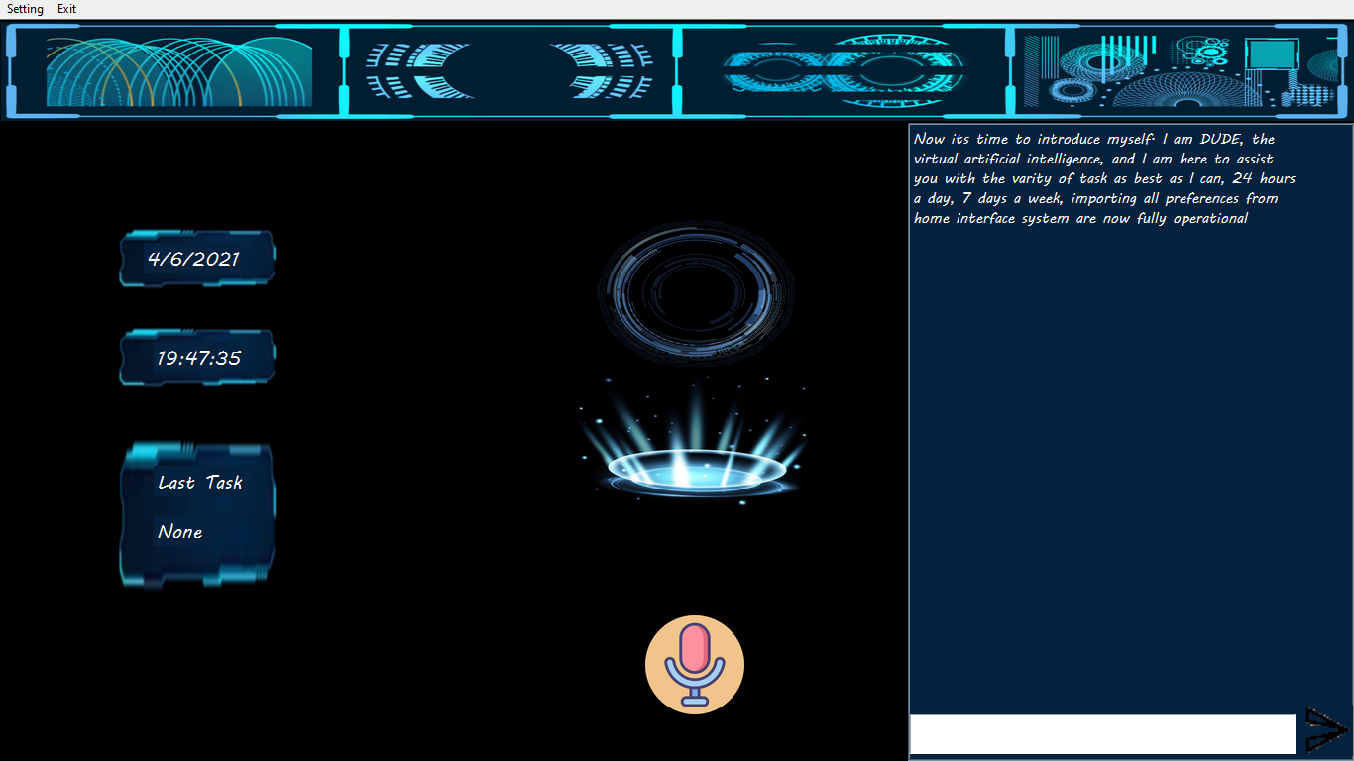
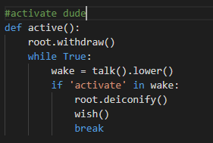
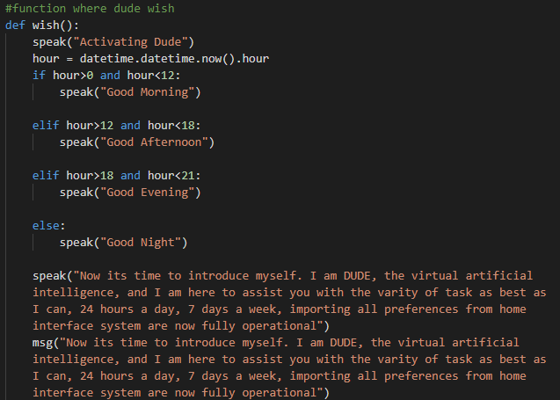
Wake-Up Dude

Slide 9
Title:
The main aim of the project was to develop a Desktop Assistant that will be used to identify answers related to user submitted questions. To provide with sufficient information that is required by the user. A background research took place, which included an overview of the conversation procedure and any relevant desktop Assistant available. A desktop Assistant already in user were excellent service that is provided. The developed system is made on python programming language to be more specific Python 3.8. Different libraries where used such as Speech Recognition, Text to Speech convertor, Short Mail Transferring Protocols (SMTP), pyjokes, Wikipedia and many more. It provides information regarding the weather, News, it can play music, it can search for topics on Wikipedia, can setup an alarm, Display the current date and time. User can collect information through this application. It reduces both man power and time. Due to support of NLP user can ask queries in very formal way. No need ask queries in very strict and specific way. The user should aware of general rules of English Language. The goal is to provide people a quick and easy way to have their questions answered.
CONCLUSION

Slide 10
THANK YOU
RAGHAV BABBAR

