Slide 1

SOCIAL MEDIA WEBSITE

Slide 2
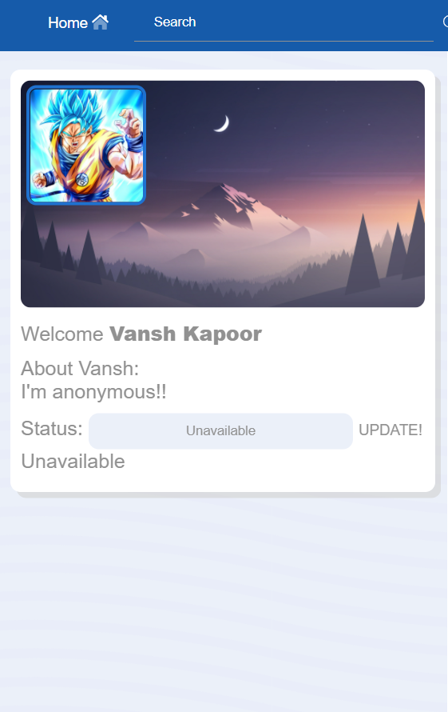
ABSTRACT
Social networking site is a Python with Django based project which allows people to communicate, share ideas, activities, events with in the network.
This system focuses on online communication.
This system allows the users to promote social responsibilities.
This is developed to provide a website for people to communicate. people who wants to share their ideas and give their views for creating social awareness can use this application.

Slide 3
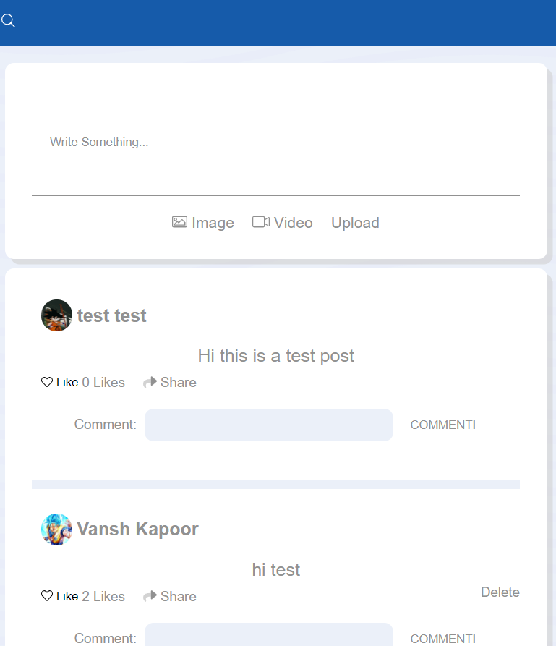
REQUIREMENTS
HARDWARE REQUIREMENT
Processor: Pentium-4 class processor or Above
RAM: 128 MB of RAM or Above
SOFTWARE REQUIREMENT
Front End: HTML, CSS, JAVASCRIPT
Language: Python with Django
Back End: MySQL
Platform and Technology
Operating System: Windows XP or Above
RAM: 128 MB and above
Hard disk: 20MB and above
Front End: HTML, CSS, JAVASCRIPT
Back End: MySQL

Slide 4


DIAGRAMS

Slide 5
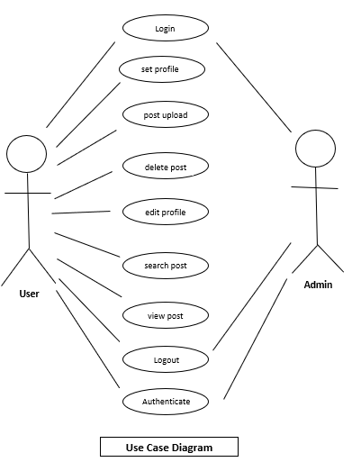
Title
USE
CASE
DIAGRAM

Slide 6
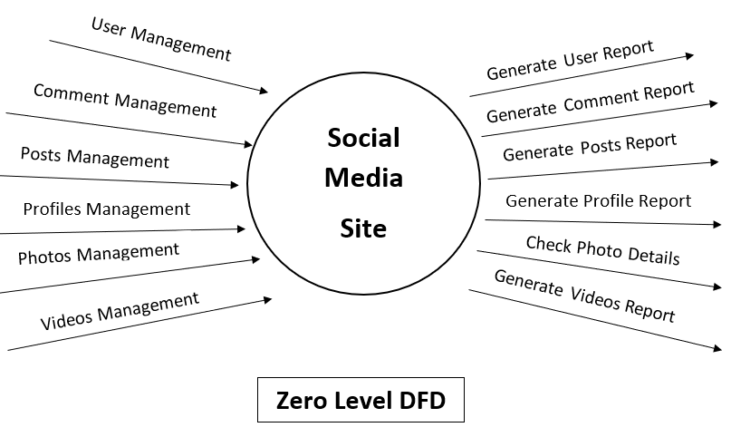
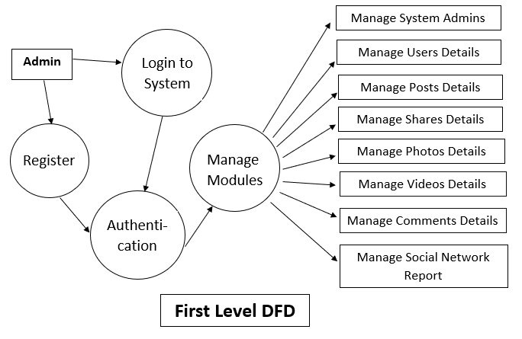
Title
DATA FLOW DIAGRAMs
ZERO-LEVEL
FIRST-LEVEL

Slide 7
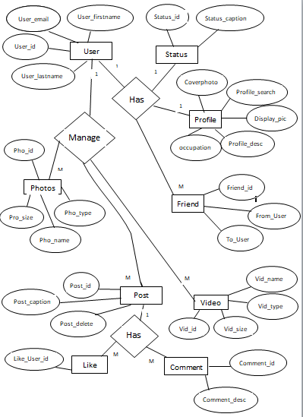
Title
ER-DIAGRAM

Slide 8
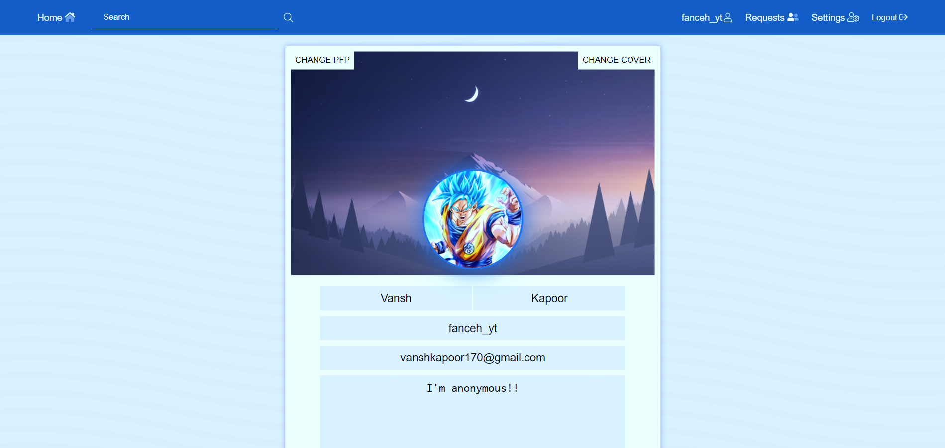
CODE

Slide 9
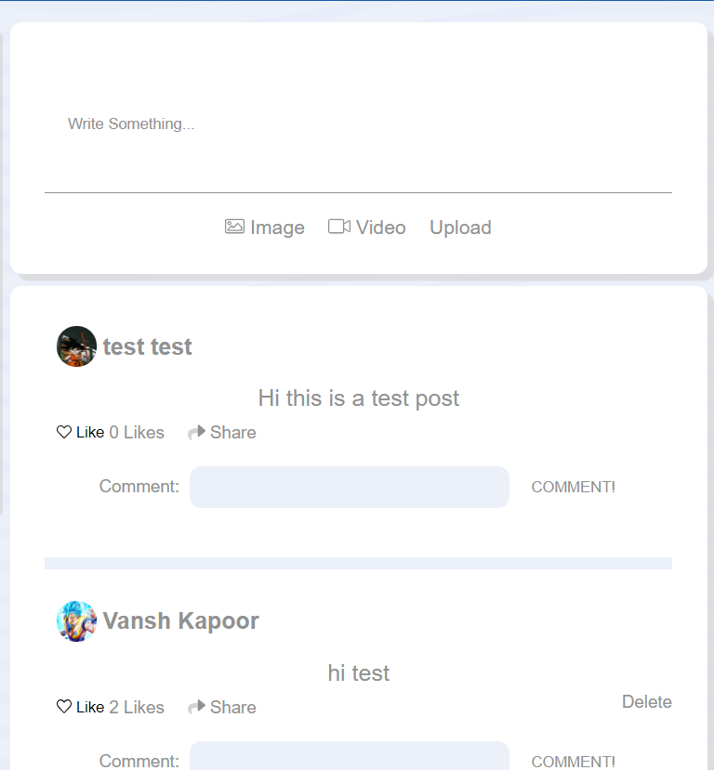
POSTS BY USERS
@login_required
def savepost(request):
if request.method == 'POST':
form = PostForm(request.POST, request.FILES)
if form.is_valid():
Form = form.save(commit=False)
Form.user = request.user
Form.save()
return redirect('usersfeed')
class post(models.Model):
user = models.ForeignKey(User, on_delete=models.CASCADE)
caption = models.CharField(max_length=100)
image = models.FileField(upload_to='images/', null=True, blank=True)
video = models.FileField(upload_to='videos/', null=True, blank=True)
created = models.DateTimeField(auto_now_add=True)
like = models.ManyToManyField(User, related_name='likes', null=True, default='')
def __str__(self):
return self.caption
def total_likes(self):
return self.like.count()

Slide 10
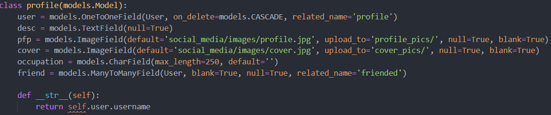
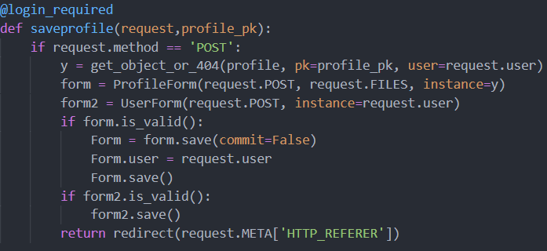
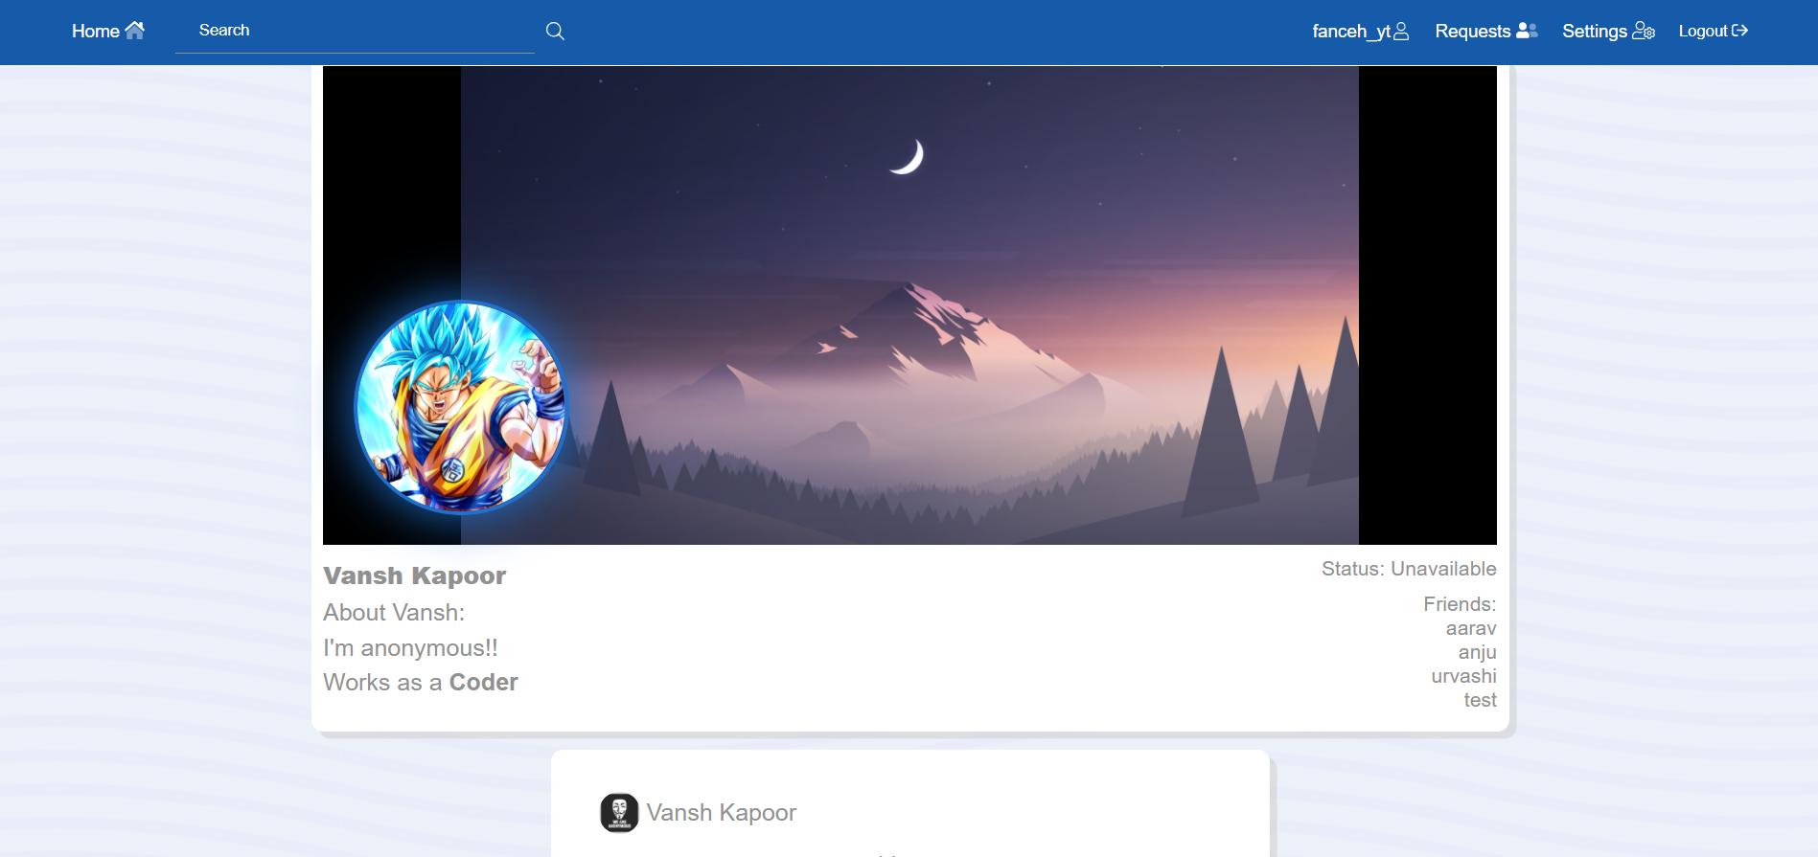
USER PROFILE

Slide 11

Title:
The coding of Social Media website was extremely fun. Hence, we enjoyed learning Python with Django. We faced many uprising errors and bugs which made us learn more about Django. We used Django’s most basic and best features to get this project done. We used models, signals, HTTP methods (POST and GET) to submit user’s data into our database.
With the reference of many Django blogs and official Django documentation, we were able to make the most amazing project with our own skills. Now, we can certainly say we are fullstack developers with newly equipped and a bunch of Django skills that we would like to ahead in future with more projects like these.
Hence, Django is really a great and one of the fastest growing frameworks for the fullstack developers. We would really recommend to start your fullstack career with Django.
CONCLUSION

Slide 12
THANK YOU
VAIBHAV AGARWAL
RAGHAV BABBAR
VANSH KAPOOR

