Slide 1
PRISM: An Experiment Framework for Straggler Analytics in Containerized Clusters
Dominic Lindsay
School of Computing & Communications
Lancaster University, UK
d.lindsay4@lancaster.ac.uk
Sukhpal Singh Gill
School of Electronic Engineering & Computer Science
Queen Mary University of London, UK
s.s.gill@qmul.ac.uk
Peter Garraghan
School of Computing & Communications
Lancaster University, UK
p.garraghan@lancaster.ac.uk

Slide 2
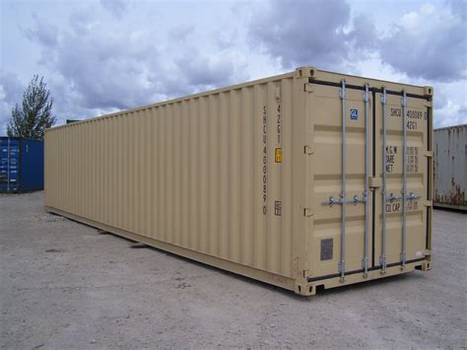
Container Orchestration
Notes:
Containers encapsule executables, configuration and their dependanceis as a single runnable image and are capable of providing mutli-tannancy without hypervisor based hardware emulation. Instead containers make use of user space tools and kernel features, resulting In higher node resource utilization, smaller image size and lower boot latencies.
Containers have received interest from academia and industry projects in support for deployment of microservices, and serveless functions alike.
And are driven by a range of open-source development efforts including:
Kubernetes
Yarn
Mesos
Such frameworks execute containerized workloads in distributed environments, by abstracting resource management and workload coordination.

Slide 3
Cluster Goals
Scalability
Resillience
Energy
Performance
Job Makespan
Scheduling Latency
Job Saturation
Throughput
Resource Failure
Workload Constraints
Workload Consoloidation
Cooling
Notes:
Container application frameworks execute workloads as jobs composed of task encapsulating work dependencies to be completed on the computing substrate.
Framework performance is measured along several dimensions including:
- Job throughput and cluster scalability
- Job and Scheduling Performance
- Resilience to resource failure and workload constraints.
- Energy Utilisation including cooling, workload consolidation.
frameworks allows tuning of framework properties by means of configuration and modular extension.

Slide 4
Experimentation
Experimentation:
Used to understand framework performance
Empirical Analyses:
Execution of representative workloads on physical cluster hardware
Simulation:
Informed by results of experimentation, limited by granularity
Notes:
An effective method to measuring framework performance along these dimensions is by means of empirical experimentation, allowing researchers to conduct thorough analyses of framework by measuring performance metrics whilst executing representative workloads.
By executing workload benchmarks and comparing performance metrics researchers are able to conduct critical analyses of framework performance.
However such experimentation are often limited by access to representative computing infrastructure.
As such researchers often employ simulation informed by metrics capture by empirical analyses of available computing Infrastrure.
However configuration and execution of orchestration frameworks, application, and workloads requires substantial domain knowledge in order to capture metrics required to inform fine grained simulation.
And as such simulation often fails to capture transient system phenomena.
=======================================
This is because:
Configuration and tuning ​of diverse orchestration and application frameworks required significant domain knowledge.
Whilst manifestation of system behavior requires selection and design of complex workload patterns.
= However empirical experimentation is often challenging due to limited access to representative infrastructure. =
Empirical experimentation is often challenging either because of limited access to representative infrasture.
However configuration and execution of orchestration frameworks, application, and workloads requires substantial domain knowledge in order to capture metrics required to inform fine grained simulation.
However configuration and execution of orchestration frameworks
Whilst Coarse grained simulation fail model emerging system phenomena such as straggler manifestation.
requires required for capturing fine grained metrics of framework performance., application and workloads requires substantial domain knowledge.
As such simulation informed by performance traces collected from experimentation on physical infrastructure is often performed to conduct analyses at scale.
However such simulation are limited by their emulation environment,
Fine grained simulation of system condition are complex and requires extensive expertise and time to design.
Whilst Coarse grained simulation fail model emerging system phenomena such as straggler manifestation.
---------------------
However empirical experimentation is often challenging
- limited access to representative infrastructure
- Limited domain knowledge of application and orchestration framework

Slide 5
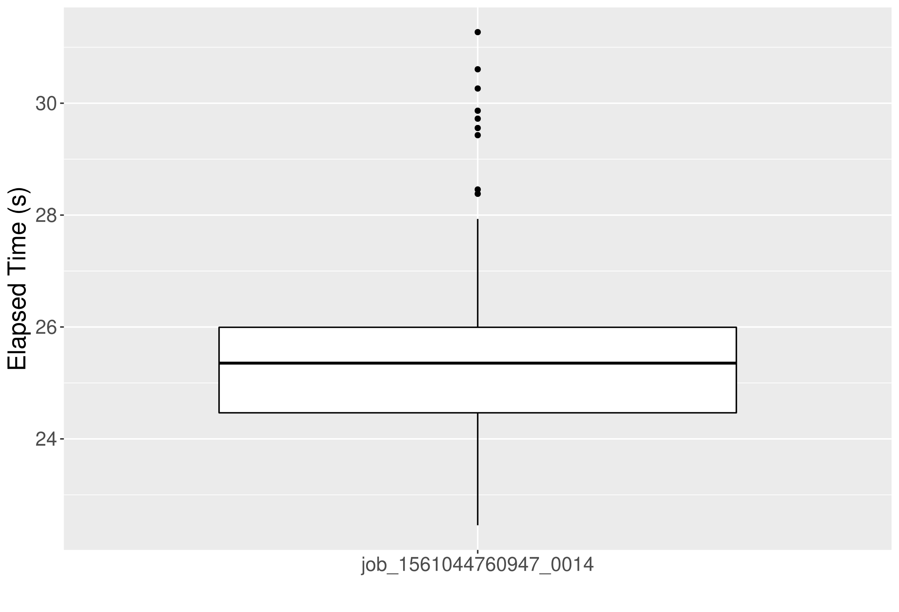
Stragglers
Straggler
Tasks
Stragglers:
Temporarily slow tasks, impacting
overall job performance
Influenced by temporal stochastic
behaviour:
- Component Failure
- Resource Saturation
- Software Defects
Notes:
One such phenomena is straggler manifestation.
Stragglers describes abnormally slow tasks, responsible for stopping job completing in a predictable manner and caused by non-deterministic system behaviors.
Factors influencing such behaviors are often temporal and may include one, or a combination of:
- Resource Saturation
- Component Failure
- Application Bugs/Defects
- Framework Limitations
Capturing and reproducing workloads patterns and system configuration for simulation is challenging and requires fine grained experimentation.

Slide 6
Experimentation Activities
Prepare Testbed
Prepare
Job Trace
Prepare Cluster
Deploy Orchestration Platform
Execute Experiment
Execute Job Trace
Monitor Execution
Collect and Analyse
Collect Performance Metrics
Transform Metrics
Trace Persistence and Analyses
Notes:
Experimentation allows researchers to truth out understanding of underlying system behaviours and operations, by conducting methodical execution of experimentation workloads under known system conditions.
An experiment can viewed as three stage lifecycle.
An initial stage is concerned with configurating the experimentation testbed and workload pattern.
An execution stage submits jobs to the orchestration platform and monitors there progress.
Following completion of an experiment traces are collected and transformed into a meta-state.

Slide 7
Experimentation is Complex
Straggler manifestation is hard:
Requires complex tuning of workloads and orchestration platform, application framework and cluster infrastructure
Constrain experimentation diligence:
Manual Experimentation is complex and time consuming
Requires domain expertise
Lack of open tools – limiting reproducibility
Notes:
However manifesting transient behavior is complex and requires fine tuning of orchestration and application platform as well as the cluster infrastructure.
This is problem, because features available in one orchestration or application framework may be described using different language or may not be present at all.
Furthermore, tools designed for injecting desired system behavior are often experiment specific, and are unrelease meaning they are inaccessible to the research community.
These factors constrain experiment fidelity, by imposing time constraint on researchers, and limit experimentation combinations.

Slide 8

PRISM Framework
Experimentation Framework
Captures experimentation Lifecycle
Aims:
Capture Framework Config & Automate Deployment
Pluggable configuration and resource saturation
Trace Transformation
Automate experimentation execution.
Notes:
PRISM aims to encapsulate the experiment lifecycle as configurable modules executed as a pipeline.
Specifically PRISM has four objectives:
- Simplify configuration of experimental testbeds, and workload patterns
- Automate deployment of application frameworks
- Trace Transformation, allowing automated transformation of a trace information to job descriptions.
- Automated execution, monitoring and collection of experimental jobs and their traces.

Slide 9
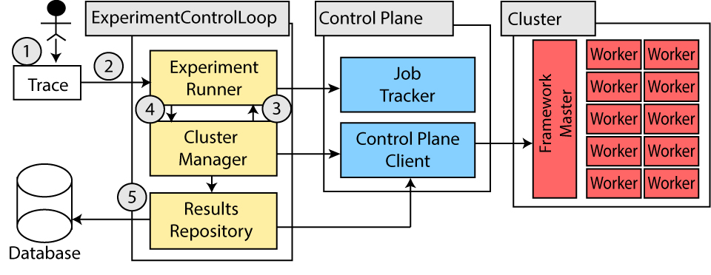
PRISM Framework
Notes:
PRISM is composed of three main components.
Experiment Runner is responsible for trace transformation, job execution and monitoring and provide a pluggable interace for allowing reseachers to implement custom trace transformation and experimentation monitoring routines.
The Cluster Manager abstract interaction with the orchestration platform. This is accomplished by implementation generalised interface with bespoke implementations, designed to mediate interactions between the experimentation runner, results repository and the application framework control plane.
The Results repository collect performance traces and transforms them to a meta-form for long term persistence.
These components are composed to enable several features which make PRISM an attractive platform

Slide 10
PRISM Features
Automated Application Framework Deployment
Encapsulation of Application Framework Configuration
Trace Transformation and Automated Workload Execution.
Configurable Resource Saturation
Automated Trace Collection and Persistence
Notes:
Specifically PRISM provide several desirable features for capturing domain knowledge and providing reduced configuration complexity:
Encapsulation of framework configuration.
Automated Application Framework Deployment
Modular trace transformation
Automated Trace Collection and Persistence
Modular Resource Saturation

Slide 11
Workload Trace Transformation
input_spec = InputTransformer.factory(“yarn_csv”)
exp_runner = ExperimentRunner(input_spec, “/20g_AIW.txt”)
Execute workload…
output_spec = OutputTransformer.factory(“yarn”)
r_repo = ResultsRepository(output_spec, “20g_wordcount”)
submitTime, startTime, finishTime, jobID, jobType, input_path
1566610131444,1566611254376,1566611635158,job_1566569075310_0217,word count,hdfs://wordcount/20G_AIW.txt
{
job_type: wordcount
input_path: hdfs://wordcount/20G_AIW.txt
job_makespan: 1103
}
Notes:
Trace Transformation describes conversion of a traces from one representation to another, and is used for repeating workload execution and persisting traces with minimal human intervention.
PRISM Provides strategy pattern containers, allowing injection of custom transformation algorithms.
In this case we can observe initialization of the experiment runner and results repository with yarn_csv input spec, and we are able to transform yarn specific traces into a meta data form by using the yarn_output_spe.
These will be used for transforming from yarn performance traces to Job Submission, and then back to a meta state for long term persistence and analyses.

Slide 12
Resource Injection
Resource Saturation
PRISM provides configurable resource saturation
Saturation Sidecar Container
Colocation of containers consume configurable volume of system resources
Contention and Interference
Resource saturation leads to starvation and reduced performance
Notes:
Manipulation of PRISM deployment environment is enabling through configurable resource consuming containers.
Each Resource Consuming container is colacated as a sidecare caontainer with the relevant worker node.
Enabling researchers to conduct transient system experimentation such as modelling of resource saturation and contentions, by providing controlled resource pre-loading.

Slide 13
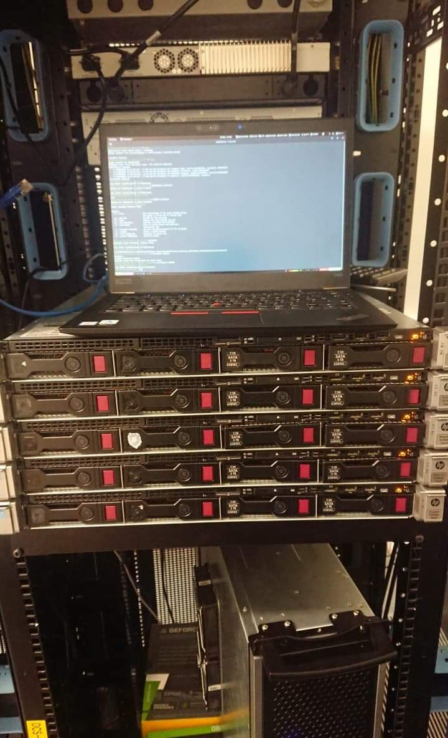
PRISM Use case: Straggler Analytics
Study Aim:
Study effects of resource contention & interference on stragglers
Experimentation:
100 WordCount job runs (4800 total)
CPU Contention injection (0% - 80%)
Data input sizes (20 & 40GB input)
Testbed:
38 Node Kubernetes Cluster
4 core i7 – 4770k @ 3.9GHz, 8GB DDR3 Ram, 256GB SSD
Hadoop 2.9.2
Yarn Nodemanagers: 1 CPU, 2GB slots
Notes:
In order to understand how straggler manifestation impacts container framework orchestration we conducted an prelimary investigation under varying system conditions.
Previous studies have shown exposure to resource contention may lead to increased straggler manifestation.
With that in mind we executed 4800 jobs, grouped into 100 job runs, each configured for different system conditions.
Including varying data input size and cpu contention
Our testbed consists of a 38 node Kubernetes cluster, each node possess:
Each node possses 4 core i7, 8gb of ram and 256gb ssd.
We configured the Hadoop Yarn application framework.
Each nodemanage was configured to split the node resource into 4 x 1 CPU, 2GB Memory Slots.

Slide 14
Configuring an Experiment
straggler_analyses_20gb_20%.yml
experimentID: straggler_20gb_20%_util
results_repository:
trace_path: “./test_trace.csv”
trace_parser: “csv_to_yarn_wordcount_parser”
experiment_runner:
trace_writer_module: csv
trace_parser: yarn_json_parser
cluster_spec:
framework: hadoop-hdfs-yarn
size: 38
master:
image: yarn:resourcemanager
image: hdfs:namenode
worker:
image: yarn:nodemanager
image: hdfs:datanode
...
ResourceInjection:
image: resource_isolation:CPU
args:
- 20
Notes:
Experiment runs are described by yaml manifest files, identifying Configurable components, paths to input traces, cluster configuration and output specifications.
These manifest can be shared along with their modules in order to support experiment reproduction.

Slide 15
Deploying an Experiment
Single Line Execution
prismUser# PRISM.py deploy straggler_20gb_20%.yml
--------------------
config check: PASS
experiments found: 1
deploy platform: 38 containers, hdfs
Deploy platform: 38 containers, yarn
experiment jobs: 100
experiment application: wordcount
starting experiment: straggler_20gb_20%_util
Notes:
Finally experiments can be executed as single command.
PRISM will deploy our application framework, execute a workload and persist our results according to the experiment confiugation yaml

Slide 16

PRISM Experimental Automation Review
Experiments can now be encapsulated:
Containers encapsulate framework configuration and experiment variability
Workload execution has been automated
Experimentation can be repeated by providing trace transformation algorithms
Resources saturation can be configured and enabled via containers
Experiment setup reduced from hours to minutes
Notes:
The experimentation lifecycle is captured within experimentation framework, reducing complexity associated with running containerised experimentation.
We have modularised application framework deployment, and provided interface for extending PRISM to include a variety of application frameworks.
Containers are used as our smallest unit of variability, and allow injection of bespoke or custom behaviours
This may include features such as resource saturation and trace transformation.
Thus experiments can be easily described, shared and repeated independently.

Slide 17
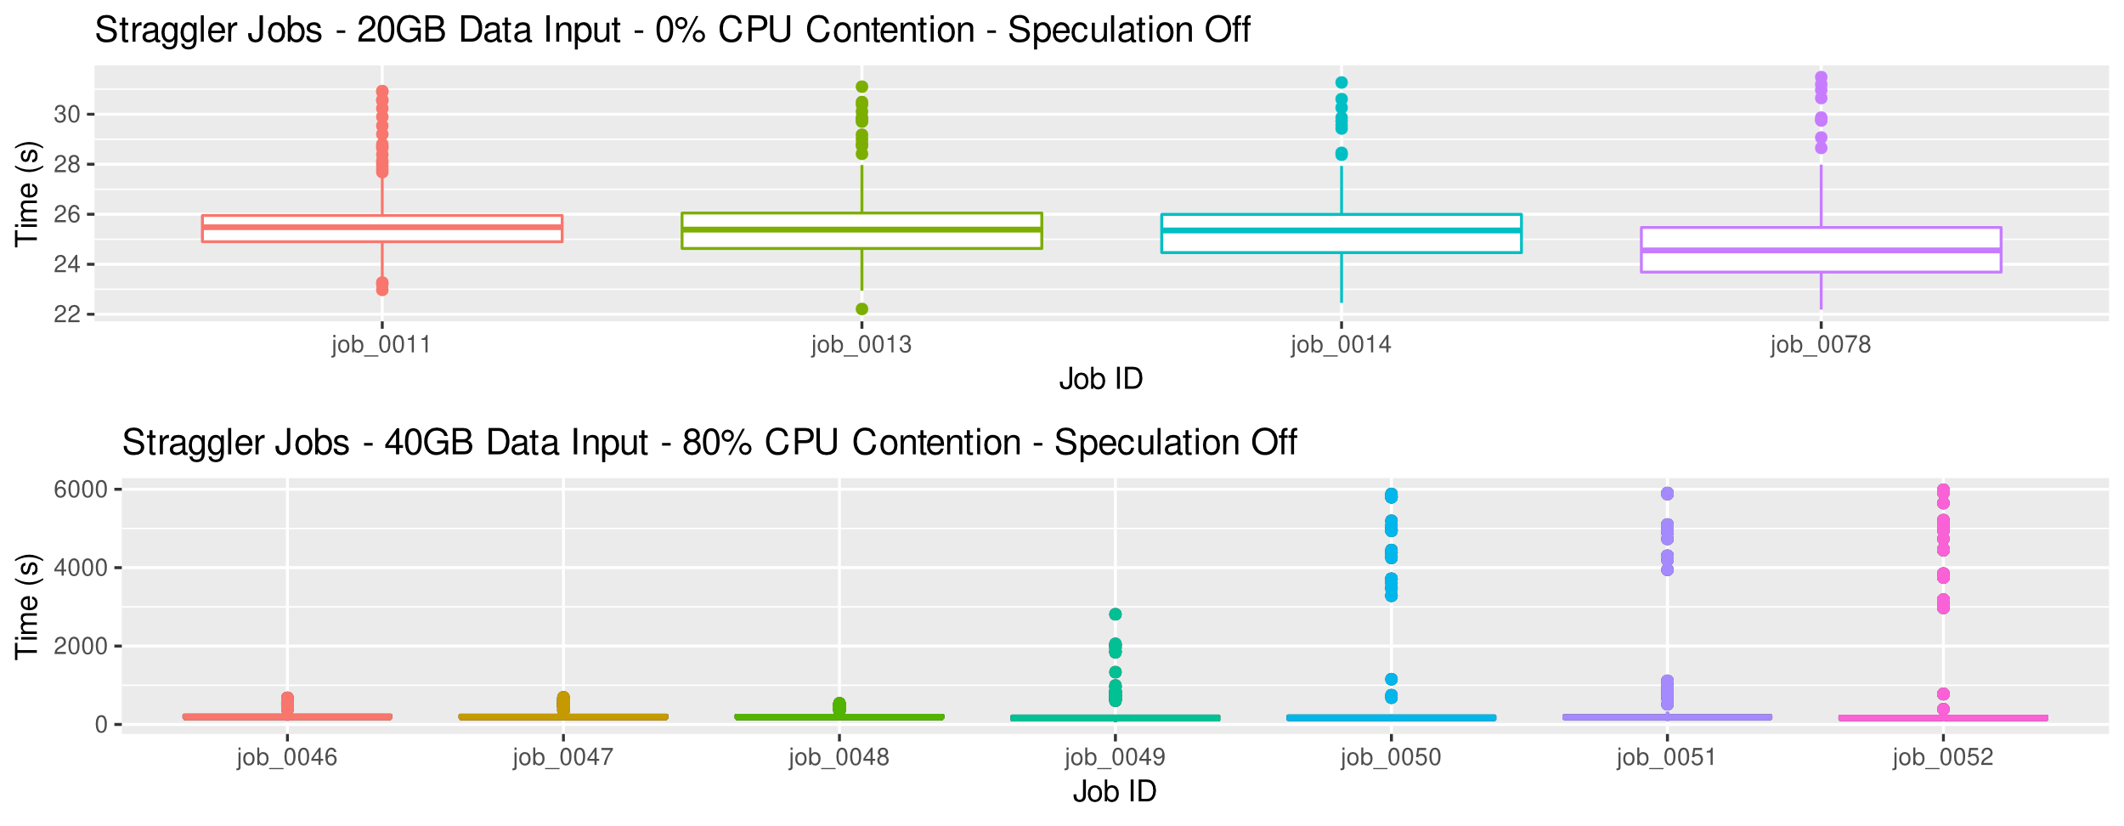
Analyses: Stragglers
Speculation | Data Input (GB) | CPU Contention | JCT μ (s) | JCT (deviation)
Disabled | 20 | 20 | 1188.1 | 568.5
Enabled | 40 | 80 | 3609.6 | 637.5
Notes:
Due to the highly transient nature of straggler manifestation we were only able to observe straggler incident during two experiment separate runs.
This is because straggler manifestation is not deterministic and replaying deterministic system condition may not lead to straggler manifestation
We observe a high number of straggler during our 40GB, 80% CPU contention run, we belive this is because the application framework assume exclusive access to system resources and is affected by resource contention and interference.
We also observer manifestations During our 20GB, 0%CPU, whilst this is a little less intutative we belive that these were cause by slot starvation. Here the application framework attempts to execute too many tasks in parallel, leading to increased task latencies, due to resource starvation.

Slide 18
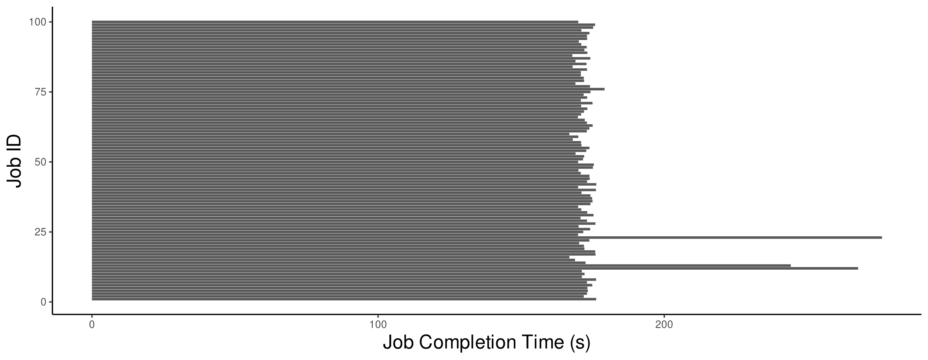
Straggler Manifestation Findings
Straggler manifest more frequent with higher CPU resource interference
Application frameworks also responsible for managing resource units effectively
More work is needed to understand how application frameworks can adjust resource quotas to meet job requirements
Notes:
This work provides a prelimary investigation into straggler manifestion
We found resource contention can lead to increased stragglers, however it is not the only cause.
Application Frameworks constraints can also lead to straggler manifestation, these may include interference, resource starvation and contention.
This is because the scheduler is because resource are ofren under contention in multi-tentant systems, and YARN is not capable of dynamically adjust configured slots in response to resource availability.
We believe straggler manifestation can be managed by tracking slot performance and dynamically managing resource pools.

Slide 19

Conclusions
Automated Experiment Framework for Containerized Clusters
Simplify/accelerate experiment design
Rapid configuration/deployment with configuration less complexity
Conducted case study on straggler manifestation
Future Work
  Provide Kubernetes and Mesos drivers
Better Trace Transformation
Integrate with Telemetry Services (influxdb, prometheus)
Decouple from Kubernetes
Refactor into single project and release to public!

Slide 20
Thank you for listening
Questions!

