Slide 1
PRISM
Dominic Lindsay

Slide 2
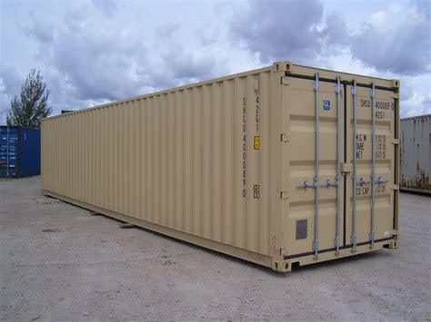
Container Orchestration
Notes:
Containers encapsule executables, configuration and their dependanceis as a single runnable image and are capable of providing mutli-tannancy without hypervisor based hardware emulation. Instead containers make use of user space tools and kernel features, resulting In higher node resource utilization, smaller image size and lower boot latencies.
Containers have received interest from academia and industry projects.
Leading to development of several open-source several containerised application frameworks, including:
Several Containerised Orchestration Frameworks exist including:
Kubernetes Yarn Mesos
Such frameworks enable execution of containerised workloads in distributed environments, by abstracting resource management and workload coordination.

Slide 3
Cluster Goals
Scalability
Resillience
Energy
Performance
Job Makespan
Scheduling Latency
Job Saturation
Throughput
Resource Failure
Workload Constraints
Workload Consoloidation
Cooling
Notes:
Conatinerised Orchestration Frameworks aim to achieve several objectives in parralel including:
- Job and Scheduling Performance
- Job throughput and cluster scalability
- Resilience to resource failure and workload constraints.
- Energy Utilisation including cooling, workload consoladation.
Container orchestatration frameworks execute workloads as jobs composed of task encapsulating work dependencies to be completed on the computing substrate.
Framework performance is measured along several dimensions including:
- Job and Scheduling Performance
- Job throughput and cluster scalability
- Resilience to resource failure and workload constraints.
- Energy Utilisation including cooling, workload consoladation.
frameworks allows tuning of framework prorperties by means of configuration and modular extention.

Slide 4
Experimentation
Conducted via Empirical Analyses of workload execution on physical infrastructure
Performance is used to inform Simulation used for demonstrating operation at scale.
Enable critical Analyses of Orchestration Platform
Notes:
An effective method to measuring framework performance along these dimensions is by means of experimentation, allowing researchers to conduct thorough analyses of framework by measuring framework performance metrics.
An effective method for evaluating framework performance is empirical experimentation on physical infrastructure.
By executing workload benchmarks and comparing performance metrics researchers are able to conduct critical analyses of framework performance.
Such experimentation is often limited by access to representative computing infrastructure.
As such researchers often employ simulation informed by metrics capture by empirical analyses of available computing Infrastrure.
This is because:
Configuration and tuning ​of diverse orchestration and application frameworks required significant domain knowledge.
Whilst manifestation of system behavior requires selection and design of complex workload patterns.
= However empirical experimentation is often challenging due to limited access to representative infrastructure. =
Empirical experimentation is often challenging either because of limited access to representative infrasture.
However configuration and execution of orchestration frameworks, application, and workloads requires substantial domain knowledge in order to capture metrics required to inform fine grained simulation.
However configuration and execution of orchestration frameworks
Whilst Coarse grained simulation fail model emerging system phenomena such as straggler manifestation.
requires required for capturing fine grained metrics of framework performance., application and workloads requires substantial domain knowledge.
As such simulation informed by performance traces collected from experimentation on physical infrastructure is often performed to conduct analyses at scale.
However such simulation are limited by their emulation environment,
Fine grained simulation of system condition are complex and requires extensive expertise and time to design.
Whilst Coarse grained simulation fail model emerging system phenomena such as straggler manifestation.
---------------------
However empirical experimentation is often challenging
- limited access to representative infrastructure
- Limited domain knowledge of application and orchestration framework

Slide 5
Stragglers
Abnormally slow performing tasks blocking completion of a Job and thus degrading job performance
Caused by Transient System Phenomena.
Cause are not easily captured, constraining simulation fidelity.
Notes:
One such phenomena is straggler manifestation.
Stragglers are caused by non-deterministic system behaviors such as component failure or software defects, and manifest as momentarily underperforming tasks which greatly impact job completion performance.
Factors influence such behaviors are often temporal and may include one, or a combination of:
- Resource Saturation
- Component Failure
- Application Bugs/Defects
- Framework Limitations
Capturing and reproducing workloads patterns and system configuration for simulation is challenging and requires fine grained experimentation.

Slide 6
Experimentation is Complex
Experimentation is Complex
Orchestration Frameworks Configuration and Workload Pattern Generation Requires Specialised Domain Knowledge
As such experimentation diligence is constrained.
Notes:
Manifestation such behavior requires fine tuning of experimentation platforms and workloads.
This is challenging because frameworks often expose a wide range of configuration parameters.
Tools designed for inject desired behavior are experiment specific and often undocumented or unreleased.
These factors constrain experiment fidelity, by imposing time constraint on researchers, and limited experimentation combinations.

Slide 7
Experimentation Life Cycle
Prepare Testbed
Prepare Job Trace
Prepare Cluster
Deploy Orchestration Platform
Execute Experiment
Execute Job Trace
Monitor Execution
Collect and Analyse
Collect Performance Metrics
Transform Metrics
Trace Persistence and Analyses
Notes:
An experiment can viewed as three stage lifecycle.
An initial stage is concerned with configurating the experimentation testbed and workload pattern. An execution stage submits jobs to the orchestration platform and monitors there progress.
Following completion of an experiment traces are collected and transformed into a meta-state.

Slide 8
PRISM framework goals.
A Framework for empirical experimentation.
Automate Deployment of experimental platform
Automated workload execution and monitoring.
Automated trace collection and persistence.
Notes:
PRISM aims to encapsulate the experiment lifecycle as configurable modules executed as a pipeline.
Specifically PRISM has three main aims:
- Simplify configuration of experimental testbeds, and workload patterns
- Automate deployment of application frameworks
- Trace Transformation, allowing automated transformation of a trace information to job descriptions.
- Automated execution, monitoring and collection of experimental jobs and their traces.

Slide 9
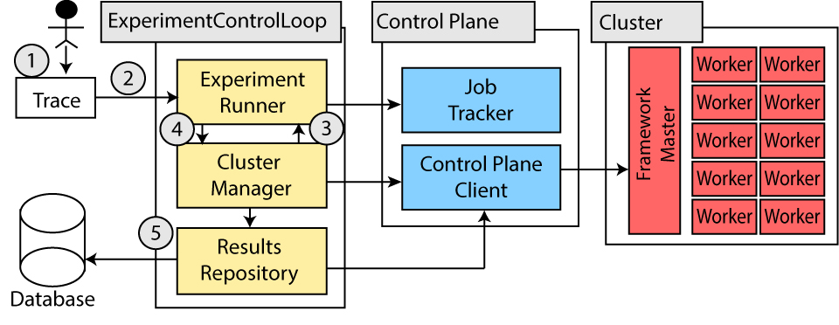
PRISM Framework
Notes:
PRISM is composed of three main components.
Experiment Runner is responsible for trace transformation, job execution and monitoring. Researchers must implement trace transformation algorithms enabling execution of performance traces as jobs in the orchestration framework.
The Cluster Manager abstract interaction with the orchestration platform, by providing a collection of interfaces, enabling experiment runner to interact with a range of application frameworks.
The Results repository collect performance traces and transforms them to a meta-form for long term persistence.
These components are composed to enable several features which make PRISM an attractive platform

Slide 10
Automated Deployment
Automated Orchestration Framework and Application Deployment.
Encapsulate Orchetration configuration as containers.
Notes:
- PRISM encapsulate framework deployment as containerired application components and is capable of automated deployment of scheduling frameworks and orchestration platforms.
This has two advantages,
- First deployment of platforms can now be done from a single configuration file. - Second domain expertise can be captured by containers allowing experimentation sharing.

Slide 11
Automated Job Execution and Monitoring
Automated workload execution
Execution monitoring for capturing zombie executions
Notes:
Workloads can be submitted and monitored with minimum human intervention.
This allows researchers to queue experimentation variation and improves experimentation diligence by enabling increasing execution throughput.

Slide 12
Framework Specific Modules
Abstract framework specific control planes via interface.
Notes:
Frameowkr specific modules

Slide 13
Resource Injection
Configurable resource injection.
Resource specific containers saturate resources to a specified threshold.
Notes:
Manipulation of PRISM deployment environment is enabling through configurable resource consuming containers.
Enabling researchers to conduct transient system experimentation by increasing resource consumption and saturation.

Slide 14
Simplified Configuration
straggler_analyses_20gb_20%.yml
Single Line Execution
experimentID: straggler_20gb_20%_util
results_repository:
trace_path: “./test_trace.csv”
trace_parser: “csv_to_yarn_wordcount_parser”
Experiment_runner:
trace_writer_module: csv
trace_parser: yarn_json_parser
Cluster_spec:
framework: hadoop-hdfs-yarn
size: 38
master:
image: yarn:resourcemanager
image: hdfs:namenode
ResourceInjection:
image: resource_isolation:CPU
args: 20%
prismUser# PRISM.py deploy straggler_20gb_20%.yml
Config_Check: PASS
Experiments Found: 1
Starting Experiment: straggler_20gb_20%_util
Notes:
Experiments are configurare by YAML manifest describing required modules and containers for deployment, transformation, execution of representative runs.
Here ‘straggler_20gb_20%_util’ is configured to deploy a 38 node yarn cluster and execute a pre-collected csv formatted job trace

Slide 15
PRISM Use case: Straggler Analytics
Study effects of resource contention and interference on straggler manifestation
Experiment consisted of 4800 unique Wordcount Jobs.
Experiment runs composed 100 jobs
CPU Contention injection
0%, 20%, 40%, 60%, 80%
Range of data input sizes:
20GB and 40GB input data.

Slide 16
Method: Testbed and Experiment
38 Node Kubernetes Cluster
4 core i7 – 4770k, 8GB Ram, 256GB SSD.
Hadoop 2.9.2
1 CPU, 1GB slots.

Slide 17
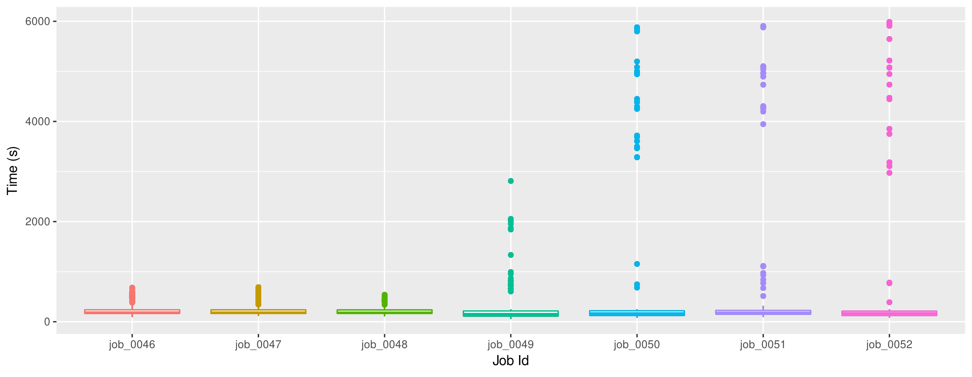
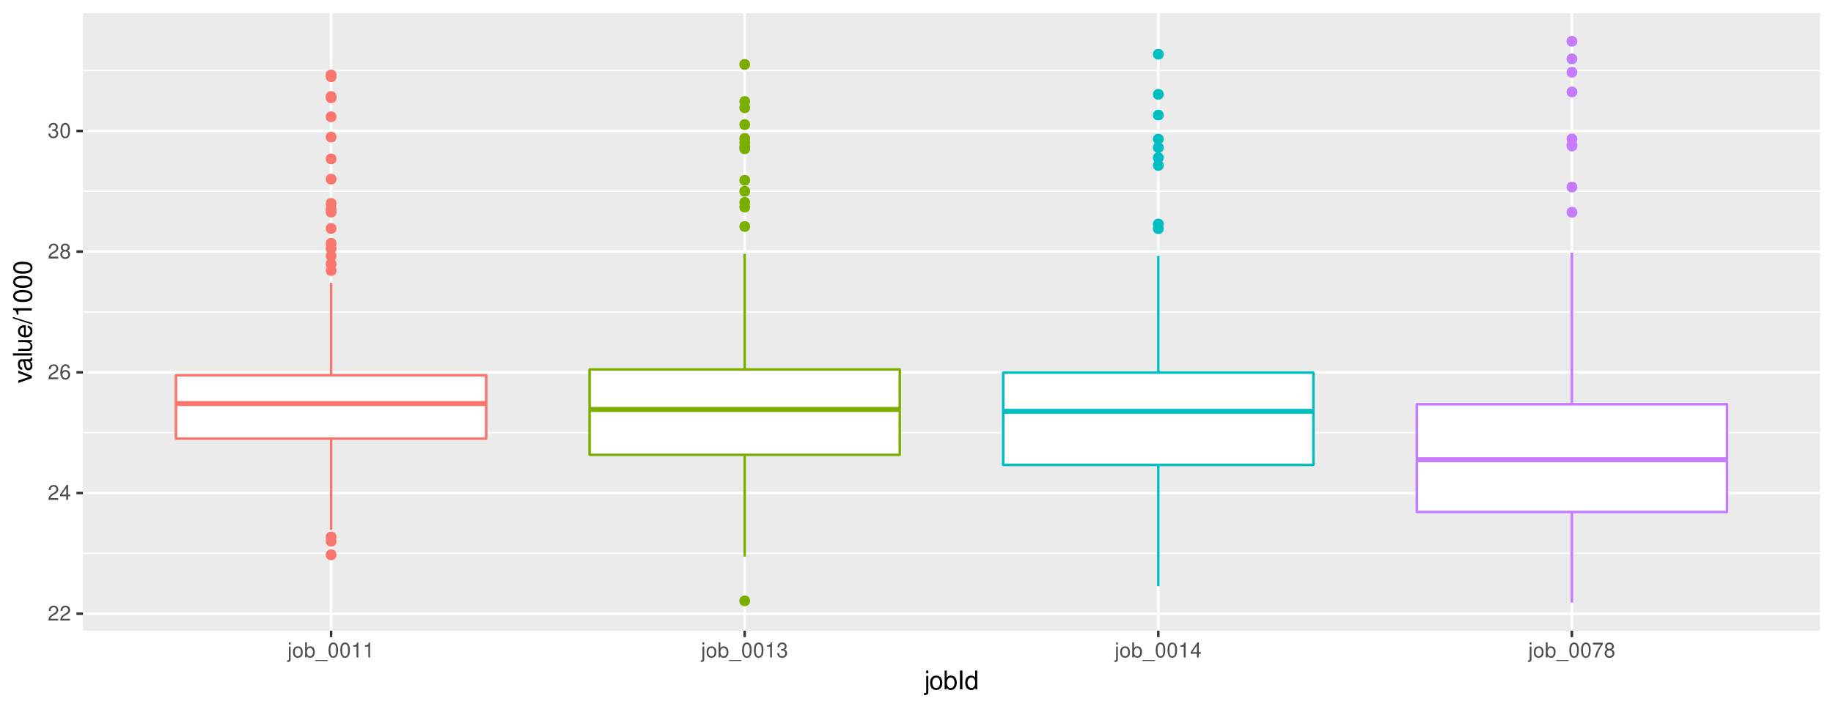
Analyses: Stragglers
Speculation | Data Input (GB) | CPU Contention | JCT μ (s) | JCT (deviation)
Enabled | 80 | 80 | 1608.8 | 236.8
Disabled

Slide 18
Analyses: Experiment Automation

Slide 19
Discussion
Framework exhaustion == straggler
Man hours reduce using PRISM

Slide 20
Questions
Framework exhaustion == straggler
Man hours reduce using PRISM

