Slide 1
Assignment-1
GROUP NUM: 11
PLOT UNDIRECTED, DIRECTED AND MIXED GRAPH FROM ADJACENCY MATRIX
Team members:
Anshul Agarwal IWM2017008
Vardhan Malik IWM2017007
Aman Gupta IWM2017006

Slide 2
Question:
Adjacency matrix is taken as an input.
We have to plot an undirected, directed and mixed graph for the adjacency matrix.

Slide 3
Tech Stack:
Language used: Python
Library used : Networkx
Inbuilt used function : DiGraph(), Graph()
Code link: Link

Slide 4
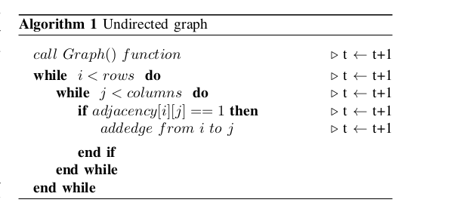
Undirected Graph
For an undirected graph,the adjacency matrix is symmetric. All the edges of undirected graph are bidirectional in nature.
0 1 0 1
1 0 1 0
0 1 0 1
1 0 1 0

Slide 5
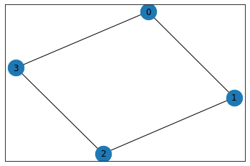
Undirected Graph
INPUT: OUTPUT:
Num of vertex: 4
Number of edges: 8
Source, Destination: 0 1
Source, Destination: 1 0
Source, Destination: 1 2
Source, Destination: 2 1
Source, Destination: 2 3
Source, Destination: 3 2
Source, Destination: 3 0
Source, Destination: 0 3

Slide 6
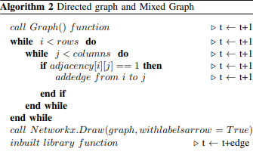
Directed and Mixed Graph
For a directed graph,the adjacency matrix need not to be symmetric. If the value of adjacency matrix is 1 (adjacency[i][j]=1), then there is an edge between the vertex i and vertex j, otherwise there is no edge between the two vertices.Mixed graph is formed by undirected and directed graph.
0 1 0 1
1 0 0 0
0 1 1 1
0 0 1 0

Slide 7
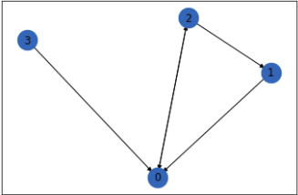
Output
Let the input adjacency matrix be
0 0 1 0
1 0 0 0
1 1 0 0
1 0 0 0

Slide 8
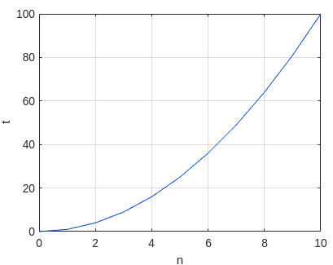
Time Complexity of Algorithm
The Time Complexity of an Algorithm is: T=O(n^2+E).
Where n is no. of vertices and E is number of edges in the graph.
There are E edges in the graph and for representing each edges takes O(1) so total edge representation takes O(E), and we need to check for all possible edges which takes O(n^2).

Slide 9
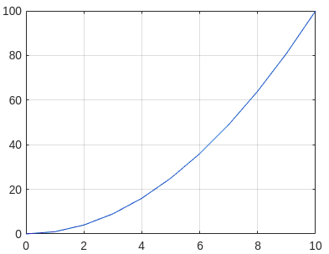
Space Complexity of Algorithm
The Space Complexity of an Algorithm is: O(n^2).
Where n is no. of nodes in the graph.
For storing the graph in adjacency matrix takes n^2 spaces.

