Slide 1

BOOK STORE SQL PROJECT
Name: Koushik Bera
Technology: MySQL
Project Type: Database Design & SQL Analysis

Slide 2

INTRODUCTION
Designing a Book Store Database
Core Management
Analytical Power
Manages books, customers, and orders efficiently.
Enables deep analysis of sales, customer behavior, and inventory.
MySQL Foundation
Built using MySQL for robust database operations.

Slide 3

Problem & Solution
Challenges Faced
Our SQL Solution
Manual record keeping leads to errors.
A structured relational database using SQL to overcome these challenges, ensuring accuracy and efficiency.
Difficulty in tracking stock and sales.
Lack of proper customer insights.
Time-consuming data retrieval processes.

Slide 4

PROJECT PURPOSE
Driving Business Intelligence
Data Storage
Securely store book, customer, and order data.
Relationship Management
Maintain data integrity using primary and foreign keys.
Reporting
Generate comprehensive sales and revenue reports.
Decision Support
Provide insights to support informed business decisions.

Slide 5
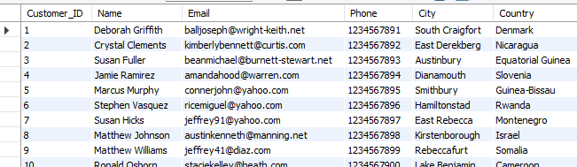
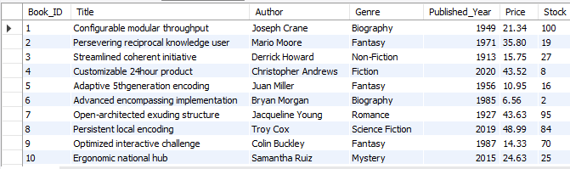
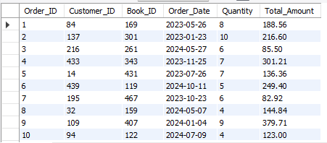
Database Overview: book_store
Customers Table
Key Components
Database Name: book_store
Tables: Books, Customers, Orders
Keys Used: Primary Key, Foreign Key
Books Table
Orders Table

Slide 6

BOOKS TABLE
Managing Your Inventory
Table: books
Book_ID (Primary Key)
Title
Author
Genre
Published_Year
Price
Stock
This table is crucial for efficient inventory management and tracking.

Slide 7
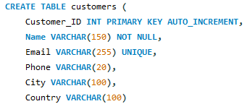
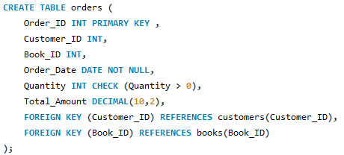
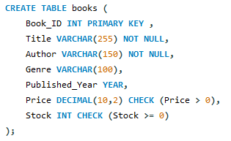
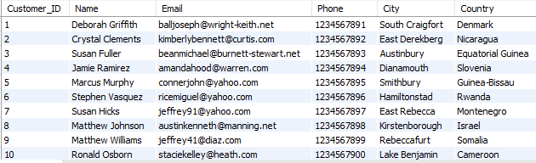
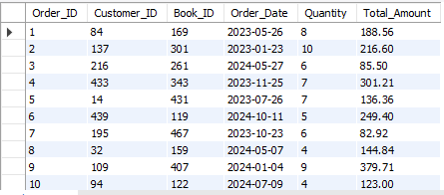
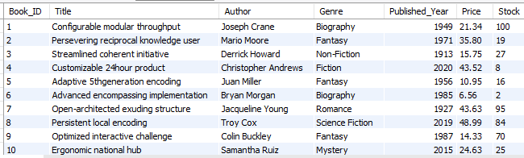
Customers & Orders
Customers Table
Orders Table
Books Table
Customer_ID (PK)
Order_ID (PK)
Name, Email, Phone
Customer_ID (FK)
City, Country
Book_ID (FK)
Quantity, Total_Amount

Slide 8




EXECUTION FLOW
From Input to Insight
Input
Book data, Customer data, Order transactions.
Processing
SQL queries, JOIN, GROUP BY for data manipulation.
Output
Revenue, Best-selling books, Remaining stock reports.

Slide 9
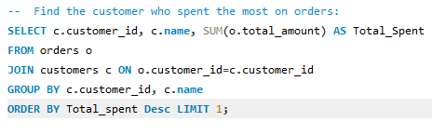
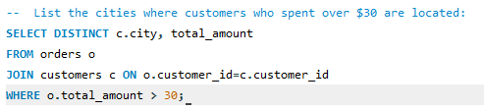
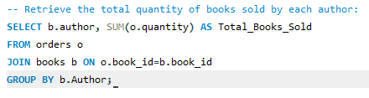
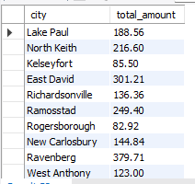


SQL Implementation
Visualizing the database structure and query results from MySQL Workbench.
Key SQL commands utilized: SELECT, WHERE, JOIN, SUM, AVG, COUNT.

Slide 10

CONCLUSION
Project Outcome & Impact
1
Real-World Application
2
Data Integrity
Demonstrates practical SQL database design skills.
Ensures proper data relationships and consistency.
3
Business Analysis
4
Academic & Interview Asset
Provides useful insights for strategic decision-making.
A strong project for academic portfolios and job interviews.

