Slide 1




a
NEXT GEN EMPLOYABILITY PROGRAM
Creating a future-ready workforce
College Name
Arunachala college of engineering for women,Manavilai
Team Members
Student Name :Babisha.K
Student ID :au960221104039

Slide 2

CAPSTONE PROJECT SHOWCASE
Project Title
Car Rentals Application with Django Framework
Abstract | Problem Statement | Project Overview | Proposed Solution | Technology Used | Modelling & Results | Conclusion

Slide 3
Abstract
The car rental industry has witnessed significant growth over the years, drive by the increasing demand for flexible transportation options. The proposed car rental application will offer an intuitive user interface for both customers and administrators, facilitating seamless browsing, booking, and management of rental vehicles.
Key functionalities:
User Registration and Authentication
Vehicle Catalog
Booking System
Admin Panel
Payment Integration
Reviews and Ratings.
Source :

Slide 4
Problem Statement The problem statement is to automate vehicle rental and reservation so that clients don't have to waste time calling and waiting for a vehicle. The Manual car rental system provides services only during office hours. So; customers have limited time to make any transactions or reservation of the cars. The existence of the online car rental systems nowadays has overcome the limitation of the business operation hour. Example: online car rental systems in Malaysia and most of the systems offered reservation service for tourists or traveller. There are some customers who faced a problem in choosing car to be rented which suitable with some of the important requirements. To rent a car a prospective renter must first go to the nearest office to register as a client. Cars that provide difficulties to rent out are normally advertised in local or national newspaper.and it involves a lot of paper work and consumes time.
Source :

Slide 5
Project Overview Car Rental application will provide users with a convenient way to browse available vehicles, make bookings, manage reservations, and facilitate secure transactions. The project leverages the Django framework for backend development, ensuring scalability, security, and rapid development. It provides, 1. User Authentication and Registration: *Users can create accounts or log in securely using email/password authentication. *Registration process includes verification steps to ensure authenticity. 2. Vehicle Catalog: *Users can browse and filter vehicles based on their preferences, including category, price range, and location. 3. Booking System: *Booking system allows users to reserve vehicles for specific dates and times. 4. Payment Integration: *Multiple payment methods are supported, ensuring flexibility for users.
Source :

Slide 6
Proposed Solution
.
Leveraging Django framework, develop a user-friendly car rental platform.
Features include user authentication, vehicle catalog, and booking system.
Admin dashboard enables management of vehicles, users, and bookings.
Secure payment integration ensures seamless transactions.
Responsive design offers optimal user experience across devices.
Users can leave reviews, enhancing transparency and trust.
Requirements analysis guides detailed feature specifications.
Design phase includes wireframing, database schema, and architecture planning.
Development involves backend logic in Django and frontend using modern web technologies.
Deployment and maintenance ensure scalability, reliability, and continuous improvement.
Source :

Slide 7
Key Features:
User Authentication and Registration:
Users can register accounts securely with email verification or log in using social media accounts.
Forgot password functionality for account recovery.
Vehicle Catalog:
The application maintains a diverse catalog of vehicles with detailed specifications, including make, model, year, features, and images.
Users can browse vehicles by category, filter based on preferences such as price range or vehicle type, and view availability calendars.
Source :

Slide 8
Payment Integration:
Secure payment gateways integrated to facilitate seamless transactions.
Support for multiple payment methods such as credit/debit cards, PayPal, and online banking.
Reviews and Ratings:
Users can leave reviews and ratings for rented vehicles and overall rental experience.Reviews contribute to the transparency and credibility of vehicle listings, helping future renters make informed decisions.
Source :

Slide 9


Technology Used
Front-end
Back-end
Source :

Slide 10
Modelling & Results
Employ Django ORM for database modeling, defining entities.
Implement robust user authentication and registration functionalities, ensuring data integrity and security.
Develop a dynamic vehicle catalog and booking system with search and filtering options for user convenience.
Create an admin dashboard for efficient management of vehicles, users, bookings, and reviews.
Integrate secure payment gateways like Stripe or PayPal for seamless online transactions.
Enable users to leave reviews and ratings, enhancing transparency and trust within the platform.
Deliver a user-friendly interface with responsive design, optimizing user experience across devices.
Source :

Slide 11
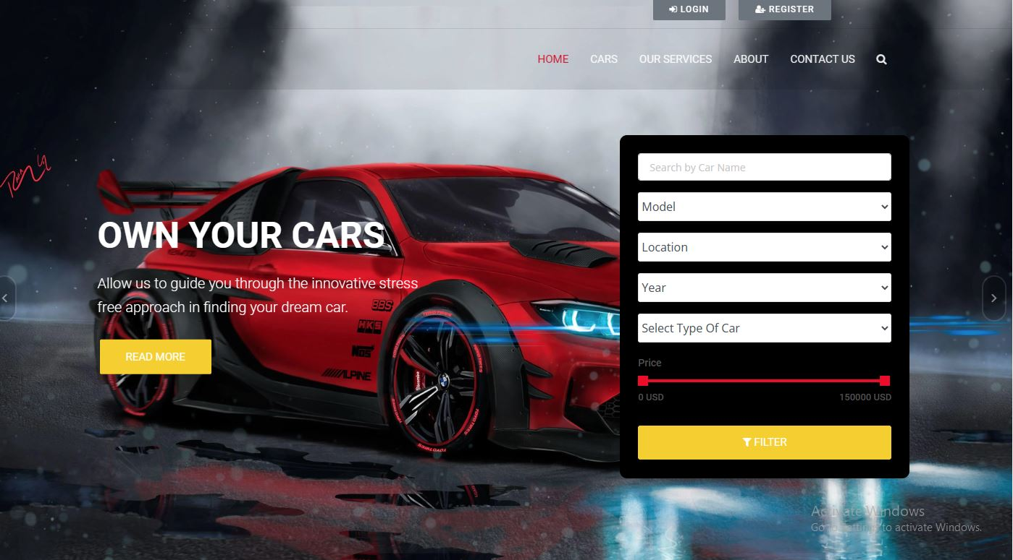
Homepage

Slide 12
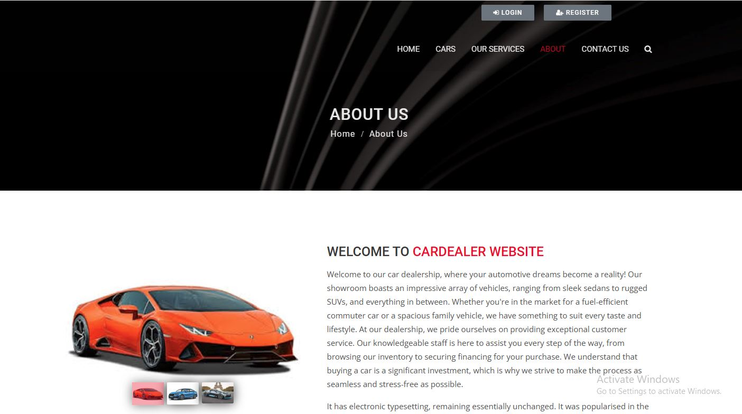
About-Us-Page

Slide 13
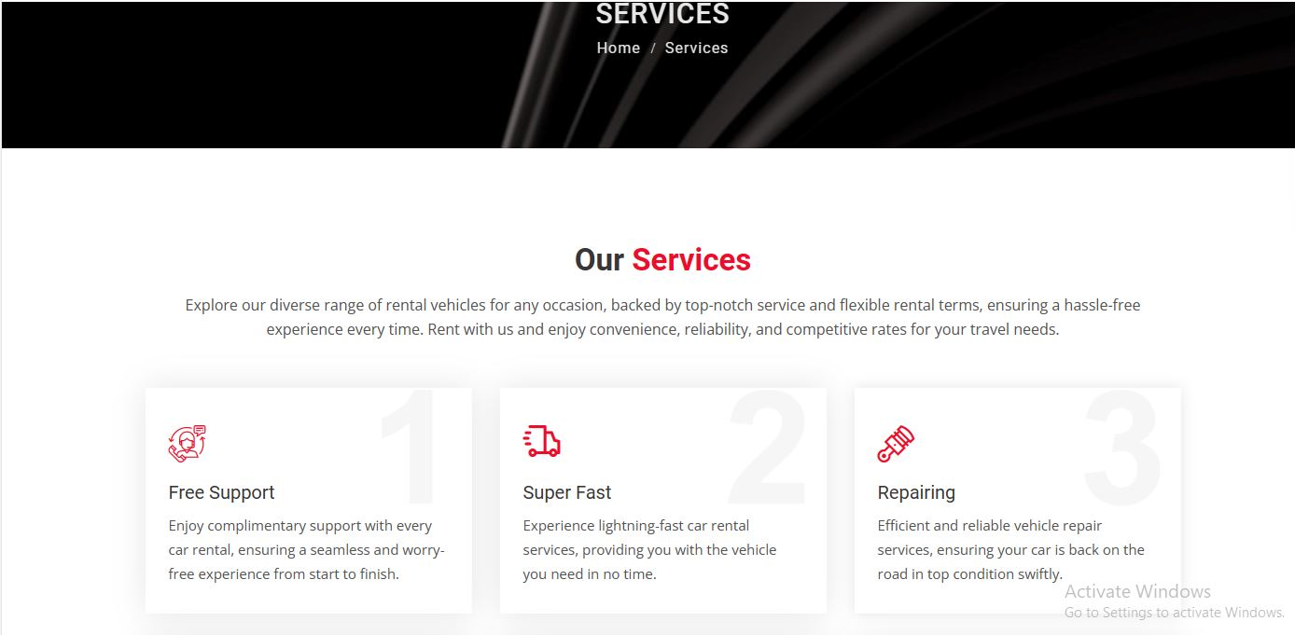
Service-Page

Slide 14
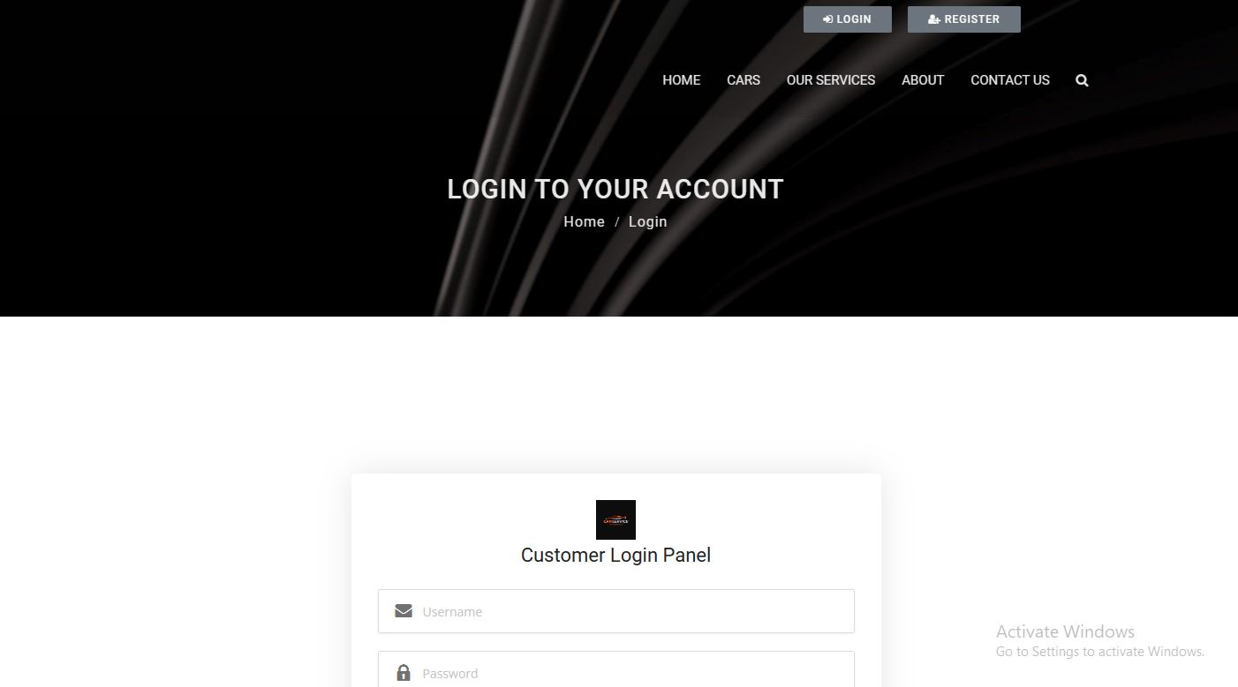
Login page

Slide 15
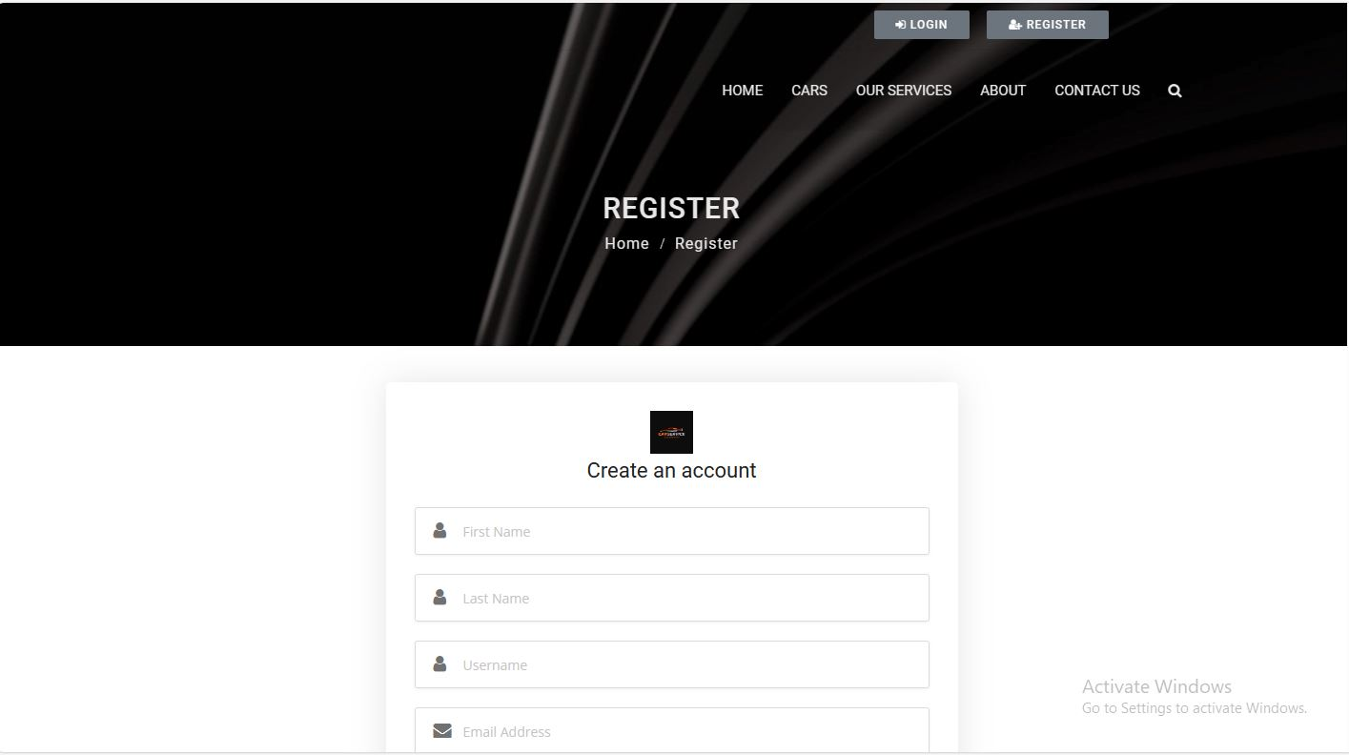
Register page

Slide 16
Future Enhancements:
Advanced search with refined filters for vehicle features and specifications.
Predictive analytics for dynamic pricing based on demand and seasonality.
Integration with IOT devices for real-time vehicle monitoring and management.
Personalized recommendations using machine learning algorithms.
Multi-language support for a more diverse user base.
Peer-to-peer rental marketplace to expand rental inventory.
Geofencing and remote access features for enhanced security and convenience.
Augmented reality vehicle visualization for immersive booking experience.
Voice-activated commands for hands-free interaction.
Sustainability initiatives promoting eco-friendly rental options and practices.

Slide 17
Conclusion
The development of a comprehensive car rental application using Django framework presents a robust solution to address the evolving needs of rental businesses and customers.. With user-friendly interfaces, secure payment integration, and personalized recommendations, the platform is poised to attract a diverse user base and foster trust and loyalty among customers. Through continuous monitoring, maintenance, and updates, the car rental application strives to deliver value, efficiency, and satisfaction to both users and rental businesses, ultimately shaping the future of car rental services.
Source :

Slide 18
Thank You!
Notes:
Thank You !!

