Slide 1
Analysis of Data Driven and Scientific Algorithms (Group no: 11)
Under guidance of Dr. J Tang
BY:
BABITA SINGH
NINAD LANKE
DHAVAL DHOLAKIYA

Slide 2
Motivation and Problem Definition
Analyzing performance of various data driven and scientific algorithms in terms of time matrix.
This analysis includes comparison of performance in different frameworks.
The algorithms include :
Scientific Algorithms | Data Driven Algorithms | Scientific + Data Driven Algorithms
Page Rank Matrix Multiplication | Document Set Search | Breadth First Search Semantic Analysis Sorting Algorithm

Slide 3
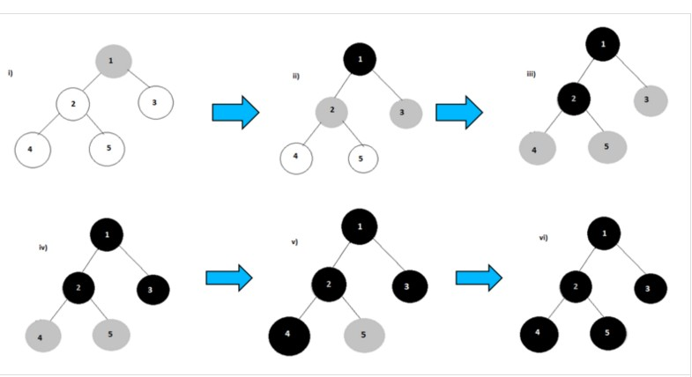
Breadth First Algorithms
Mapper:
1<tab>2,3|0|GRAY|source 2<tab>1,3,4,5|Integer.MAX_VALUE|WHITE|null 3<tab>1,4,2|Integer.MAX_VALUE|WHITE|null Reducer:
Reducer 1: (part-r-00000) 2<tab>1,3,4,5,|1|BLACK|1 5<tab>2,|2|BLACK|2 Reducer 2: (part-r-00001) 3<tab>1,4,2,|1|BLACK|1 Reducer 3: (part-r-00002) 1<tab>2,3,|0|BLACK|source 4<tab>2,3,|2|BLACK|2

Slide 4
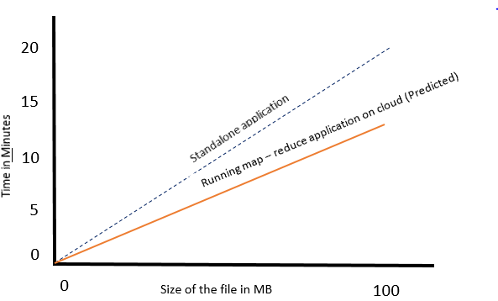
BFS Analysis

Slide 5
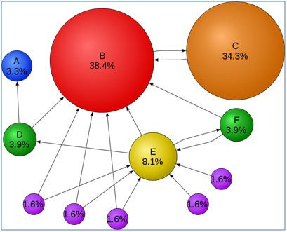
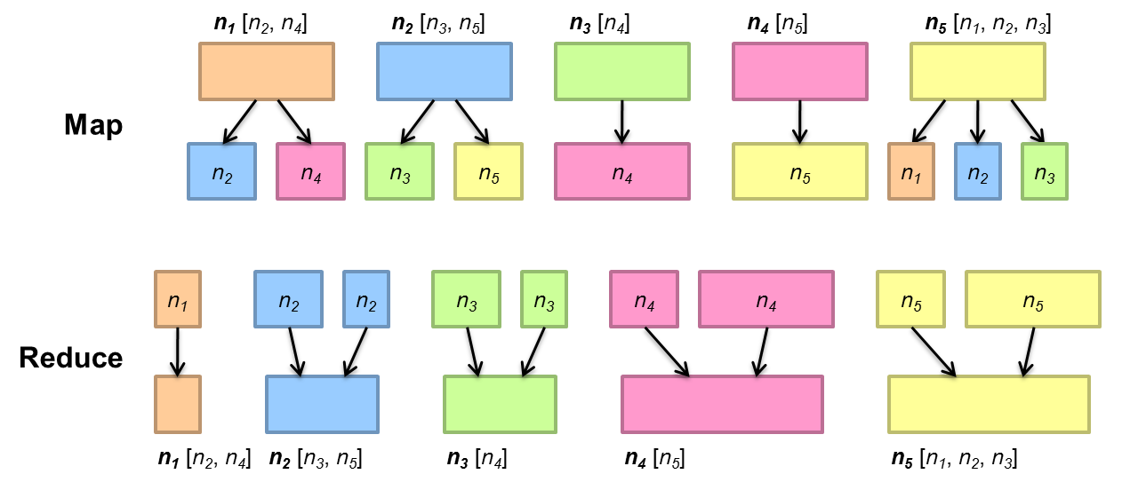
Page Rank in MapReduce

Slide 6
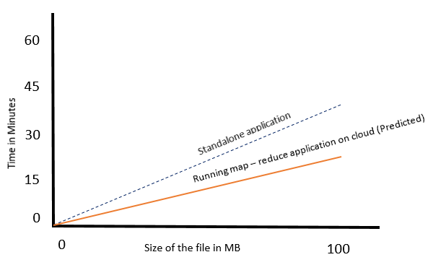
Analysis of Page Rank Algorithm

Slide 7
Natural Language Processing Algorithm - (Semantic Analysis)
Train Data
Test Data
Removal of non – words
(Numbers, special characters, punctuation marks)
Removal of stop words
Pass word and actual sentiment (0/1) as key-value pair
Count the actual sentiment of word. If 0, then decrement count, if I, then increment count
Store the word and the count
Check every word and check the count.
If total count is positive, then predict that the sentence was positive
else negative
Mapper
Reducer
Predictor

Slide 8
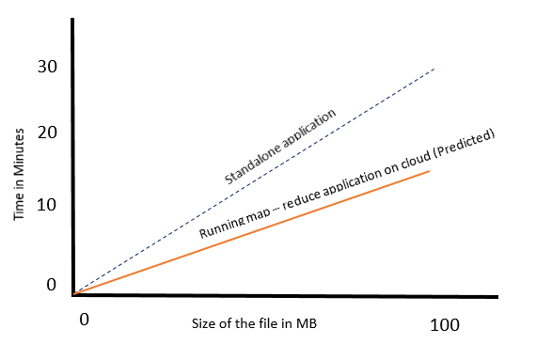
Analysis of NLP (Semantic Analysis)

Slide 9
Searching Algorithm
Multiple file inputs
Check if the word is present
Pass the file name and
the line number as key and value
Store the lines number for a particular file (line)
Output the file name and the corresponding lines in which the word is found
Mapper
Reducer

Slide 10
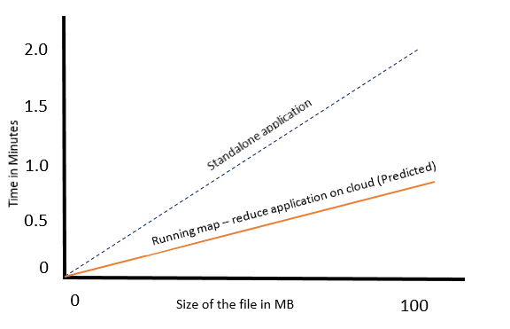
Analysis of Searching Algorithm

Slide 11
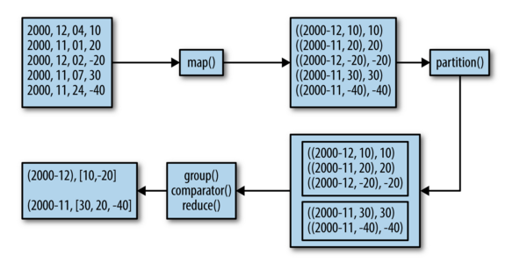
Sorting Algorithm

Slide 12
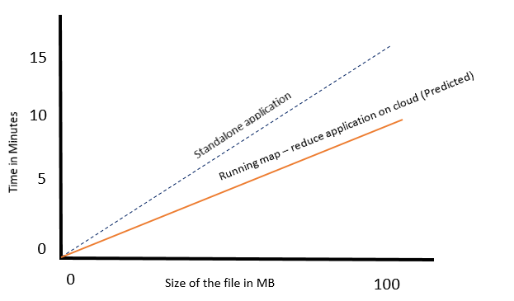
Analysis of Sorting Algorithm

Slide 13
Matrix Multiplication
Checks data in the row and column
incrementally
Pass the output cell location as key and values of the current row and column as value
Calculates the output cell value corresponding to key which is output cell location
Outputs the calculated cell which came as a key from the Mapper
Mapper
Reducer

Slide 14
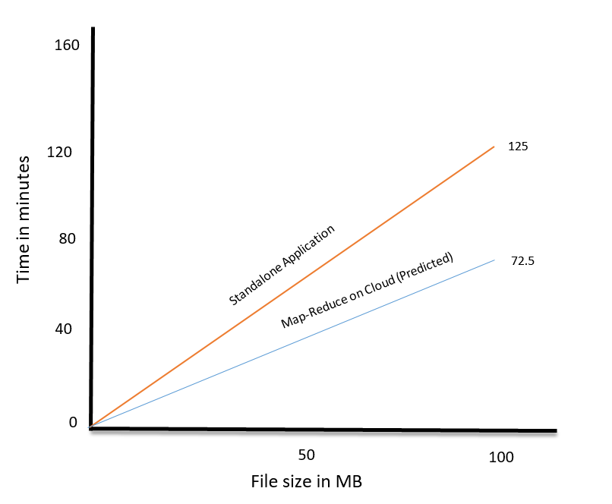
Analysis of Matrix Multiplication

Slide 15
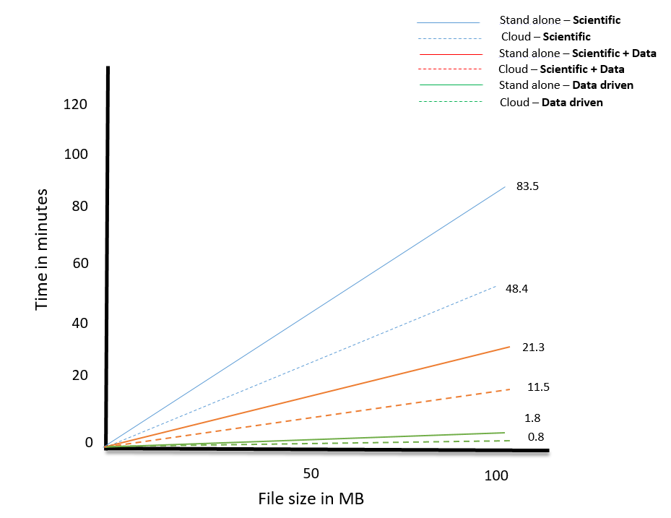

Slide 16
Contributions
Ninad: NLP, Document Search, Sorting Algorithm
Babita: BFS, Page Rank Algorithm
Dhaval: Matrix Multiplication, Cloud Implementation

Slide 17
Papers Referred
http://wcnc2016.ieee-wcnc.org/sites/wcnc2016.ieee-wcnc.org/files/u42/Invited%20Talk%20-%20Albert%20Zomaya.pdf
http://ilpubs.stanford.edu:8090/422/1/1999-66.pdf
http://infolab.stanford.edu/~backrub/google.html
http://introcs.cs.princeton.edu/java/16pagerank/
http://grids.ucs.indiana.edu/ptliupages/publications/BigDataMR%232.pdf
http://grids.ucs.indiana.edu/ptliupages/publications/BigDataMR%232.pdf
http://cgl.soic.indiana.edu/publications/cloudcomp_camera_ready.pdf

Slide 18
Thanks
Any Questions ?

