Slide 1
KNN using NLP
Done by:
P. Babitha

Slide 2
KNN
KNN stands for K- Nearest Neighbour
It falls under supervised learning algorithm and can used for solving non-linear data.
It is one of the most simplest method for classification as well as regression.
It is mainly based on feature similarity.
It is based on measuring distances between test data and each of training data . Distance can be measured using Euclidean ,Manhattan formulas.
Classification is done by majority votes to its neighbours.

Slide 3
Working steps:
STEP 1: Choose the number K of neighbors.
STEP 2: Take the K nearest neighbors of the new data point, according to the Euclidean distance.
STEP 3: Among these k neighbors, count the number of data points in each category.
STEP 4: Assign the new data point to the category where you counted the most neighbors.

Slide 4
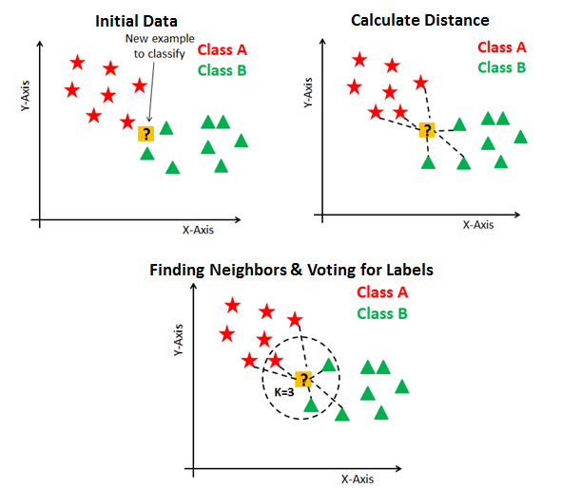
Example:

Slide 5
NLP
NLP stands for Natural Language Processing.
It is a model used to process the texts to classify before fitting that classification algorithms on the observations containing the texts.
It is a field in machine learning with the ability of computer to understand, analyze, manipulate.
You can also use NLP on a text review to predict if the review is a good one or a bad one.
Examples : google voice search

Slide 6
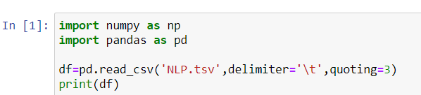
Importing libraries

Slide 7
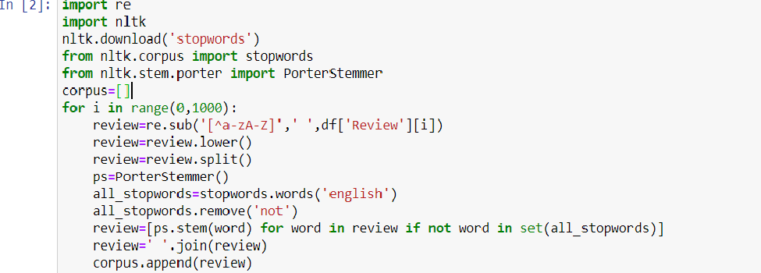
Importing NLTK library

Slide 8
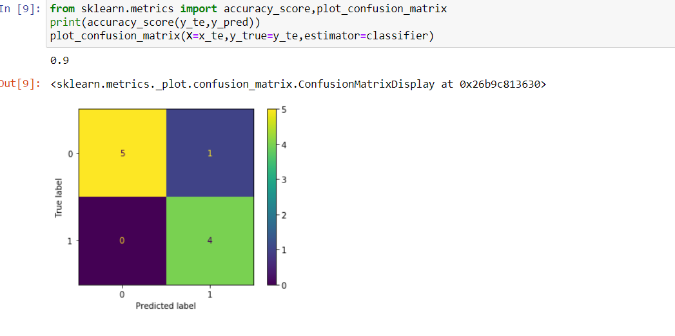
Plotting the output

Slide 9
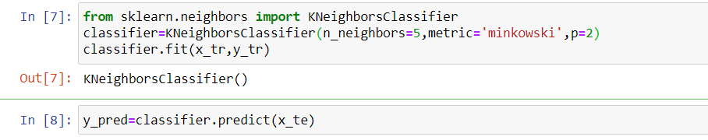
Choosing neighbors and predicting

Slide 10
Thank You

