Slide 1

Inventory Data Analysis
Babitha Raghavan

Slide 2
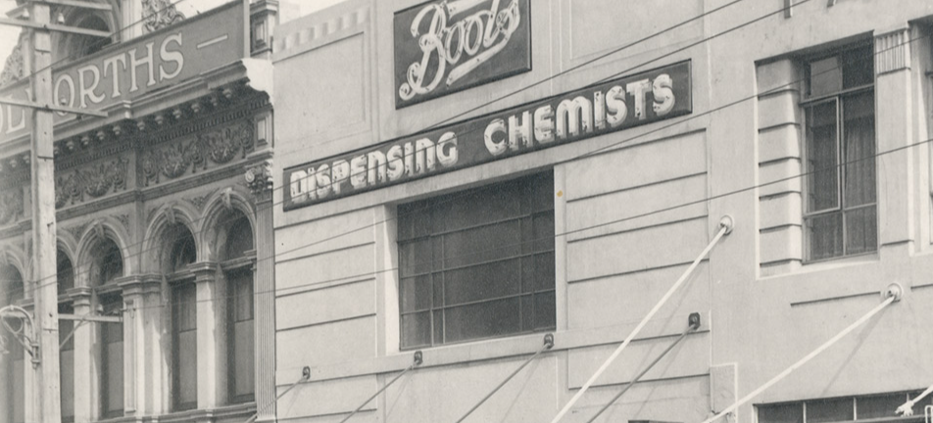
Introduction
The goal of this project is to analyse historic stock/inventory data to decide:
Inventory trends over time
Identify popular products and stores
Stockouts and replenishment analysis
Boots Heritage - Historic business from its first days as a herbalist store in Nottingham in the mid 1800s to its position as a modern global brand .

Slide 3
Dataset
Boots historic data from Nov 2019 - Feb 2020
Inventory, Product, Sales, Store data
Include 80 stores and 991 products
Data Analytics encompasses the practice of scrutinising and deciphering data to unreath valuable insights while pinpointing recurring patterns and emerging trends.
By turning data into actionable information, data analytics enables business to make data driven decisions, ensuring products are available on demand, enhancing customer satisfaction.

Slide 4
Exploratory Data Analysis

Slide 5
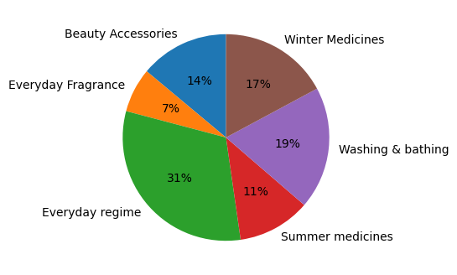
Product Category
Toiletries - 50%
Health - 30%
Beauty - 20%

Slide 6
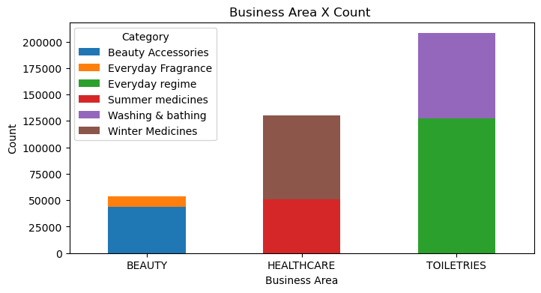
Business Area

Slide 7
Analysis

Slide 8
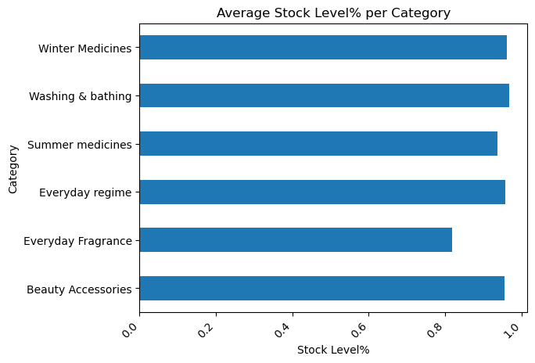
Stock level%
Stock Level% - measures inventory performance
Good Stock Level - 80%
Average between 40% -80%

Slide 9
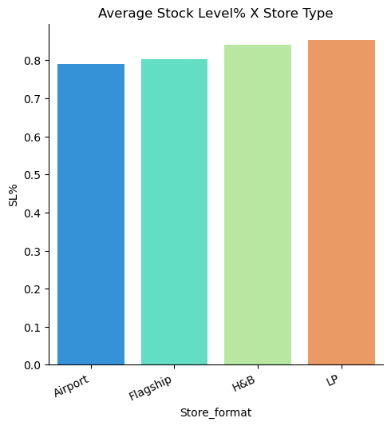
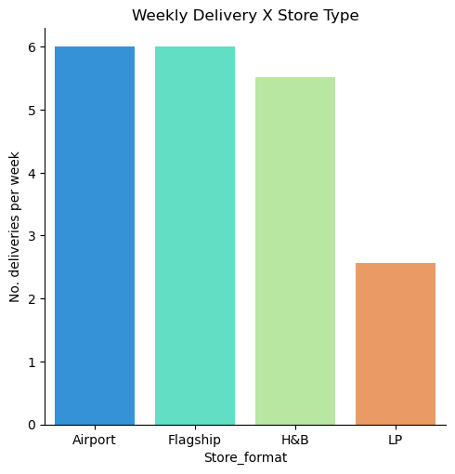
Stock level & No. of delivery per store type.
Store type LP requires less than 50% delivery, as the stock levels are very high.

Slide 10
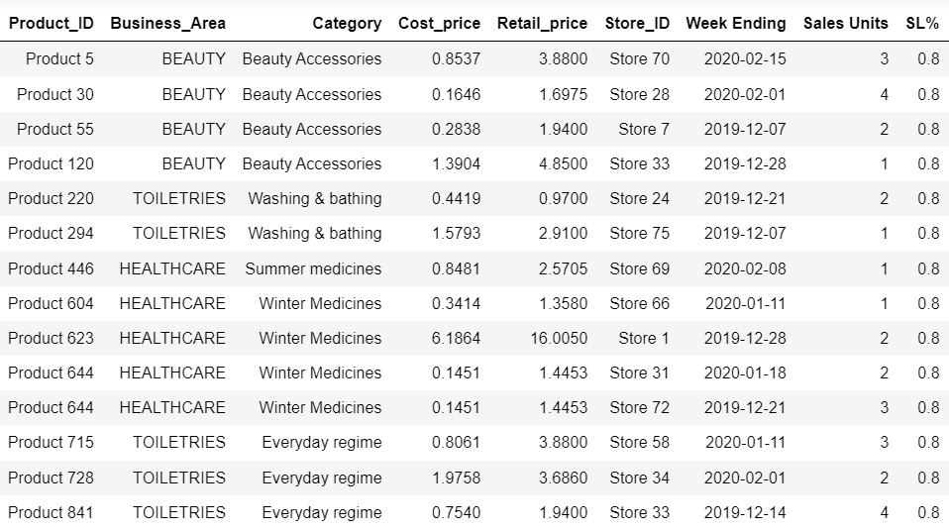
Products with 80% Stock Level maintained

Slide 11
Stockouts and replenishment
Average SL% - between 40 and 80
SL% below 40 - Overstocked
SL% above 80 - Understock
Percentage of products in various stores, in over stock is 3.5% and
Under stock is 94.6%, which require immediate replenishment.

Slide 12
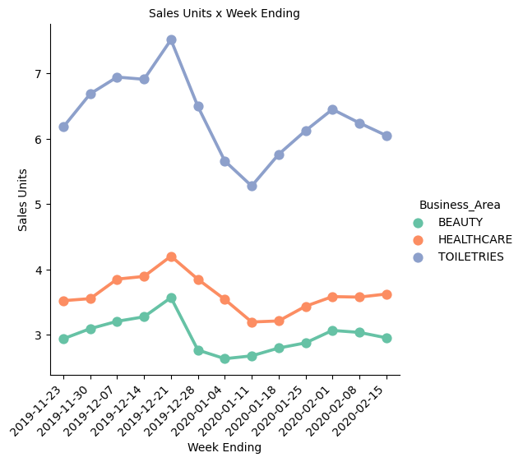
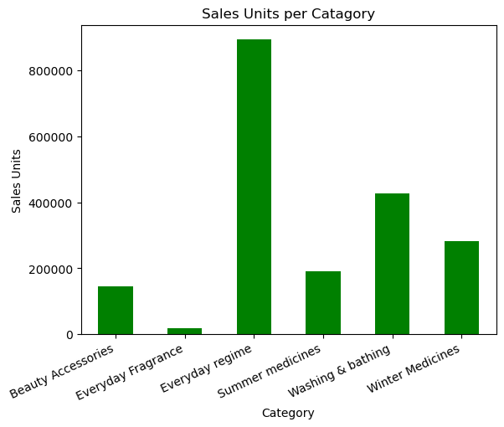
Sales Units
Units sold in Toiletries are more than double that of Beauty and Healthcare.

Slide 13
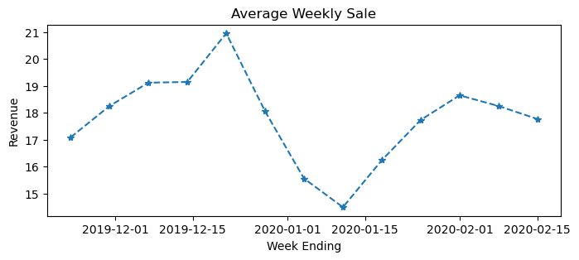
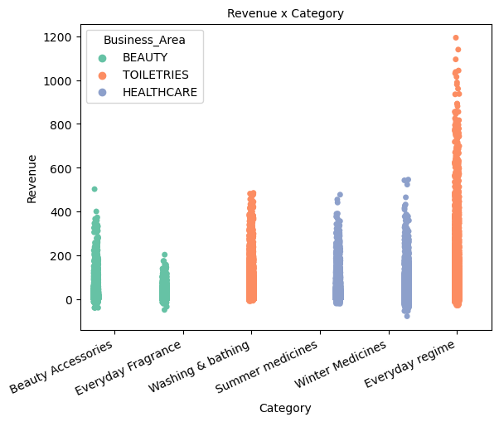
Revenue
Revenue from Toiletries is much higher than that of Beauty and Healthcare, similar to Units sold.

Slide 14
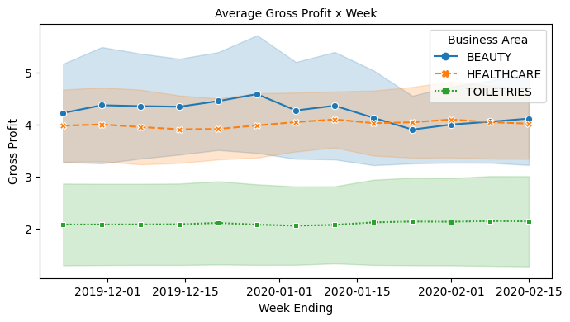
Gross Profit
Gross Profit from Beauty and Healthcare is more than 50% higher compared to Toiletries, in contradiction to Revenue and Units sold.

Slide 15
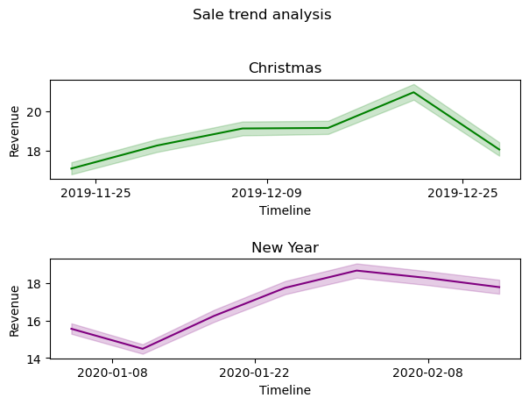
Seasonal Data
Seasonal peak during christmas months and sudden drop in New Year.
Gradual pick up later on and stays steady

Slide 16
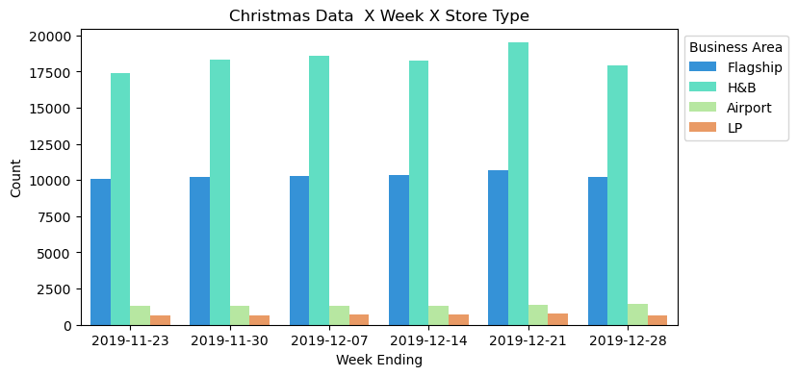
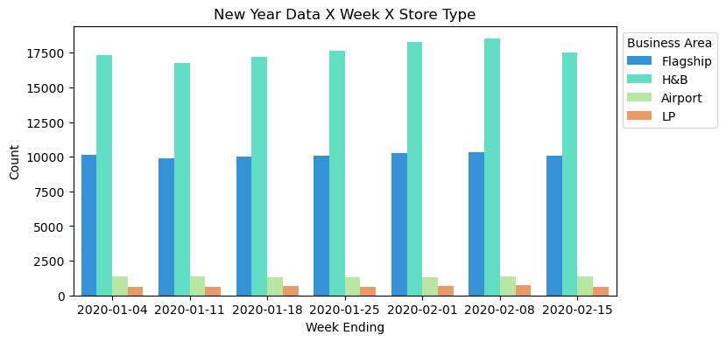
Seasonal Data
Inventory per store type
over Christmas and New Year months

Slide 17
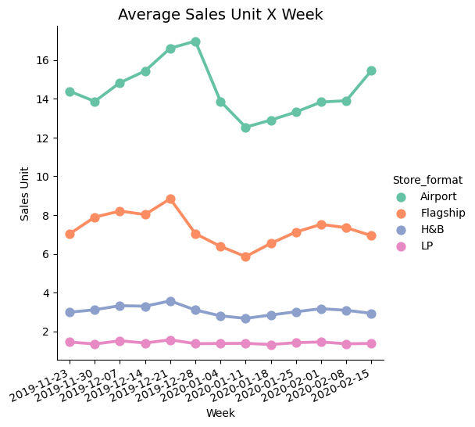
Sale Units
Sale units per week categorised per store type.
Airport has highest number of units sold, Flagship come below and shoes seasonal variation.
H&B, LP stays low and steady on units sold.

Slide 18
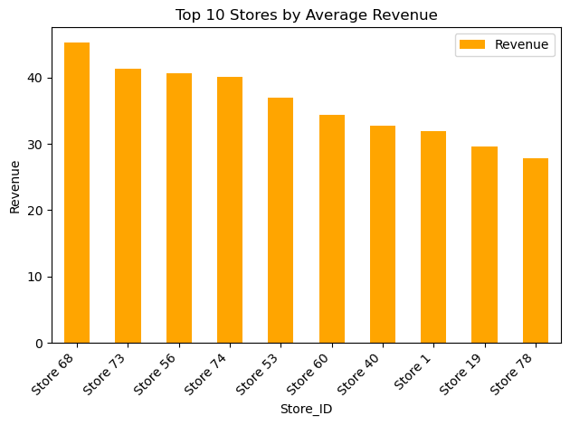
Top 10 Stores
Stores in the descending order of the revenue generated.

Slide 19
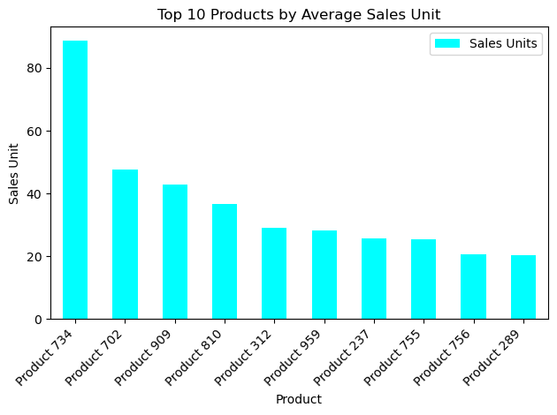
Top 10 products
sold
Products with highest no. of Sales Units all over the 80 stores.
Product 734 is the most popular product.

Slide 20
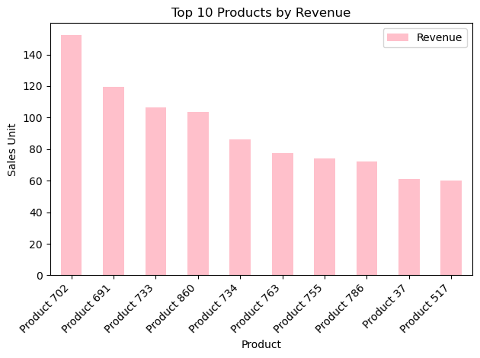
Top 10 products by revenue
Products with highest revenue in all the stores in descending order.

Slide 21
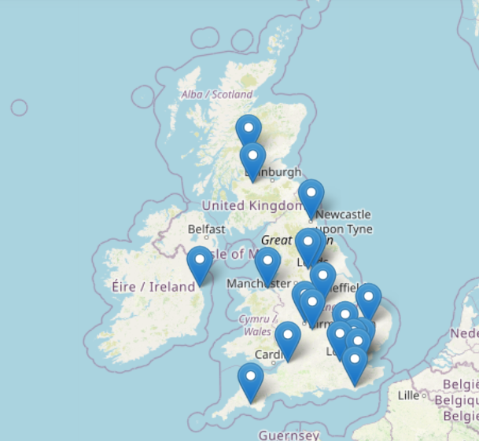
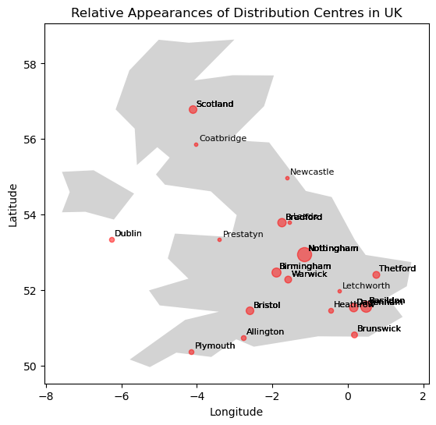
Distribution Centres in UK

Slide 22
Insights and Recommendation
Stock Level% - LP stores stock level need to be improved, to reduce holding cost, by applying discounts and promotions on low moving products.
Product Category - Promote the sale of everyday fragrance which is lowest in sale units, and has proven to be the highest profitable category. Promote sale on the same by adverts on offer and discounts.
Seasonal Trend - Average revenue generated was peaked during christmas and dropped drastically by 2nd week of Jan 2020, in Flagship and Airport stores.
While H&B, LP stores have a steady sale during the period considered.
Stockouts - 89% of products in various stores are under stock and require immediate replenishment. 9% is overstocked.

Slide 23
Conclusion
Analysis was performed prominently on grouped data such as category and Store type , could be performed on individual product or store, for detailed analysis.
Seasonal variation in sales shows peak in sale units during holiday weeks.
Hence can prepare the stock ready and frequent deliveries for this period.
Promotion and discounts on low moving products need to be applied to reduce holding cost. Plan future ordering of the products based on demand.
LP and H&B store types need to be focussed on improving sales, service and identify products of high demand.

Slide 24
Thank You

