Slide 1



SHEKHAWATI LOGISTICS
Delivering Trust Across India
FLEET OWNERS
TRANSPORT CONTRACTORS
COMMISSION AGENTS
Head Office: Bangalore, Karnataka
With Mr. K. S Shekhawat experiences in handling general cargo, heavy consignments, Over Dimensional Consignments (ODC), project cargo and specialized transportation requirements, we offer a wide range of vehicles to meet diverse customer needs.

Slide 2

Who We Are ?
Shekhawati Logistics is a premier, Bangalore-headquartered transportation and logistics company with a robust pan-India network.
We Are
Proud Fleet Owners, Transport Contractors, and Commission Agents specializing in seamless freight movement.
What We Handle
From standard Full Truck Loads (FTL) to complex Over Dimensional Cargo (ODC), leveraging our extensive fleet and deep industry expertise.
Our Promise
Strategically located branches across India guarantee rapid response, live tracking, and reliable supply chain solutions.

Slide 3







What We Offer
Full Truck Load (FTL)
Over Dimensional Cargo (ODC)
Daily services across all major routes in India.
Expert handling of heavy, over-sized, and project consignments.
Fleet & Vehicle Supply
Containerized Shipping
A wide range of vehicles from pick-ups to heavy trailers.
Secure transport via 20 FT to 32 FT containers, including SXL & MXL configurations.
Transport Contracting & Commission Agency
Live GPS Tracking
End-to-end logistics management.
100% monitored fleet for real-time visibility and safety.

Slide 4
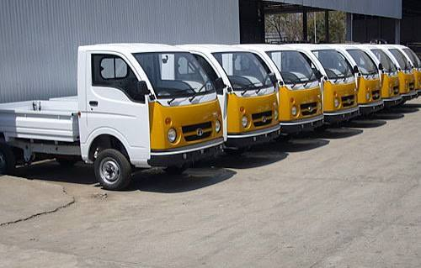
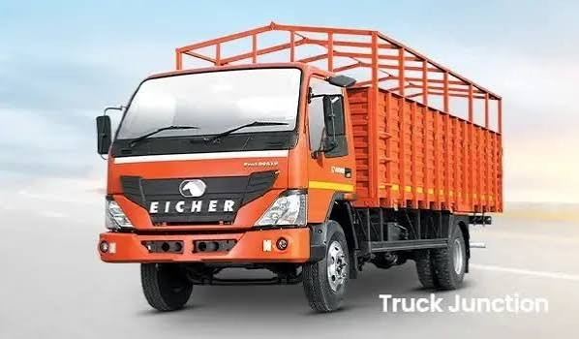
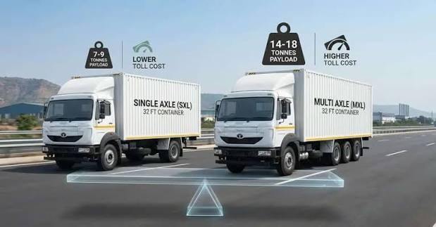
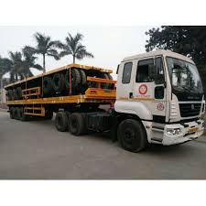
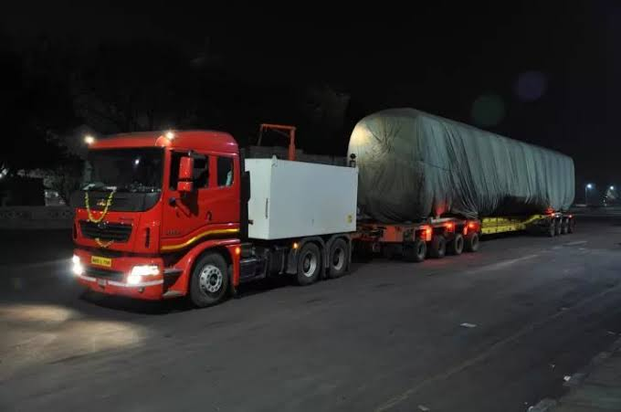
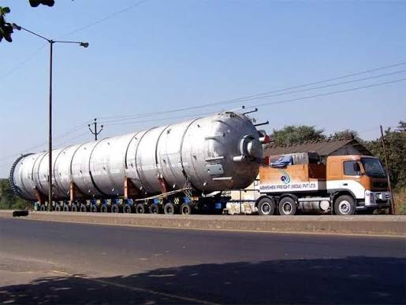
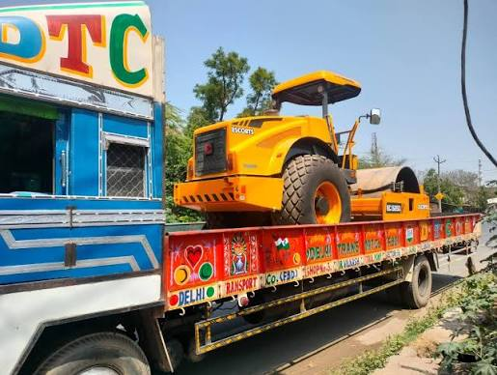
Our Fleet Strength
A comprehensive fleet engineered for every freight requirement — from last-mile delivery to heavy project cargo.
Pick-up Vehicles
19 FT Canter
Containers (20 FT – 32 FT)
40 FT Trailer
For quick local distribution and last-mile delivery.
Ideal for medium-sized loads and intercity distributions.
Standard heavy-duty haulage for bulk cargo.
SXL and MXL options for secure, weather-proof transport.
50 FT & 60 FT Trailers
Low Bed & Heavy ODC
32 FT JCB SXL & MXL Trucks
High-capacity movement for large volume consignments.
Specialized for heavy machinery, project cargo, and over-dimensional consignments.
open-body platform truck primarily used for transporting construction machinery like backhoe loaders (JCBs), excavators, and oversized cargo across India

Slide 5

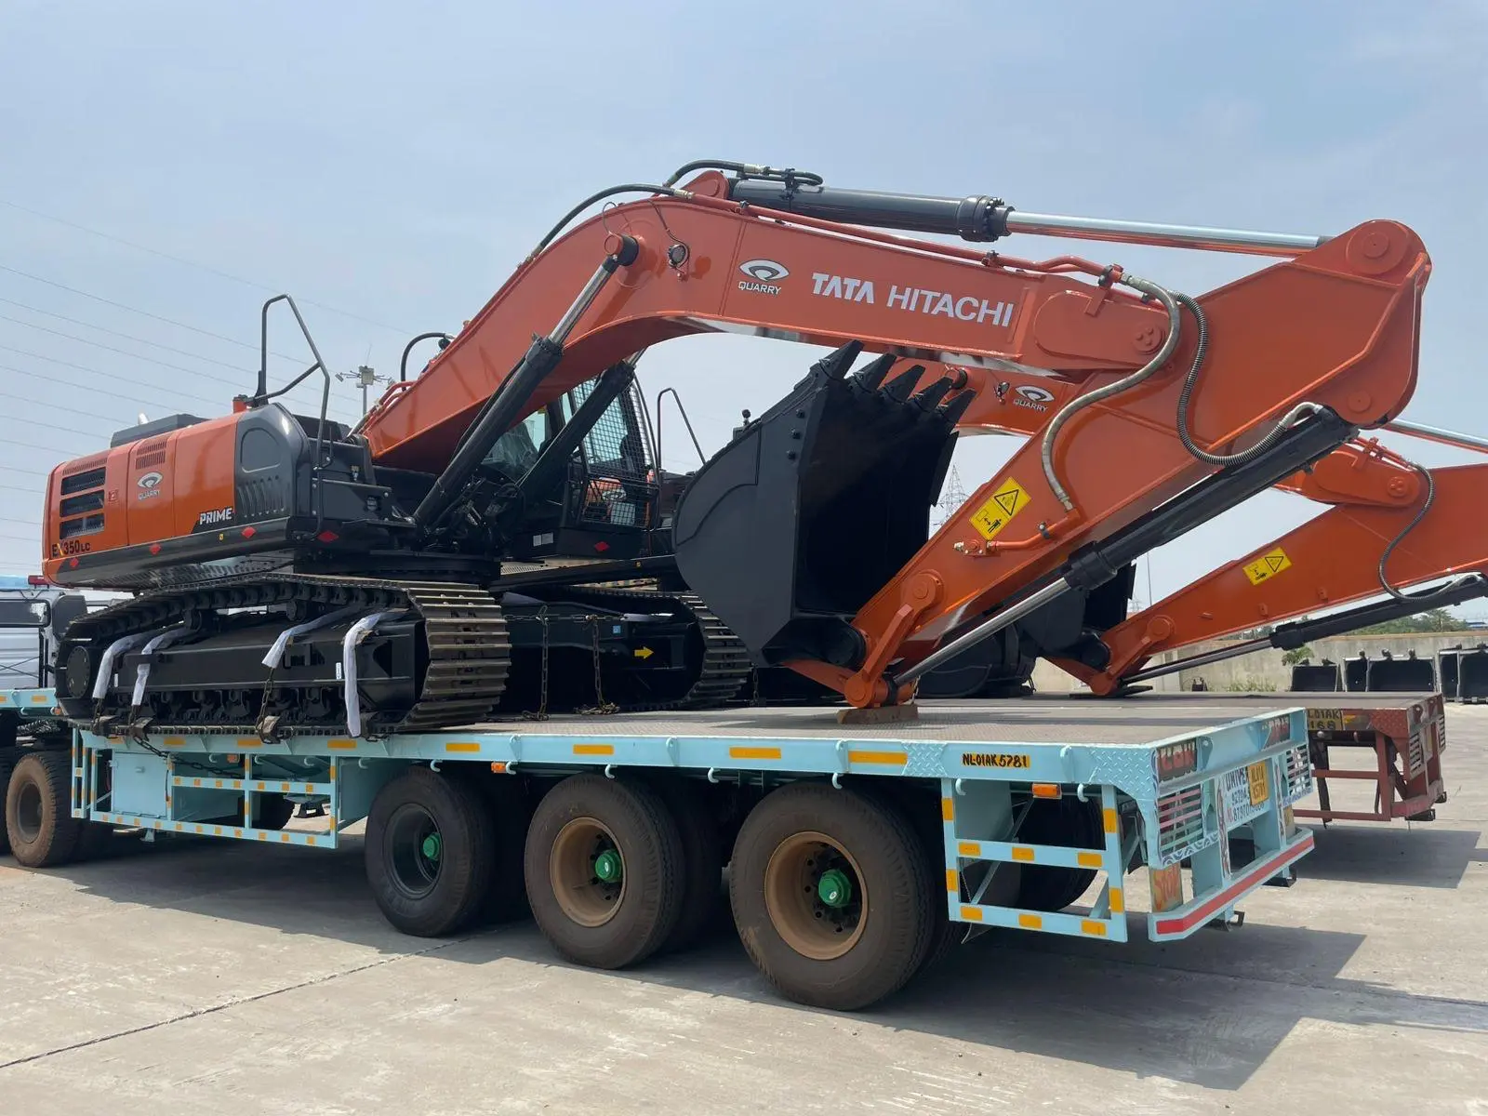
Logistics Services!
Consumer Goods & E-Commerce
We are certified with FSSAI for transporting
Foods and Consumer products. We deploy
Double-Driver and Express Delivery to meet
extremely short TAT times for our e-
Commerce customers.
Automobile Transportations
We are the pioneers in Automobile
transportation and are currently associated
with most major Auto and Earth Moving OEM’s. We
deploy skilled and trained Drivers for loading,
unloading and movement of these vehicles to
ensure 99.9+% on-time and safe deliveries.

Slide 6
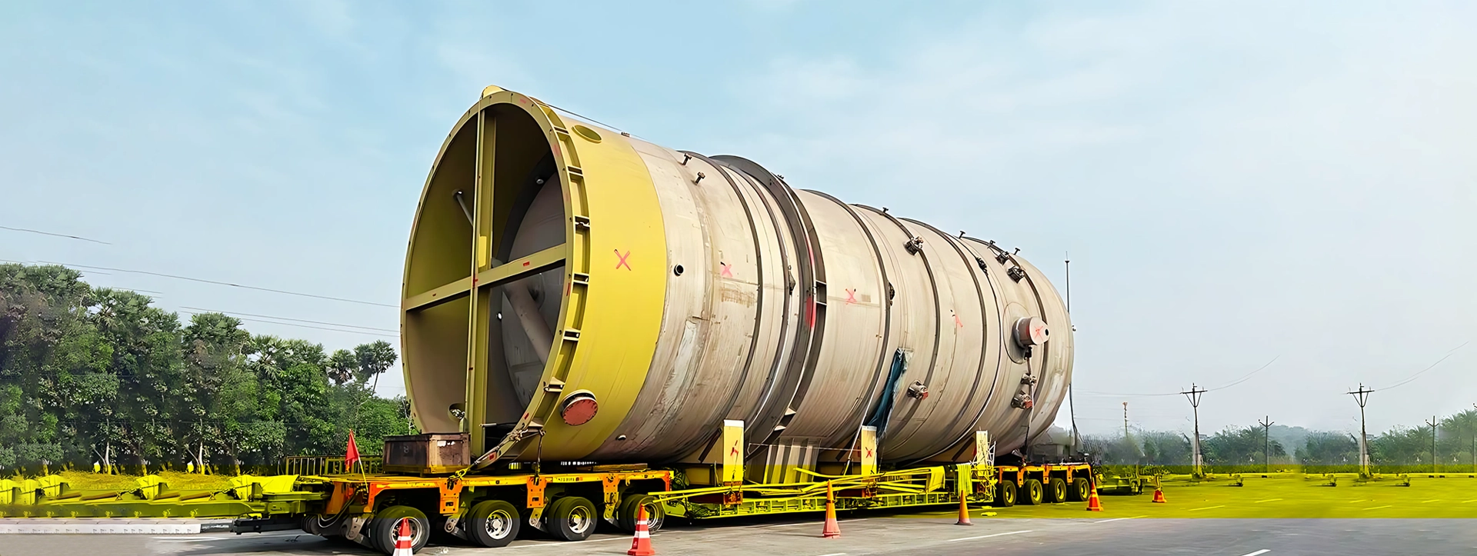
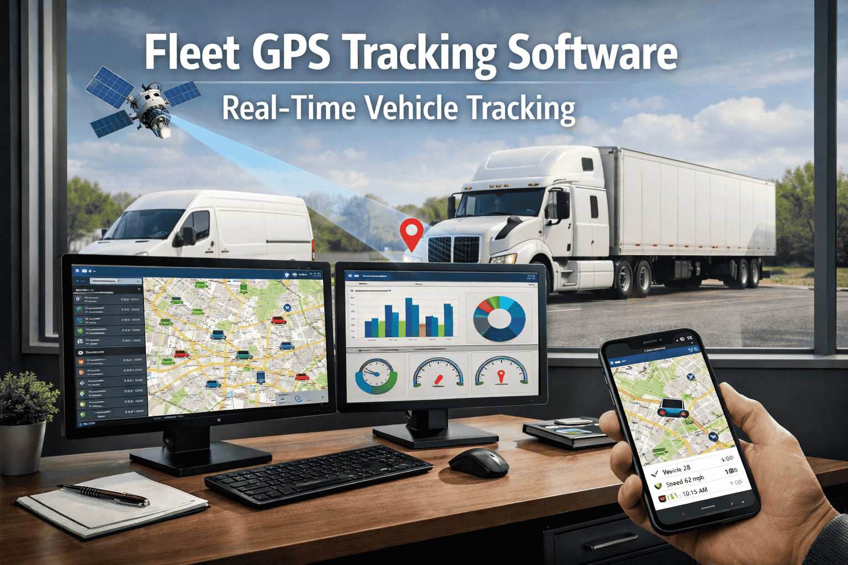
Logistics Services!
Projects & Over Dimensional Cargo
We specialize in project cargo and have
completed several projects for materials
including reactors, boilers, transformers,
wagons and heavy machinery up to remote
site-locations. We undertake the temporary
road construction and offloading these
project cargo using modern handling
equipment and skilled labour.
24x7 Logistics Control Tower
We have developed in-house LCT to meet the
requirement of our Customers and to manage
contingencies.
GPS & Tracking
All our vehicles are GPS enabled with Geo fencing,
Cloud SaaS, GPS, Analytics and alerts. The GPS
can be integrated with customers Tracking
systems using APIs. Hired vehicles can be tracked
using phone Tracking so􀅌ware.

Slide 7

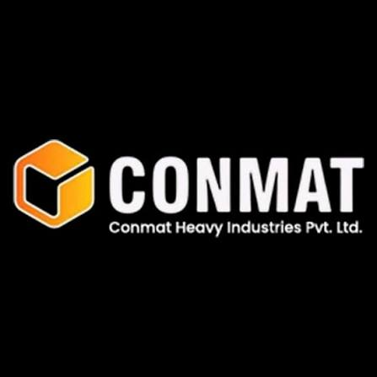













Our Valuable Clients

Slide 8
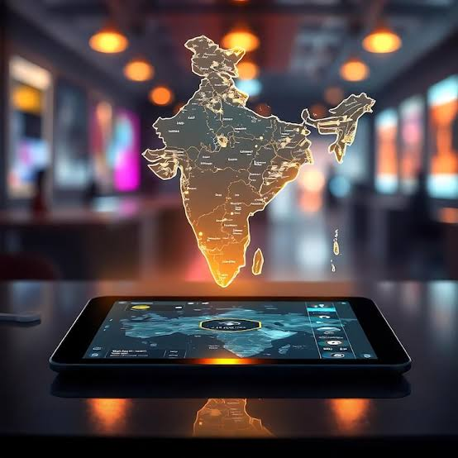


Our Presence
HEAD OFFICE
Bangalore, Karnataka
BRANCH OFFICES
Navi Mumbai
D-152, First Floor, Disma Complex, Kalamboli, Navi Mumbai – 410 218.
Vapi
305, Brahmdev Complex, 3rd Floor, opp. Brahmdev Mandir, N.H. 8, Balitha Vapi – 396 191.
Raipur
Shop No. 6, Sinha Complex, Ganpat Chowk, Ring Road No. 2, Heerapur, Raipur – 492 099 (C.G.)
Gurugram
IMT Road, Near Haryana Gramin Bank Hayatpur, Distt. Gurugram (Hr.) – 122505.
Jamshedpur
NH-33 Beside Sahara City, Near Kumrum Basti, Pardih Mango, Jamshedpur – 831 012.
Service Coverage: Gujarat, Maharashtra, M.P., Rajasthan, Chhattisgarh, Odisha, Jharkhand, Bihar, West Bengal, Assam, Mumbai & East Zone.

Slide 9

Our Presence
Serving Worldwide
BRANCH OFFICES
Chennai
Address -No-242/241,22nd Cross street, Sakthivel Nagar main road , Puzhal , Chennai -600066
Hyderabad
Plot number 6 . 2nd floor beside kar plaza muthangi village Patancheru mandal disst Sangareddy 502300 telangana.
Nagpur
Office Nishan crane Building bhawani kata kapsi bhandara road Nagpur -440008 (MH).
Madhya Pradesh
Service near Madhav Nagar Gate Jabalpur Road Katni, MP 483501.
Jamshedpur
Service Coverage: Gujarat, Maharashtra, M.P., Rajasthan, Chhattisgarh, Odisha, Jharkhand, Bihar, West Bengal, Assam, Mumbai & East Zone.

Slide 10
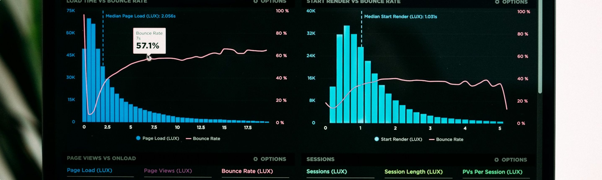

Our Strengths
Diverse Fleet
Live GPS Tracking
From small pick-up vehicles for local runs to 32 FT SXL/MXL containers, JCB SXL & MXL trucks
and heavy ODC trailers.
All vehicles equipped with live GPS, providing clients complete transparency and real-time ETA updates.
Own Fleet
ODC & Container Specialists
We are not just agents — we are fleet owners, giving you direct control over pricing and timelines.
Proven track record in handling complex over-dimensional consignments and secure containerized cargo.
Pan-India Reach
Timely Delivery
An extensive network spanning the East, West, North, and South zones of India.
A commitment to daily services and on-time dispatch — every time.

Slide 11
Get In Touch
Corporate Head Office
Branch Contacts:
Navi Mumbai – 9284956732 / 7284956732
Raipur – 7688833385 / 9079869068
Vapi - 9694254008
Gurugram – 9899580721 / 9312580721
Jamshedpur – 9334611977/ 9771234905
Chennai - 8122570776
Hyderabad - 9553015015
Nagpur – 9649325770 / 8319395095
Madhya Pradesh - 9752588725
Shekhawati Logistics
No.23, 1st Floor, Dr. Devaraj URS Truck Terminal, Dasanapura, Nelamangala,
Bangalore, Karnataka - 562162
Phone
9008898260 / 9886966001
Email
bng@shekhawatilogistics.com
shekhawatilogisticsbng@gmail.com
Thank You
Delivering Trust Across India

