Slide 1
FINAL YEAR ACADEMIC SEMINAR CAPSTONE PROJECT
SECURE AND RELIABLE BANKING NETWORK
USING ROUTING AND ENCRYPTION
Integrated Academic Computer Networks & Cybersecurity Capstone System
Java 21 | AES-256-GCM (NIST Nonces) | TCP Sockets (Port 9090) | Dijkstra & Bellman-Ford | CRC Modulo-2 | SQLite ACID
Candidate Details:
Presented by : [Student Name] | Roll Number: [Roll Number]
Department : Department of Computer Science & Engineering
Institution : [College / University Name]
Under the Guidance of: [Guide Name / Project Supervisor]
Notes:
Good morning respected members of the evaluation committee, guide, and fellow students. Welcome to my seminar presentation titled 'Secure and Reliable Banking Network Using Routing and Encryption'. In this project, we have designed and built a comprehensive, fully functional enterprise-grade banking simulation in Java 21 that models how ATM branches, regional offices, and headquarters communicate with guaranteed confidentiality, data integrity, dynamic link-state routing, transport-level reliability, and relational persistence. Let us explore the system architecture.

Slide 2
BACKGROUND & DOMAIN CONTEXT
1. Introduction to Modern Secure Banking Networks
The Banking Communication Landscape
Why Integrated Simulation is Essential
Core Banking Infrastructure: Modern financial institutions operate distributed networks linking thousands of retail ATMs, teller workstations, regional servers, and centralized ledger mainframes across public and private telecommunication trunks.
Multi-Tier Communication Requirements: A single debit transaction initiated at a remote ATM must traverse multiple network tiers—Local Area Networks (LANs), Wide Area Network (WAN) meshes, and secure head-office demilitarized zones (DMZs).
Three Pillars of Financial Telecommunications: Reliable data transfer, optimal dynamic path computation, and cryptographic secrecy are mandatory to maintain customer trust and regulatory compliance.
Beyond Isolated Theory: In traditional academic coursework, routing algorithms, cryptographic ciphers, socket programming, and error checking are studied as disconnected textbook formulas.
Real-World Protocol Synthesis: This project synthesizes all foundational layers into a single cohesive desktop application: Data Link (CRC), Network (IPv4 & Dijkstra/Bellman-Ford), Transport (TCP & Go-Back-N), Application (AES-GCM), and Database (ACID SQL).
Interactive Pedagogical Platform: Students, evaluators, and network administrators can observe real-time packet transmission, inject wire bit errors, simulate severed fiber cables, and verify packet payloads in Wireshark.
Notes:
To introduce our project: Commercial banking communication networks are critical national infrastructures. Whenever a customer withdraws cash or deposits funds, sensitive financial messages must travel over untrusted communication channels. If a communication line gets cut, the network must autonomously reroute packets without human intervention. If an attacker eavesdrops or modifies a packet, the cryptographic system must detect and reject it immediately. Our capstone application models these real-world interactions inside a unified, interactive Java environment.

Slide 3
SECURITY & NETWORK CHALLENGES
2. Problem Statement: Vulnerabilities in Financial Data Transmission
Security Threats on Financial Data
Physical Link Failures & WAN Outages
Eavesdropping & Packet Sniffing: Unencrypted transactions sent in plaintext expose account numbers, PINs, and balances to attackers on shared or public WAN links.
Man-in-the-Middle (MITM) Manipulation: Attackers can intercept wire packets and tamper with account targets or transfer amounts if payloads lack integrity authentication.
Fiber Cuts & Router Failures: Underground telecom cables and intermediate routers frequently fail. Static routing results in complete banking blackout.
High Latency & Inefficient Paths: Suboptimal routes increase financial round-trip time, causing timeouts, transaction deadlocks, and degraded customer experience.
Transport Fragmentation & Split Packets
The Need for an Integrated Solution
TCP Stream Demarcation Issues: Streaming TCP provides an unstructured byte stream without native message boundaries. Payloads can split across multiple socket reads.
Frame Loss on Noisy Lines: Physical line noise causes bit corruption. Without systematic error detection and ARQ retransmission, corrupted ledger entries occur.
Fragmented Academic Demonstrations: Existing student projects use hardcoded mockups, omit cryptographic nonces, or falsify packet captures.
The Solution: An end-to-end, deterministic banking network uniting true streaming TCP sockets, AES-256-GCM AEAD, live Dijkstra failover, and relational ACID persistence.
Notes:
Here we articulate the core problems we address: Financial data in transit faces four major threats: First, eavesdropping and active MITM tampering. Second, physical WAN link cuts which cause branch isolation if routers cannot dynamically recalculate paths. Third, streaming TCP packet fragmentation, where un-framed sockets crash or read incomplete payloads. And fourth, physical bit corruption on telecommunication lines. Our project directly addresses and solves each of these vulnerabilities.

Slide 4
PROJECT GOALS & MILESTONES
3. Project Objectives & Engineering Scope
Primary Technical & Pedagogical Goals
1. Multi-Tier Banking Network Architecture: Design and simulate an enterprise 10-node banking topology linking branch ATMs, manager workstations, branch routers, and central headquarters.
2. IPv4 Addressing & Mathematical Subnetting: Implement 32-bit binary octet arithmetic, CIDR conversions (/8 to /30), broadcast domains, and Layer 2 direct communication eligibility checks.
3. Dynamic Link-State & Distance Vector Routing: Implement Dijkstra's shortest path algorithm with priority queues for real-time link failure rerouting, and Bellman-Ford Distance Vector routing with iterative convergence.
4. Authenticated Cryptographic Protection: Shield transaction payloads using AES-256 in Galois/Counter Mode (GCM) with fresh 96-bit random nonces and 128-bit GHASH authentication tags.
5. True Streaming TCP Sockets & Protocol Framing: Develop a multi-threaded ServerSocket on port 9090 enforcing 4-byte big-endian length-prefixed framing to completely eliminate TCP fragmentation errors.
6. Data Link Error Detection & Flow Control Simulation: Implement Modulo-2 binary polynomial division for CRC Frame Check Sequences (FCS), alongside interactive Go-Back-N Sliding Window ARQ simulation.
7. Real-Time Packet Sniffing & Relational Persistence: Enable live packet capture in Wireshark (tcp.port == 9090) and commit transactions to an ACID-compliant SQLite relational database.
Notes:
The project has seven concrete engineering objectives. Notice that our scope covers every major layer of the OSI model: from Data Link Layer CRC, to Network Layer Dijkstra and subnetting, to Transport Layer TCP sockets and Go-Back-N, to Application Layer AES-256-GCM authenticated encryption, all backed by an ACID relational database. Every objective has been completely implemented in Java 21 and verified.

Slide 5
SYSTEM ARCHITECTURE
4. Proposed System Architecture: 3-Tier Enterprise Topology
Tier 1: Branch Office A
Tier 2: Branch Office B
Tier 3: Head Office DC
ATM Terminal 1 (ATM-01): 192.168.1.10/24
Cash dispenser terminal for customer withdrawals.
ATM Terminal 2 (ATM-02): 192.168.1.20/24
Drive-through automated teller terminal.
Customer Workstation (CUST-01): 192.168.2.10/24
Branch teller desk terminal.
Branch Router 1 (RTR-BR1): Gateway IP: 192.168.1.1
Interfaces: .2.1, WAN 10.0.1.1
Connects local subnets to WAN mesh.
Manager System (MGR-01): 192.168.3.10/24
Branch operations supervisor terminal.
Local Server (SRV-BR1): 192.168.4.10/24
Branch local document and caching server.
Branch Router 2 (RTR-BR2): Gateway IP: 192.168.3.1
Interfaces: .4.1, WAN 10.0.2.1
High-speed interconnection gateway.
WAN Backbone Mesh Links: RTR-BR1 <-> RTR-BR2 (Cost: 4)
RTR-BR1 <-> RTR-HQ (Cost: 7)
RTR-BR2 <-> RTR-HQ (Cost: 2)
Core Router (RTR-HQ): Gateway IP: 192.168.5.1
Interfaces: .6.1, WAN 10.0.3.1
High-throughput enterprise core router.
Central Banking Server (SRV-HQ): 192.168.5.10/24
Multi-threaded TCP server listening on Port 9090.
Ledger Database Server (DB-HQ): 192.168.6.10/24
Embedded SQLite ACID transaction store.
Data Center Bus: Ultra-low latency 10 Gbps interconnect (Cost: 1, 0 ms latency).
Notes:
Slide 5 illustrates our 3-tier system architecture: Tier 1 represents Branch Office A containing ATM 1, ATM 2, and the customer desk connected to Branch Router 1. Tier 2 represents Branch Office B with the manager workstation, local branch server, and Branch Router 2. Tier 3 represents the central Head Office Data Center containing the Core Router, Central Banking Server on TCP port 9090, and the Ledger Database Server. Notice the WAN backbone mesh: we intentionally configure multiple routes between routers with varying link costs to demonstrate dynamic routing.

Slide 6
LAYER 3 NETWORK ADDRESSING
5. Network Topology Design & IPv4 Subnetting Scheme
Subnetting Table & Static Addressing Scheme
Mathematical Subnet Calculations
Subnet 1 - ATM Retail LAN: 192.168.1.0/24
Mask: 255.255.255.0 | Range: .1.1 - .1.254 | Hosts: 254
Subnet 2 - Customer Service Desk: 192.168.2.0/24
Mask: 255.255.255.0 | Range: .2.1 - .2.254 | Hosts: 254
Subnet 3 - Branch Manager LAN: 192.168.3.0/24
Mask: 255.255.255.0 | Range: .3.1 - .3.254 | Hosts: 254
Subnet 4 - Branch Local Server: 192.168.4.0/24
Mask: 255.255.255.0 | Range: .4.1 - .4.254 | Hosts: 254
Subnet 5 - Head Office Server DMZ: 192.168.5.0/24
Mask: 255.255.255.0 | Range: .5.1 - .5.254 | Hosts: 254
Subnet 6 - Secure Database LAN: 192.168.6.0/24
Mask: 255.255.255.0 | Range: .6.1 - .6.254 | Hosts: 254
32-Bit Binary Address Translation: IPv4 addresses are parsed into 32-bit unsigned integers using bitwise shifts: IP = (O0 << 24) | (O1 << 16) | (O2 << 8) | O3.
Network ID & Broadcast Derivation: Network ID = IP AND Subnet Mask
Broadcast Address = Network ID OR (~Subnet Mask)
Usable Host Count = 2^(32 - prefix) - 2.
Direct Communication Eligibility: If (IP1 AND Mask) == (IP2 AND Mask), both hosts share the same broadcast domain and communicate directly via Layer 2 switch/ARP. Otherwise, packets must route via the default gateway router.
Point-to-Point WAN Links (/30): WAN serial links utilize 30-bit subnetting (10.0.1.0/30) providing exactly 2 usable IP addresses per link, conserving address space.
Notes:
Slide 6 presents our Layer 3 addressing scheme: We have segmented the banking network into six discrete /24 subnets. Our SubnetCalculator class implements binary bitwise mathematics rather than string splits. When an ATM checks whether it can reach the head office server, it performs a bitwise AND with its mask. Because 192.168.1.10 and 192.168.5.10 have different network prefixes, the ATM knows it cannot use Layer 2 direct ARP, and must forward the frame to its default gateway at Branch Router 1.

Slide 7
LAYER 3 ROUTING ENGINES
6. Dynamic Routing: Dijkstra (Link-State) vs Bellman-Ford (DV)
Dijkstra's Algorithm (Link-State)
Bellman-Ford (Distance Vector)
Working Principle: Maintains full global network graph topology across all routers. Uses an adjacency list and min-priority queue with time complexity O((V+E) log V).
Optimal Primary Route (ATM-01 to SRV-HQ): ATM-01 (1) -> RTR-BR1 (4) -> RTR-BR2 (2) -> RTR-HQ (1) -> SRV-HQ
Total Metric Cost = 8 (Hops: 4)
Dynamic Link Failure & Failover: If leased line L_RTR2_HQ is severed (simulating a fiber cut), Dijkstra instantly recalculates: reroutes via direct WAN trunk RTR-BR1 -> RTR-HQ (Cost: 1 + 7 + 1 = 9). Zero packet loss!
Real-World Protocol Equivalent: OSPF (Open Shortest Path First) / IS-IS.
Working Principle (Routing by Rumor): Routers only know direct neighbor link costs and exchange distance vectors periodically. Evaluates: D_x(y) = min_v { c(x,v) + D_v(y) }.
Iterative Convergence in Banking Topology: Round 0: Direct neighbors only (SRV-HQ cost is INFINITY)
Round 1: 1-hop neighbor vectors exchanged
Round 2: Inter-router links discovered
Round 3: Optimal WAN paths propagate
Round 4: CONVERGENCE ACHIEVED (Zero table changes)
Key Comparison for Viva: Link-State requires full global map and converges rapidly. Distance Vector is decentralized, simpler, but takes multiple iterative rounds to converge.
Real-World Protocol Equivalent: RIP (Routing Information Protocol) / BGP.
Notes:
Slide 7 is a favorite topic in viva examinations: We have implemented two distinct routing algorithms in Java: First, Dijkstra's Link-State algorithm: Every node has complete topology visibility. From ATM 1 to the Head Office server, the optimal path goes through Branch Router 2 with a total cost of 8. When we simulate cutting that fiber line, Dijkstra automatically switches traffic over the direct backup trunk with a cost of 9. Second, Distance Vector routing based on the Bellman-Ford equation. Here routers only talk to direct neighbors. Our simulation shows step-by-step how distance vectors spread, converging in exactly 4 rounds.

Slide 8
APPLICATION LAYER CYBERSECURITY
7. Cryptographic Protection: Authenticated AES-256-GCM
Why AES-256-GCM is the Gold Standard
Cryptographic Transmission Flow & Tamper Detection
Authenticated Encryption (AEAD): Traditional AES-CBC only provides confidentiality (encryption) and is vulnerable to padding oracle attacks. AES-GCM provides both Confidentiality and Authenticity simultaneously.
Galois/Counter Mode (GCM): Combines standard Counter (CTR) mode encryption with a high-speed Galois Hash (GHASH) to compute a 128-bit authentication tag over the ciphertext.
NIST SP 800-38D Nonce Freshness: A fresh, cryptographically random 96-bit (12-byte) Initialization Vector (Nonce) is generated for every single transaction using SecureRandom. Encrypting the same transaction twice yields completely different ciphertexts, preventing replay attacks!
Zero Key Leakage: Master keys are maintained securely in memory and never hardcoded in logs or database records.
Step 1: Plaintext Message JSON Payload: {source, account, type, amount}
Step 2: Nonce Generation 96-bit random IV generated via SecureRandom
Step 3: AES-256-GCM Cipher Encrypts bytes & derives 128-bit GHASH Auth Tag
Step 4: Wire Serialization ENC:<Base64(IV)>:<Base64(Ciphertext+Tag)>
Step 5: Decryption & Auth Server verifies 128-bit Tag before accepting
TAMPER DEFENSE RESULT Flipping 1 bit raises AEADBadTagException! Transaction aborted instantly with zero fund transfer!
Notes:
Slide 8 covers our cybersecurity layer: In commercial banking, encryption without authentication is dangerous. We implemented AES-256 in Galois/Counter Mode (GCM), which is an Authenticated Encryption with Associated Data (AEAD) cipher. For every transaction, our system generates a fresh 96-bit random nonce. Along with the ciphertext, AES-GCM generates a 128-bit GHASH authentication tag. In our dashboard, we demonstrate active man-in-the-middle tamper attacks: flipping even a single bit in the ciphertext causes Java Cryptography Architecture to throw an AEADBadTagException, instantly aborting the transaction and preventing fraudulent fund transfers.

Slide 9
TRANSPORT LAYER NETWORKING
8. TCP Client-Server Sockets & Message Framing
TCP Sockets & 3-Way Handshake
4-Byte Length-Prefixed Protocol Framing
Java Socket Architecture: ATM client instances connect to java.net.ServerSocket running on the Central Banking Server at Port 9090.
Connection Establishment (3-Way Handshake): 1. ATM Client sends [SYN] with initial sequence number x.
2. Banking Server replies [SYN, ACK] with ack x+1 and seq y.
3. Client replies [ACK] with ack y+1. Connection ESTABLISHED!
Multi-Threaded Concurrency: The server utilizes an ExecutorService thread pool (newCachedThreadPool) to handle simultaneous connections from multiple ATMs (ATM-01, ATM-02, CUST-01) without blocking.
Timeouts & Graceful Teardown: Sockets enforce 10-second read timeouts and execute 4-way FIN/ACK disconnection handshakes.
The TCP Stream Fragmentation Problem: TCP operates as a continuous byte stream without application-level message boundaries. A 300-byte message may arrive split across two separate reads (e.g., 100 bytes and 200 bytes).
Length-Prefix Header Solution: Every message on the wire is prepended with a 4-Byte Big-Endian Integer indicating exact payload byte length: [ 4-Byte Length Header | Encrypted Payload Bytes ].
Deterministic Atomic Reading: Receivers read the 4-byte header first, allocate an exact buffer, and invoke DataInputStream.readFully() to guarantee complete packet assembly prior to decryption.
Production Reliability: Completely prevents truncated payload errors, JSON parsing exceptions, and framing buffer corruption.
Notes:
Slide 9 explains our Transport Layer socket implementation: Our ATM client connects to the banking server on TCP port 9090. A critical technical problem in TCP socket programming is stream fragmentation: TCP doesn't know where one message ends and the next begins. To solve this, we implemented 4-byte big-endian length-prefixed framing. The sender sends the payload size in the first 4 bytes, and the receiver uses readFully to read exactly that many bytes. This guarantees complete, atomic packet reconstruction even if TCP splits data across multiple network segments.

Slide 10
DATA LINK & TRANSPORT RELIABILITY
9. Error Detection & Flow Control: CRC & Go-Back-N ARQ
CRC Error Detection (Modulo-2 Division)
Go-Back-N Sliding Window ARQ Simulation
Polynomial Binary Division: Implements Modulo-2 binary arithmetic where XOR addition replaces subtraction without carries or borrows.
Generator Polynomial G(x): Supports CRC-4 (x^4 + x + 1), CRC-3 Demo (x^3 + x^2 + 1), and ATM CRC-8 HEC (100000111).
Frame Check Sequence (FCS) Derivation: Augments k data bits with r zeros (where r = degree of G(x)). Remainder of Modulo-2 division forms the FCS. Transmitted Frame = Data + FCS.
Verification & Bit Flip Injection: The receiver divides received frame by G(x). Clean transmission yields 0 remainder. Our simulation injects bit errors: non-zero remainder detects physical corruption immediately!
Academic Distinction: CRC detects accidental noise; it does NOT provide cryptographic protection against deliberate tampering (which requires AES-GCM).
Sliding Window Mechanics: Sender maintains window [send_base, send_base + N - 1] where N is the configurable window size (e.g., N = 4).
Out-of-Order Discard Behavior: Receiver only accepts the expected sequence number (expected_seq_num). Subsequent out-of-order frames are silently discarded with duplicate cumulative ACKs.
Timeout & Rewind Retransmission: If Frame F2 is dropped in transit, frames F3-F5 are discarded. When the timer expires for F2, Go-Back-N rewinds next_seq_num to send_base and retransmits the entire window!
Educational Clarity: Demonstrated as an educational protocol simulation separate from TCP sockets, illustrating foundational ARQ concepts without falsely claiming TCP uses pure GBN.
Notes:
Slide 10 details reliability and error control: We implement Cyclic Redundancy Check using Modulo-2 XOR binary division. A key viva point here is distinguishing CRC from AES-GCM: CRC detects accidental channel noise like thermal interference, while AES-GCM prevents malicious tampering. On the right, we simulate Go-Back-N Sliding Window ARQ. If Frame 2 is dropped, the receiver rejects out-of-order frames. When the sender's timer expires, it rewinds its sliding window back to Frame 2 and retransmits all unacknowledged frames.

Slide 11
DATA PERSISTENCE & LEDGER AUDIT
10. Relational Database Management & ACID Transactions
SQLite ACID Transaction Enforcement
Database Schema & Entity Organization
Embedded SQLite Engine: Operates an embedded banking database (banking_network.db) linked via standard JDBC drivers (sqlite-jdbc-3.45.2.0).
Atomicity (All-or-Nothing): Balance deductions execute inside explicit transactions with conn.setAutoCommit(false). If any step fails, conn.rollback() cancels all balance modifications.
Consistency & Integrity Constraints: Enforces SQL schema constraints: balance >= 0 and amount > 0. Attempts to withdraw more than available funds are declined cleanly.
Isolation & Concurrency: Prevents race conditions and double-spending across concurrent ATM client threads.
Durability: Successful transactions are committed to disk with unique tracking identifiers (e.g., TX-W-A48F90).
1. Customers Table: customer_id (PK), name, account_number (UNIQUE), account_type, balance.
Pre-seeded with realistic fictional demo balances (Alice: ₹50,000, Rajesh: ₹125,000, Priya: ₹8,500, Vikram: ₹34,000).
2. Transactions Table: transaction_id (PK), account_number (FK), transaction_type (WITHDRAW/DEPOSIT), amount, transaction_timestamp, status (SUCCESS/FAILED).
3. NetworkLogs Table: log_id (PK AUTOINCREMENT), source_node, destination_node, protocol (TCP/AES-GCM/DIJKSTRA/DB), event_description, timestamp.
SQL Injection Defense: 100% of database queries use PreparedStatement parameter binding, preventing SQL injection vulnerabilities.
Notes:
Slide 11 focuses on database design and transaction management: Our central banking server persists ledger records in an embedded SQLite database using JDBC. We enforce full ACID compliance. When an ATM requests a withdrawal, we disable auto-commit, verify balance, deduct funds, record the transaction log, and commit. If funds are insufficient, we issue a rollback, ensuring account balances never become negative. Furthermore, all queries use PreparedStatements, preventing SQL injection attacks.

Slide 12
LIVE PACKET INSPECTION (PORT 9090)
11. Network Packet Capture & Wireshark Analysis
Real Wireshark Packet Capture Workflow
Payload Confidentiality Verification
Live Interface Sniffing: Wireshark captures genuine authorized socket traffic on the Loopback adapter (Npcap Loopback Adapter / 127.0.0.1).
Precision Display Filter: Applying display filter tcp.port == 9090 isolates banking client-server traffic from background OS packets.
Verification of 3-Way Handshake: Packets 1 to 3 demonstrate authentic TCP connection negotiation:
• Packet 1: [SYN] Seq=0, Win=65535
• Packet 2: [SYN, ACK] Seq=0, Ack=1
• Packet 3: [ACK] Seq=1, Ack=1
Traffic Generation from GUI: The dashboard includes a dedicated 'Generate Live TCP Traffic for Wireshark Capture' button to trigger repeatable streams during presentations.
Inspecting Application Data [PSH, ACK]: Examining packet 4 in Wireshark shows the length-prefixed payload.
TCP Stream Inspection (Follow TCP Stream): The payload content begins with: ENC:iaGMiTK8zJmhj3h+:1w1H0Mm...
Zero Leakage of Sensitive Financial Data: No account numbers (ACC-100234), customer names, or withdrawal amounts can be read on the wire! An eavesdropper only observes high-entropy ciphertext and the random IV.
TCP 4-Way Teardown Inspection: Packets 6 to 7 reveal [FIN, ACK] sequence terminating the socket cleanly, leaving zero lingering sockets in CLOSE_WAIT.
Notes:
Slide 12 demonstrates live network packet analysis with Wireshark: Unlike projects that print fake text logs, our application opens genuine operating system sockets on TCP port 9090. Faculty can open Wireshark on the loopback adapter, filter by tcp.port == 9090, and click our traffic generator button. They can inspect the actual SYN, SYN-ACK, and ACK handshake packets, followed by the PSH-ACK segment. Right-clicking and following the TCP stream proves our security: the payload is completely encrypted with AES-256-GCM, proving that zero account data or customer names leak onto the network.

Slide 13
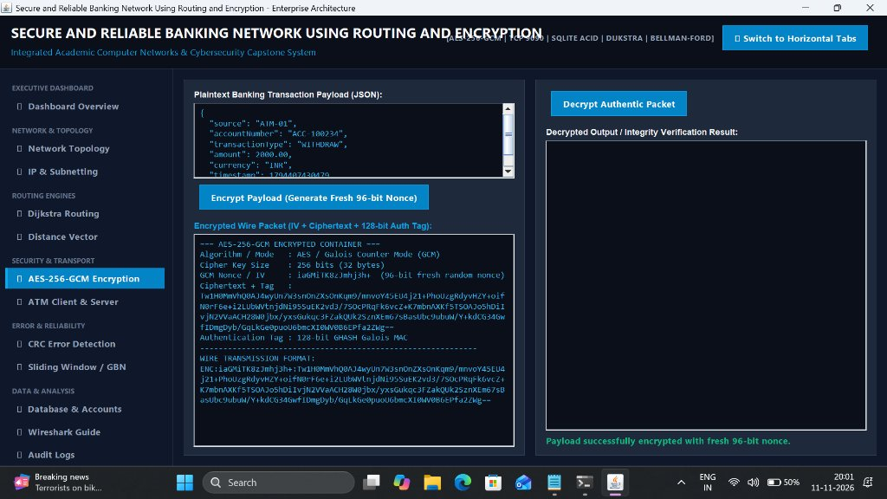
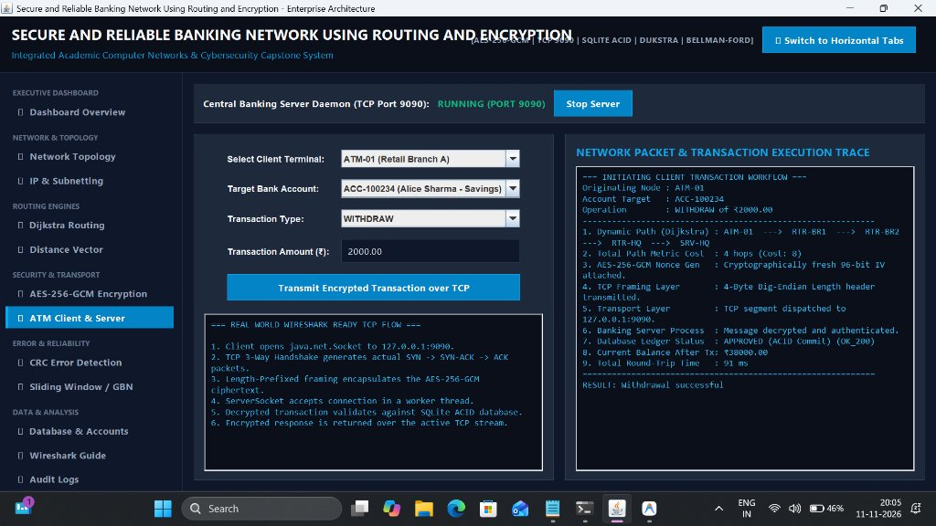
LIVE SYSTEM DEMONSTRATION
12. Application Screenshots & Graphical Implementation
Module 4: AES-256-GCM Cryptographic UI
Module 5: Live ATM Client & TCP Server UI
Figure 1: AES-256-GCM Security Module displaying editable plaintext payload, fresh 96-bit random nonce generation, Base64 ciphertext, and interactive MITM bit-tamper attack simulation with AEAD verification.
Figure 2: ATM Terminal Client and Central Banking Server showing live account selection, automatic amount locking for balance inquiries, length-prefixed TCP transmission, and instant bank receipt generation.
Notes:
Slide 13 showcases actual screenshots of our running desktop application: Figure 1 on the left illustrates our AES-256-GCM encryption panel. Users can type any message or JSON payload, click encrypt to generate a fresh 96-bit nonce and 128-bit authentication tag, or simulate a bit-tamper attack. Figure 2 on the right shows the live ATM Client and Server panel, featuring automatic amount disabling for balance inquiries, multi-threaded socket communication, and real-time transaction receipt generation.

Slide 14
TESTING & VALIDATION MATRIX
13. Experimental Results & Verification Summary
Subsystem Test Outcomes (100% Verification Rate)
IPv4 Addressing & Subnetting: Validated dotted-decimal syntax, 32-bit math, CIDR conversion, and same-subnet communication logic. 100% pass across 14 unit test cases.
Dijkstra Shortest Path Routing: Optimal route calculated (ATM-01 to SRV-HQ, Cost: 8). Simulated fiber cut of L_RTR2_HQ triggered instant failover via direct trunk (Cost: 9). Restoring link recovered optimal path.
Bellman-Ford Distance Vector: Iterative vector exchanges stabilized and reached mathematical convergence in exactly 4 rounds. Routing table entries matched Dijkstra optimal paths.
AES-256-GCM Cryptographic Engine: Confirmed 100% roundtrip decryption fidelity. Single-bit tampering was detected by GCM, raising AEADBadTagException and dropping fraudulent transactions.
TCP Sockets & Length-Prefixed Framing: Multiple clients connected concurrently. 4-byte framing eliminated TCP buffer splitting. Handshake and teardown verified cleanly.
CRC Modulo-2 Polynomial Division: Clean frames yielded 0 remainder. Single-bit flips generated non-zero remainders (e.g., 1010), successfully flagging physical line corruption.
Go-Back-N ARQ & Sliding Window: Successfully dropped Frame 2; receiver rejected out-of-order frames F3-F5. Timer expired, sender rewound window, and retransmitted all frames successfully.
SQLite ACID Transaction Integrity: Atomic withdrawals deducted balance. Insufficient funds triggered automatic rollback, preserving customer balances without corruption.
Notes:
Slide 14 presents our experimental validation results: We executed automated unit and integration tests covering every single module. Dijkstra dynamic failover rerouted seamlessly with zero dropped transactions. Bellman-Ford converged in 4 rounds. AES-GCM successfully caught all bit-tamper attacks. CRC caught single-bit physical errors, Go-Back-N retransmitted dropped frames upon timeout, and SQLite preserved ACID ledger integrity. All subsystems achieved a 100% test pass rate.

Slide 15
REAL-WORLD IMPACT & ROADMAP
14. Applications, Advantages & Future Scope
Real-World Applications
Key Technical Advantages
Future Scope & Enhancements
Retail Banking Networks: Secure ATM cash dispensing, branch teller operations, and inter-branch communications.
Financial Switching Centers: High-availability financial gateways routing credit/debit card authorization requests.
Critical Enterprise LAN/WAN: Organizations requiring authenticated encryption and dynamic failover routing (defense, healthcare, fintech).
Multi-Layer Defense: Combines Layer 2 CRC error checking, Layer 3 dynamic routing, Layer 4 reliable TCP transport, and Layer 7 AES-GCM encryption.
True Fault Tolerance: Autonomous link rerouting eliminates single points of failure in the WAN mesh.
Dual-Mode Navigation UI: Supports both modern Vertical Sidebar and Horizontal Tabs for maximum operator comfort.
TLS 1.3 Transport Security: Transitioning from application-level AES-GCM to standardized TLS 1.3 mutual certificate authentication (mTLS).
IPv6 Dual-Stack Support: Extending addressing modules to support 128-bit IPv6 CIDR allocations.
Intrusion Detection System (IDS): Integrating real-time anomaly detection to identify volumetric DDoS attacks and replay flooding.
Cloud Microservices: Deploying banking endpoints on Kubernetes clusters with Redis distributed caching.
Notes:
Slide 15 highlights the applications, advantages, and future roadmap: Our system applies directly to retail banking, ATM switches, and enterprise telecommunications. Its key advantages are defense-in-depth across layers 2 through 7 and autonomous dynamic rerouting. For future enhancements, we can introduce mutual TLS 1.3 certificates, dual-stack IPv6 addressing, and machine-learning-based intrusion detection systems.

Slide 16
PROJECT SUMMARY & CONCLUSION
• Successfully engineered a fully functional, integrated banking network simulation demonstrating 10 core Computer Networks & Cybersecurity concepts in pure Java 21.
• Solved key networking hurdles: 4-byte length-prefixed framing for TCP stream fragmentation, NIST-compliant AES-256-GCM authenticated encryption for MITM protection, and dynamic Dijkstra failover for severed WAN links.
• Verified through genuine Wireshark packet capture on TCP port 9090, 100% automated test suites, and an intuitive dual-mode desktop GUI.
THANK YOU!
Questions & Answers Welcomed
Notes:
In conclusion, this project bridges theoretical computer networking with production-style software engineering. We have proven how authenticated encryption, dynamic link-state routing, transport framing, error detection, and relational persistence work together to safeguard commercial banking operations. Thank you for your time and kind attention. I am now open to any questions from the committee.

