Slide 1

Variables in Java
Clean, visual and exam-ready notes
A variable is a named storage location used to store data during program execution.
Meaning
Syntax
Data Types
Scope
Examples
Java Programming • Variables
Neat & Clean Presentation

Slide 2

JAVA VARIABLES • 02
Presentation Roadmap
What you will learn
1
What is a variable?
2
Declaration & initialization
3
Primitive and non-primitive data types
4
Local, instance and static variables
5
Scope, constants and common mistakes
Java Programming • Variables
Neat & Clean Presentation

Slide 3

JAVA VARIABLES • 03
Core Concept
What is a Variable?
• A named memory location.
• Stores one value at a time.
• Value can be changed later.
• Each variable has a data type.
int age = 20;
String name = "Raj";
boolean passed = true;
Java Programming • Variables
Neat & Clean Presentation

Slide 4

JAVA VARIABLES • 04
Declaration Syntax
How to create a variable
Syntax Pattern
dataType variableName = value;
dataType
type of value
variableName
memory box name
value
data stored
;
statement end
Java Programming • Variables
Neat & Clean Presentation

Slide 5
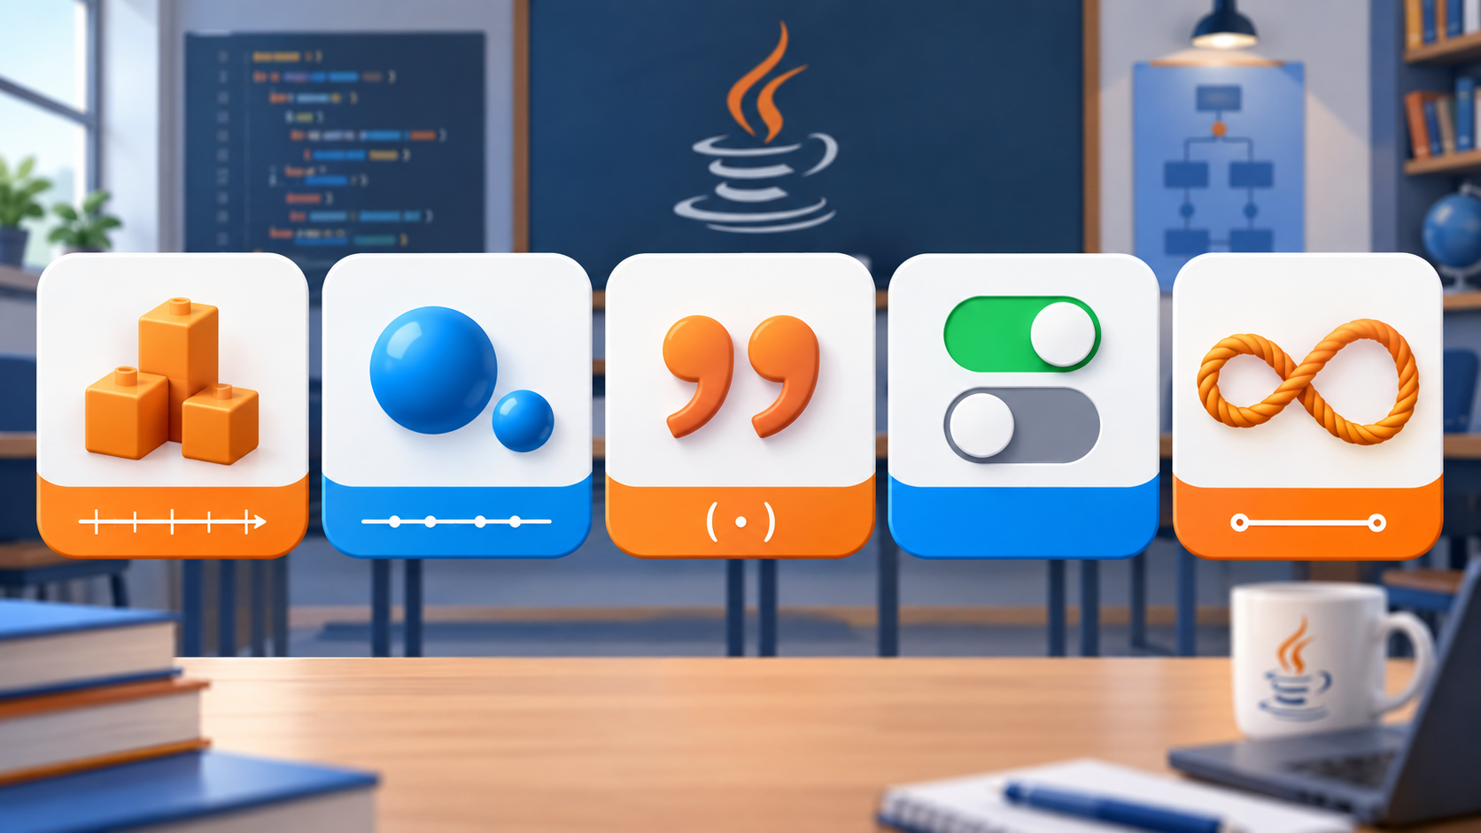
JAVA VARIABLES • 05
Data Types
Choose the correct data type
int
double
char
boolean
String
Whole number
Decimal
One character
true / false
Text
10
95.5
A
true
"Hello"
Right data type = better memory use + fewer errors.
Java Programming • Variables
Neat & Clean Presentation

Slide 6
JAVA VARIABLES • 06
Assignment & Update
Assigning and changing values
• Assignment stores a value in a variable.
• The same variable can get a new value.
• Java checks the value type before storing.
int score = 50;
score = 80;
score = score + 10; // 90
Java Programming • Variables
Neat & Clean Presentation

Slide 7

JAVA VARIABLES • 07
Naming Rules
Rules for Variable Names
• Start with letter, _ or $.
• Do not start with a number.
• No spaces or symbols like @, #, %.
• Do not use Java keywords.
• Names are case-sensitive.
Good: studentName, totalMarks
Bad: 2marks, total marks, class
Java Programming • Variables
Neat & Clean Presentation

Slide 8

JAVA VARIABLES • 08
Types of Variables
Local vs Instance vs Static
Local
Instance
Static
Inside method/block
Inside class, outside method
static keyword
short life
object copy
shared copy
class Student {
String name; // instance
static String school; // static
void show(){ int age = 18; } // local
}
Java Programming • Variables
Neat & Clean Presentation

Slide 9

JAVA VARIABLES • 09
Scope & Lifetime
Scope and Lifetime
• Scope means where a variable is accessible.
• Local variables work only inside their block.
• Instance variables live with the object.
• Static variables live with the class.
if (marks >= 33) {
String result = "Pass";
}
// result is not available outside
Java Programming • Variables
Neat & Clean Presentation

Slide 10

JAVA VARIABLES • 10
final Keyword
Constants using final
Use final when the value should not change after initialization.
final double PI = 3.14159;
final int MAX_MARKS = 100;
// PI = 3.14; // not allowed
• Improves safety.
• Makes fixed values clear.
• Usually written in CAPITAL_LETTERS.
Java Programming • Variables
Neat & Clean Presentation

Slide 11

JAVA VARIABLES • 11
Common Mistakes
Avoid these mistakes
• Using a variable before declaring it.
• Assigning the wrong type of value.
• Forgetting semicolon at the end.
• Using unclear names like a, b, x1.
• Trying to change a final variable.
int age = "twenty"; // wrong
int age = 20; // correct
Java Programming • Variables
Neat & Clean Presentation

Slide 12
JAVA VARIABLES • 12
Final Recap
Recap + Mini Practice
• Variable = named box to store data.
• Declaration pattern: dataType name = value;
• Choose the correct data type.
• Use meaningful names and proper scope.
• Use final for values that never change.
Practice Task:
Create variables for name, age, marks, grade, and pass status.
Thank You
Java Programming • Variables
Neat & Clean Presentation

