Slide 1
Chapter 9
Function

Slide 2
Function
Suppose, a program related to graphics needs to create a circle and color it depending upon the radius and color from the user. You can create two functions to solve this problem:
  create a circle function
  color function
Dividing complex problem into small components makes program easy to understand and use.

Slide 3
Types of function
Depending on whether a function is defined by the user or already included in C compilers, there are two types of functions in C programming
There are two types of function in C programming:
  Standard library functions
  User defined functions

Slide 4
Standard library functions
The standard library functions are built-in functions in C programming to handle tasks such as mathematical computations, I/O processing, string handling etc.
These functions are defined in the header file. When you include the header file, these functions are available for use. For example:
The printf() is a standard library function to send formatted output to the screen (display output on the screen). This function is defined in "stdio.h" header file.
There are other numerous library functions defined under "stdio.h", such as scanf(), fprintf(), getchar() etc. Once you include "stdio.h" in your program, all these functions are available for use.

Slide 5
User-defined function
As mentioned earlier, C allow programmers to define functions. Such functions created by the user are called user-defined functions.
You can create as many user-defined functions as you want.
Remember, function name is an identifier and should be unique.

Slide 6
How user-defined function works?
#include <stdio.h>
void functionName()
{
... .. ...
... .. ...
}
int main()
{
... .. ...
... .. ...
functionName();
... .. ...
... .. ...
}

Slide 7
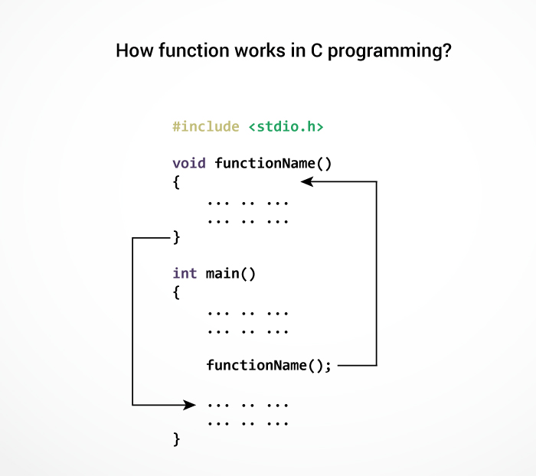
How function works in C?
Starting point of C program

Slide 8
Advantages of user-defined function
The program will be easier to understand, maintain and debug.
Reusable codes that can be used in other programs
A large program can be divided into smaller modules. Hence, a large project can be divided among many programmers.

Slide 9
Example: User-defined function
#include <stdio.h>
int addNumbers(int a, int b); // function prototype
int main()
{
int n1,n2,sum;
printf("Enters two numbers: ");
scanf("%d %d",&n1,&n2);
sum = addNumbers(n1, n2); // function call
printf("sum = %d",sum);
return 0;
}
int addNumbers(int a,int b) // function definition
{
int result;
result = a+b;
return result; // return statement
}

Slide 10
Function prototype
A function prototype is simply the declaration of a function that specifies function's name, parameters and return type. It doesn't contain function body.
A function prototype gives information to the compiler that the function may later be used in the program.
Syntax:
The function prototype is not needed if the user-defined function is defined before the main() function.

Slide 11

Calling a function
Control of the program is transferred to the user-defined function by calling it.
Syntax of function call

Slide 12
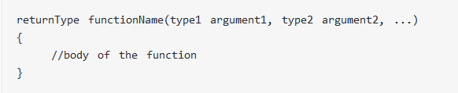
Function definition
Function definition contains the block of code to perform a specific task i.e. in this case, adding two numbers and returning it.
Syntax of function definition

Slide 13
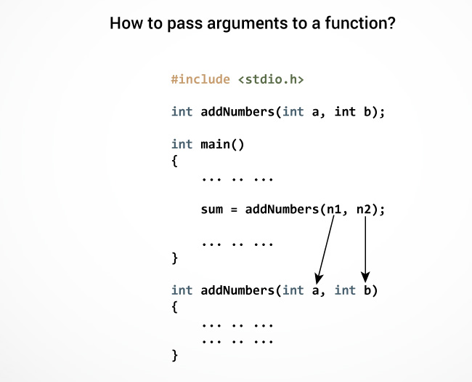
Passing arguments to a function

Slide 14
Return Statement
The return statement terminates the execution of a function and returns a value to the calling function.
The program control is transferred to the calling function after return statement.

Slide 15
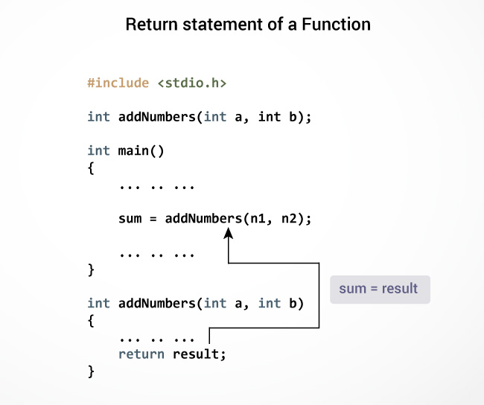
How return statement works?

Slide 16
Example 1: No arguments passed and no return Value
#include <stdio.h>
void checkPrimeNumber();
int main()
{
checkPrimeNumber(); // argument is not passed
return 0;
}
// return type of the function is void because function is not returning anything
void checkPrimeNumber()
{
int n, i, flag=0;
printf("Enter a positive integer: ");
scanf("%d",&n);
for(i=2; i <= n/2; ++i)
{
if(n%i == 0)
{
flag = 1;
}
}
if (flag == 1)
printf("%d is not a prime number.", n);
else
printf("%d is a prime number.", n);
}

Slide 17
Example 2: No arguments passed but a return value
#include <stdio.h>
int getInteger();
int main()
{
int n, i, flag = 0;
n = getInteger(); // no argument is passed
for(i=2; i<=n/2; ++i)
{
if(n%i==0){
flag = 1;
break;}
}
if (flag == 1)
printf("%d is not a prime number.", n);
else
printf("%d is a prime number.", n);
return 0;
}
int getInteger() // returns integer entered by the user
{
int n;
printf("Enter a positive integer: ");
scanf("%d",&n);
return n;
}

Slide 18
Example 3: Argument passed but no return value
#include <stdio.h>
void checkPrimeAndDisplay(int n);
int main(){
int n;
printf("Enter a positive integer: ");
scanf("%d",&n);
// n is passed to the function
checkPrimeAndDisplay(n);
return 0;}
// void indicates that no value is returned from the function
void checkPrimeAndDisplay(int n) {
int i, flag = 0;
for(i=2; i <= n/2; ++i) {
if(n%i == 0){
flag = 1;
break;
}
}
if(flag == 1)
printf("%d is not a prime number.",n);
else
printf("%d is a prime number.", n);
}

Slide 19
Example 4: Argument passed and a return value
#include <stdio.h>
int checkPrimeNumber(int n);
int main(){
int n, flag;
printf("Enter a positive integer: ");
scanf("%d",&n);
// n is passed to the checkPrimeNumber() function
// the value returned from the function is assigned to flag variable
flag = checkPrimeNumber(n);
if(flag == 1)
printf("%d is not a prime number",n);
else
printf("%d is a prime number",n);
return 0;}
// integer is returned from the function
int checkPrimeNumber(int n){
int i;
for(i=2; i <= n/2; ++i) {
if(n%i == 0)
return 1;}
return 0;
}

