Slide 1
C Programming
if...else Statement

Slide 2
C if statement
if (testExpression)
{
// statement(s)
}

Slide 3
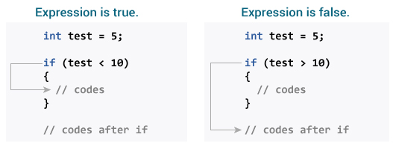
How if statement works?
The if statement evaluates the test expression inside the parenthesis.
  If the test expression is evaluated to true (nonzero), statement(s) inside the body of if is executed.
  If the test expression is evaluated to false (0), statement(s) inside the body of if is skipped from execution.

Slide 4
Example 1: if statement
// Program to display a number if user enters negative number
#include <stdio.h>
int main()
{
int number;
printf("Enter an integer: ");
scanf("%d", &number); // Test expression is true if number is greater than 0
if (number > 0)
{
printf("You entered positive number %d\n", number);
}
printf("The if statement is easy.");
return 0;
}

Slide 5
C if...else statement
if (testExpression)
{
// statement(s) inside the body of if
}
else
{
// statement(s) inside the body of else
}

Slide 6
How if...else statement works?
If test expression is evaluated to true,
  statement(s) inside the body of if statement is executed
  statement(s) inside the body of else statement is skipped from execution.
If test expression is evaluated to false,
  statement(s) inside the body of else statement is executed
  statement(s) inside the body of if statement is skipped.

Slide 7
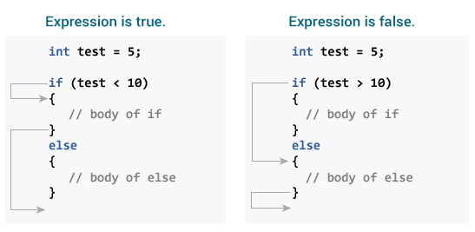
How if...else statement works?

Slide 8
Example 2: if else statement
// Program to display a number if user enters negative number
#include <stdio.h>
int main()
{
int number;
printf("Enter an integer: ");
scanf("%d", &number); // Test expression is true if number is greater than 0
if (number > 0)
{
printf("You entered positive number %d\n", number);
}
else
printf(" You entered negative number %d\n", number");
return 0;
}

Slide 9
if...else Ladder ( if...else if....else Statement )
if (testExpression1)
{
// statement(s)
}
else if(testExpression2)
{
// statement(s)
}
else if (testExpression 3)
{
// statement(s)
}
.
.
else
{
// statement(s)
}

Slide 10
Example 3: C if...else Ladder
// Program to relate two integers using =, > or <
#include <stdio.h>
int main() {
int number1, number2;
printf("Enter two integers: ");
scanf("%d %d", &number1, &number2);
//checks if two integers are equal.
if(number1 == number2)
{
printf("Result: %d = %d",number1,number2);
}
//checks if number1 is greater than number2.
else if (number1 > number2)
{
printf("Result: %d > %d", number1, number2);
}
// if both test expression is false
else
{
printf("Result: %d < %d",number1, number2);
}
return 0;
}

Slide 11
Nested if...else
It is possible to include if...else statement(s) inside the body of another if...else statement.

Slide 12
Example 4: Nested if...else
#include <stdio.h>
int main() {
int number1, number2;
printf("Enter two integers: ");
scanf("%d %d", &number1, &number2);
if (number1 >= number2)
{
if (number1 == number2)
{
printf("Result: %d = %d",number1,number2);
}
else
{
printf("Result: %d > %d", number1, number2);
}
}
else
{
printf("Result: %d < %d",number1, number2);
}
return 0;
}

