Slide 1
Chapter 9
Recursion

Slide 2
Recursion
A function that calls itself is known as a recursive function. And, this technique is known as recursion.

Slide 3
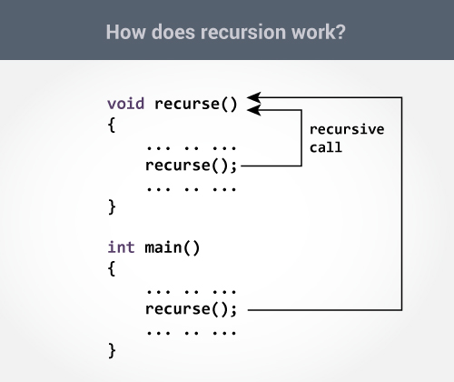
How recursion works?

Slide 4
Example: Sum of Natural Numbers Using Recursion
#include <stdio.h>
int sum(int n);
int main()
{
int number, result;
printf("Enter a positive integer: ");
scanf("%d", &number);
result = sum(number);
printf("sum = %d", result);
return 0;
}
int sum(int num)
{
if (num!=0)
return num + sum(num-1); // sum() function calls itself
else
return num;
}

Slide 5
User-defined function
As mentioned earlier, C allow programmers to define functions. Such functions created by the user are called user-defined functions.
You can create as many user-defined functions as you want.
Remember, function name is an identifier and should be unique.

Slide 6
How user-defined function works?
#include <stdio.h>
void functionName()
{
... .. ...
... .. ...
}
int main()
{
... .. ...
... .. ...
functionName();
... .. ...
... .. ...
}

Slide 7
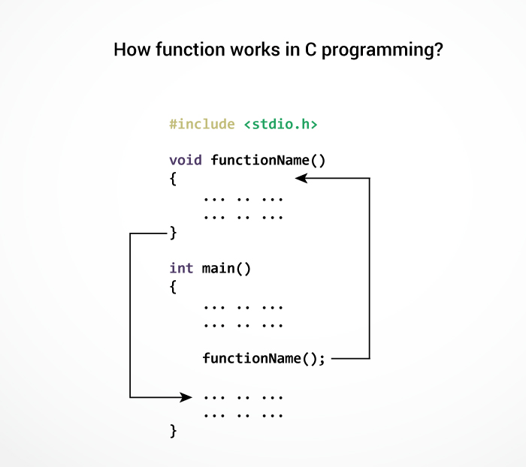
How function works in C?
Starting point of C program

Slide 8
Advantages of user-defined function
The program will be easier to understand, maintain and debug.
Reusable codes that can be used in other programs
A large program can be divided into smaller modules. Hence, a large project can be divided among many programmers.

Slide 9
Example: User-defined function
#include <stdio.h>
int addNumbers(int a, int b); // function prototype
int main()
{
int n1,n2,sum;
printf("Enters two numbers: ");
scanf("%d %d",&n1,&n2);
sum = addNumbers(n1, n2); // function call
printf("sum = %d",sum);
return 0;
}
int addNumbers(int a,int b) // function definition
{
int result;
result = a+b;
return result; // return statement
}

Slide 10
Function prototype
A function prototype is simply the declaration of a function that specifies function's name, parameters and return type. It doesn't contain function body.
A function prototype gives information to the compiler that the function may later be used in the program.
Syntax:
The function prototype is not needed if the user-defined function is defined before the main() function.

Slide 11

Calling a function
Control of the program is transferred to the user-defined function by calling it.
Syntax of function call

Slide 12
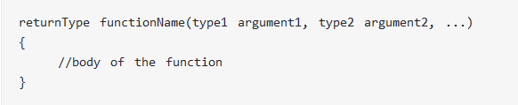
Function definition
Function definition contains the block of code to perform a specific task i.e. in this case, adding two numbers and returning it.
Syntax of function definition

Slide 13
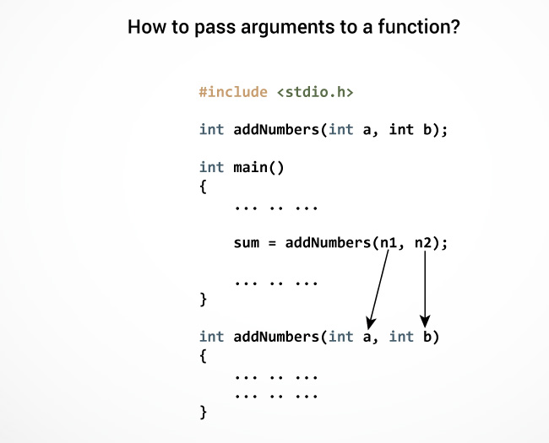
Passing arguments to a function

Slide 14
Return Statement
The return statement terminates the execution of a function and returns a value to the calling function.
The program control is transferred to the calling function after return statement.

Slide 15
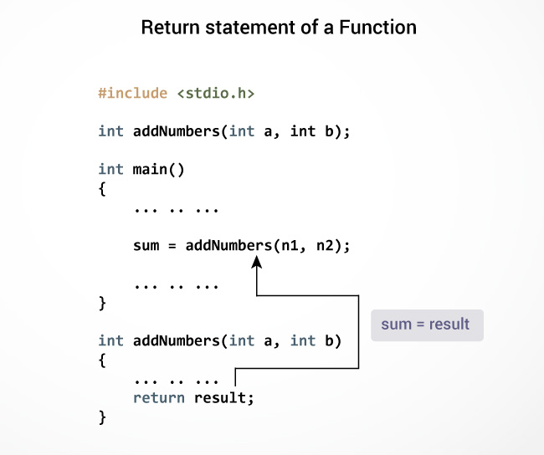
How return statement works?

Slide 16
Example 1: No arguments passed and no return Value
#include <stdio.h>
void checkPrimeNumber();
int main()
{
checkPrimeNumber(); // argument is not passed
return 0;
}
// return type of the function is void because function is not returning anything
void checkPrimeNumber()
{
int n, i, flag=0;
printf("Enter a positive integer: ");
scanf("%d",&n);
for(i=2; i <= n/2; ++i)
{
if(n%i == 0)
{
flag = 1;
}
}
if (flag == 1)
printf("%d is not a prime number.", n);
else
printf("%d is a prime number.", n);
}

Slide 17
Example 2: No arguments passed but a return value
#include <stdio.h>
int getInteger();
int main()
{
int n, i, flag = 0;
n = getInteger(); // no argument is passed
for(i=2; i<=n/2; ++i)
{
if(n%i==0){
flag = 1;
break;}
}
if (flag == 1)
printf("%d is not a prime number.", n);
else
printf("%d is a prime number.", n);
return 0;
}
int getInteger() // returns integer entered by the user
{
int n;
printf("Enter a positive integer: ");
scanf("%d",&n);
return n;
}

Slide 18
Example 3: Argument passed but no return value
#include <stdio.h>
void checkPrimeAndDisplay(int n);
int main(){
int n;
printf("Enter a positive integer: ");
scanf("%d",&n);
// n is passed to the function
checkPrimeAndDisplay(n);
return 0;}
// void indicates that no value is returned from the function
void checkPrimeAndDisplay(int n) {
int i, flag = 0;
for(i=2; i <= n/2; ++i) {
if(n%i == 0){
flag = 1;
break;
}
}
if(flag == 1)
printf("%d is not a prime number.",n);
else
printf("%d is a prime number.", n);
}

Slide 19
Example 4: Argument passed and a return value
#include <stdio.h>
int checkPrimeNumber(int n);
int main(){
int n, flag;
printf("Enter a positive integer: ");
scanf("%d",&n);
// n is passed to the checkPrimeNumber() function
// the value returned from the function is assigned to flag variable
flag = checkPrimeNumber(n);
if(flag == 1)
printf("%d is not a prime number",n);
else
printf("%d is a prime number",n);
return 0;}
// integer is returned from the function
int checkPrimeNumber(int n){
int i;
for(i=2; i <= n/2; ++i) {
if(n%i == 0)
return 1;}
return 0;
}

