Slide 1
Recruitment & Hiring Funnel Analytics
Where candidates drop off • Hiring efficiency • Cost • Recommended actions
Dataset: 10,000 recruitment records
By Barbara Dixon

Slide 2
Executive Summary
The recruitment funnel converts 10,000 applicants into 414 hires.
Applicants
Hires
Overall hire rate
Avg. time-to-hire
Avg. cost per hire
10,000
414
4.14%
33.08 days
€3,732.49
What the data tells us
Stakeholder takeaway
• The largest funnel loss occurs before screening: 72.30% of applicants do not progress.
• Employee Referral is the strongest source by hire rate at 5.94%.
• Operations has the highest average cost per hire at €4,082.12.
• Michael Wagner has the strongest overall recruiter performance.
• The biggest opportunity is not simply generating more
applicants.
• The priority is improving early-stage screening and conversion.
• Cost and recruiter practices should be managed using performance metrics, not volume alone.
• The recommendations focus on practical actions HR can test and monitor.
Recruitment & Hiring Funnel Analytics | 2

Slide 3
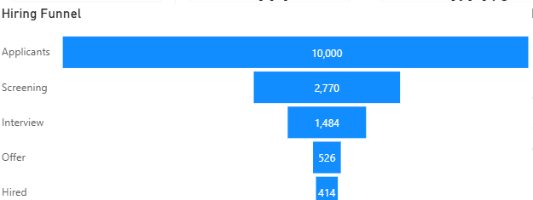
1. The Main Bottleneck Is Initial Screening
Candidate volume falls sharply before screening.
72.30%
largest funnel drop-off
7,230 of 10,000 applicants do not reach screening.
Recommended action
• Standardize screening criteria.
• Use early eligibility filters where appropriate.
• Track screening conversion by source and recruiter.
Recruitment & Hiring Funnel Analytics | 3

Slide 4
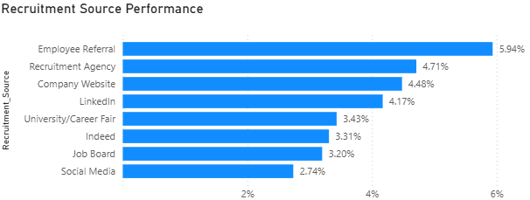
2. Source Quality Matters More Than Applicant Volume
Employee Referral converts the strongest share of applicants into hires.
What stands out
• Employee Referral: 5.94% hire rate — highest in the dataset.
• LinkedIn generates the most hires (103), but at 4.17% conversion.
• Social Media has the lowest hire rate at 2.74%.
Recommended action
• Strengthen the employee referral program.
• Assess recruitment agencies on both conversion and cost.
• Avoid judging channels on applicant volume alone.
Recruitment & Hiring Funnel Analytics | 4

Slide 5
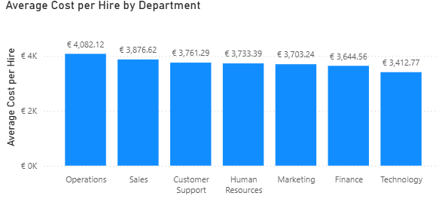
3. Where Are Hiring Time and Cost Highest?
Use both speed and cost metrics to target process improvements.
Average Time-to-Hire by Department
Human Resources
34.48 days
Operations
34.01 days
Customer Support
34.00 days
Marketing
33.33 days
Finance
32.97 days
Sales
32.00 days
Technology
31.78 days
Key insight
Cost insight
• HR is slowest at 34.48 days; Technology is fastest at 31.78 days.
• Operations has the highest average cost per hire: €4,082.12.
Recruitment & Hiring Funnel Analytics | 5

Slide 6
4. Recommended Actions & Next Steps
Focus on conversion, cost efficiency and repeatable recruiter practices.
01
02
03
04
Improve screening
Prioritize quality channels
Scale best practices
Investigate high-cost departments
Standardize initial screening criteria and measure screening conversion by source.
Invest more deliberately in Employee Referral and evaluate agency cost-effectiveness.
Review Michael Wagner's practices and identify what can be standardized across the team.
Audit sourcing efficiency and time-to-hire high cost in depts. to reduce per-hire expenses.
The key message
The priority is not simply to attract more applicants — it is to improve the quality and conversion of candidates entering the funnel.
Success measures: screening conversion • time-to-hire • cost per hire • source hire rate
Recruitment & Hiring Funnel Analytics | 6

