Slide 1

Capstone Project
Airbnb Booking Analysis
- Babu Reddy

Slide 2
The Airbnb Analysis follows :
Problem Statements
Data Information
Analysis of Data
Data Cleaning/ Imputation
Data Preparation
Model Training
Evaluation Metrics
Challenges
Conclusion

Slide 3
What can we learn about different hosts and areas?
What can we learn from predictions? (ex: locations, prices, reviews, etc)
Which hosts are the busiest and why?
Is there any noticeable difference of traffic among different areas and
what could be the reason for it?
Problem Statements

Slide 4
Data Summary
Data set file: Airbnb booking Analysis of New York City 2008-2019
Shape:
Columns-16
Rows-48894
Important columns:
host_id,
host_name,
neighbourhood_group,
neighbourhood,
latitude,

Slide 5

Continue
longitude,
availability_365,
calculated_host_listings_count.

Slide 6
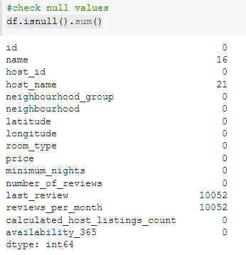
Data Cleaning and imputation
Checking for Duplication in Data frame columns.
Checking for Nan Values and Replace them
by filling review columns into zeros.

Slide 7
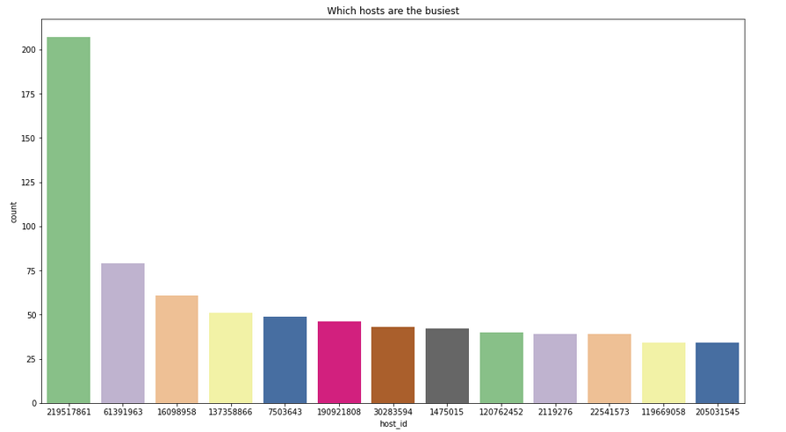
How busy are the hosts?

Slide 8
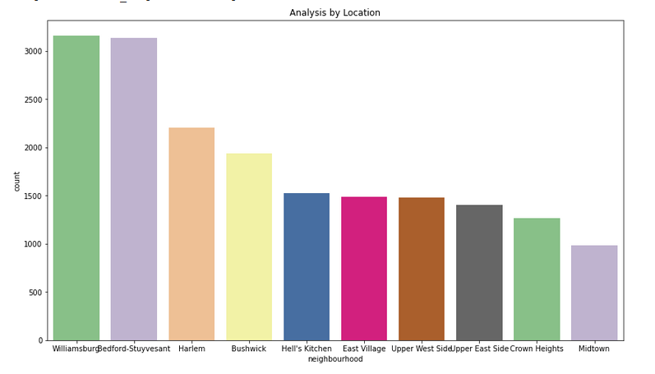
How busy are the hosts?

Slide 9
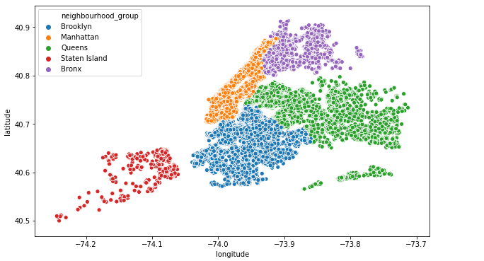
Maps of Neighbourhood_group

Slide 10
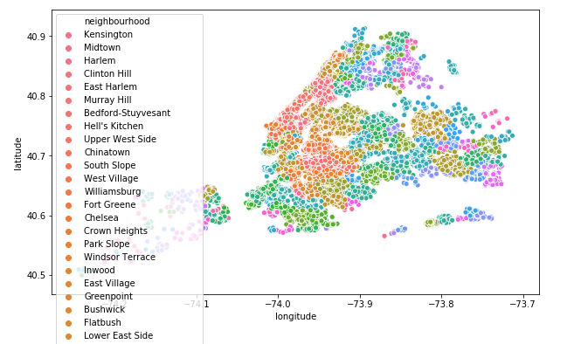
Maps of Neighbourhood_group

Slide 11
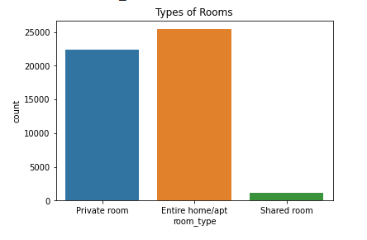
Number of Room Types

Slide 12
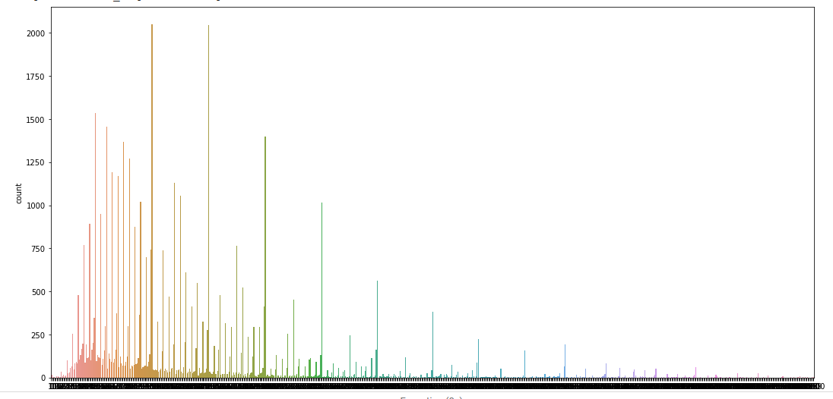
Price Variations

Slide 13
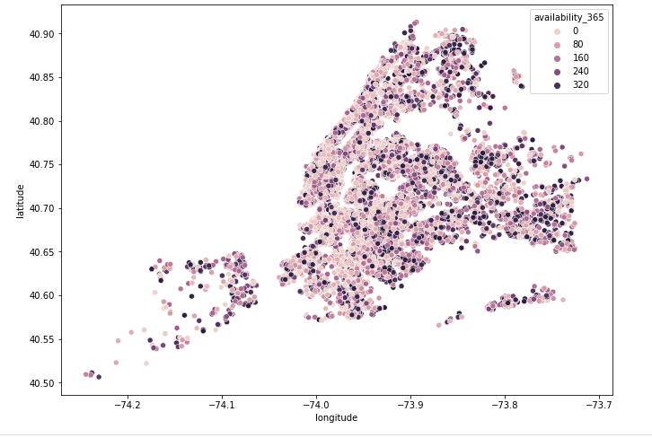
Availability of Rooms in locations

Slide 14
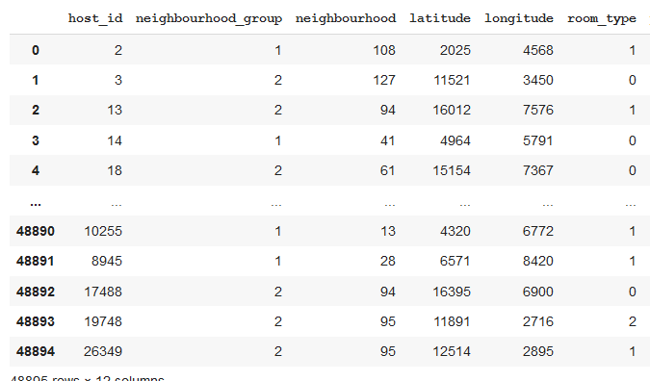
Label Encoding
Label encoding refers to covert labels into numeric form it’s a preprocessing step

Slide 15
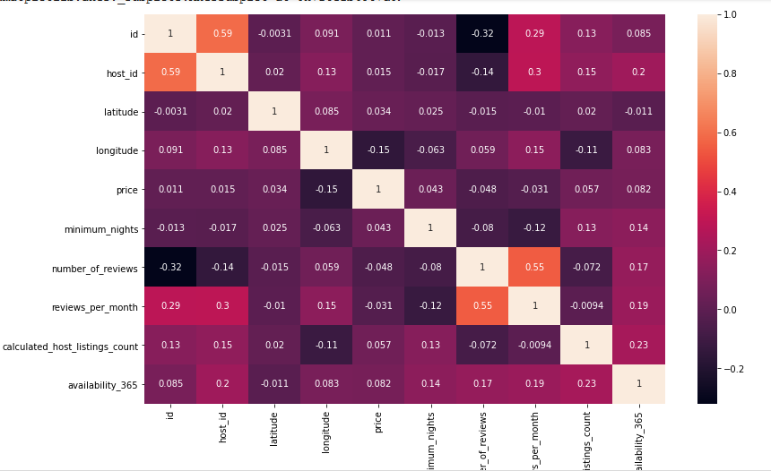
Correlation

Slide 16
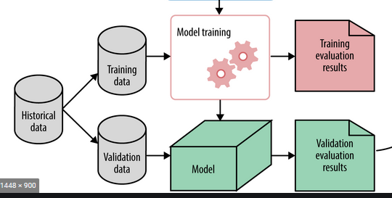
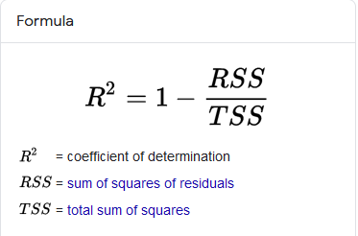
Regression
After label encoding with feature selection applied linear regression and Decision Tree And found R-sqaured vaue

Slide 17

Challenges
Dataset was having 10k+ nan values
Irrelevant/unwanted features
Difficult to plot maps.
Loading dataset was time taking
Featured labels are selected tested on linear regression.
By splitting 20% data r2 score was=0.26
We tried with decision tree and score was not improved
By tuning the min_samples_leaf (the minimum number of samples required to be at a leaf node ) R2 score was improved on tested data
Since company growth was from 2015-19 there were very less booking data in starting days

Slide 18
Conclusion
Through this EDA and visualization project few intresting insights are
Maximum prices in location i,e manhattan.
The performance of prediction with higher prices was poor R2 Value.
Some host are having a high bookings count, reviews and more are a superhost.

Slide 19
Future analysis
Expand our Analysis to multiple cities and compare patterns and trends amongst these cities.
From the insights we've got derived, we might prefer to build predictive models victimisation totally different features from the dataset.
we hope to implement the visualizations and techniques utilized in this project to several alternative fields in datasets

Slide 20


Q&A
https://slides.app.goo.gl/Pm6VL

