Slide 1


Slide 2
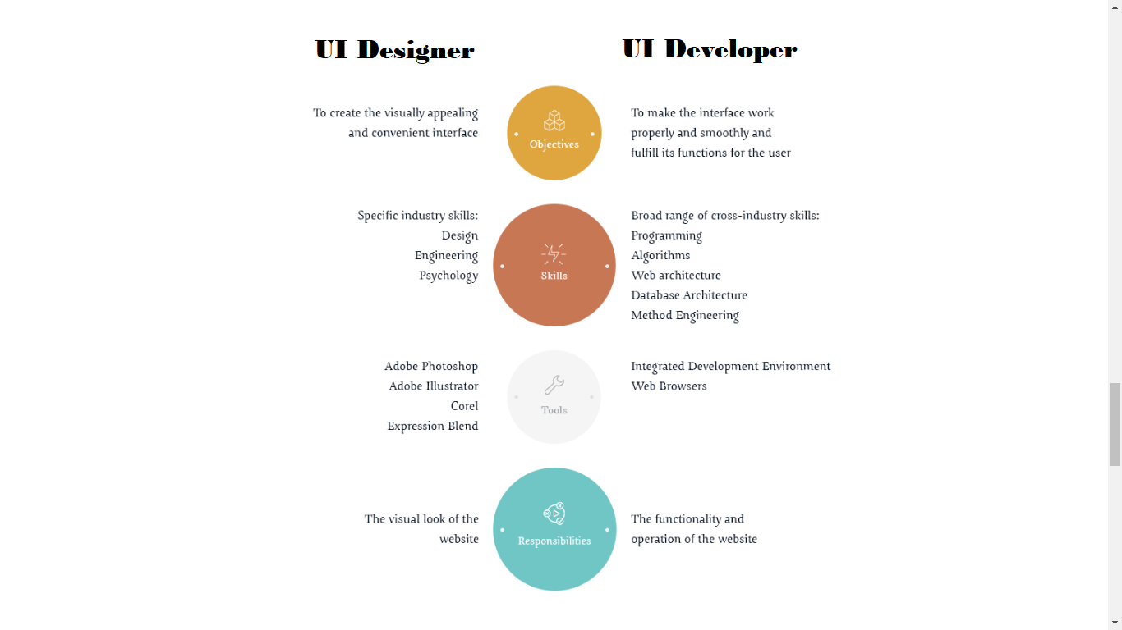
UI Designer Vs Ui developer

Slide 3
Editors / IDE
Notepad++ - https://notepad-plus-plus.org/download/v7.5.8.html
Atom - https://atom.io/
Sublime - https://www.sublimetext.com/3
Visual Studio Code - https://code.visualstudio.com/download
https://www.youtube.com/watch?v=8tkuu0Rugg4
Webstrom - https://www.jetbrains.com/webstorm/download/#section=windows

Slide 4
Intro to HTML
Structure
Basics
DOM
Inline Vs Block Level elements
Elements

Slide 5
Whats Not HTML5?
SVG: Not HTML5. It's at least five years old.
CSS3: Not HTML5. It's...CSS.
Geolocation: Not HTML5.
Client Storage: Not HTML5. It was at one point, but was removed from the spec, due to the fact that many worried that it, as a whole, was becoming too complicated. It now has its own specification.
Web Sockets: Not HTML5. Again, was exported to its own specification.

Slide 6
Whats New in HTML5?
New Doctype
No need of specifying “type” for <script> and <link>
Its not XHTML Don’t have to have end tags and quotes for attributes

Slide 7
Anchor tag
<a href=“#bottom” target=“_blank”>Test</a>
<a name=“bottom”>bottom</a>
href=“http://google.com”
target=“_blank|_self|_parent|_top|framename”
3 states: unvisited, visited, active
New HTML5 attributes: download, media

Slide 8
Comment tag
<!-- comment -- >
We can even comment script content.
For generating documentation.
For better readability of code.

Slide 9
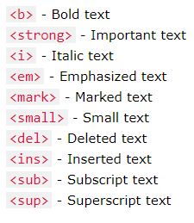
Text Formating tags

Slide 10
Table tag
<table>, <tr>, <th>, <td>
Border, cellspacing, cellpadding
<thead><tbody> <tfoot>
<colgroup><col>
rowspan and colspan

Slide 11
Lists and PRE
<ul> | <ol> | <li>
Type=“square|disc|circle”
<pre>
Preformatted content
fixed-width font (usually Courier)

Slide 12
<div> and <span>
Div
Block level
Can specify width and height
Span – inline
Inline
Cant specify width and height

Slide 13
image
<img src="smiley.gif" alt="Smiley face" height="42" width="42“/>
alt=“alternate text”
Inline element
title=“tooltip”
We can nest them with <a>

Slide 14
marquee
<marquee>I will scroll</marquee>
width = “”
direction = “up | down | left | right”
scrolldelay = “” → time between 2 scrolls
scrollamount = “” → speed of scrolling
loop = “” → how many time to loop
Behavior = “scroll, slide and alternate”

Slide 15
Form and Form elements
<form></form>
Input | textarea | button | select | fieldset | label
action = “url”, method=“get|post, name=“myform”, target=“_blank | _self | _parent | _top”, submit=“asdasd()”
HMTL 5: autocomplete = “on|off” and novalidate
<input/>
type = “text | password | submit | button | radio | checkbox | …..”
HTML5 → new tags
Name=“” and Value = “”
<lable for=“id”>

Slide 16
Fieldset and legend
<form>
<fieldset> <legend>Personalia:</legend> Name: <input type="text"><br> Email: <input type="text"><br> Date of birth: <input type="text"> </fieldset>
</form>
disabled=“”, form=“”,

Slide 17
Frames and iframes
<frameset> NOT supported in HTML5
<frameset>
rows=“”, cols=“”
<frame>
src=“”
frameborder=“0|1”, noresize=“noresize”, scrolling=“yes|no|auto”
<iframe>
src=“”, width=“”, height=“”
name=“” → <a target=“”>google</a>

Slide 18
Audio & Video
<video width="320" height="240" controls> <source src="movie.mp4" type="video/mp4"> <source src="movie.ogg" type="video/ogg"> Your browser does not support the video tag. </video>
<audio controls> <source src="horse.ogg" type="audio/ogg"> <source src="horse.mp3" type="audio/mpeg"> Your browser does not support the audio element. </audio>

Slide 19
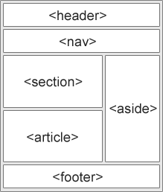
Semantic tags
Tag name gives us idea of what the tag does
In HTML4 we use <div> <p> <span> for everything

Slide 20
App cache
HTML5 provides application cache, which means that a web application is cached, and accessible without an internet connection. Application cache gives an application three advantages:
Offline browsing - users can use the application when they're offline
Speed - cached resources load faster Reduced server load - the
browser will only download updated/changed resources from the server
<html manifest=“myManifest.appcache | http://asdasdasd.com/myManifest.mf”> ……….. </html>

Slide 21
Manifest file
CACHE MANIFEST index.html forms.html stylesheet.css images/logo.png scripts/main.js
If manifest/resource fails to download, cache will be failed and precious cached version will be reflecting.

Slide 22
SVG & Canvas
Scalar Vector Graphics
It has several methods for drawing paths, boxes, circles, text, and graphic images.
Resolution independent
Suitable for application with large rendering areas and not for complex apps
Canvas is used to draw graphics through JS
Its like an image and is resolution dependent
Best suited for game

Slide 23
Drag & Drop
draggable=“true”
Events: ondragstart, ondrop,

Slide 24
Web Storage
Problems with cache
Cookies are included with every HTTP request
Slows down the application
Sends data over network unencrypted
Limited to 4KB
HTML5 → Session Storage & Local storage

