Slide 1
MUTUAL FUND
Analytics Capstone
Bluestock Mutual Fund Analysis
Vishal Hedau
June 2026

Slide 2
Project Overview
Bluestock Mutual Fund Analysis · 2022–2026
📊 Analyze Mutual Fund NAV Data
🔍 Perform EDA & Analytics
Historical price analysis from 2022–2026
Exploratory data analysis & performance metrics
⚙️ Build ETL Pipeline
📈 Create Power BI Dashboard
Automated extraction, transformation & loading
Interactive visual reporting & filtering
🗄️ Store Data in SQLite
💡 Generate Investment Insights
Efficient relational database storage
Data-driven recommendations for investors

Slide 3
Project Architecture
End-to-end data pipeline design
📁
⚙️
🗄️
🔍
📊
💡
Raw Data
ETL Pipeline
SQLite Database
EDA & Analytics
Power BI Dashboard
Final Insights
40 Fund Schemes · Daily NAV · CSV Files
Extract → Transform → Load
Structured Storage · Queryable
Trend · Volatility · Correlation
Interactive Slicers · KPIs
Rankings · Recommendations

Slide 4
Dataset Description
Scope & structure of the mutual fund data
📂
📅
🗓️
40
Daily
2022–26
Mutual Fund Schemes
NAV Data Frequency
Analysis Period
📈
📈
🏆
🏆
Fund
Fund
KPIs
KPIs
Returns Tracked
Returns Tracked
Performance Metrics
Performance Metrics

Slide 5
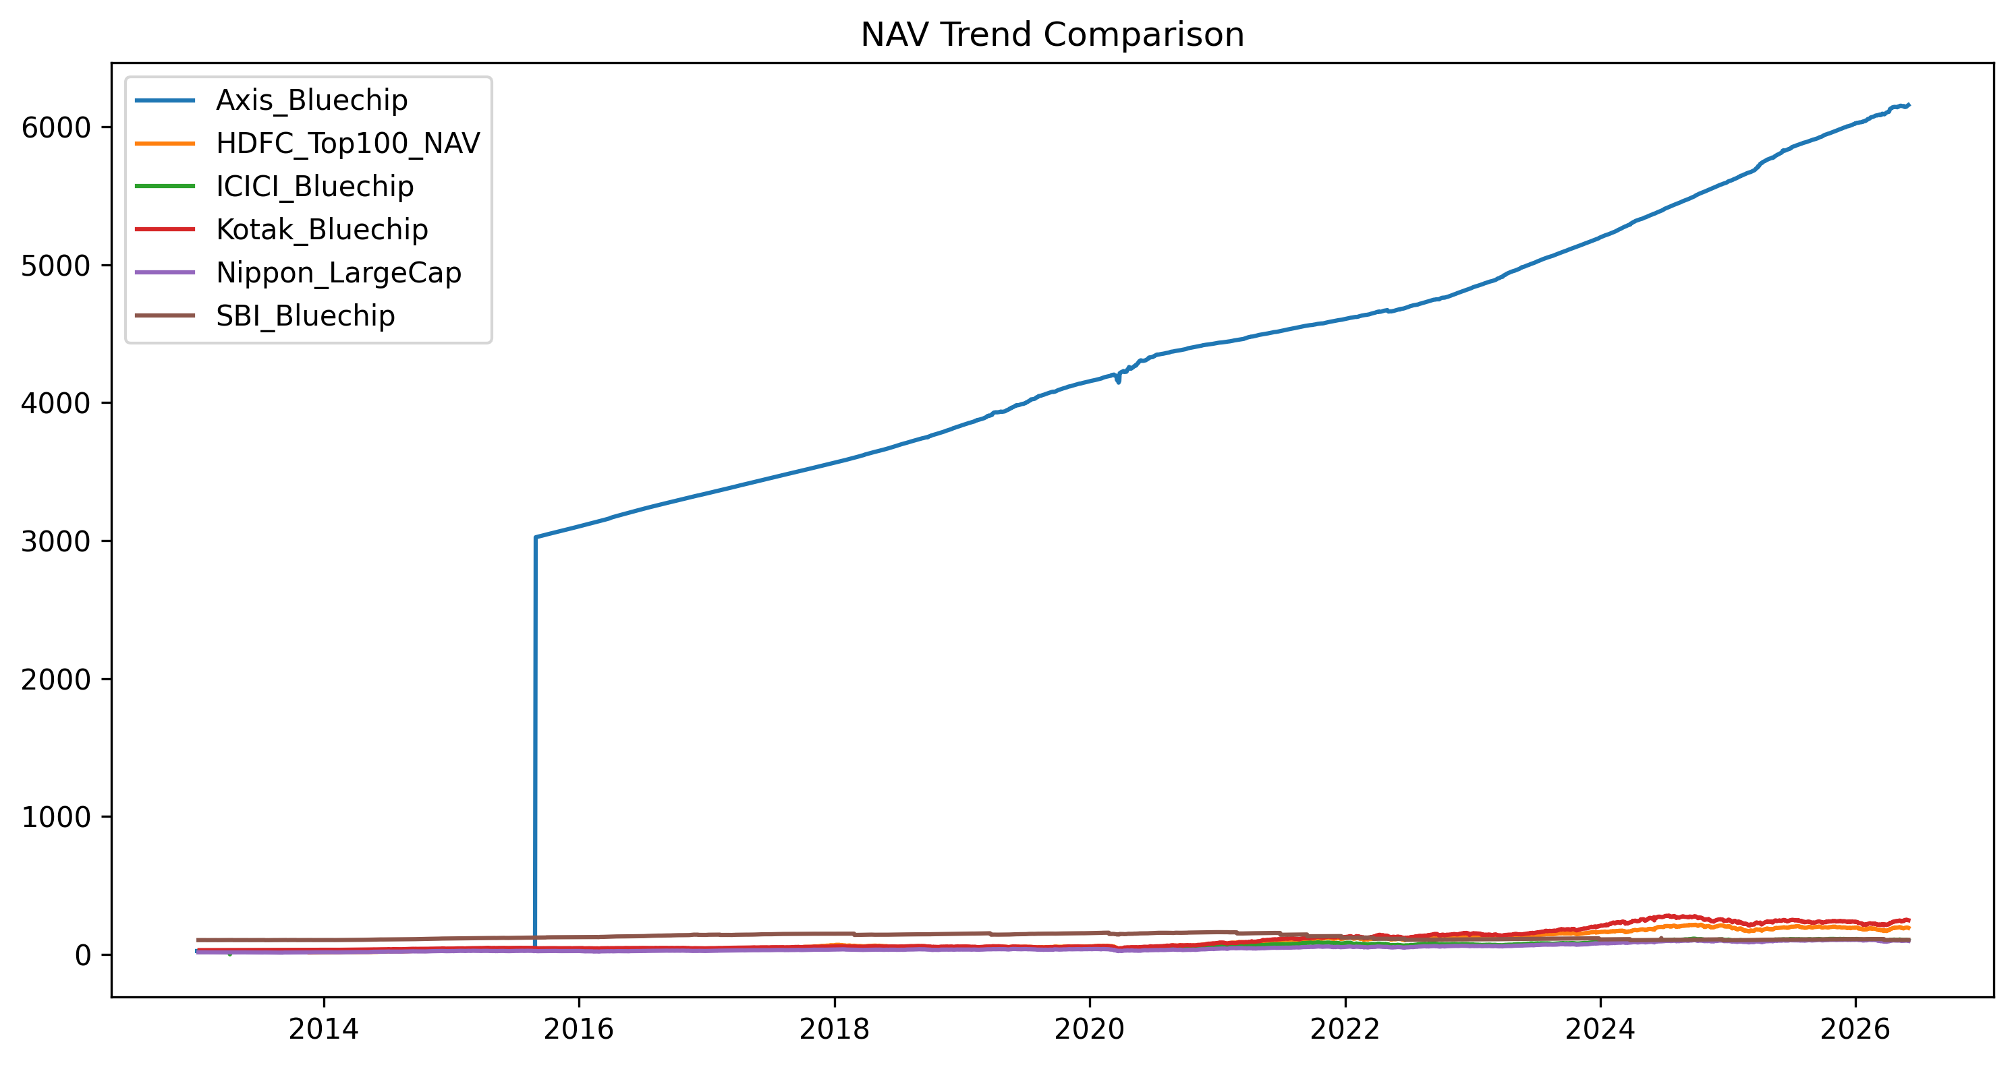
NAV Trend Analysis
Historical NAV movement across all 40 fund schemes
📊 Chart: reports\nav_trend.png
📈 Key Points
Overall upward NAV trend across the period
Strong growth during bull market phases
Market corrections clearly observed

Slide 6
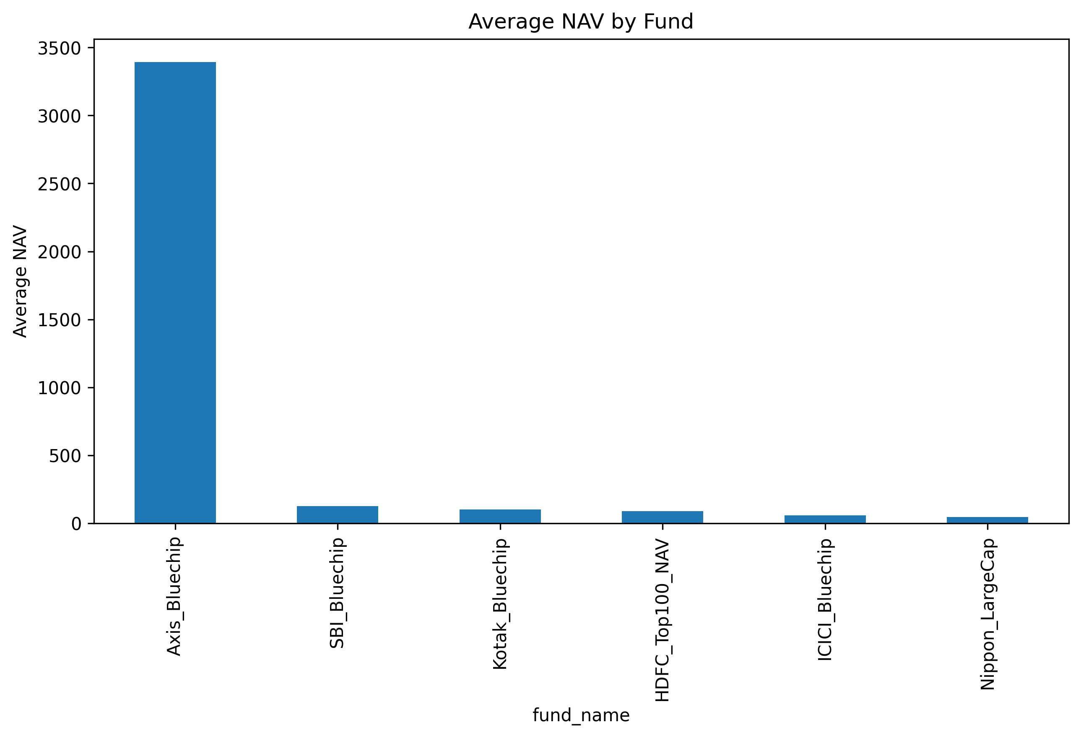
Average NAV Analysis
Scheme-wise average NAV comparison
📊 Chart: reports\avg_nav.png
📊 Key Points
Cross-scheme comparison of average NAV
High NAV funds identified & highlighted
Wide spread indicates fund diversity

Slide 7
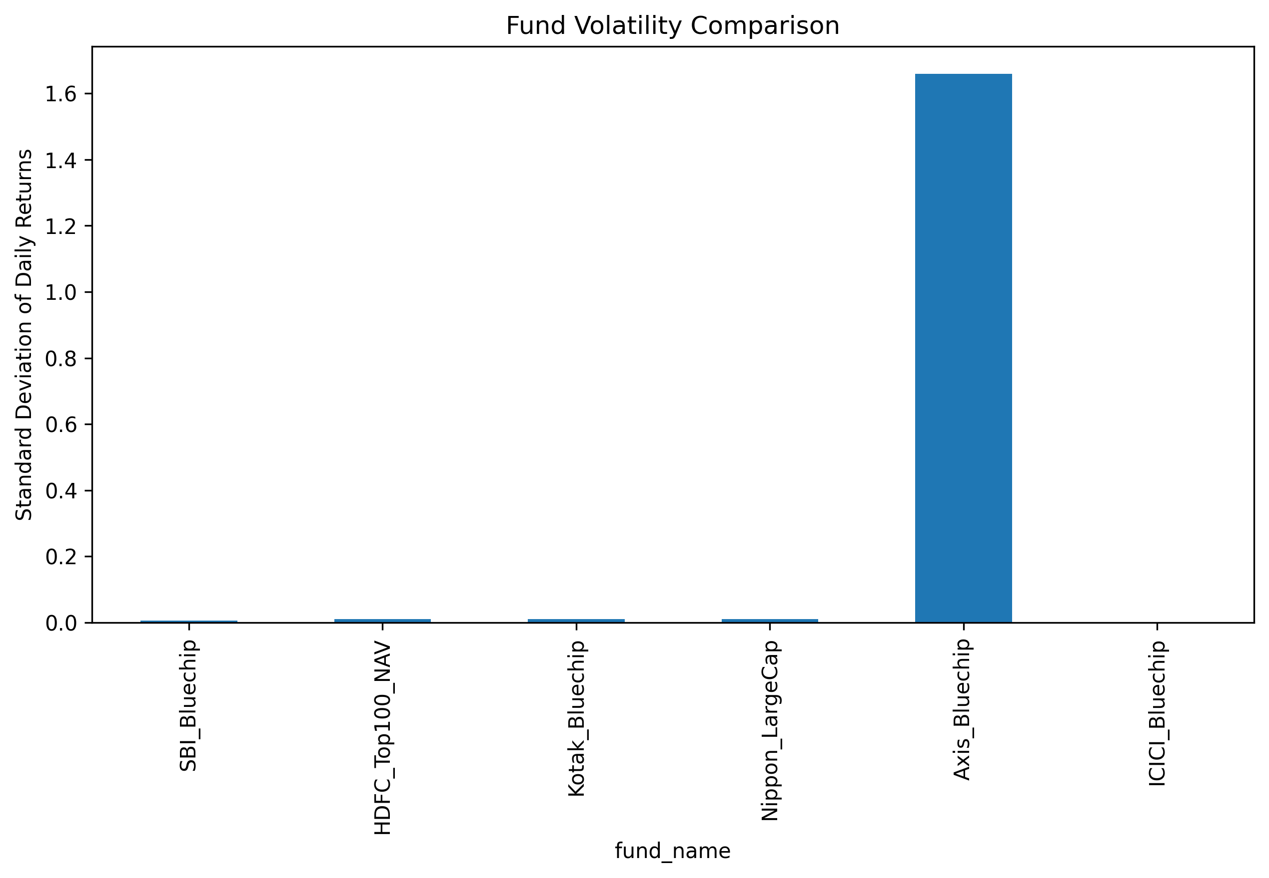
Volatility Analysis
Risk comparison across fund schemes
📊 Chart: reports\volatility.png
⚠️ Key Points
Risk profiling across fund schemes
Stable low-risk funds identified
High-risk funds with greater return potential

Slide 8
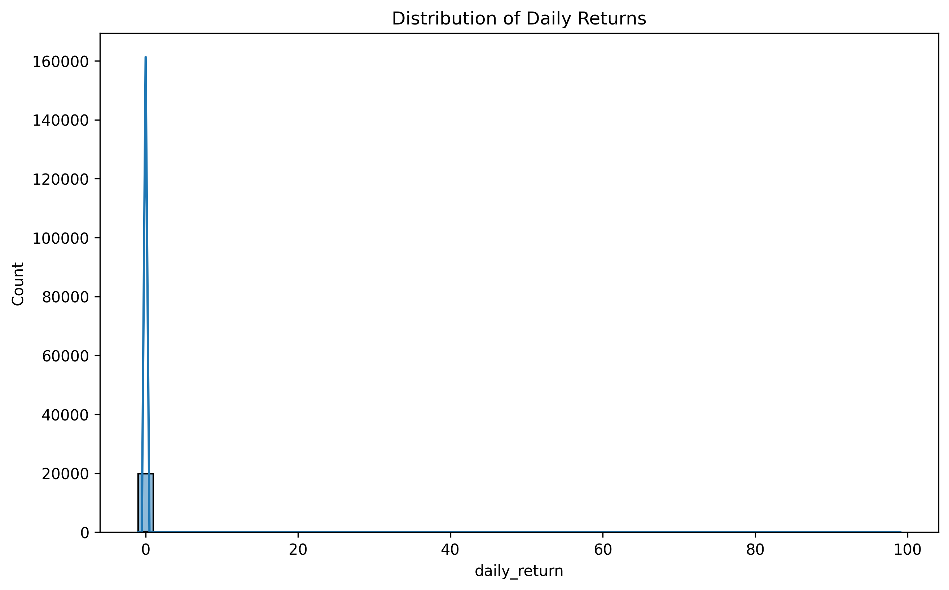
Return Distribution
Distribution of fund returns and performance spread
📊 Chart: reports\return_distribution.png
🔍 Key Points
Return spread analysis across schemes
Fund performance consistency measured
Outlier funds identified for review

Slide 9
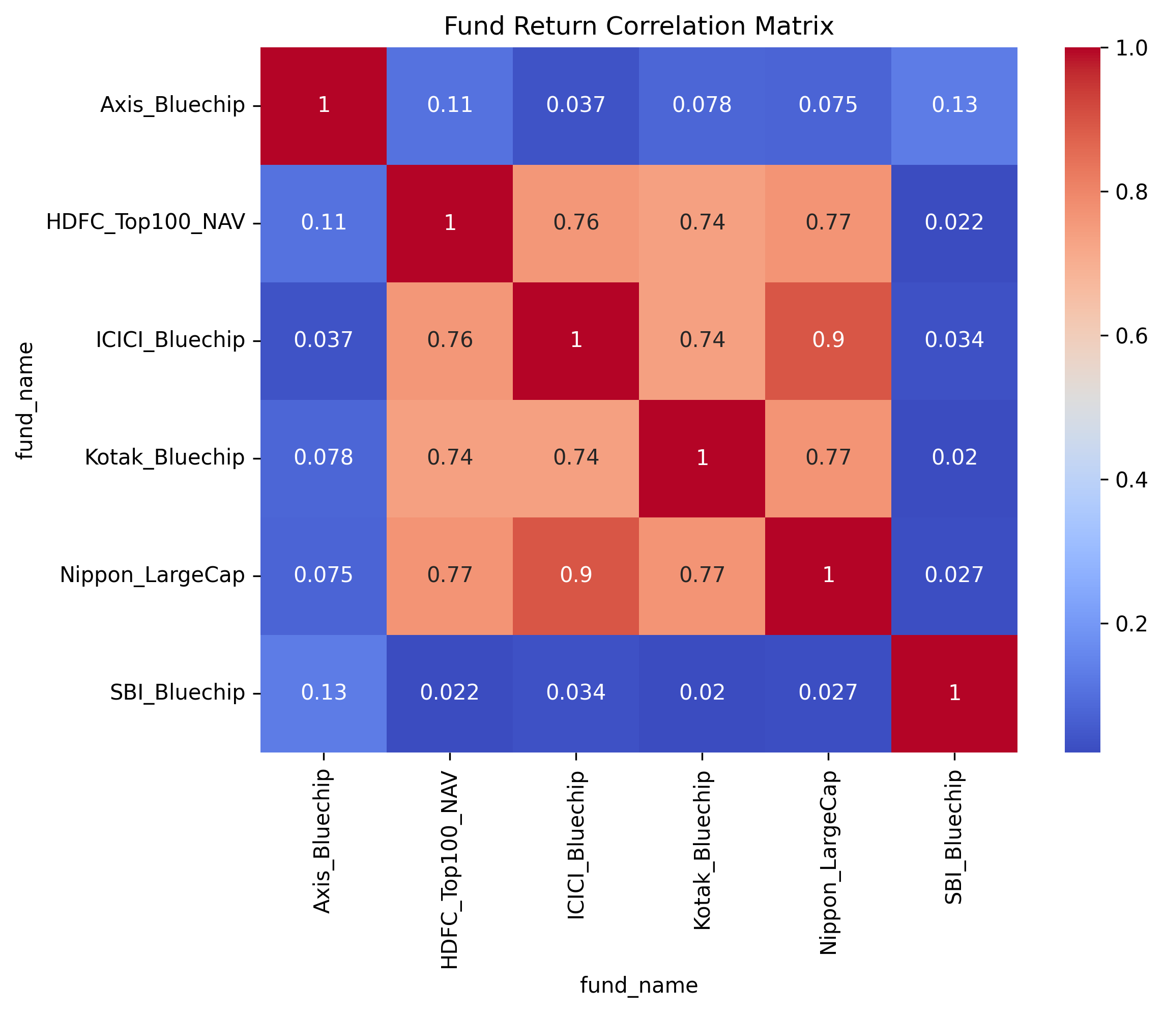
Correlation Matrix
Inter-fund correlation for portfolio diversification
📊 Chart: reports\correlation_matrix.png
🔗 Key Points
Highly correlated fund pairs identified
Diversification opportunities revealed
Portfolio optimization insights

Slide 10
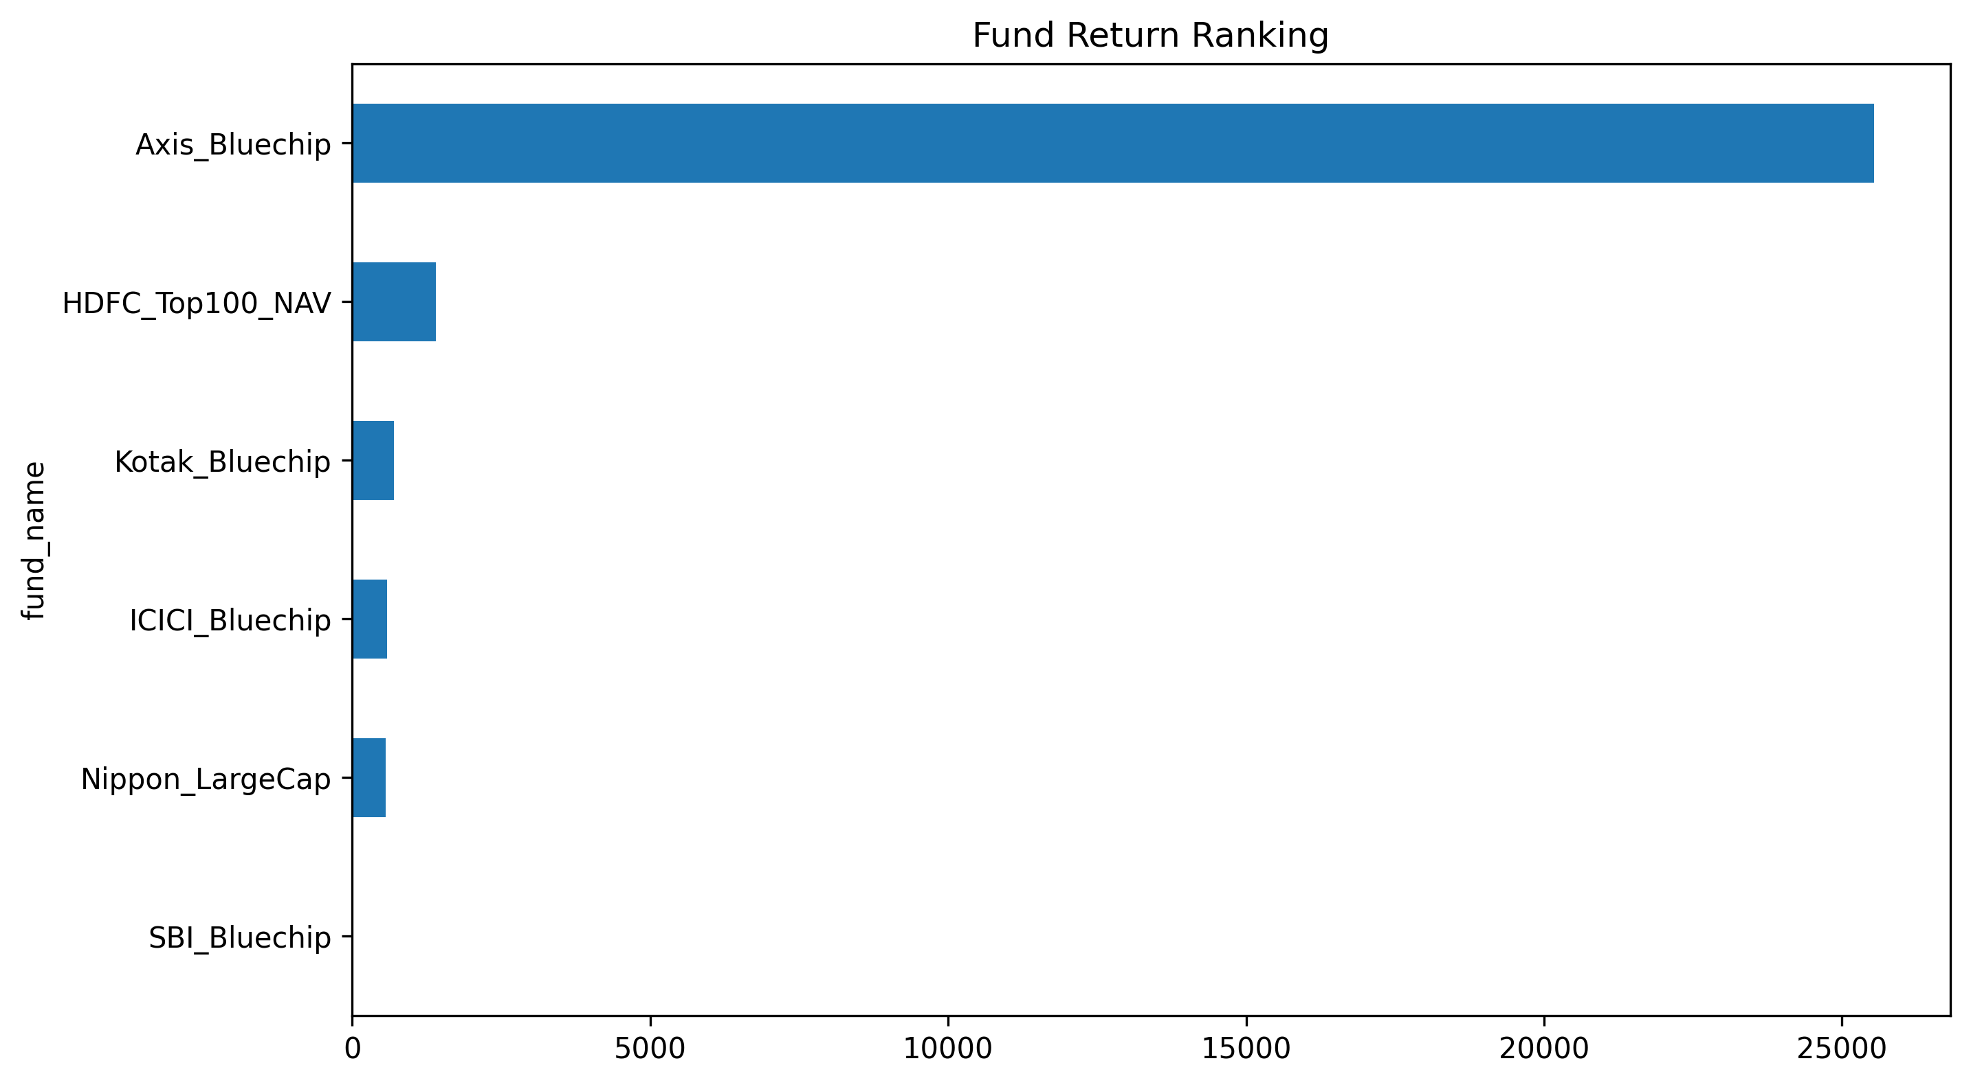
Fund Return Ranking
Performance ranking of all 40 mutual fund schemes
📊 Chart: reports\fund_return_ranking.png
🏆 Key Points
Best performing funds ranked by returns
Top return generators highlighted
Clear performance tiers visible

Slide 11
Power BI Dashboard Overview
dashboard\bluestock_mf.pbix · Interactive Analytics
Bluestock Mutual Fund Dashboard | bluestock_mf.pbix
Fund Scheme ▼
Date Range ▼
Category ▼
40
₹284
+38%
12.4%
Total Funds
Avg NAV
Top Return
Avg Vol.
📈 NAV Trend Line
🥧 Fund Category Split
🏆 Top 10 Funds
📌 Interactive slicers for fund & date
🔎 Fund filtering & drill-through
📊 Performance tracking KPIs
🔄 Cross-visual highlighting

Slide 12
Key Findings & Conclusion
Bluestock Mutual Fund Analysis · Vishal Hedau · June 2026
🔍 Key Findings
✅ Conclusion
Mutual funds showed consistent long-term growth
Some funds delivered higher returns with higher risk
Diversification reduces portfolio volatility
Top-ranked funds outperformed their peers
ETL pipeline successfully automated data processing
SQLite database enabled efficient & structured storage
Analytics and dashboard provided actionable insights
Bluestock Mutual Fund Analytics Capstone | Vishal Hedau | June 2026

