Slide 1
● CIVIC SANITATION ● SMART STEWARDSHIP ● CLOSED-LOOP
CleanLoop
Smart Waste Management & Civic Remediation System
"Small Actions. Cleaner Streets. Better Tomorrow."
PROJECT TEAM MEMBERS
ACADEMIC & INSTITUTIONAL GUIDANCE
Bhuthukuri Sunitha (241FA04492)
Frontend & UI Engineering / State Architecture
Project Guide:
[Pooja Mam]
Academic Department & Institution:
Department of Computer Science & Engineering
[VFSTR , Vadlamudi]
B.Tech Training Project Evaluation • Academic Year 2026
Babul Kumar (241FA04534)
Backend REST APIs, Database & Cloud Deployment
Ayush Kumar (241FA04552)
Civic Workflows, Verification Audit & Gamification

Slide 2
01. CONTEXT & MOTIVATION
02 / 10
Urban Waste Bottlenecks & The Broken Civic Loop
CHALLENGES IN TRADITIONAL REPORTING
THE CLEANLOOP CLOSED-LOOP PARADIGM
• Vague Location Data
Complaints filed via phone calls or physical registers lack geo-coordinates, leaving collectors searching blindly for dump sites.
✔ Geo-Referenced Pinpointing
High-accuracy GPS detection and interactive OpenStreetMap pin-drop eliminates location ambiguity.
• Ghost Resolutions
Field workers mark complaints 'resolved' without photographic evidence, leaving citizens frustrated with uncollected waste.
✔ Mandatory Before/After Proof
Remediation requires photographic evidence from collectors, verified by supervisors before closure.
• Zero Civic Transparency
Citizens cannot track the lifecycle of their complaints, creating mistrust between citizens and municipal authorities.
✔ Multi-Stage Live Tracking
Citizens receive real-time notifications and an interactive 5-stage timeline from intake to resolution.
• Manual Dispatch Latency
Supervisors rely on spreadsheets to manually assign tasks, causing response delays ranging from days to weeks.
✔ Incentivized Civic Action
Green Points reward ledger gamifies reporting, converting passive citizens into active environmental stewards.
Key Takeaway: CleanLoop shifts municipal sanitation from an unmonitored reactive burden to a transparent, digitally orchestrated, and community-verified civic ecosystem.
CleanLoop • Smart Waste Management & Civic Remediation Platform | Academic Evaluation 2026

Slide 3
02. STRATEGIC GOALS
03 / 10
Project Objectives & Architectural Mission
1
Digital Intake
2
Spatial Intelligence
3
Municipal Triage
Empower citizens to log waste incidents with photos, category, and severity in under 60 seconds across desktop and mobile devices.
Capture exact coordinates via device GPS and interactive OpenStreetMap pin placement with 2dsphere geospatial indexing.
Provide administrators with an operational command center to prioritize critical reports and assign available sanitation collectors.
4
Evidence-Based Verification
5
Closed-Loop Tracking
6
Civic Gamification
Enforce supervisory comparison of citizen 'Before' photographs against collector 'After' photographs prior to complaint closure.
Deliver end-to-end transparency with multi-stage status history, timestamps, and real-time in-app notifications.
Reward citizen contributions through an immutable Green Points ledger, unlockable milestone badges, and civic leaderboards.
CleanLoop • Smart Waste Management & Civic Remediation Platform | Academic Evaluation 2026

Slide 4
03. ENGINEERING STACK
04 / 10
Modern Full-Stack MERN & Cloud Architecture
FRONTEND CLIENT
BACKEND SERVICES
DATABASE & MEDIA
DEVOPS & PRODUCTION
React 18 & Vite 6
Modern functional component architecture with fast HMR builds
Node.js & Express.js
Asynchronous MVC REST API engine and route middleware
MongoDB Atlas
M0 multi-region cloud cluster with high availability
Vercel Edge Network
Global CDN hosting frontend SPA with rewrite rules
React Router DOM 6
Client-side routing with authenticated role guards
JWT & bcryptjs
Stateless bearer token auth and salted password hashing
Mongoose 8 ODM
Strict document schemas, validation hooks & 2dsphere indexes
Render Cloud Platform
Node.js web service running with reverse proxy support
Leaflet & Supercluster
Interactive maps with client-side geospatial clustering
Helmet & CORS
HTTP security headers and origin-whitelisting guards
Cloudinary CDN
Secure multipart photographic storage and thumbnail transforms
Git & GitHub
Strict version control and clean commit tracking
Lucide React Icons
Clean, accessible iconography across all dashboards
Express Rate Limit
Protects public authentication and intake routes
OpenStreetMap Tiles
High-reliability public geographic tile rendering
Automated Audit Suites
383 automated assertions covering Phase 2-10 features
CleanLoop CSS Tokens
Bespoke Warm Ivory & Deep Slate responsive theme
Multer & MemoryStorage
Stream-based multipart media parsing and validation
CleanLoop • Smart Waste Management & Civic Remediation Platform | Academic Evaluation 2026

Slide 5
04. ARCHITECTURE & WORKFLOW
05 / 10
Multi-Tier Infrastructure & Closed-Loop Lifecycle
SYSTEM ARCHITECTURE TOPOLOGY
1. Presentation Tier (Vercel Edge)
React 18 SPA + Vite 6
• Citizen Portal (Report & Track)
• Municipal Command Console
• Field Collector Interface
• React Leaflet Map UI
2. Application Tier (Render API)
Node.js + Express.js API
• JWT Auth & RBAC Middleware
• Multi-Stage Lifecycle Engine
• Rate Limiter & File Validator
• Idempotent Green Points Engine
3. Data & Storage Tier (Cloud)
MongoDB Atlas + Cloudinary
• Mongoose Relational Models
• 2dsphere Geospatial Indexes
• Cloudinary Image Hosting
• OpenStreetMap Tile Service
THE 8-STAGE CLOSED-LOOP COMPLAINT LIFECYCLE
1. Citizen Reports
Photo, GPS, Category
Status: 'pending'
2. Admin Triage
Priority & Verification
Status: 'under_review'
3. Crew Dispatch
Collector Assigned
Status: 'assigned'
4. Crew Accepts
Task Acknowledged
Status: 'accepted'
5. Remediation
On-site Cleanup
Status: 'in_progress'
6. Evidence Sub.
After-photos Uploaded
Status: 'awaiting_verif'
7. Admin Audited
Before/After Verified
Status: 'resolved'
8. Rewards Paid
Green Points Ledger
+ Badges Unlocked
CleanLoop • Smart Waste Management & Civic Remediation Platform | Academic Evaluation 2026

Slide 6
05. SYSTEM CAPABILITIES
06 / 10
Core Modules & Role-Based Functionalities
CITIZEN PORTAL
MUNICIPAL COMMAND CENTER
• Frictionless Reporting: Instant intake with image uploads, waste category selection, and severity levels.
• Operational KPI Dashboard: Real-time metrics: Total Reports, Pending Triage, Active Field Work, Resolved.
• Dual-Mode Geolocation: High-precision GPS auto-detection or interactive manual pin placement on OpenStreetMap.
• Spatial Triage & Clustering: Interactive city map with dynamic marker clustering and kernel density heatmaps.
• Live Status Timeline: Interactive 5-stage visual tracker with municipal action logs and supervisor notes.
• Sanitation Fleet Dispatch: Real-time collector roster management, workload balancing, and one-click task assignment.
• Notification Center: In-app notifications for report confirmation, assignment dispatch, and verified resolution.
• Comprehensive Audit Log: Immutable audit trail recording every state change, timestamp, and actor identity.
SANITATION COLLECTOR CONSOLE
SUPERVISORY AUDIT & REWARDS
• Mobile-Optimized Queue: Task list prioritizing assigned incidents with direct location navigation.
• Before/After Comparison: Side-by-side photo comparison modal allowing supervisors to inspect cleanup quality.
• Two-Step Task Progression: Accept task to notify command center, then mark 'In Progress' upon arrival on-site.
• One-Click Verification: Transitions complaint to 'resolved' and assignment to 'verified' with audit timestamps.
• Cleanup Evidence Upload: Direct camera upload of 'After' remediation photographs and field notes.
• Green Points Ledger: Awards +50 to +100 Green Points with strict atomic idempotency protection against duplicate payouts.
• Task History Ledger: Personal completion metrics tracking total cleanups performed.
• Civic Badges & Leaderboard: Automatic milestone badge unlocks and privacy-safe civic leaderboard rankings.
CleanLoop • Smart Waste Management & Civic Remediation Platform | Academic Evaluation 2026

Slide 7
06. DATA ARCHITECTURE & APIS
07 / 10
Mongoose Document Schemas & REST API Endpoints
CORE MONGOOSE SCHEMAS & RELATIONSHIPS
ACTUAL RESTFUL API ENDPOINT ARCHITECTURE
■ User Model
name, email, passwordHash, role: ['user','admin','collector'], pointsBalance, phone, address
POST /api/auth/register & /login
Public registration, bcrypt hash comparison, JWT issue (24h expiry)
POST /api/complaints
Authenticated citizen incident submission with Cloudinary image uploads
■ Complaint Model
title, category, priority, status, location: { type: 'Point', coordinates: [lng, lat] }, images: [{ url, publicId }], citizenId (ref: User), statusHistory: [{ status, changedAt, changedBy }]
GET /api/complaints/my
Retrieves paginated personal complaint history with status filters
GET /api/admin/complaints
Admin dashboard triage queue with status, priority, and date sorting
■ Assignment Model
complaintId (ref: Complaint), collectorId (ref: User), status: ['assigned','accepted','in_progress','submitted_for_verification','verified'], evidencePhotos: [{ url, publicId }], completionNotes
POST /api/admin/assignments
Dispatches sanitation crew and syncs complaint to 'assigned'
PATCH /api/collector/assignments/:id/submit
Collector submits cleanup evidence photos and field remediation notes
■ PointsTransaction Model
citizenId (ref: User), complaintId (ref: Complaint), points, type: 'credit', reason, balanceAfter, timestamp (Immutable Ledger)
PATCH /api/admin/complaints/:id/verify-resolution
Supervisory verification: sets 'resolved', credits Green Points atomically
■ UserBadge & Notification
userId, badgeId, unlockedAt | recipient, title, message, type, isRead, link
GET /api/rewards/leaderboard
Public civic ranking with masked identities and privacy guards
GET /api/complaints/public/impact
Public counter fetching live statistics directly from MongoDB Atlas
CleanLoop • Smart Waste Management & Civic Remediation Platform | Academic Evaluation 2026

Slide 8
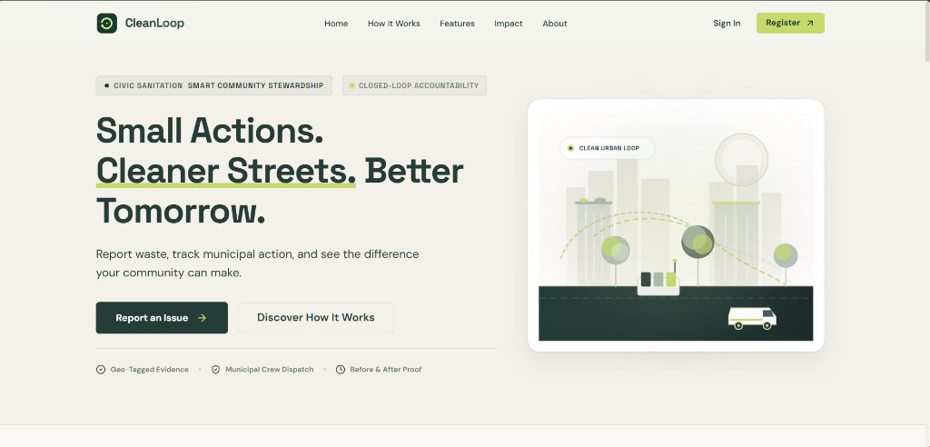
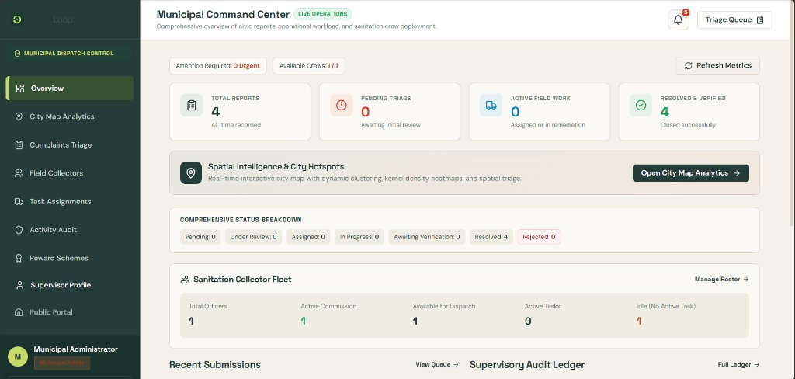
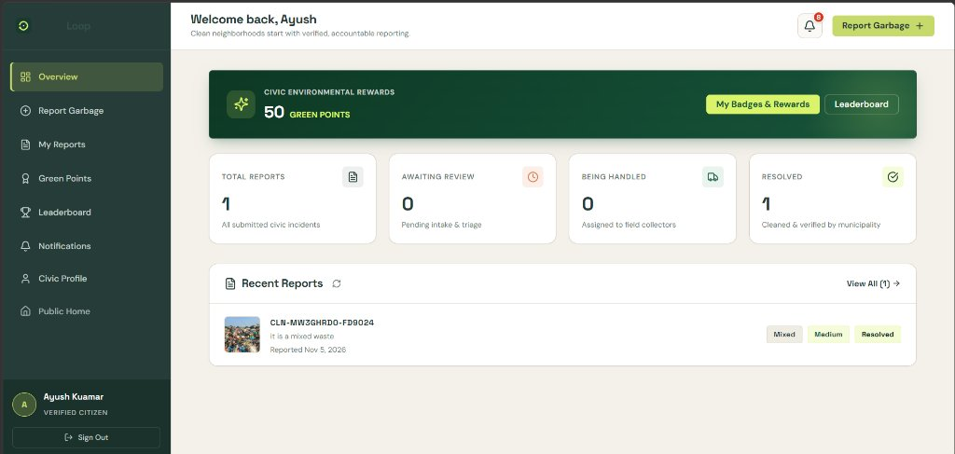
07. INTERFACE DEMONSTRATION
08 / 10
Live Application Screenshots & Operational UI
PUBLIC CIVIC PORTAL
Hero illustration, brand tagline, instant CTA navigation
MUNICIPAL COMMAND CENTER
Operational KPIs, spatial triage, fleet status & audit ledger
CITIZEN DASHBOARD & REWARDS
50 Green Points balance, report metrics, live status tracking
Key UI Innovations: Side-by-side Before/After photo comparison modal • Dynamic OpenStreetMap clustering • 5-Stage live status timeline • Mobile-first responsive navigation
CleanLoop • Smart Waste Management & Civic Remediation Platform | Academic Evaluation 2026

Slide 9
08. ENGINEERING & ROADMAP
09 / 10
Key Challenges Overcome & Future Project Horizons
ENGINEERING CHALLENGES OVERCOME
FUTURE EXPANSION & HORIZONS
✔ Atomic Reward Idempotency
Preventing duplicate Green Point credits when admins clicked verification repeatedly. Solved with database constraints, audit status gates, and single-credit checks.
★ AI Waste Image Classification
Train a computer vision model (TensorFlow.js / Gemini Vision) to automatically classify garbage type (plastic, organic, toxic) and recommend priority.
✔ Multi-Role Access Control (RBAC)
Managing 3 distinct user scopes (Citizen, Admin, Collector) without route bleeding. Implemented modular JWT middleware and React route guards.
★ IoT Smart Bin Telemetry
Deploy ultrasonic fill-level sensors on municipal bins to auto-generate collection assignments when fill capacity reaches 80%.
✔ Geospatial Clustering Performance
Rendering hundreds of incident pins caused DOM lag. Solved by integrating Supercluster on top of Leaflet for fluid multi-level zoom clustering.
★ Automated Route Optimization
Apply Dijkstra / TSP routing algorithms to calculate optimal fuel-efficient routes for collection trucks across assigned hotspot clusters.
✔ Cloud Cold-Start Resilience
Render free-tier instances sleep after inactivity. Implemented 30s frontend timeout handling, health check aliases, and Express trust-proxy configs.
★ Civic SMS / IVR Telephony
Provide telephone-based reporting and automated SMS notifications to ensure rural and non-smartphone users are included in the loop.
CleanLoop • Smart Waste Management & Civic Remediation Platform | Academic Evaluation 2026

Slide 10
09. PROJECT SUMMARY
10 / 10
Conclusion & Production Architecture
CIVIC & SOCIAL VALUE
TECHNICAL ROBUSTNESS
PRODUCTION DEPLOYMENT
• Closed-Loop Accountability
Eliminates ghost closures through mandatory supervisory photo audit.
• 383 Automated Tests
Comprehensive test suites verified 100% PASS with 0 regressions.
• Frontend (Vercel)
Edge CDN with SPA catch-all rewrites at cleanloop.vercel.app.
• Civic Participation
Empowers citizens to actively engage in neighborhood cleanliness via Green Points.
• Scalable Cloud Design
Modular micro-architecture ready to onboard multiple municipal wards.
• Backend (Render)
Express Node service with reverse proxy at cleanloop-api.onrender.com.
• Sanitation Dignity
Equips collectors with transparent digital task queues and performance metrics.
• Enterprise Security
Strict JWT auth, salted hashes, CORS guards, and sanitized inputs.
• Database & Media
MongoDB Atlas cloud cluster + Cloudinary CDN media pipeline.
Thank You!
Questions & Demonstration Discussion
Project Team: Bhuthukuri Sunitha (241FA04492) | Babul Kumar (241FA04534) | Ayush Kumar (241FA04552)
Repository: https://github.com/Babul534/CleanLoop.git
CleanLoop • Smart Waste Management & Civic Remediation Platform | Academic Evaluation 2026

