Slide 1

Go(lang)
SE4458 Babür Gür 23070006120 Assignment 1

Slide 2
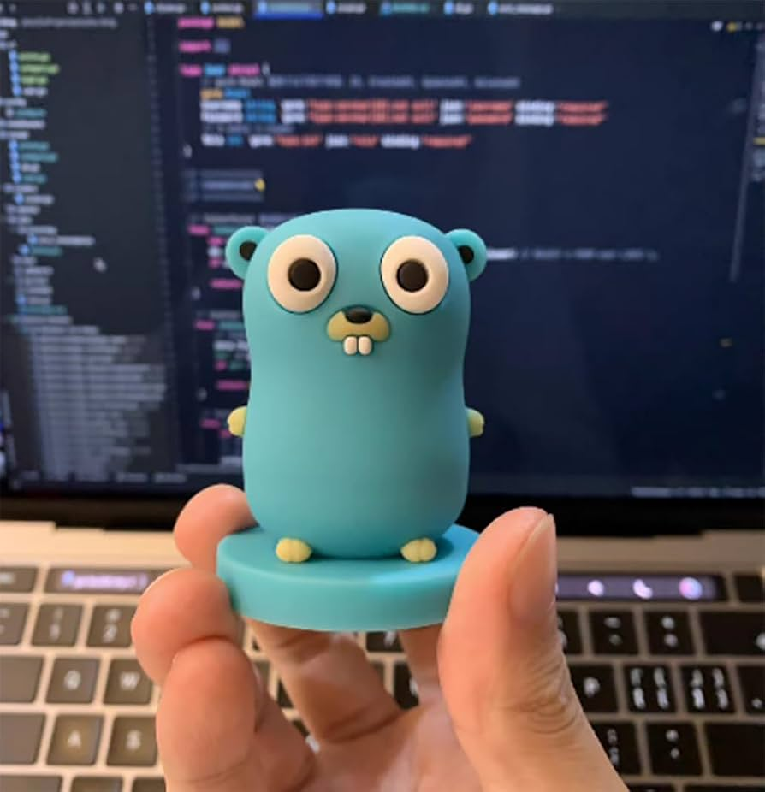
Quick Background
Go is an open-source programming language designed for systems programming and known for its simplicity, concurrency support, and efficient memory management.
Go was created at Google by Robert Griesemer, Rob Pike, and Ken Thompson, development started in 2007, and was released as an open-source project in 2009.

Slide 3
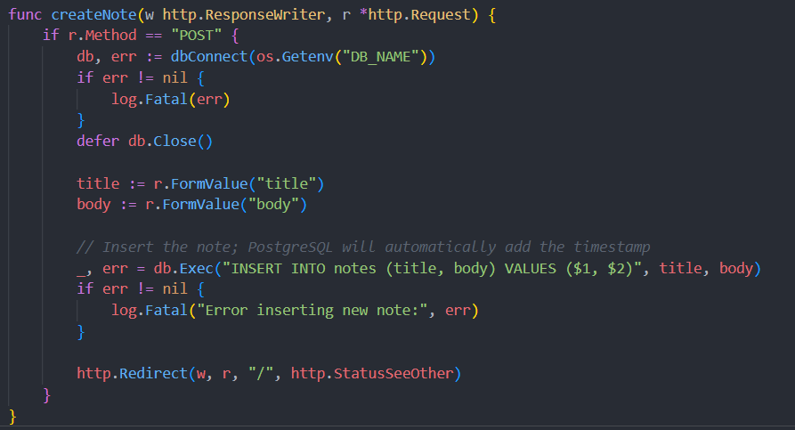
Why Go
Simplicity and Performance
Statically typed and compiled
Concurrency
Easy Concurrency through Goroutines and Channels
Highly Scalable
Robust Standard Library
Error Handling

Slide 4
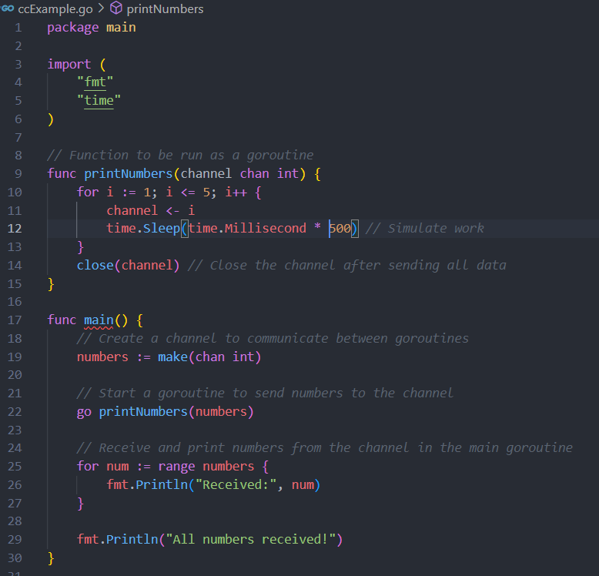
About Scalability
Goroutines
Lightweight threads managed by Go scheduler
Multiple go routines can be run to leverage multi-core systems fully
Channels
Allows safe communication between goroutine
Easy data consistency without tools like mutex
Channels allow orchestrating goroutines simply

Slide 5
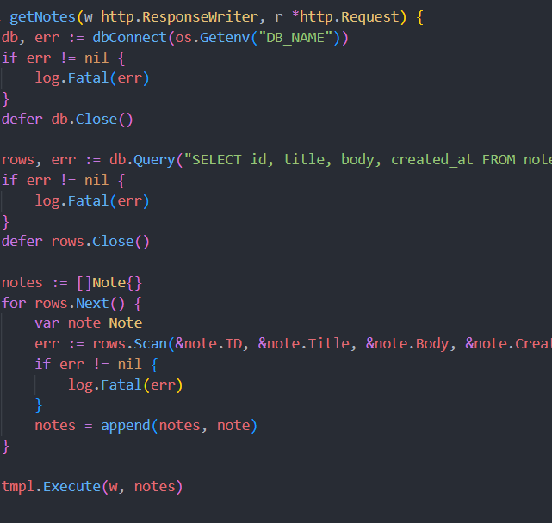
Error handling and Standard Library
Error Handling
Simple, explicit error handling
Encourages handling errors right after they happen
Batteries-included Standard Library
Includes:
Net/http package for client and server tasks
Encoding/json package
Os package
Time package

Slide 6

Why choose go?

Slide 7
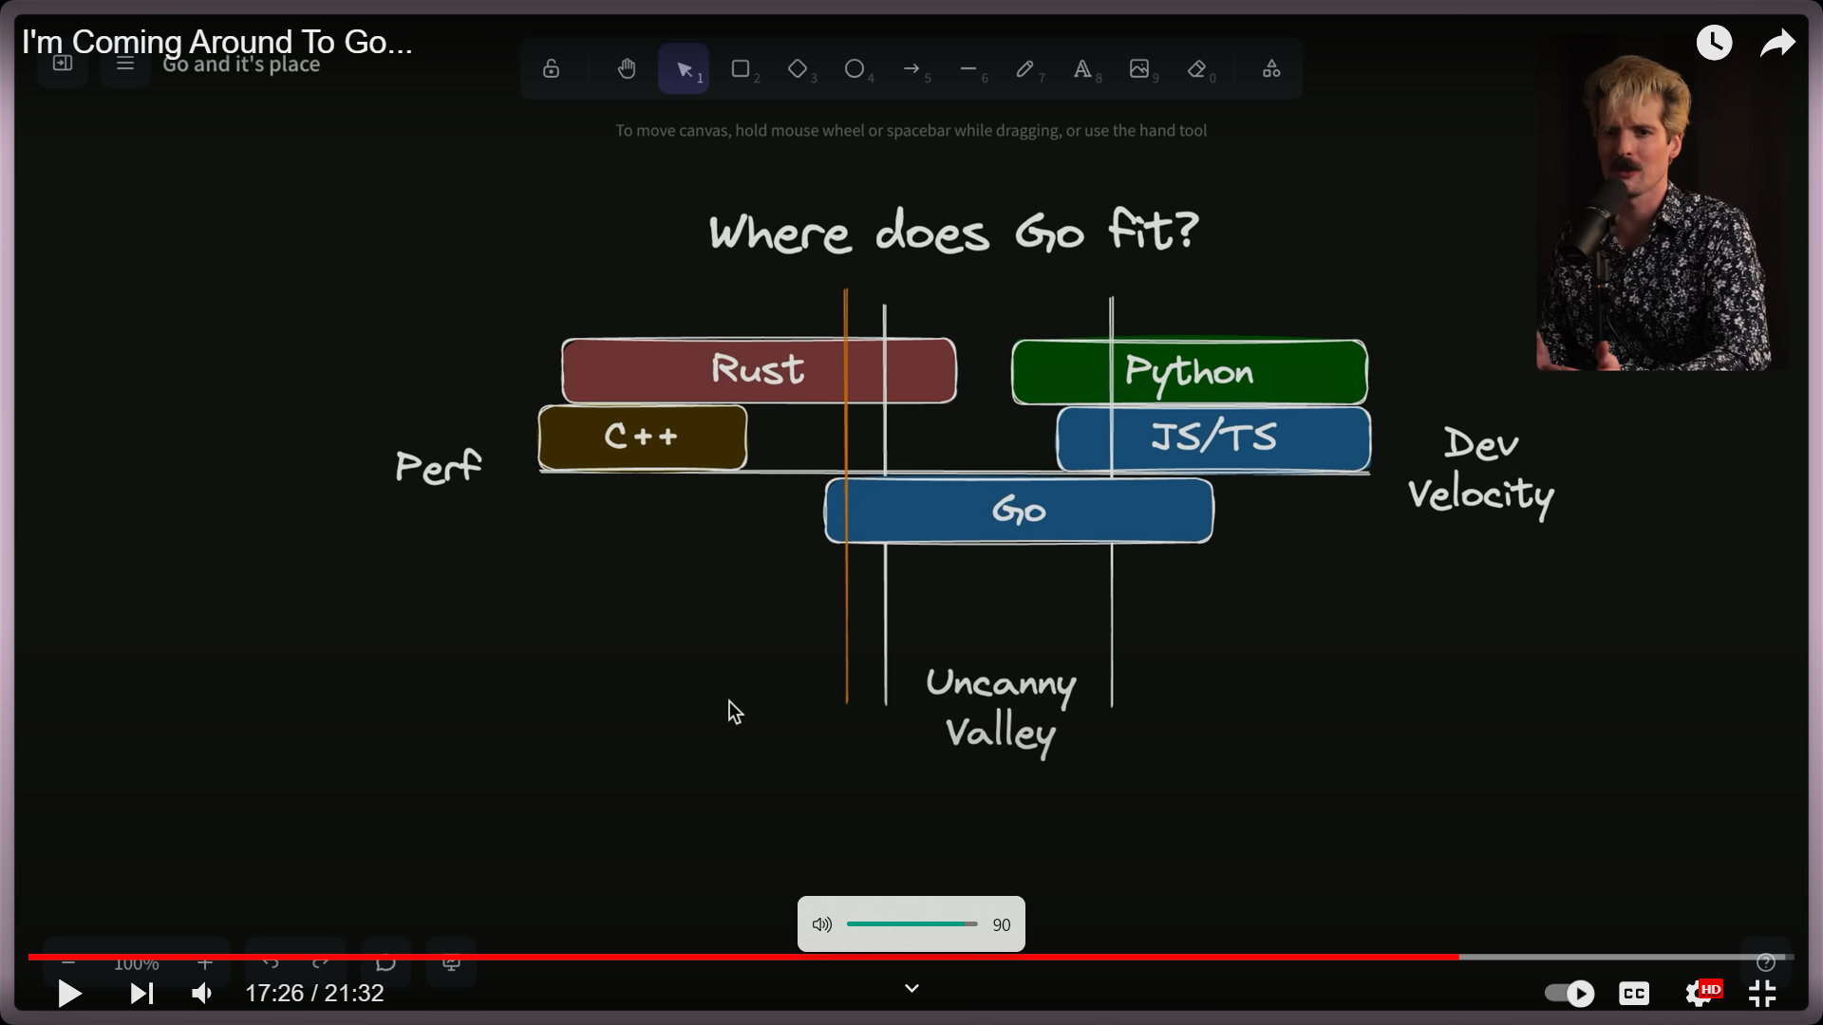
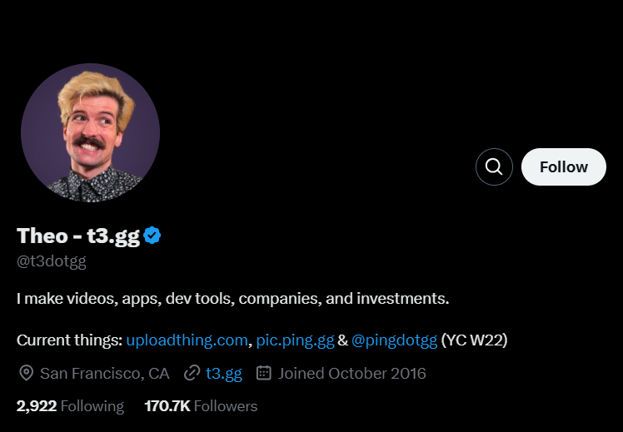
Ex Twitch dev
Source
“I’m Coming Around To Go…” https://www.youtube.com/watch?v=N8fjU_hlwDI
don’t take my word…

Slide 8








Who is currently using Go?
Popular Apps using Go
Uber
Dropbox
Twitch
SoundCloud
Netflix
Services using Go
Kubernetes
Docker
Terraform

Slide 9
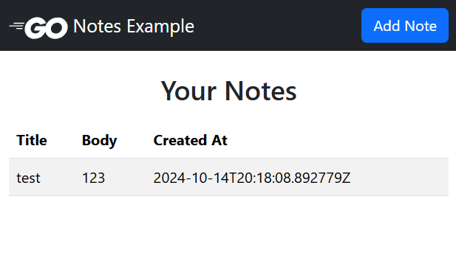
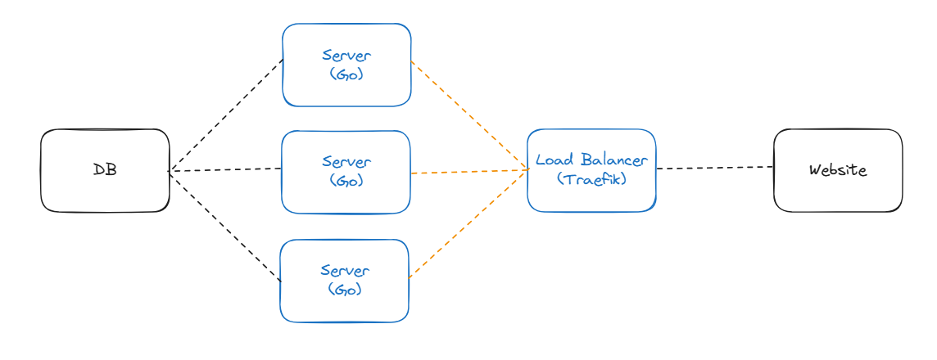
Go Example project
Simple note webapp in go
Stack used:
Go
Bootstrap
PostgreSQL
Traefik
Docker Compose

Slide 10
How to run the example
Download the repo
https://github.com/BaburG/SE4458-Go-Example
Have docker compose (or Docker Desktop) installed
https://www.docker.com/
In the project folder run the command
$docker compose up

Slide 11
Bibliography
https://codewave.com/insights/companies-using-golang-apps-startups/
https://www.youtube.com/watch?v=N8fjU_hlwDI
https://en.wikipedia.org/wiki/Go_(programming_language)
https://chatgpt.com/
https://go.dev/solutions/case-studies

