Slide 1

COCA-COLA RETAILER ANALYSIS
-By
-Baby G
-4Th BCA ‘A’
-BCA232661
-Data Analysis

Slide 2
agenda
Business overview
data analysis
Result from the analysis done
COCA-COLA SALES DASHBOARD

Slide 3
business analysis
The data set is of coca-cola business.
It has spread it’s business across south , Midwest , northeast, southeast
And west.
It’s retailers are bevco , dreamco , fizzysip and sodapop.
It has a variety of beverage brands like Dasani water, diet coke, coke, powerade and sprite.

Slide 4
Data analysis
We used excel for analysis the data.
Steps followed were:
Looked for anomalies.
Created pivot tables for visualisations.
From the pivot tables, charts were made.
All the charts and slicers added in the dashboard were organized and formatted.
Calculated average operating margin, total revenue, total operating expenses and operating profit ratio.

Slide 5
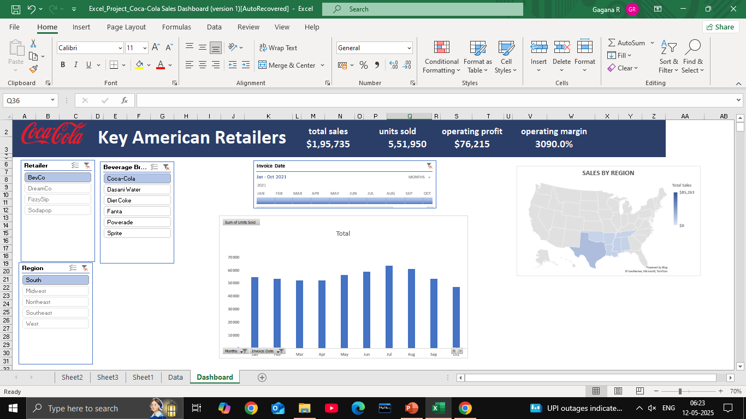
KPI (KEY PERFORMANCE INDICATORS)
THESE ARE METRICS USED TO TRACK AND MEASURE THE SUCCESS OF SPECIFIC OBJECTIVES.

Slide 6
GRAPHS
GRAPHS OR CHARTS IN EXCEL ARE VISUAL TOOLS USED TO REPRESENT DATA FOR EASIER UNDERSTANDING, COMPARISION AND TREND ANALYSIS.

Slide 7
TIMELINE
TIMELINES ARE SPECIAL SLICERS USED TO FILTER DATA-BASED DATA IN PIVOTTABLES OR PIVORCHARTS.
THEY ALLOW YOU TO VISUALLY FILTER BY TIME PERIODS LIKE YEARS, QUARTERS, MONTHS OR DAYS USING A SCROLLABLE BAR.

Slide 8
SLICERS
SLICERS ARE VISUAL FILTERS IN EXCEL USED TO MAKE IT EASIER TO FILTER DATA IN PIVOTTABLES, PIVOTCHARTS AND TABLES.
THEY PROVIDE BUTTONS THAT YOU CAN CLICK TO FILTER DATA QUICKLY AND INTERACTIVELY.

Slide 9
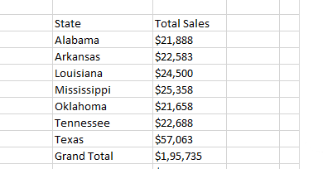
MAPS

Slide 10
COCA-COLA SALES DASHBOARD
A DASHBOARD IS SINGLE PAGE REPORT SHOWING ALL THE IMPORTANT VALUES RELATED TO BUSINESS.

