Slide 1
Q1
Indicate whether the following statements are true or false. Justify your answer.
Buffering can be used to improve I/O efficiency for files that are being written and re-read rapidly.
Process will be in either running or ready state after performing an I/O system call if non-blocking I/O is used.
Device drivers are part of the kernel I/O subsystem.

Slide 2
Q1
Indicate whether the following statements are true or false. Justify your answer.
Buffering can be used to improve I/O efficiency for files that are being written and re-read rapidly.
False: Buffering is mainly used to cope with device speed mismatch or transfer size mismatch.
Process will be in either running or ready state after performing an I/O system call if non-blocking I/O is used.
False: Using non-blocking I/O, the process will be able to continue to execute after the system call.
Device drivers are part of the kernel I/O subsystem.
False. Device drivers are not part of the kernel I/O subsystem.

Slide 3
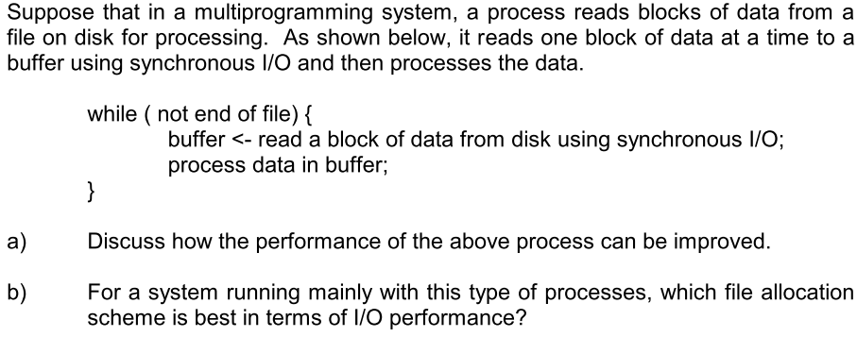
Q2

Slide 4
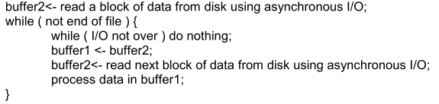
Q2 (a)
Discuss how the performance of the above process can be improved
→ Using double-buffer and asynchronous I/O

Slide 5
Q2 (b)
For a system running mainly with this type of processes, which file allocation scheme is best in terms of I/O performance?
→ Contiguous file allocation is most suitable.

Slide 6
Q3
During his presentation, a salesman emphasized on the substantial effort his company has made to improve the performance of their UNIX version - one example he quoted was that the disk driver used the SCAN algorithm and also queued multiple requests within a cylinder in sector order. You bought a copy and wrote a program to randomly read 10,000 blocks spread across the disk. The performance measured was the same as what would be expected from FCFS algorithm. Was the salesman lying?

Slide 7
Q3 (a)
Not necessarily.
if the requests are issued one at a time.
The disk driver has no opportunity for SCAN optimization (SCAN=FCFS)
Solution: generates many concurrent I/Os

Slide 8
Q3 (b)
Under what circumstances could a disk scheduling discipline not improve the performance or even degrade performance of the system?

Slide 9
Q3 (b)
Under light load conditions.
If overhead for scheduling is significantly more than the average seek time.

Slide 10
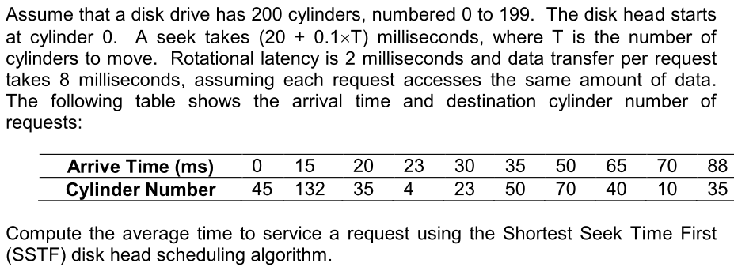
Q4

Slide 11
What is the time for one request?
Service time
= seek time + rotational latency + data transfer time
= 20+0.1*T +2 +8

Slide 12
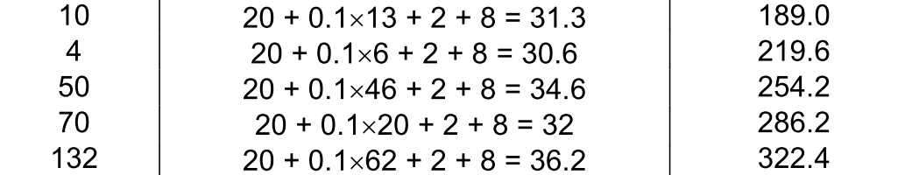
Average Service Time
Average=322.4/10=32.24 milliseconds.

