Slide 1
1. Indicate whether the following statements are true or false. Justify your answers.
(a) In the dining-philosopher problem with five philosophers, if we allow at most four of them to be hungry simultaneously, deadlock may still occur.
(b) It is impossible to have a deadlock involving only one single process.
(c) If a resource allocation graph contains a cycle, then a deadlock has occurred.

Slide 2
1a) In the dining-philosopher problem with five philosophers, if we allow at most four of them to be hungry simultaneously, deadlock may still occur.
False.
Justification: Deadlock does not occur, since at least one philosopher can get both chopsticks.

Slide 3
1b) It is impossible to have a deadlock involving only one single process.
True.
Justification: The hold-and-wait condition can never be satisfied.

Slide 4
1c) If a resource allocation graph contains a cycle, then a deadlock has occurred.
False.
Justification: It depends on the number of instances per resource type.

Slide 5
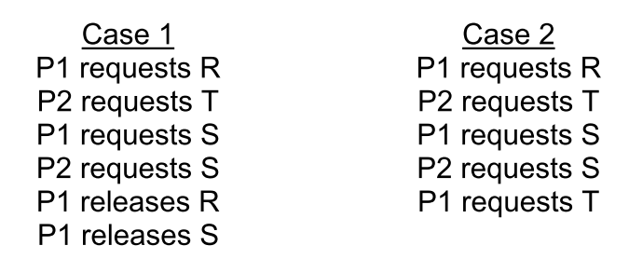
2. Use resource-allocation graphs to model the following situations, and determine if deadlock occurs in each case. There are three resource types, R, S, and T, each having a single instance.

Slide 6
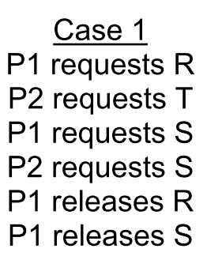
Case 1: Resource Graph
P1
P2
R
R
R
R
S
T

Slide 7
Case 1: Resource Graph
P1
P2
R
R
R
R
S
T

Slide 8
Case 1: Resource Graph
P1
P2
R
R
R
R
S
T

Slide 9
Case 1: Resource Graph
P1
P2
R
R
R
R
S
T

Slide 10
Case 1: Resource Graph
P1
P2
R
R
R
R
S
T

Slide 11
Case 1: Resource Graph
P1
P2
R
R
R
R
S
T

Slide 12
Case 1: Resource Graph
P1
P2
R
R
R
R
S
T

Slide 13
Case 1: Resource Graph
P1
P2
R
R
R
R
S
T

Slide 14
Case 1: Resource Graph
P1
P2
R
R
R
R
S
T

Slide 15
Case 1: Resource Graph
P1
P2
R
R
R
R
S
T
No deadlock.

Slide 16
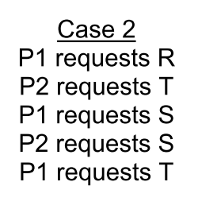
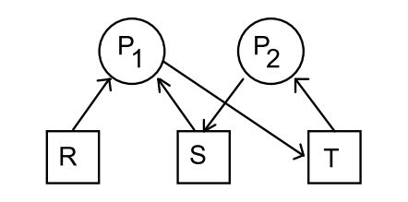
Case 2: Resource Graph
Deadlock!

Slide 17
3. A resource-allocation state is given below. Assume Available = 2
If PROCESS 4 requests for one more unit of the resource, does this lead to a safe state or an unsafe one?
(b) If PROCESS 3 requests for one more unit of the resource, does this lead to a safe state or an unsafe one?
 | Allocation | Max | Need
PROCESS 1 | 1 | 6 | 5
PROCESS 2 | 1 | 5 | 4
PROCESS 3 | 2 | 4 | 2
PROCESS 4 | 4 | 7 | 3

Slide 18
If PROCESS 4 requests for one more unit…
 | Allocation | Max | Need
PROCESS 1 | 1 | 6 | 5
PROCESS 2 | 1 | 5 | 4
PROCESS 3 | 2 | 4 | 2
PROCESS 4 | 4 | 7 | 3
Available = 2
 | Allocation | Max | Need
PROCESS 1 | 1 | 6 | 5
PROCESS 2 | 1 | 5 | 4
PROCESS 3 | 2 | 4 | 2
PROCESS 4 | 5 | 7 | 2
Available = 1
→unsafe, since Need_{i} > Available for all i.

Slide 19
If PROCESS 3 requests for one more unit…
 | Allocation | Max | Need
PROCESS 1 | 1 | 6 | 5
PROCESS 2 | 1 | 5 | 4
PROCESS 3 | 2 | 4 | 2
PROCESS 4 | 4 | 7 | 3
Available = 2
 | Allocation | Max | Need
PROCESS 1 | 1 | 6 | 5
PROCESS 2 | 1 | 5 | 4
PROCESS 3 | 3 | 4 | 1
PROCESS 4 | 5 | 7 | 2
Available = 1
→Safe, since sequence <PROCESS 3, PROCESS 2, PROCESS 1, PROCESS 4> satisfies safety requirement.

Slide 20
4. Consider the following snapshot of a system’s state, with four processes (P0, P1, P2 and P3) and three resource types (A, B and C). The current Allocation, Need and Available matrices are shown in the below table. Compute the minimum value for x, so that this system state is safe. Justify your answer.
 |  | Available
 |  | A B C 0 1 x
Process | Allocation | Need
 | A B C | A B C
P0 | 2 1 1 | 0 1 0
P1 | 1 1 0 | 2 1 2
P2 P3 | 1 1 1 1 1 1 | 2 0 1 4 1 0

Slide 21
The minimum value of x is 0 with the safe sequence <P0,P2,P1,P3>.
Running the safety algorithm, Available matrix evolves as follows.
Available Need Allocation Process completion
A B C A B C
0 1 x=0 0 1 0 2 1 1 P0
2 2 1 2 0 1 1 1 1 P2
3 3 2 2 1 2 1 1 0 P1
4 4 2 4 1 0 1 1 1 P3
5 5 3

