Slide 1
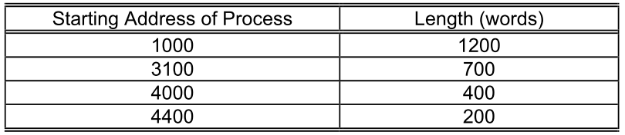
Q1
1. A particular computer system provides a total memory of 4800 words to users. It supports multiprogramming with multiple-partition. At a given moment in time, the memory is occupied by four processes:

Slide 2
Q1 (2)
When a new process requests memory, the following method is employed:
STEP 1: Use the Best-fit algorithm to allocate memory for this new process. Do Step 2 only if there is no hole which fits the memory request.
STEP 2: Do memory compaction by moving occupied partitions towards lower memory addresses. Compaction stops when a sufficiently large hole is formed for the new memory request. If, at the end of compaction, there is still insufficient space, the process requesting for more memory is blocked.

Slide 3
Q1 (3)
The Operating System receives three new memory requirements from processes: 600, 250 and 1050 words (requested in this order).
a) Show the memory allocation after all three requests have been serviced.
b) If the algorithm in Step 1 had been First-fit, show the memory allocation after all three requests have been serviced.
c) In this particular case, which algorithm yields a lower overhead in terms of total relocation of occupied partitions?

Slide 4
Q1 (Best Fit)
Req:
600
Req:
250
0
0
0
1000
1000
1000
1000
1000
1000
2200
2200
2200
900
600
600
600
3100
2800
2800
250
250
300
3800
3100
3050
200
50
50
4000
3800
3100
200
4000
3800
4400
200
4600
4400
4000
200
4600
4800
4400
200
4800
4600
Occupied
200
4800
Free

Slide 5
Q1 (Best Fit)
Req:
1050
Moved
0
1000
1200
1200
1000
1200
2200
600
600
600
250
250
2800
250
Compact
1050
3050
1000
1050
50
50
700
50
50
3100
700
700
200
3800
200
200
200
4000
200
200
400
4400
400
400
4600
200
200
200
4800

Slide 6
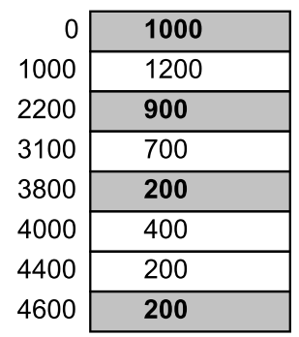
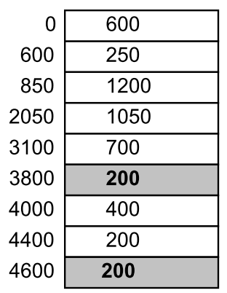
Q1 (b): First Fit
1200

Slide 7
Q1 (c )
The total movement of partitions:
- Best Fit: 2050 words (1200 + 600 + 250)
First Fit: 1200 words.
In this particular case, First Fit has lower overhead.

Slide 8
Q2
2. a) Identify memory allocation schemes that suffer from internal fragmentation.
b) Explain why memory compaction cannot be performed if absolute address format is used in the code.

Slide 9
Q2a
2. a) Identify memory allocation schemes that suffer from internal fragmentation.
→ fixed partitioning and paging

Slide 10
Q2
2. b) Explain why memory compaction cannot be performed if absolute address format is used in the code.
If absolute address is used, the code and data cannot be moved around in the memory (otherwise, addressing error happens).
Compaction requires moving code and data in the memory and so it cannot be performed.

Slide 11
Q3 Memory Access Time
Consider a paging system with the page table stored in memory.
a) If a memory reference takes 200 nanoseconds, how long does a paged memory reference take?
b) If we add associative registers, and 75 percent of all page-table references are found in the associative registers, what is the effective memory reference time? (Assume that finding a page-table entry in the associative registers takes zero time, if the entry is there.)

Slide 12
Q3 (a)
400 nanoseconds, two memory accesses:
One for the page table
One for the word in memory.

Slide 13
Q3 (b)
Access time
200, when the reference in associative registers.
400, otherwise.
Effective access time = 0.75 x (200 nanoseconds) + 0.25 x (400 nanoseconds) = 250 nanoseconds.

Slide 14
Q4
Consider a computer system with a 32-bit logical address and 1-Kbyte page size. The system has 1 Gbyes of physical memory.
a) Give the format of both the logical and physical addresses of this system.
b) How many entries are there in a page table?
c) If an inverted page table is used, how many entries are there?

Slide 15

Q4 (a)
Consider a computer system with a 32-bit logical address and 1-Kbyte page size. The system has 1 GByes of physical memory.
a) Give the format of both the logical and physical addresses of this system.
Logical Address
Physical Address
Page
number
Page
offset
Frame
number
Page
offset
Step 1: total number of bits
32
30
Step 2: offset
10
10
Step 3: page/frame number
22
20

Slide 16
Q4 (b)
Consider a computer system with a 32-bit logical address and 1-KByte page size. The system has 1 GByes of physical memory
b) How many entries are there in a page table?
→ 2²²
Logical Address
Page
number
Page
offset
22 bits
10 bits

Slide 17
Q4 (c)
Consider a computer system with a 32-bit logical address and 1-Kbyte page size. The system has 1 Gbyes of physical memory
c) If an inverted page table is used, how many entries are there?
→ 2²⁰
Physical Address
Frame
number
Page
offset
20 bits
10 bits

