Slide 1
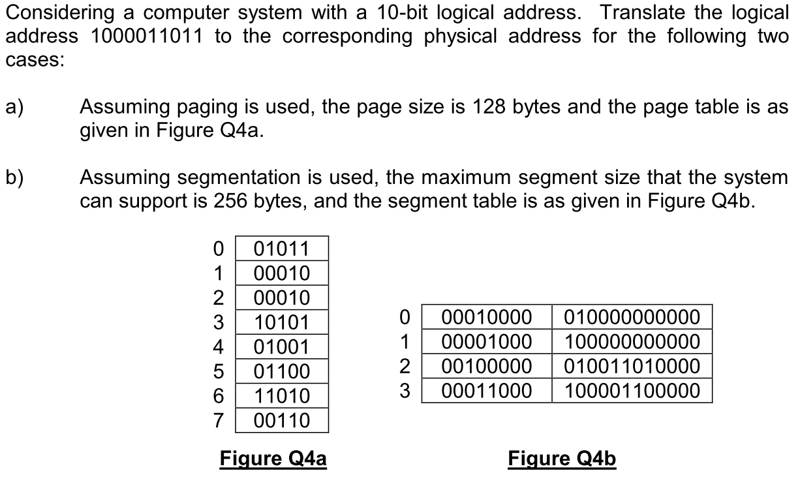
Q1

Slide 2
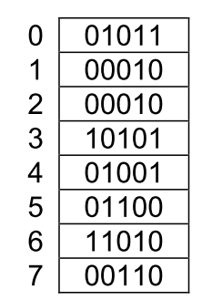

Q1 (a)
Given page size is 128 bytes→ 7 bits are needed for page offset and 3 bits for page number.
Page
number
offset
010010011011
Page table
Notes:
2 to the 30th power

Slide 3
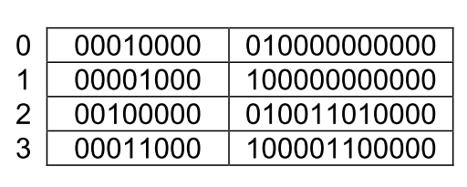
Q1 (b)
The maximum segment size is 256 bytes→ 8 bits are needed for the segment offset and 2 bits for segment number.
Seg.
number
offset
00011011 (offset)
+ 010011010000 (base)
= 010011101011
Segment table
Notes:
2 to the 30th power

Slide 4
Q2
A paged memory system uses the page size of 1024 bytes. Size of a page table entry is 4 bytes and the logical address space is 2³⁰ bytes.
a) What is the size of the page table if single level of paging is used?
b) What is the minimum number of levels of page tables needed in this system to ensure that the outmost page table will fit within a single page frame?
c) Draw an address translation diagram to show how logical address translation is performed.

Slide 5
Q2 (Answer)
a) size of page table: #pages × page_table_entry_size
=2³⁰/2¹⁰ × 4 = 2²² = 4 megabytes
b) If two-level paging is used, size of outer page table: 2²²/2¹⁰ × 4 = 2¹⁴ = 16k bytes > 1024 bytes.
If three-level paging is used, size of outer page table: 2¹⁴/2¹⁰ × 4 = 2⁶ bytes < 1024 bytes.
→ at least three levels.
Notes:
2 to the 30th power

Slide 6

Q2 (c)
30 bits
Page Number
Offset
# of Pages
30-10=20 bits
Page size
1024 bytes→10 bits
P1
P2
P3
Hints:
P1: the index in the level 3 (outmost). Each entry in level 3 page table points to a page in Level 2.
P2: the index within a page in the level 2. Each entry in level 2 page table points to a page in Level 1.
P3: the index within a page in the level 1. Each entry in level 1 page table points to a memory frame.

Slide 7
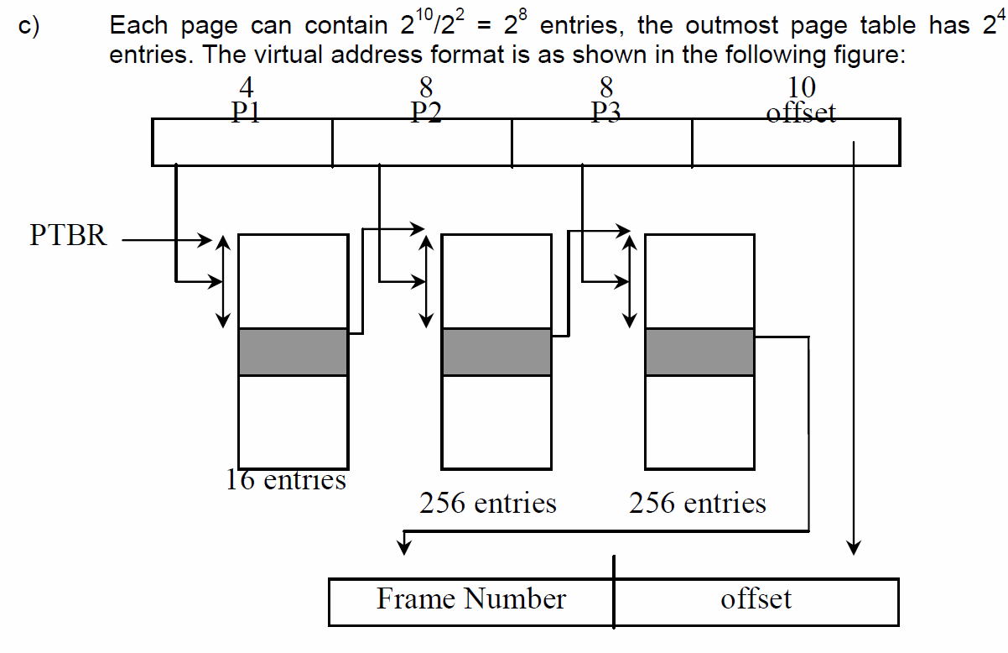
Q2 (c)
(page table
Base register)
Level 3 Page Table
A page
in
Level 2
A page
in
Level 1

Slide 8
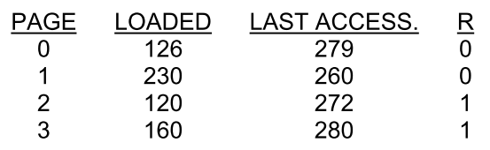
Q3
1. A computer has four page frames. The time of loading, time of last access, and the R bit for each page are as shown below (the times are in clock ticks):

Slide 9
Q3 (a)
a) Which page will FIFO replace?

Slide 10
Q3 (b)
b) Which page will second chance replace?
(different from FIFO)

Slide 11
Q3 (c)
c) Which page will LRU replace?

Slide 12

Q4
2. For each of the page replacement policies listed below, calculate the number of page faults encountered when referencing the following pages. Assume the availability of 4 empty page frames.
a) FIFO
b) CLOCK
c) LRU

Slide 13
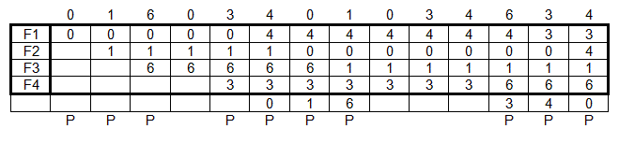

Q4 (FIFO, Final)

Slide 14
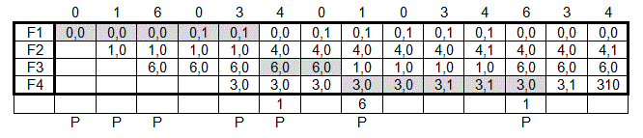

Q4 (CLOCK, Final)
Page
Number
Circular Queue
R Bit
3,1
Clock hand in shaded entry.

Slide 15
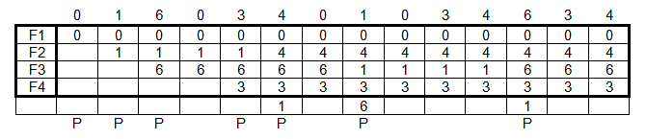

Q4 (LRU)

