Slide 1
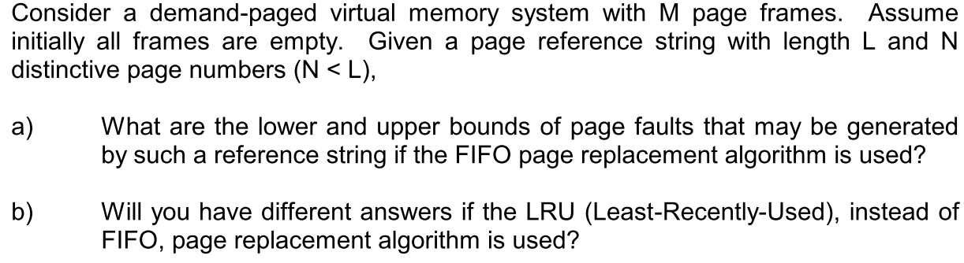
Q1

Slide 2
Q1 (a)
What are the lower and upper bounds of page faults that may be generated by such a reference string if the FIFO page replacement algorithm is used?
Hints: Consider two cases: 1) If N <= M, 2) If N > M.
Answer:
If N <= M, the lower and upper bounds are both N.
→ Once N distinct pages are loaded into the memory, no more page faults may occur.
If N>M, the lower bound is N and upper bound is L.
→ Can you construct the reference strings?

Slide 3
Q1 (a) -- If N>M
The lower bound is N
→ The reference string:
Example (N=3, L=7, M=2): P1 P2 P1 P2 P1 P2 P3
The upper bound is L.
The reference string:
Example (N=3, L=7, M=2): P1 P2 P3 P1 P2 P3 P1
P1 | P2 | … | PM | P1 | P2 | … | PM | … | … | P1 | P2 | … | PM | PM+1 | PM+2 | … | PN
P1 | P2 | … | PN | P1 | P2 | … | PN | … | … | P1 | P2 | … | PN
Notes:
The first M page references are distinctive.
There are no new page references for the next L – N references.
The last (N – M) page references are distinctive and are different from the first M references.

Slide 4
Q1 (b)
Will you have different answers if the LRU (Least-Recently-Used), instead of FIFO, page replacement algorithm is used?
→ No. The same as FIFO.

Slide 5
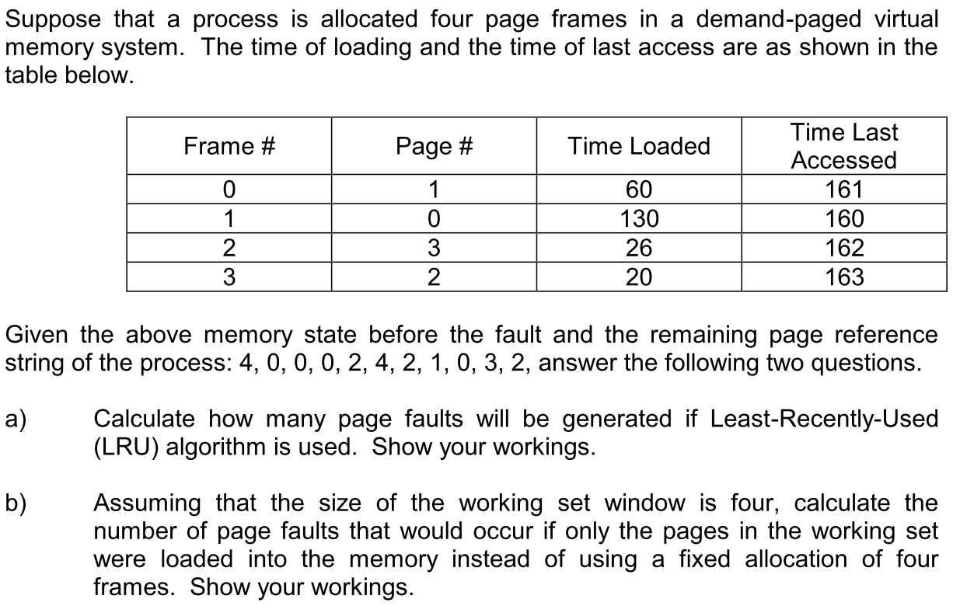
Q2

Slide 6
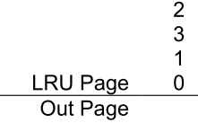




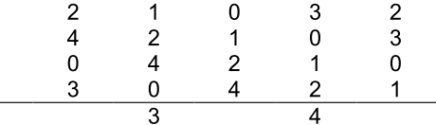
Q2 (a)
Number of page faults: 4

Slide 7
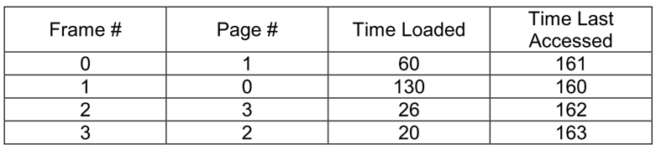

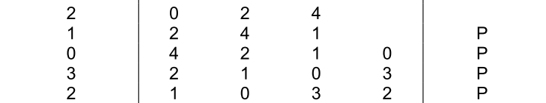
Q2 (b)
Number of page faults: 7

Slide 8

Q3
3. Consider a demand-paging system with the following time-measured utilizations:
Which (if any) of the following will (probably) improve CPU utilization?
How to get
those stats?

Slide 9
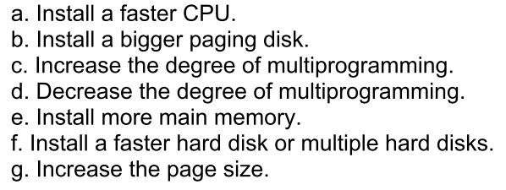
Q3: improve CPU utilization?
No.
No.
No.
Yes.
Yes.
Probably yes.
Depends on memory access pattern.

Slide 10
Q3
A possible improvement, for as the disk bottleneck is removed by faster response and more throughput to the disks, the CPU will get more data more quickly.
- Increasing the page size will result in fewer page
faults if data is being accessed sequentially
- If data access is more or less random, more paging actions could occur because fewer pages can be kept in memory and more data is transferred per page fault.

