Slide 1
AI Plagiarism &
AI-Content Detector
An Artificial Intelligence Project
“Is this the student’s work — or the internet’s?”
Muhammad Attaullah Muhammad Ibraim Abdul Samad
Course: AI-101
GPU: RTX 4060 Ti (CUDA)

Slide 2
OVERVIEW
What Is This Project?
A smart tool that reads a student’s work and answers one question: is the writing the student’s own — or copied / written by an AI?
Plagiarism %
AI-generated %
Integrity score
How much looks copied
How likely it is AI
100 = clean, lower = risky
It also highlights suspicious text, finds matching sources, studies writing style, exports a PDF report — and runs fully offline.

Slide 3
AI CONCEPTS
How This Is an AI Project
● Machine Learning — the model learns from thousands of human & AI essays, not fixed rules.
● Neural Networks — layered software, inspired by the brain, that learns patterns in text.
● Natural Language Processing — teaching the computer to understand human language.
● Transformers — the modern AI design (like ChatGPT). Our main model, DistilBERT, is one.
● Fine-tuning — taking a model that already knows English and training it for our job.

Slide 4
THE BRAIN
The AI Models Used
● DistilBERT classifier — main signal (60%). A fast transformer, fine-tuned to spot AI text.
● GPT-2 perplexity — measures how predictable the text is. AI is smooth; humans are messier. (25%)
● Burstiness — humans vary sentence length; AI stays steady. (15%)
● TF-IDF + cosine similarity — turns text into numbers to find copied passages (plagiarism).
● Stylometry — a writing “fingerprint” compared to the student’s past work.

Slide 5
HARDWARE & CUDA
Training on an RTX 4060 Ti
Training needs millions of calculations — too slow for a CPU. We used an NVIDIA GeForce RTX 4060 Ti (GPU), which runs many calculations at once.
● CUDA — NVIDIA tech that lets our code run on the GPU. Training is GPU-only by design.
● Mixed precision (AMP) — uses smaller FP16 numbers where safe: faster and less memory.
Using device: cuda
GPU Detected: NVIDIA GeForce RTX 4060 Ti
AMP matmul on GPU: OK

Slide 6
TOOLS & SOFTWARE
What Was Installed
PyTorch (CUDA) — Deep-learning engine, runs on GPU
HuggingFace Transformers — Provides DistilBERT & GPT-2
scikit-learn — TF-IDF + cosine for plagiarism
spaCy — Language analysis for writing style
Flask + SQLAlchemy — Backend server + database
React + Tailwind — The web page the user clicks
ReportLab / PDF.js — PDF report + file preview

Slide 7
4 STEPS
How the Model Was Trained
1
Collect data — Real human & AI essays from Kaggle datasets.
2
Clean & balance — Merge, remove duplicates, balance, split 80/10/10 (seed 42 → 49,400 rows).
3
Train on the GPU — Fine-tune DistilBERT for 3 epochs, batch 16, mixed precision on the 4060 Ti.
4
Check & save best — Test accuracy/F1 each pass; keep the best model.

Slide 8
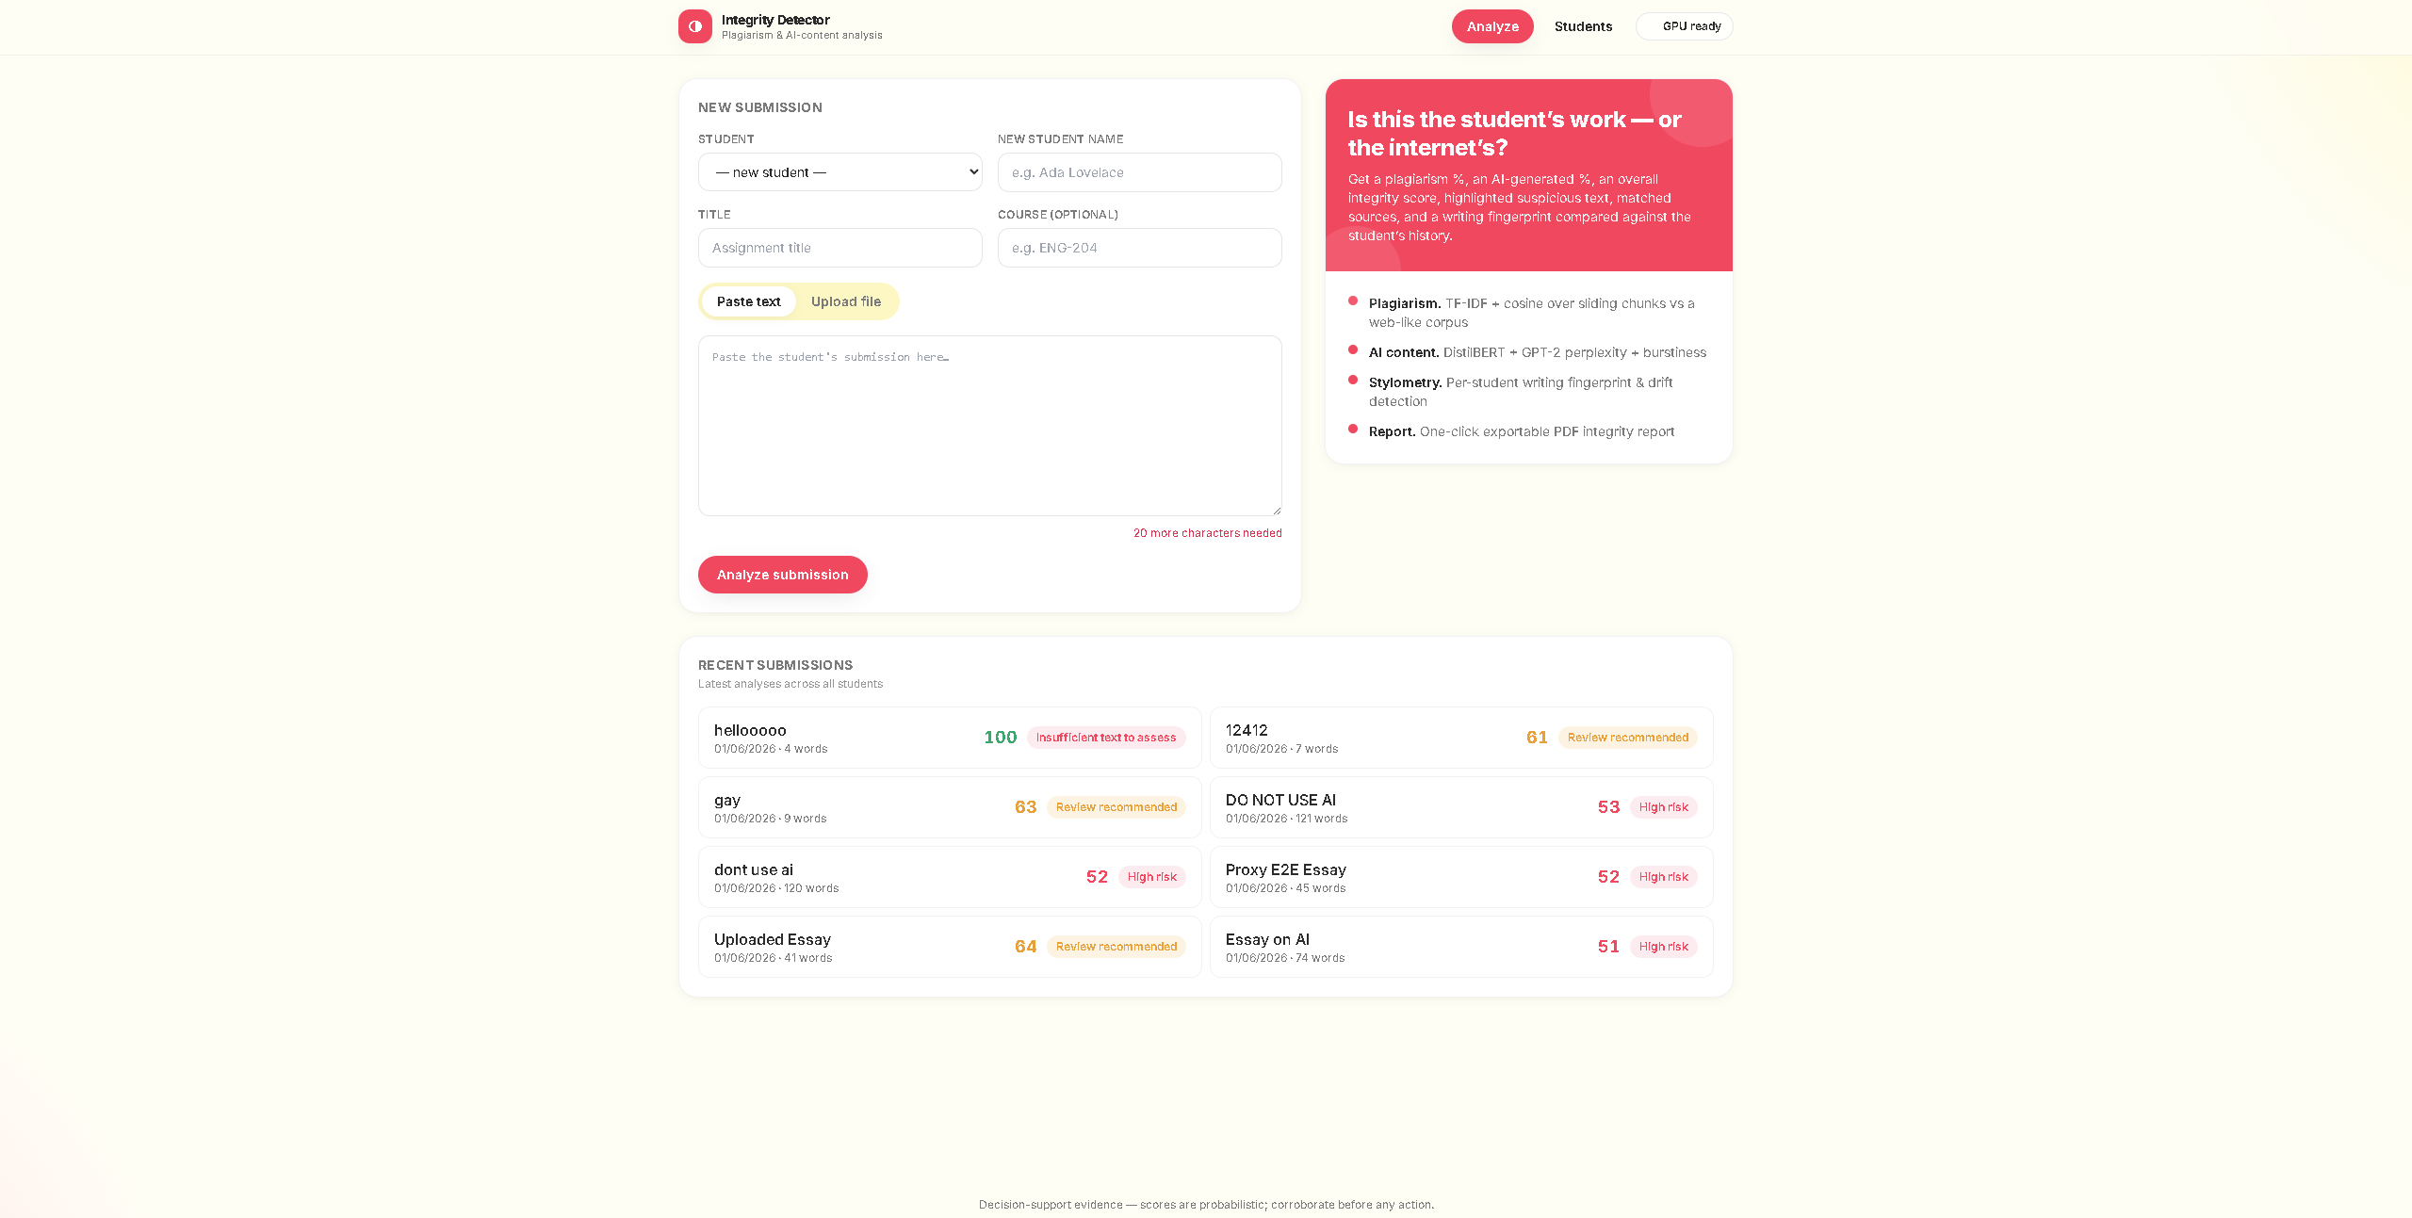
LIVE DEMO
How the App Works
Pick a student, paste text or upload a file, then click Analyze. “GPU ready” = the card is active.

Slide 9
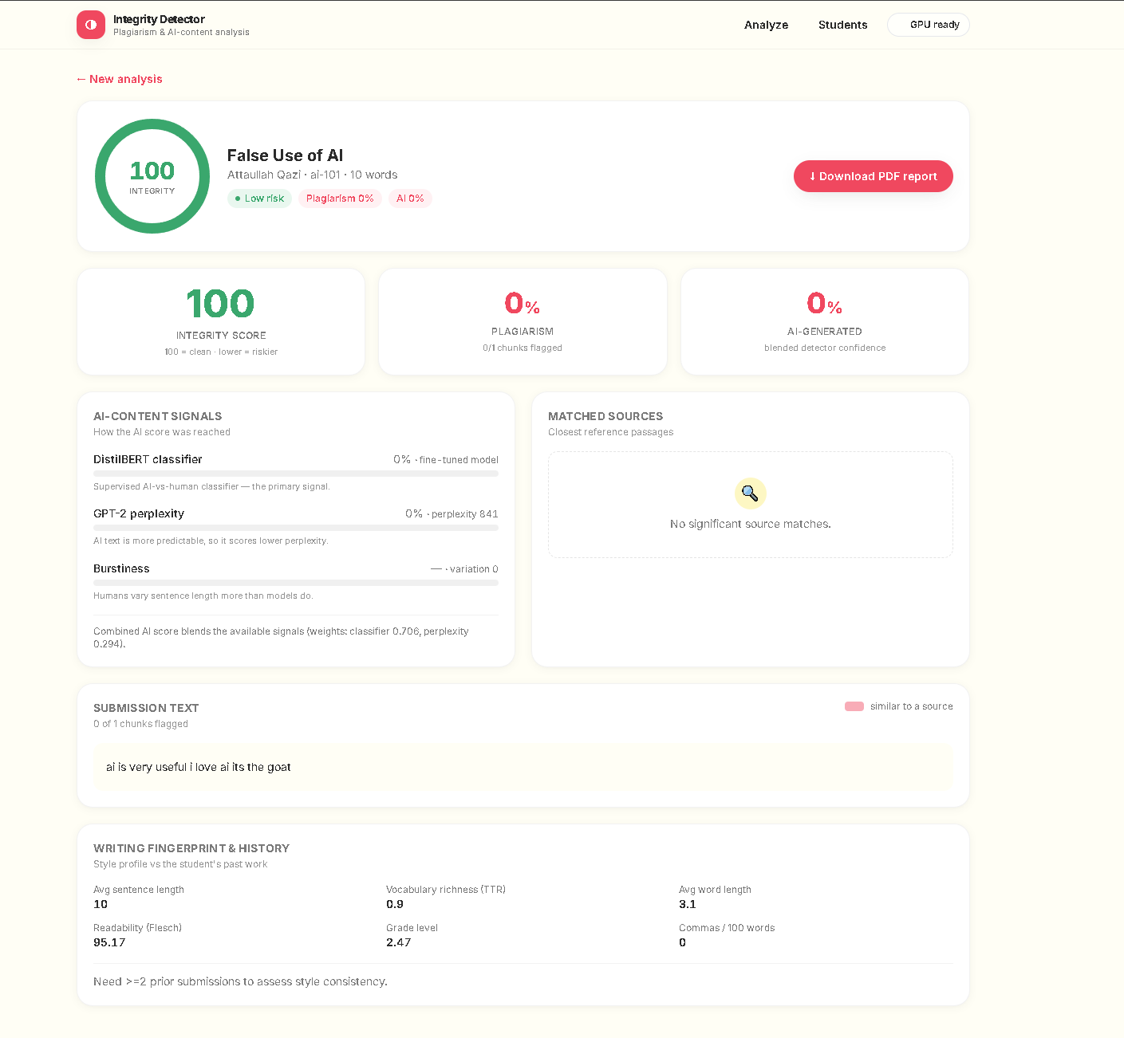
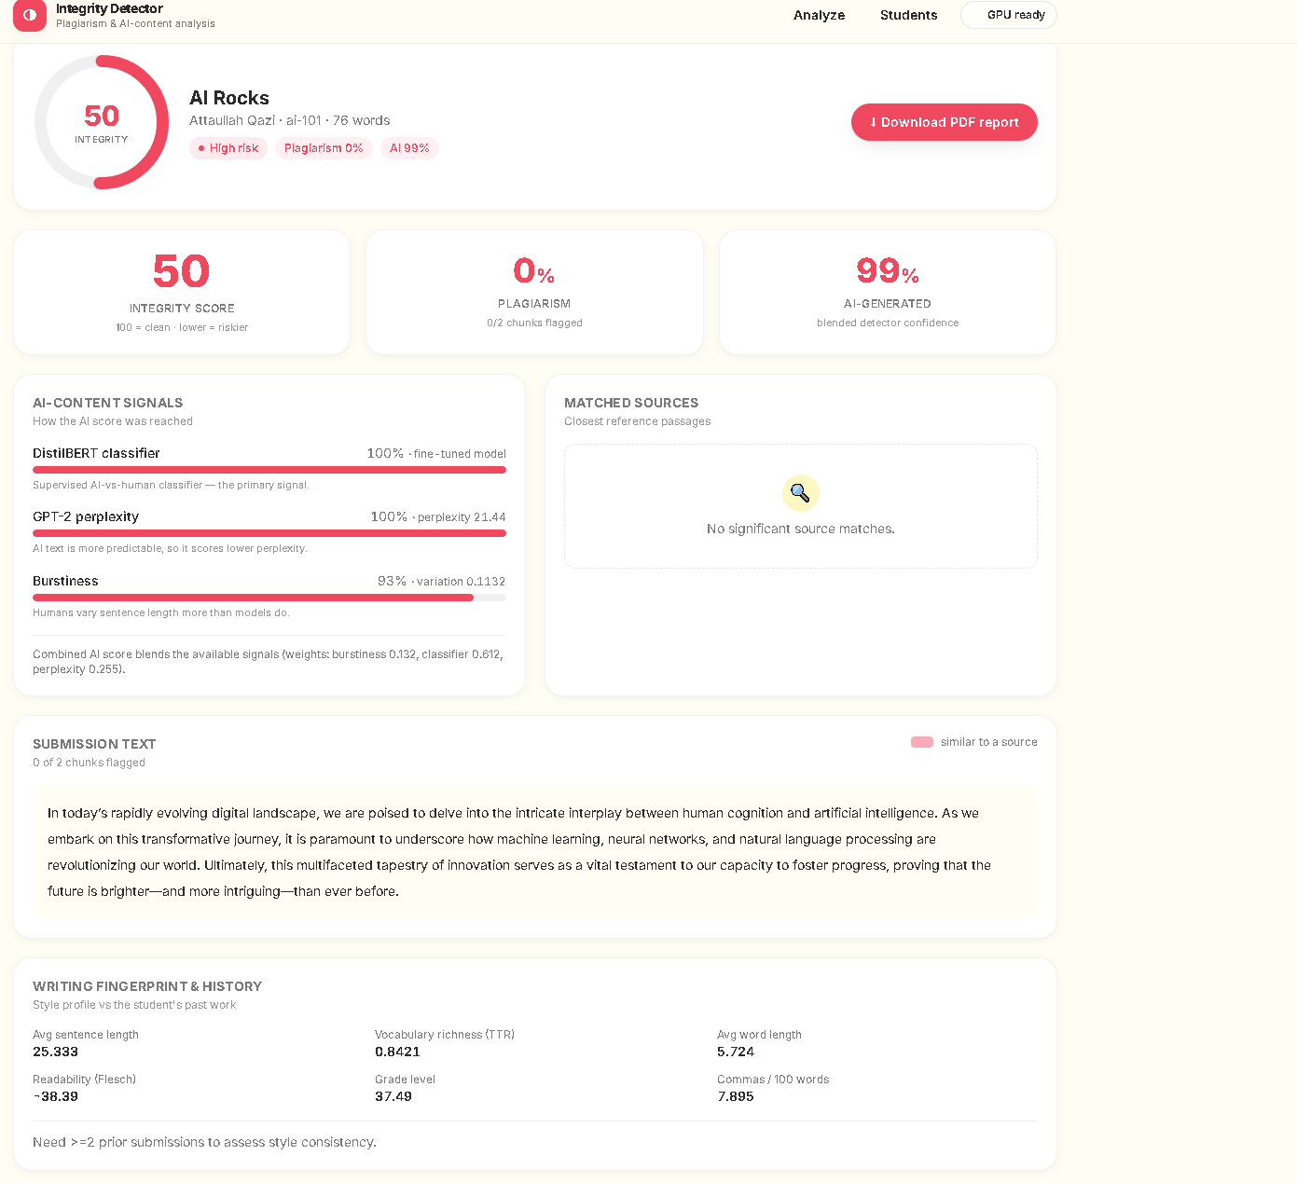
RESULTS
Human vs AI — Caught Correctly
Honest sentence → 100, Low risk
AI paragraph → 99% AI, High risk

Slide 10
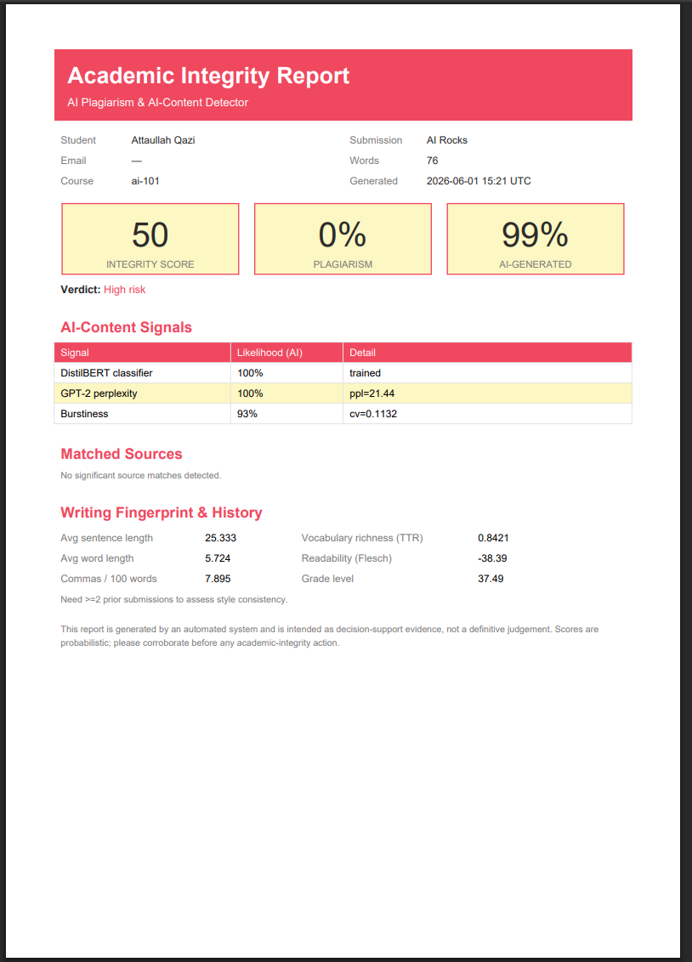
OUTPUT
One-Click PDF Report
Every analysis exports a clean, themed PDF.
PDF, Word and text uploads are read automatically.

Slide 11
THE MATH, SIMPLY
How the Scores Are Made
● Plagiarism % = share of text that closely matches a known source.
● AI % = DistilBERT (0.60) + perplexity (0.25) + burstiness (0.15).
● Integrity = 100 − 0.5 × plagiarism% − 0.5 × AI%.
Very short text is marked “insufficient to assess”, not accused. The report is decision-support evidence — a teacher always confirms before acting.

Slide 12
Summary
● A complete AI system, end to end: data → model → web app.
● Fine-tuned a transformer (DistilBERT) on an RTX 4060 Ti with CUDA + mixed precision.
● Blends 5 AI signals to protect academic integrity in the age of AI writing.
Thank you

