Slide 1
StressThermal
A multidimensional simulation environment for IC interconnect reliability analysis
TODO
→
Prototype
→
Alpha
→
Beta
→
LCA
ANALYSIS MODES
Electrical analysis
Mechanics
Thermal
TODO
LCA
Alpha
Electrical current
Electrostatic
∇·σ + b = 0
ρcₚ ∂T/∂t − ∇·(k∇T) = Q
∇·(σₑ∇φ) = ∇·Jᴅ
Quasistatic force equilibrium
Heat equation
Jᴅ = −∂(ε∇φ)/∂t
∇·(ε∇φ) = −ρf
Current Laplace equation
Poisson equation in dielectrics
Solve for: displacement field u
Solve for: temperature field T
Solve for: electric potential φ, then derive electric field E = −∇φ
COUPLED ANALYSIS
Thermomechanical
Electrothermal
Electromechanical
Alpha
TODO
TODO
Thermal expansion
Joule heating · temperature-dependent conductivity
Inverse piezoelectric effect
Temperature-dependent mechanical properties
Electrical current → Thermal
Electrical analysis → Mechanics
Thermal → Mechanics
Δεᵗʰ ≈ αᵣₑₗ(T̄) ΔT I
Q = J꜀·E = σₑ(T)|E|²
σⱼᵖ = −Σᵢ eᵢⱼ (Eᵢⁿᵉʷ − Eᵢᵒˡᵈ)
Thermal → Mechanics
Thermal → Electrical current
C = C(T)
T → σₑ(T) → re-solve electric potential φ
E = −∇φ; J꜀ = σₑ(T)E
NUMERICS
Spatial discretization
Time integration
Nonlinear solution
Linear solvers
FEM · Mechanics
TRBDF
Newton method
Direct · Iterative
FVM · Thermal / Electrical
Notes:
本次汇报将分为五个部分。首先，我们将明确TCAD的基础定位和核心价值。其次，将重点分析TCAD在半导体、量子计算和可控核聚变这三大未来赛道中所发挥的全局性作用。接着，我们会探讨TCAD在产学研联动中的价值。然后，通过国际经验教训，阐述自主可控EDA/TCAD的重要性。最后，将以国产企业为例，展望我国EDA生态的构建与未来启示。

Slide 2
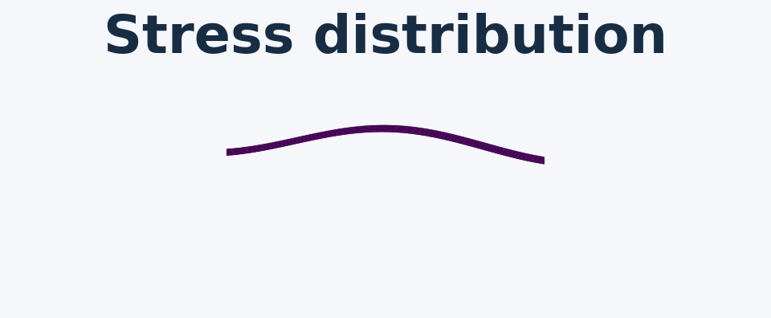
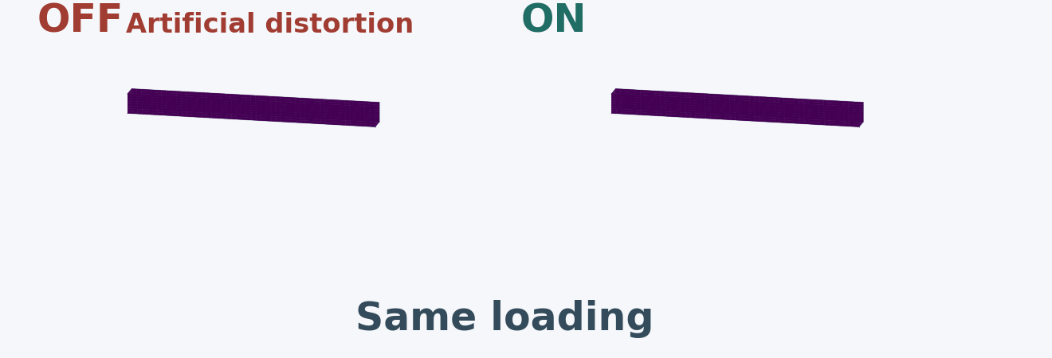


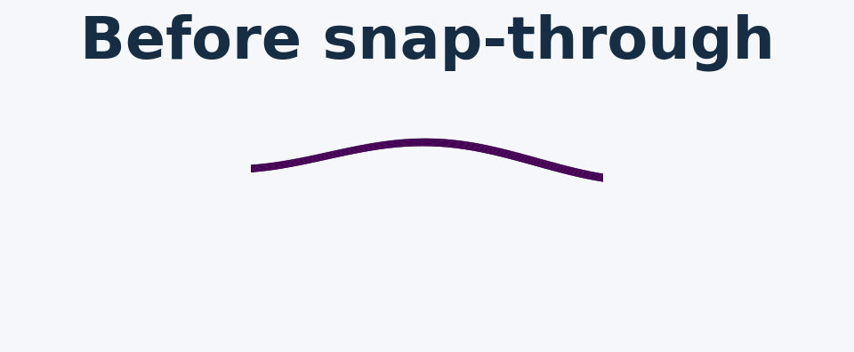
Mechanics
Mature mechanics capabilities with extensive nonlinear analysis
Rich material models, elements, stress-causing mechanisms and boundary conditions
Analysis methods
Element library
Nonlinear analysis
Quasistatic equilibrium
Continuum elements
Geometric nonlinearity
LCA
How does it deform
Plane strain · 3D solid
LCA
Large deformation and rotation
under slowly applied loads?
Triangle
Quadrilateral
LCA
Plane stress
TODO
LCA
TODO
Linear buckling
Axisymmetric
TODO
TODO
Mode 1
Composite solid shell
At what load and in what
Mode 2
Alpha
Tetrahedron
Hexahedron
shape does it buckle?
Mode 3
Structural elements
LCA
TODO
Post-buckling
3D Timoshenko
TODO
TODO
composite beam
How does it deform and
Interpolation
CSSE
Beam
Boundary & interface nonlinearity
carry load after buckling?
First / second order
LCA
Alpha
TODO
Mechanical contact
TODO
Mixed mesh
TODO
Crack analysis
TODO
Material models
Stress-causing mechanisms
Material nonlinearity
Elastic
LCA
see material models
Isotropic / anisotropic
Thermal mismatch · intrinsic stress
LCA
(cubic, hexagonal, orthotropic)
Densification
TODO
Viscous & viscoelastic
LCA
Grain growth
TODO
Boundary conditions & constraints
Viscous · Maxwell · standard linear solid
Gravity force
Prototype
Prescribed displacement
LCA
Plastic & viscoplastic
Alpha
Surface reflow force
TODO
Displacement rate · traction · pressure
LCA
Incremental / deformation plasticity · Anand
Edge dislocation
TODO
Point force
LCA
Power-law creep
Prototype
Inverse piezoelectric effect
TODO
Moment · symmetry
Alpha
Bailey–Norton · Mukherjee–Bird–Dorn
Fluid surface tension / pressure
TODO
Periodic boundary condition
Alpha
Swelling
Prototype
Cohesive zipping force
TODO
Coupling boundary condition
Alpha
Cohesive damage / softening
Prototype
Phase change
TODO
Beam-plate coupling
Alpha
Temperature-dependent material parameters
LCA
Etch / deposition stress rebalancing · etc.
LCA
Variable boundary conditions
Alpha
Notes:
本次汇报将分为五个部分。首先，我们将明确TCAD的基础定位和核心价值。其次，将重点分析TCAD在半导体、量子计算和可控核聚变这三大未来赛道中所发挥的全局性作用。接着，我们会探讨TCAD在产学研联动中的价值。然后，通过国际经验教训，阐述自主可控EDA/TCAD的重要性。最后，将以国产企业为例，展望我国EDA生态的构建与未来启示。

Slide 3
Thermal
Comprehensive thermal physics support
Steady-state & transient · conduction, convection and radiation
Analysis methods
Material properties
Alpha
Alpha
Steady-state · Transient
Thermal conductivity
Isotropic / anisotropic
(orthotropic, aligned with X / Y / Z)
Heat transfer mechanisms
Alpha
Heat storage
Conduction
Mass density ρ · specific heat capacity cₚ
Heat flow within and between materials
cₚ is per unit mass; ρcₚ is heat capacity per unit volume
Convection
Surface emission
Heat exchange with a surrounding liquid or gas
Emissivity
Radiation
Temperature-dependent material parameters
Radiative heat exchange with the environment
Boundary & interface conditions
Volumetric heat generation
Thermal boundary conditions
Alpha
Prescribed temperature
Alpha
Temperature ramps
Alpha
Applied heating
Prescribed heat flux
Alpha
Contact power
Alpha
Volumetric power density
Adiabatic boundary (insulated): zero normal heat flux
Alpha
Electrical heating
Ambient heat exchange
Joule heating in conducting materials
Convection
Alpha
Radiation
Alpha
Thermal resistor
Prototype
Material interfaces
Temperature / flux continuity
Prototype
Interface thermal resistance
Prototype
Notes:
本次汇报将分为五个部分。首先，我们将明确TCAD的基础定位和核心价值。其次，将重点分析TCAD在半导体、量子计算和可控核聚变这三大未来赛道中所发挥的全局性作用。接着，我们会探讨TCAD在产学研联动中的价值。然后，通过国际经验教训，阐述自主可控EDA/TCAD的重要性。最后，将以国产企业为例，展望我国EDA生态的构建与未来启示。

Slide 4
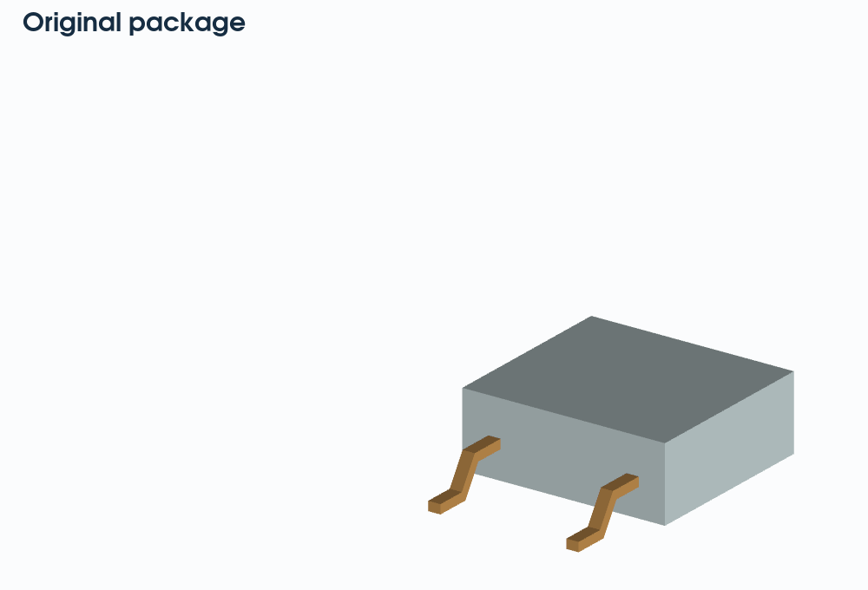
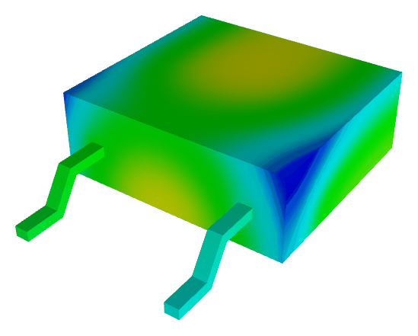
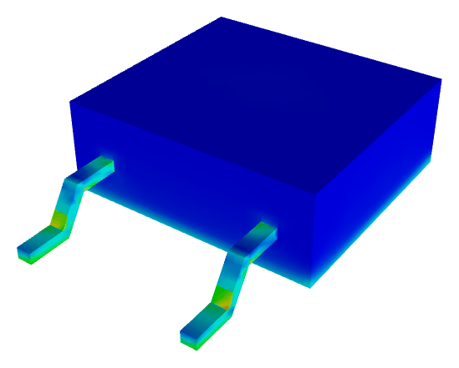
Case 1 — Package thermomechanical reliability
Source: adapted from Sentaurus Applications Library
Solver: StressThermal
Post-processing: h5py · NumPy · VTK · Pillow
ACCURACY
Geometry
Temperature
Equivalent stress
Temperature
Metric
StressThermal
Golden tool - S
Golden tool - A
Maximum Temperature
490.016
489.456
489.433
Mapping
(K)
Maximum Equivalent
1105.175
1105.423
1106.836
Stress (MPa)
PERFORMANCE
Case background
Time (s)
StressThermal
Golden tool - S
Golden tool - A
Power-device package (adapted from PowerSO-10RF / LDMOS)
Thermal solve
4.25
2.30
8.30
Uneven heating → expansion mismatch → stress
Mechanics solve
7.07
4.24
10.00
Thermal · Highlighted feature
Mechanics · Highlighted feature
82,477 solid tetrahedra · 15,653 solid vertices
Steady-state
Quasistatic equilibrium
Conduction · convection
Thermal mismatch
Radiation
Prescribed displacement
Notes:
本次汇报将分为五个部分。首先，我们将明确TCAD的基础定位和核心价值。其次，将重点分析TCAD在半导体、量子计算和可控核聚变这三大未来赛道中所发挥的全局性作用。接着，我们会探讨TCAD在产学研联动中的价值。然后，通过国际经验教训，阐述自主可控EDA/TCAD的重要性。最后，将以国产企业为例，展望我国EDA生态的构建与未来启示。

Slide 5
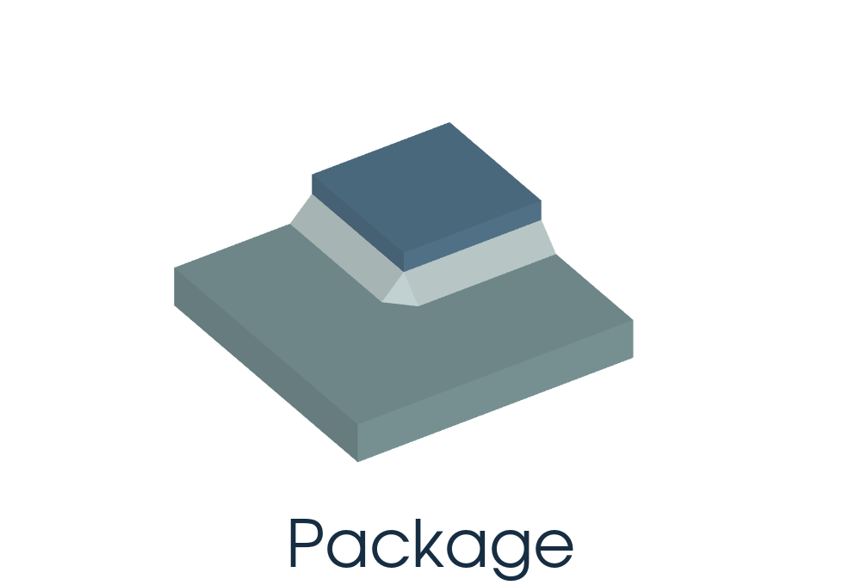
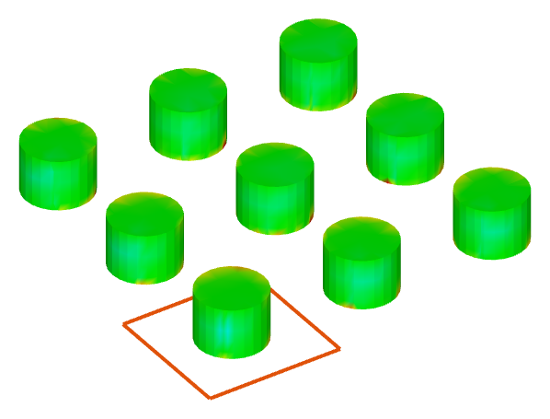
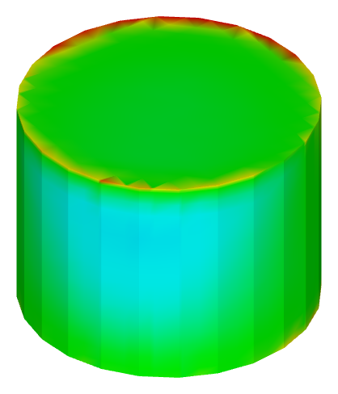
Case 2 — Submodelling
Source: adapted from Sentaurus Applications Library
Solver: StressThermal
Post-processing: h5py · NumPy · VTK · Pillow
ACCURACY
Geometry
3 × 3 pillar array
Single-pillar submodel
Maximum Equivalent
Global-to-local displacement
Stress (MPa)
StressThermal
Golden tool - S
Golden tool - A
Mapping
Global
887.678
887.678
887.678
Local
703.701
703.701
703.700
PERFORMANCE
Equivalent stress
Equivalent stress
Case background
Time (s)
StressThermal
Golden tool - S
Golden tool - A
Flip-chip package · 3 × 3 copper pillars
Global solve
16.69
16.45
38.60
Cooling: 180 °C → 25 °C
Local solve
43.02
39.10
77.50
Highlighted feature: Mechanical submodelling
Global: 246,681 tets · Local: 422,904 tets
Map global displacement
Refine the single-pillar mesh
Solve local stress
Notes:
本次汇报将分为五个部分。首先，我们将明确TCAD的基础定位和核心价值。其次，将重点分析TCAD在半导体、量子计算和可控核聚变这三大未来赛道中所发挥的全局性作用。接着，我们会探讨TCAD在产学研联动中的价值。然后，通过国际经验教训，阐述自主可控EDA/TCAD的重要性。最后，将以国产企业为例，展望我国EDA生态的构建与未来启示。

Slide 6
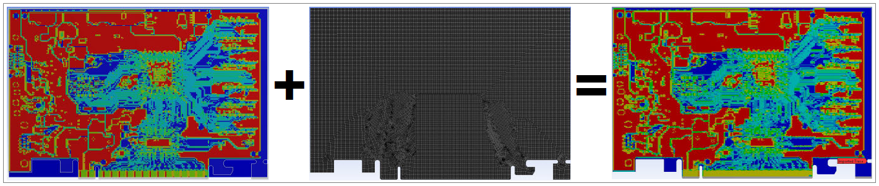
Future plans
From physics features to integrated solutions
TODO FEATURES
GT = Golden Tool
Mechanics
Electrical Analysis
Electrical Related
Risks & gaps
Coupling
Buckling
GT-S / GT-A
Electrical current
GT-S / GT-A
Electromechanical
GT-S / GT-A
Crack analysis
GT-S / GT-A
Electrostatic
GT-S / GT-A
Electrothermal
GT-S / GT-A
01 Reference
Contact analysis
GT-S / GT-A
Follows GT-S; GT-A coverage limited.
GT-A has higher market share.
SOLUTIONS & APPLICATIONS
Hybrid Bonding
Vibration Analysis
02 Thermal analysis numerics
GT-S / GT-A
GT-A only
A next-generation solution for high-density,
Chip / package / PCB reliability
GT-S: FVM / GT-A: FEM
low-power chip-to-chip integration.
Identify package / PCB resonance
Separate validation needed.
Existing foundation
Planned extensions
Existing foundation
Planned extensions
Stress analysis
Mechanical contact
Stress analysis
Frequency / Modal
03 User adoption
Crack analysis
Harmonic Response
GT-S / GT-A input styles
Cohesive damage / softening
Response Spectrum
Learning & migration barriers.
Trace Mapping
04 Pre/post-processing
GT-A only
ECAD copper layout → FE material properties
Existing foundation
Planned extensions
Only solver core available;
1 Source fraction
2 Target FE mesh
3 Mapped fraction
pre/post-processing needed.
Stress analysis
ECAD import & alignment
Thermal analysis
Copper-fraction source grid
Grid–FE overlap weighting
Source: GT-A reference guide · 2025 R1
Effective material properties
Notes:
本次汇报将分为五个部分。首先，我们将明确TCAD的基础定位和核心价值。其次，将重点分析TCAD在半导体、量子计算和可控核聚变这三大未来赛道中所发挥的全局性作用。接着，我们会探讨TCAD在产学研联动中的价值。然后，通过国际经验教训，阐述自主可控EDA/TCAD的重要性。最后，将以国产企业为例，展望我国EDA生态的构建与未来启示。

Slide 7
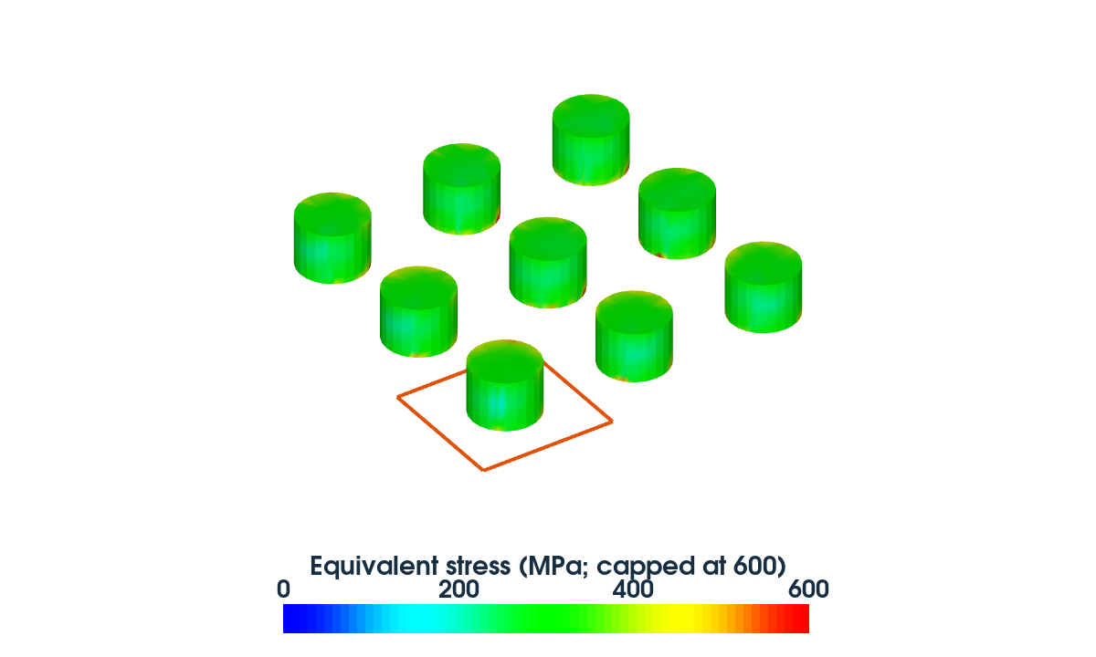
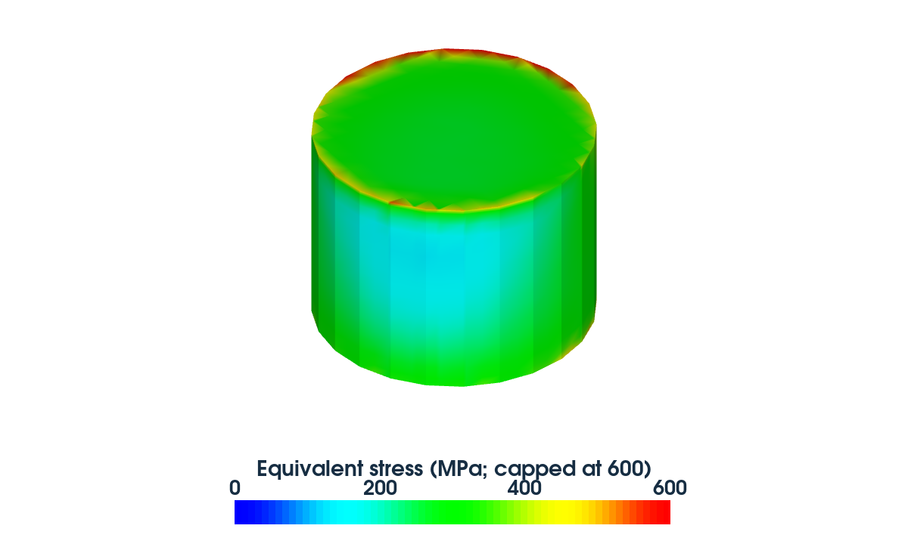
Mechanics & Thermal
Shared capabilities · Backup
Data interfaces
Multiscale modeling · Submodeling
Data import
Coarse global response → refined local detail
External mesh import (supports GFR and DF-ISE)
3 × 3 copper-pillar array
Single-pillar submodel
Field import to resume simulations (GFR)
Results output
Field results (GFR)
→
Probe / profile results (X–Y tables)
Supported output fields
Mechanics
Displacement · displacement increments · pseudo displacement
Stress components · von Mises stress · pressure
180 → 25 °C · Equivalent stress · 0–600 MPa
Principal stresses / strains · principal directions
Elastic / plastic / viscoplastic / creep / swelling strain
Source: CopperPillar_FlipChip_Crack · vendor-run submodel adaptation
Equivalent plastic / viscoplastic / creep strain
Strain energy densities · energy-rate densities
Interpolate global fields onto local outer boundaries
Nodal forces · reaction forces
Mechanics: displacement increments → local stress
Stress / strain maxima · etc.
Thermal
Thermal: temperature → local temperature / heat flow
Temperature · previous temperature · temperature gradient
Heat flux · total heat-source density · Joule heating
Derived hotspot maps · etc.
Notes:
本次汇报将分为五个部分。首先，我们将明确TCAD的基础定位和核心价值。其次，将重点分析TCAD在半导体、量子计算和可控核聚变这三大未来赛道中所发挥的全局性作用。接着，我们会探讨TCAD在产学研联动中的价值。然后，通过国际经验教训，阐述自主可控EDA/TCAD的重要性。最后，将以国产企业为例，展望我国EDA生态的构建与未来启示。

