Slide 1
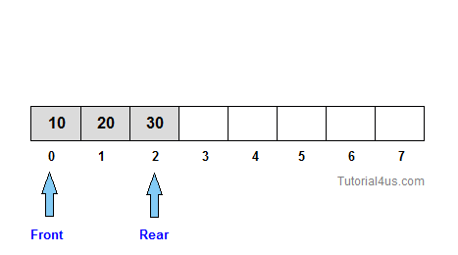
Queue Theory

Slide 2
Queue Data Structure is a linear data structure that is open at both ends and the operations are performed in First In First Out (FIFO) order.
We define a queue to be a list in which all additions to the list are made at one end (back of the queue), and all deletions from the list are made at the other end(front of the queue). The element which is first pushed into the order, the delete operation is first performed on that.

Slide 3
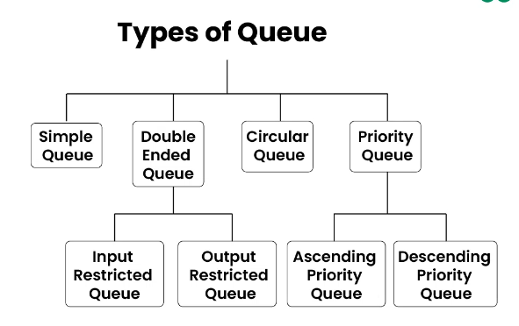

Slide 4
Basic Operations in Queue
Enqueue: Adds (or stores) an element to the end of the queue..
Dequeue: Removal of elements from the queue.
Peek or front: Acquires the data element available at the front node of the queue without deleting it.
rear: This operation returns the element at the rear end without removing it.
isFull: Validates if the queue is full.
isEmpty: Checks if the queue is empty.

Slide 5
Enqueue Algorithm
Enqueue Operation Queues maintain two data pointers, front and rear. Therefore, its operations are comparatively difficult to implement than that of stacks. The following steps should be taken to enqueue (insert) data into a queue −
Step 1 − Check if the queue is full.
Step 2 − If the queue is full, produce overflow error and exit.
Step 3 − If the queue is not full, increment rear pointer to point the next empty space.
Step 4 − Add data element to the queue location, where the rear is pointing.
Step 5 − return success.

Slide 6
Dequeue Algorithm
Accessing data from the queue is a process of two tasks − access the data where front is pointing and remove the data after access. The following steps are taken to perform dequeue operation −
Step 1 − Check if the queue is empty.
Step 2 − If the queue is empty, produce underflow error and exit.
Step 3 − If the queue is not empty, access the data where front is pointing.
Step 4 − Increment front pointer to point to the next available data element. Step
5 − Return success.

Slide 7
Peek Algorithm
This function function helps to see the data at the front of the queue

Slide 8
Rear Algorithm
This function function helps to see the data at the rear of the queue

Slide 9
isFull Algorithm
As we are using single dimension dimension array to implement queue, we just check for the rear pointer pointer to reach at MAXSIZE MAXSIZE to determine determine that the queue is full.
Check the size of queue with max capacity, and return boolean

Slide 10
isEmpty Algorithm
As we are using single dimension dimension array to implement queue, we just check for the size of queue to zero.
Check the size of queue is zero, and return boolean

Slide 11
Double Ended Queue(Deque)
A Double-Ended Queue (Deque) is a generalized version of a queue that allows inserting and removing elements from both the front and the rear. Unlike a regular queue (FIFO), a deque supports both ends for insertion and removal, which makes it a versatile data structure
Operations of a Deque:
Enqueue Front: Add an element to the front of the deque.
Enqueue Rear: Add an element to the rear of the deque.
Dequeue Front: Remove an element from the front of the deque.
Dequeue Rear: Remove an element from the rear of the deque.

Slide 12
Input restricted
In this type of Queue, the input can be taken from one side only(rear) and deletion of elements can be done from both sides(front and rear). This kind of Queue does not follow FIFO(first in first out). This queue is used in cases where the consumption of the data needs to be in FIFO order but if there is a need to remove the recently inserted data for some reason and one such case can be irrelevant data, performance issue, etc.

Slide 13
Output Restricted
In this type of Queue, the input can be taken from both sides(rear and front) and the deletion of the element can be done from only one side(front). This queue is used in the case where the inputs have some priority order to be executed and the input can be placed even in the first place so that it is executed first.

Slide 14
Priority Queue
A priority queue is a special type of queue in which each element is associated with a priority and is served according to its priority. There are two types of Priority Queues. They are:
Ascending Priority Queue: Element can be inserted arbitrarily but only smallest element can be removed. For example, suppose there is an array having elements 4, 2, 8 in the same order. So, while inserting the elements, the insertion will be in the same sequence but while deleting, the order will be 2, 4, 8.
Descending priority Queue: Element can be inserted arbitrarily but only the largest element can be removed first from the given Queue. For example, suppose there is an array having elements 4, 2, 8 in the same order. So, while inserting the elements, the insertion will be in the same sequence but while deleting, the order will be 8, 4, 2.

Slide 15
Circular Queue
A Circular Queue (or Circular Buffer) is a data structure that allows the queue to wrap around to the beginning once the end is reached, making efficient use of memory. This is achieved by using modular arithmetic to cycle through the array indices in a circular manner.
Here’s an implementation of a Circular Queue in Python. This implementation uses a fixed-size list, and it uses two pointers (front and rear) to keep track of the start and end of the queue. The % operator ensures that these pointers wrap around to the start of the array when necessary.
******************************

Slide 16
Ambiguity for circular Queue
Problem with Capacity of 1:
If the circular queue has a size of 1, both the front and rear pointers would point to the same index when the queue is both empty and full, making it impossible to distinguish between the two states.
Minimum Practical Capacity = 2:
With a capacity of 2, you can have at least one element in the queue and still have space to handle the wraparound behavior properly. The queue will:
Start with an empty state (front == -1 and rear == -1 or front == rear).
Distinguish between an empty and a full queue by using a simple check like:
Empty condition: front == -1.
Full condition: (rear + 1) % capacity == front.

