Slide 1
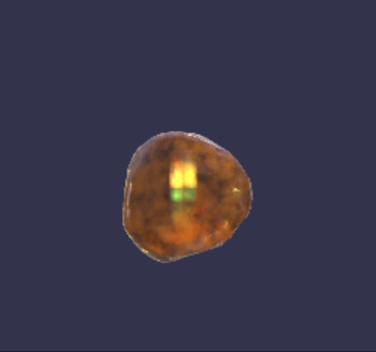
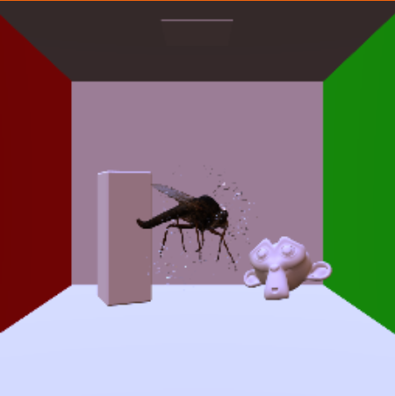
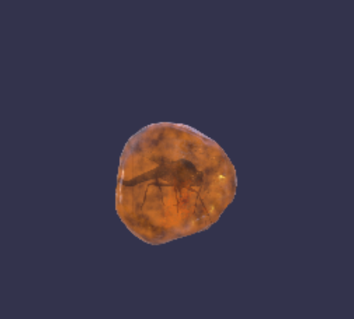
Mesh
Refraction texture
Transmissive mesh

Slide 2
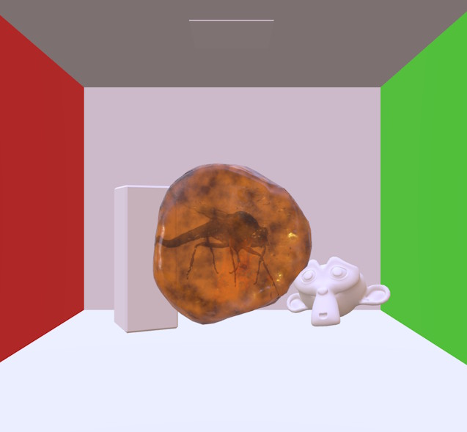
Non-transmissive meshes only
Used as refraction
texture
All meshes (non-transmissive + transmissive)

Slide 3
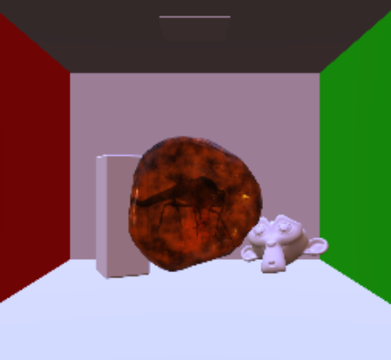
Renders non-transmissive meshes
copy
Renders transmissive meshes
Used as refraction
texture
Applies image processing post-process

