Slide 1
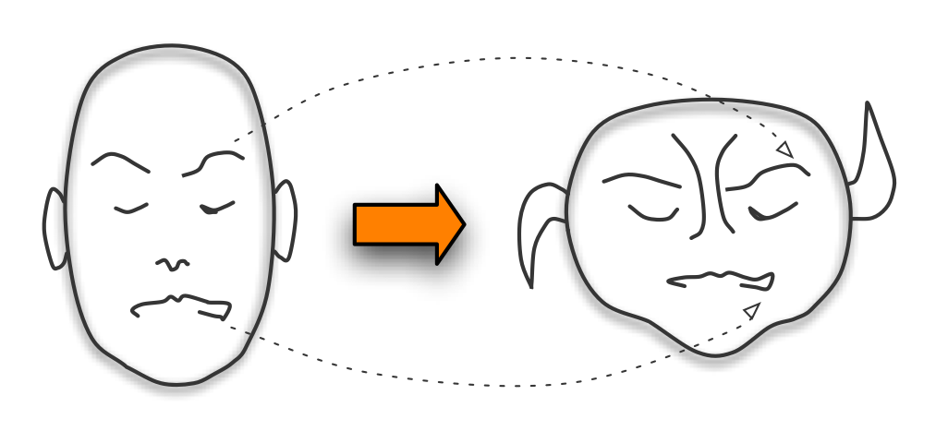
Retargeting
Algorithms for Performance-Driven Animation
J.P. Lewis Fred Pighin

Slide 2
"Don't cross the streams.”
(Ghostbusters)
Why cross-mapping?
  Different character
  Imperfect source model
Also known as:
  Performance-driven animation
  Motion retargeting

Slide 3
Performance Cloning History
L. Williams, Performance-driven Facial Animation, SIGGRAPH 1990
SimGraphics systems, 1992-present
LifeFX “Young at Heart” in Siggraph 2000 theater
J.-Y. Noh and U. Neumann, Expression Cloning, SIGGRAPH 2001
B. Choe and H. Ko, “Muscle Actuation Basis”, Computer Animation 2001 (used in Korean TV series)
Wang et. al., EUROGRAPHICS 2003
Polar Express movie, 2004

Slide 4
Face space mapping
Source space
Target space

Slide 5
Building a map from correspondences

Slide 6
Building a map from correspondences

Slide 7
Main issues
How are the corresponding faces created?
How to build mapping from correspondences?

Slide 8
Linear vs. non-linear mapping
Linear
  Global blend-shape mapping
    B. Choe and H. Ko, Analysis and Synthesis of Facial Expressions with Hand-Generated Muscle Actuation Basis, Computer Animation 2001.
    E. Chuang and C. Bregler, Performance Driven Facial Animation using Blendshape Interpolation, CS-TR-2002-02, Department of Computer Science, Stanford University
Non-linear
  Piece-wise blend-shape mapping
    I. Buck, A. Finkelstein, C. Jacobs, A. Klein, D. H. Salesin, J. Seims, R. Szeliski, and K. Toyama, Performance-driven hand-drawn animation, NPAR 2000.
    J.-Y. Noh and U. Neumann, Expression Cloning, SIGGRAPH 2001.
  Manifold learning
    Y. Wang, X. Huang, C.-S. Lee, S. Zhang, D. Samaras, D. Metaxas, A. Elgammal, and P. Huang, High Resolution Acquisition, Learning, and Transfer of Dynamic 3-D Facial Expressions, Eurographics 2004.
  Single-correspondence mapping
    J.-Y. Noh and U. Neumann, Expression Cloning, SIGGRAPH 2001.

Slide 9
Linear Mapping

Slide 10
Blendshape mapping
(Global) Change of coordinate system

Slide 11
Blendshape mapping
(Global) Change of coordinate system

Slide 12
Blendshapes: definition
per-vertex view:
 | Industry term | Math usage
w_{k} | Slider values | weights
b_{k} | Blendshape target | Basis vector

Slide 13
Blendshapes: definition
Linear algebra of blendshapes:
per-vertex view:
global view:
f : 3n x 1 vector containing all n vertices of the face, in some packing order e.g. xyzxyzxyz....
B: 3n x m matrix; each column is one of the m blendshapes, using the same packing order.
w: vector of m weights, animated over time

Slide 14
Parallel blendshapes
Use same blending weights:

Slide 15
Parallel Model Construction
Have similar blendshape controls in source, target models
Advantage: conceptually simple
Disadvantage: twice the work (or more!) -- unnecessary!
Disadvantage: cannot use PCA

Slide 16
Improvements
Adapt generic model to source (Choe et. al.)
Derive source basis from data (Chuang and Bregler)
Allow different source, target basis

Slide 17
Source model adaptation
B. Choe and H. Ko, Analysis and Synthesis of Facial Expressions with Hand-Generated Muscle Actuation Basis, Computer Animation 2001
Cross-mapping obtained simply by constructing two models with identical controls.
Localized (delta) blendshape basis inspired by human muscles
Face performance obtained from motion captured markers

Slide 18
Choe and Ko
Muscle actuation basis
Model points corresponding to markers are identified
Blendshape weights determined by least-squares fit of model points to markers
Fit of model face to captured motion is improved with an alternating least squares procedure

Slide 19
Choe and Ko
Muscle actuation basis
Fitting the model to the markers:
alternate 1), 2)
  1) solve for weights given markers and corresponding target points
  2) solve for target points location
warp the model geometry to fit the final model points using radial basis interpolation.

Slide 20
Choe and Ko
Muscle actuation basis
Fitting the model to the markers:
Alternate: solve for B, solve for W
warp the model geometry to fit the final model points using radial basis interpolation.

Slide 21
Choe & Ko

Slide 22
Derive source blendshapes from data
Principal Component Analysis
[Chuang and Bregler, 2002]

Slide 23
Recorded source motions
Source space
Target space

Slide 24
Source basis estimation
Source space
Target space

Slide 25
Target basis construction
Source space
Target space

Slide 26
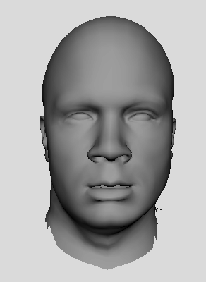
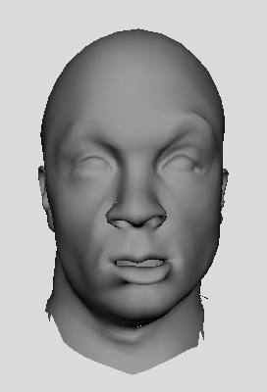
Blendshapes by Principal Component Analysis (PCA)
Automatic construction of blendshape model (given movement data)
Advantage: automatic; the most accurate model for a given number of sliders (L2 sense), easy
Disadvantage: the resulting model is not intuitive

Slide 27
Derive source basis from data
E. Chuang and C. Bregler, Performance Driven Facial Animation using Blendshape Interpolation, CS-TR-2002-02, Department of Computer Science, Stanford University

Slide 28
Chuang and Bregler,
Derive source basis from data
Parallel Model Construction approach:
  Source model automatically derived,
  Target manually sculpted
Using PCA would be unpleasant

Slide 29
Chuang and Bregler,
Derive source basis from data
Using PCA would be unpleasant
Solution: use a subset of the motion capture frames as the blendshape model.
  Subsets of the original motion capture start to “span the space” of that motion capture.
Two new problems:
  Which motion capture frames to use?
  Source blendshape basis is not exact.

Slide 30
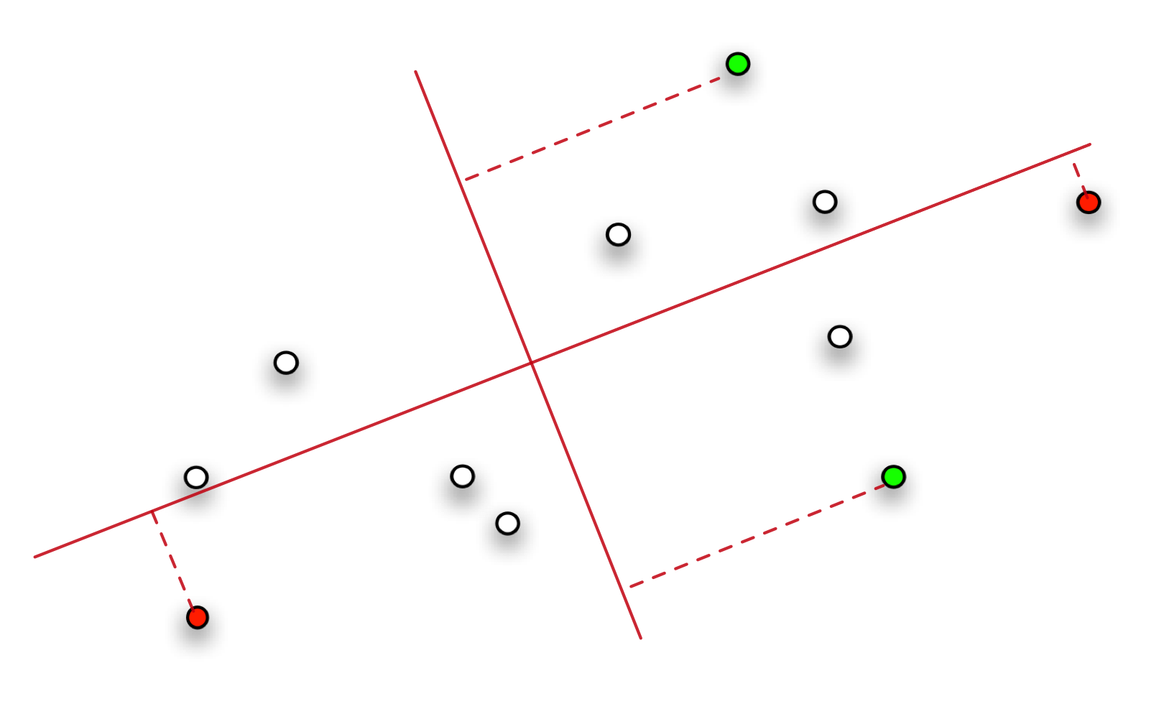
Chuang and Bregler,
Derive source blendshapes from data
Which motion capture frames to use?
Heuristic: for each of the leading PCA vectors,
Pick the mocap frame that have the largest (min,max) projections on that eigenvector.

Slide 31
Chuang and Bregler,
Derive source blendshapes from data
Two new problems:
  Which motion capture frames to use?
  Source blendshape basis is only approximate
Observation:
Directly reusing weights works poorly when the source model is not exact
  Errors in representing the source can result in large cancelling basis combinations (nearly cancelling positive, negative weights)
  Transferring these cancelling weights to target results in poor shapes

Slide 32
Chuang and Bregler,
Derive source blendshapes from data
Errors in representing the source can result in large cancelling basis combinations (nearly cancelling positive, negative weights)
+
-

Slide 33
Chuang and Bregler,
Derive source blendshapes from data

Slide 34
Chuang and Bregler,
Derive source basis from data
Solution
  Solve for the representation of the source with non-negative least squares. Prohibiting negative weights prevents the cancelling combinations.
  Robust cross mapping.

Slide 36
Non-corresponding blendshapes
?
?
?

Slide 37
Is there a “best” blendshape basis?
There are an infinite number of different blendshape models that have exactly the same range of movement. Proof:
And it’s easy to interconvert between different blendshapes
analogy: what is the best view of a 3D model? Why restrict yourself to only one view??

Slide 38
Global blendshape mapping
Motivating scenarios:
Use PCA for source!
Source or target model is pre-existing (e.g. from a library)

Slide 39
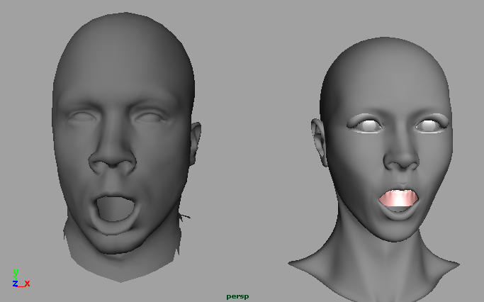
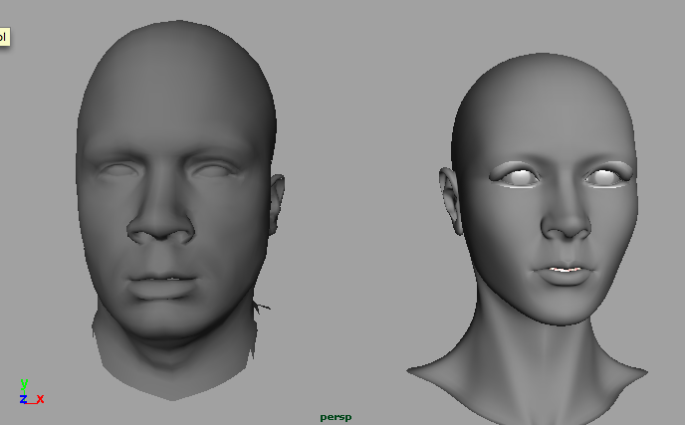
Global blendshape mapping
B,C n vertices, m blendshape targets
Manually create p ≥ m corresponding poses of each model, with weights v_{k}, w_{k}

Slide 40
Global blendshape mapping
Gather pose weight vectors v_{k}, w_{k} in columns of V,W
Solve for the “cloning matrix” E:
this matrix converts weights for one model to produce the equivalent expression in the other model.

Slide 41
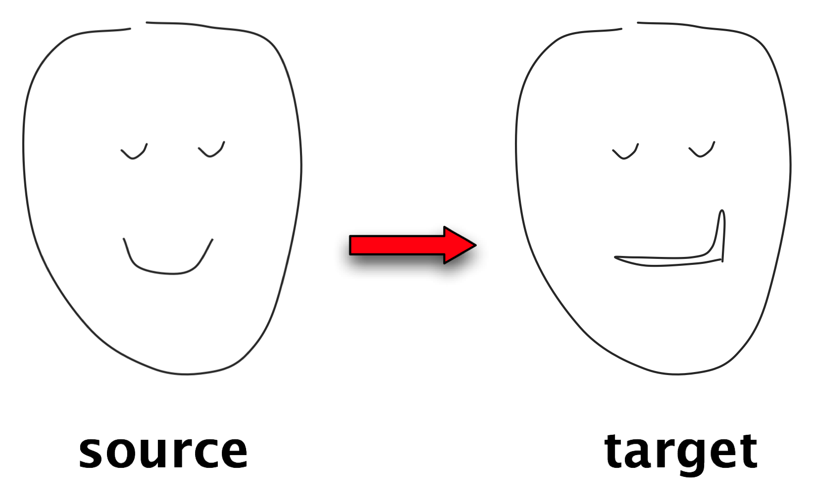
Global blendshape mapping
Intentional source-target mismatch: style transfer (person on the right has asymmetric smile)

Slide 42
Non-linear Mapping
Piecewise linear
Manifold learning
Single-correspondence

Slide 43
Piecewise linear mapping
(Local) Change of coordinate system

Slide 44
Piecewise linear mapping
I. Buck, A. Finkelstein, C. Jacobs, A. Klein, D. H. Salesin, J. Seims, R. Szeliski, and K. Toyama, Performance-driven hand-drawn animation, NPAR 2000

Slide 45
Buck et. al.
Piecewise linear mapping
Project motion onto a 2D space (PCA)
Construct Delaunay triangulation based on source blendshapes
Within a triangle use barycentric coordinates as blending weights

Slide 46
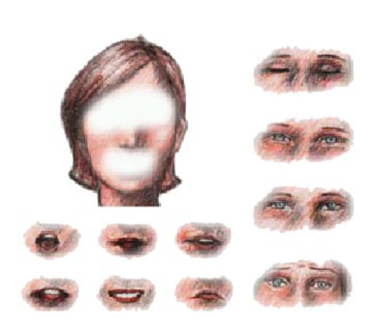
Buck et. al.
Piecewise linear mapping
Split face into 3 regions
(eyes, mouth,
rest of the face)
If frame outside of triangulated area, project onto convex hull

Slide 47
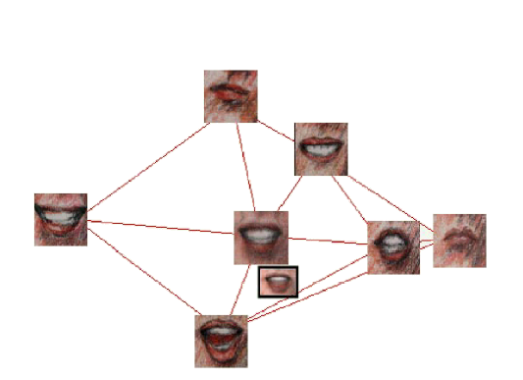
Buck et. al.
Triangulation

Slide 48
Video
hand_drawn.avi

Slide 49
Manifold learning
Source space
Target space

Slide 50
Manifold learning
Y. Wang, X. Huang, C.-S. Lee, S. Zhang, D. Samaras, D. Metaxas, A. Elgammal, and P. Huang, High Resolution Acquisition, Learning, and Transfer of Dynamic 3-D Facial Expressions, Eurographics 2004.

Slide 51
Source and target embeddings

Slide 52
Unified embedding

Slide 53
Final mapping

Slide 54
Final mapping

Slide 55
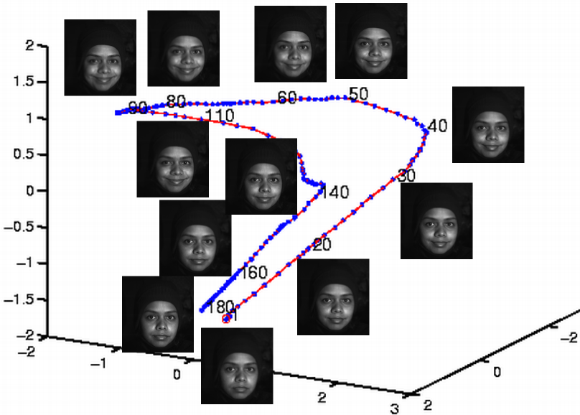
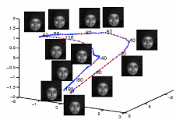
Wang et. al.
Manifold learning
Manifold (curve) of smile motion obtained by
Local Linear Embedding (from Wang et. al.)

Slide 56
Video
final-video2-edit.mov

Slide 57
Mapping from a single correspondence

Slide 58
Mapping from a single correspondence
J.-Y. Noh and U. Neumann, Expression Cloning, SIGGRAPH 2001.

Slide 59
Noh et. al.
Two issues
Find dense geometric correspondences between the two face models
Map motion using local geometric deformations from source to target face

Slide 60
Noh et. al.
Estimating geometric correspondences
Sparse correspondences through feature detection
Dense correspondences by interpolating matching features (RBF)

Slide 61
Noh et. al.
Local geometric motion transformation
Source
Target

Slide 62
Noh et. al.
Animation as displacement from the neutral/rest face
Source
Target

Slide 63
Noh et. al.
Local geometric motion transformation
?
Source
Target

Slide 64
Noh et. al.
Local change of coordinates system
Source
Target

Slide 65
Noh et. al.
Local change of coordinates system
Source
Target

Slide 66
Noh et. al.
Local coordinates system
Defined by
  Tangent plane and surface normal
  Scale factor: ratio of bounding boxes containing
  all triangles sharing vertex

Slide 67
Video
monkeyExp.mov

Slide 68
References
B. Choe and H. Ko, Analysis and Synthesis of Facial Expressions with Hand-Generated Muscle Actuation Basis, Computer Animation 2001.
I. Buck, A. Finkelstein, C. Jacobs, A. Klein, D. H. Salesin, J. Seims, R. Szeliski, and K. Toyama, Performance-driven hand-drawn animation, NPAR 2000.
E. Chuang and C. Bregler, Performance Driven Facial Animation using Blendshape Interpolation, CS-TR-2002-02, Department of Computer Science, Stanford University
J.-Y. Noh and U. Neumann, Expression Cloning, SIGGRAPH 2001.
Y. Wang, X. Huang, C.-S. Lee, S. Zhang, D. Samaras, D. Metaxas, A. Elgammal, and P. Huang, High Resolution Acquisition, Learning, and Transfer of Dynamic 3-D Facial Expressions, Eurographics 2004.

Slide 69
Future work

