Slide 1
DIGITAL PORTFOLIO
STUDENT NAME : BABYSHALINI K
REGISTER NO AND NMID:asbru2426j1385
DEPARTMENT: INFORMATION TECHNOLOGY
COLLEGE: GOVERNMENT ARTS AND SCIENCE COLLEGE,
GUDALUR,BHARATHIYAR UNIVERSITY

Slide 2
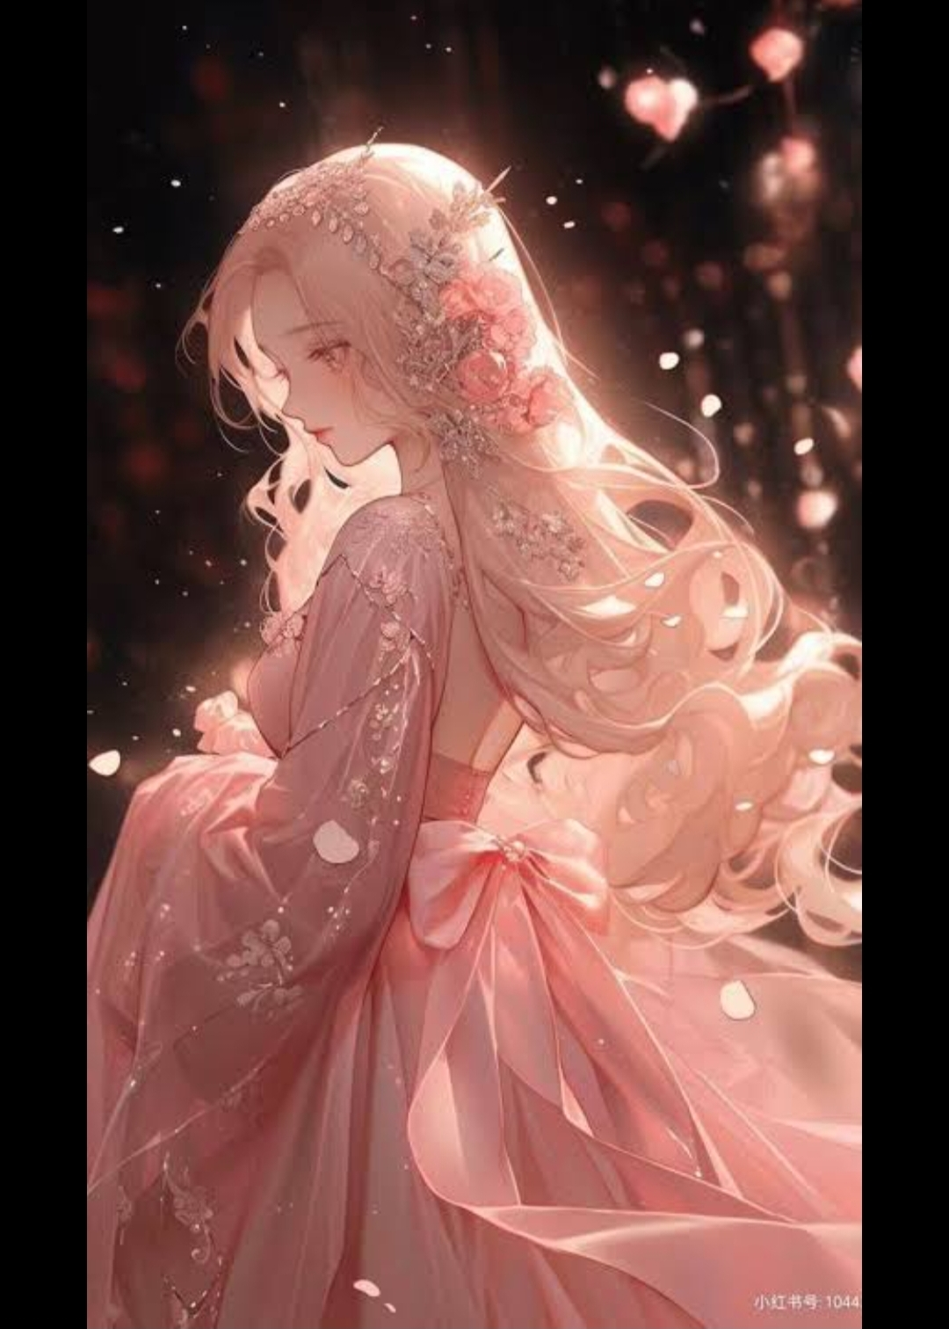
PROJECT TITLE
BABYSHALINI’S PORTFOLIO

Slide 3

AGENDA
Problem statement
Project overview
Tools and technologies
Portfolio design and layout
Features and functionality
Result and screenshot
Conclusion
GitHub

Slide 4
PROBLEM STATEMENT
Students often struggle to effectively showcase their academic achievements, technical skills, projects, and extracurricular activities using traditional methods such as paper resumes or verbal presentations. These approaches are limited, static, and fail to reflect the student’s creativity, innovation, and true potential.

Slide 5

TOOLS AND TECHNOLOGIES
Python
Java
C / C++
JavaScript
Web Development
HTML, CSS, Bootstrap
React.js, Node.js
PHP
Database management
MySQL
MongoDB
Version Control & Collaboration
Git & GitHub
GitLab
Design & Productivity
ToolsFigma / Canva
MS PowerPoint / Word / Excel
VS Code / IntelliJ IDEA

Slide 6
PORTFOLIO DESIGN AND LAYOUT
Design Style
Clean, simple, and professional User-friendly navigation Responsive design for different devices
Layout Sections
Home Page → Introduction & personal details About Me → Academic background & career goals Skills → Technical & soft skills Projects → Descriptions of completed projects with visuals/screenshots Achievements → Certificates, awards, and recognitions Contact → Email, phone, LinkedIn, GitHub links

Slide 7
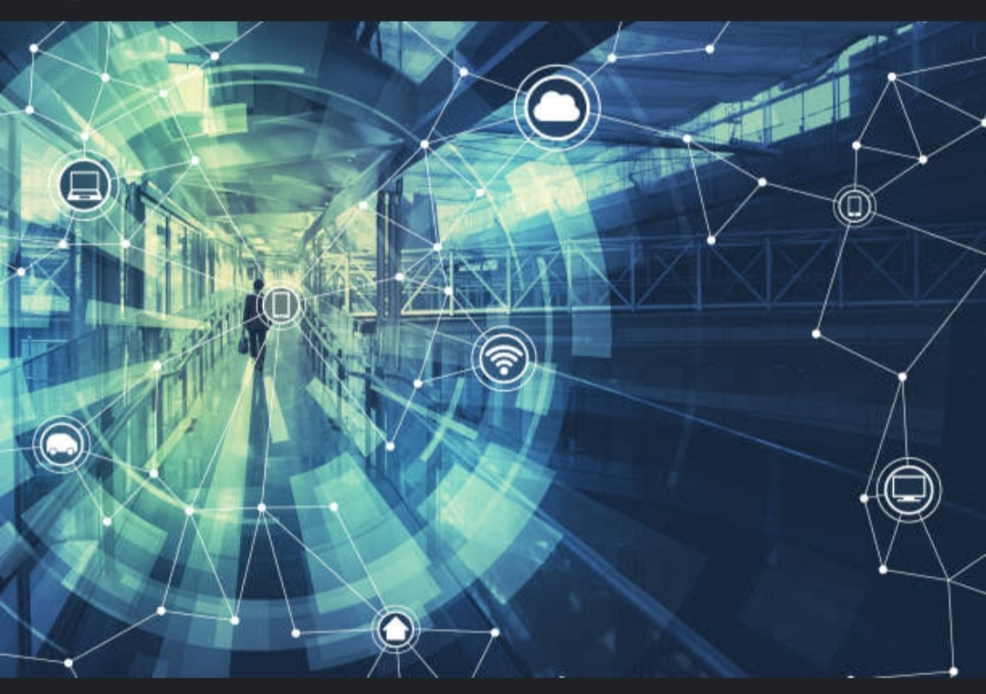
FEATURES AND FUNCTIONALITY
Interactive and user-friendly design
Responsive on all devices
Showcases skills, projects, and achievements
Supports multimedia (images, videos, links)
Easy navigation with downloadable resume option

Slide 8
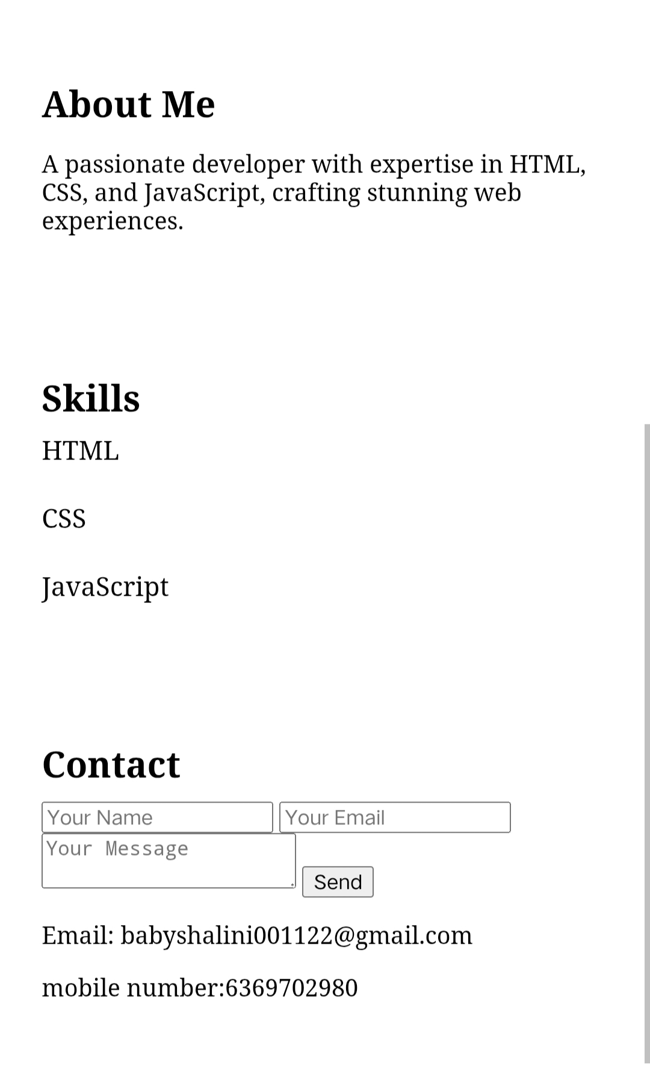
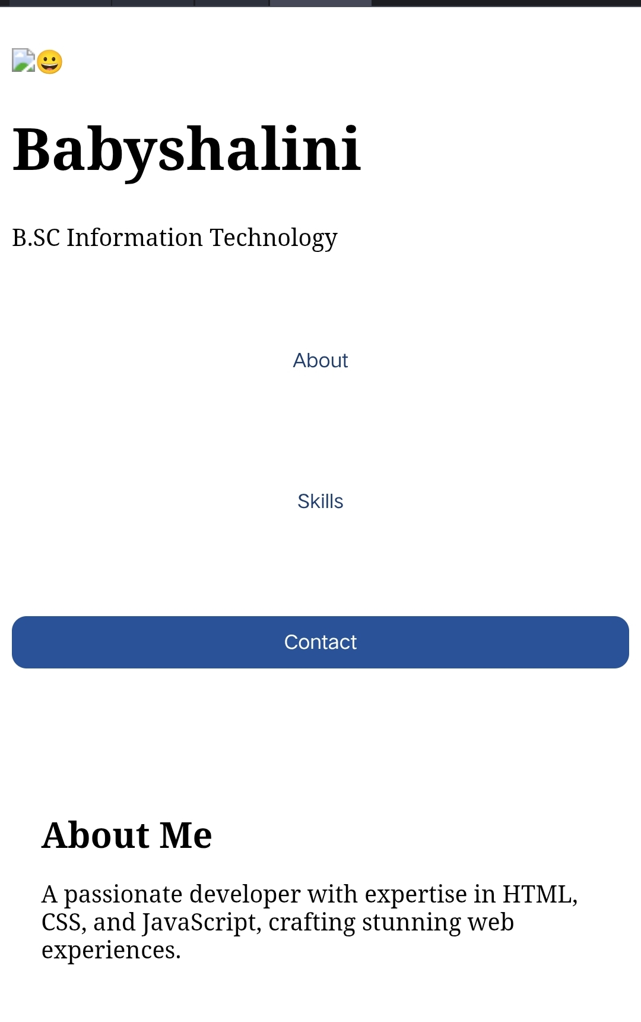
RESULT AND SCREENSHOT
Digital portfolio created to effectively showcase skills, projects, and achievements.
Provides interactive, accessible, and modern presentation.
(Insert screenshots of portfolio homepage/projects here)

Slide 9
CONCLUSION
A digital portfolio provides an interactive and modern way to present skills, projects, and achievements.
It overcomes the limitations of traditional resumes by showcasing creativity and technical abilities.
Helps students and professionals build a strong personal brand and stand out to recruiters or evaluators.

Slide 10

GITHUP LINK
https://github.com/Babyshalinii/Babyshalini-TNSDC-FWWD-DP

