Slide 1

UNCERTAINTY-AWARE IMAGE DEHAZING USING PSEUDO-INVERSE MODELING INSPIRED BY CVAE
22MAT230 - MFC 4
GROUP-6
C. Sai Jagruth - CB.SC.U4AIE24310
G. Baby Sree - CB.SC.U4AIE24318
H R Vardhan - CB.SC.U4AIE24320
Y. Likitha Reddy - CB.SC.U4AIE24361

Slide 2
INTRODUCTION
  Image enhancement improves contrast, clarity, and visibility of images.
  Satellite images are frequently degraded by haze and thin clouds.
  Atmospheric scattering causes loss of image details and reduced contrast.
  This degradation affects accurate interpretation of remote sensing data.
  Enhancing hazy images is necessary for better visual analysis.
  This work focuses on enhancing haze-degraded images using Pseudo inverse and variational autoencoders.

Slide 3
PROBLEM STATEMENT
  Haze degradation causes loss of image contrast and details.
  The degradation process makes enhancement difficult.
  One hazy image can correspond to many possible clear images.
  Traditional enhancement methods give only one output.
  These methods do not model uncertainty in degraded regions.
  Hence, an effective enhancement approach is required.

Slide 4
OBJECTIVES
  To enhance hazy images and improve visual quality.
  To obtain an initial enhanced image using pseudo-inverse method.
  To model uncertainty using Variational Autoencoder (VAE).
  To generate multiple enhanced images from a single input.
  To combine enhanced outputs to obtain better final image quality.

Slide 5
METHODOLOGY
1. Image Degradation Model :
  Hazy image formation is modeled as:
I(x) = J(x)t(x) + A(1 − t(x))
Where:
  I(x)): hazy image t(x): transmission
  A: airlight J(x): clear image
2.Linear Inverse Problem Representation
  The haze model can be written in matrix form:
I = HJ
Where:
  H: haze degradation operator
  J: unknown clean image

Slide 6
METHODOLOGY
3. Pseudo-Inverse Based Enhancement
  To obtain a stable solution, Moore–Penrose pseudo-inverse is used:
J₀ = H⁺ I
  This provides the minimum-error solution:
J₀ = arg min || HJ − I ||₂
4. Pixel-Wise Regularized Solution
  From the haze model:
J(x) = ( I(x) − A(1 − t(x)) ) / t(x)
  ​​To avoid instability when t is small, regularization is applied:
J(x) = ( I(x) − A(1 − t(x)) ) / t(x)+λ
​​Where:
  λ>0 is regularization parameter

Slide 7


METHODOLOGY
5.Transmission Estimation
  Transmission map is estimated using local averaging:
6.Uncertainty Modeling (CVAE)
  Transmission estimation is not exact.
  Hence we model uncertainty:
tₖ(x) = sₖ · t₀(x) sₖ ∈ [0.9 , 1.1]
  Each sampled transmission produces:
  Multiple valid enhanced images are generated

Slide 8


METHODOLOGY
7. Frequency Domain Fusion
  Final enhanced image obtained by averaging in frequency domain:
​Where:
  F: Fourier Transform
8. Final Mathematical Expression

Slide 9
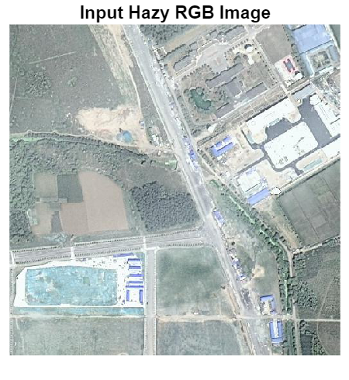

RESULTS
Input
Output

Slide 10
FUTURE WORK
  Improve image fusion technique for better quality
  Reduce processing time of the model
  Apply the method to real-time image enhancement
  Test the model on more real-world images
  Use lightweight models for faster execution

Slide 11
THANK YOU

